Slide 1
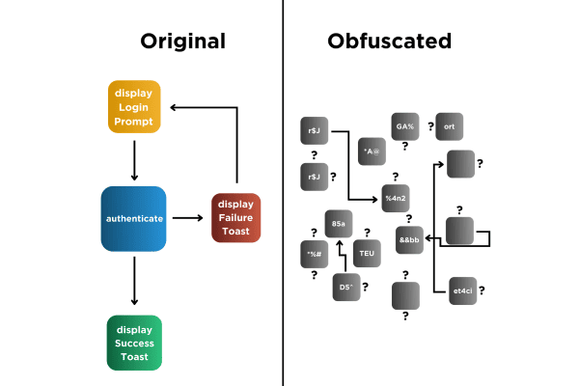
Obfuscation
Dr: Nabil Ismail By :Amira Mohamed Menshawy

Slide 2
Obfuscation Project
This project demonstrates a code obfuscation tool written in Python. The tool performs the following techniques:
Renaming Variables: Changes variable names to random meaningless strings.
Adding Dead Code: Inserts unnecessary or unreachable code to confuse the reader.
Code Compression: Removes whitespace to make the code harder to read.
Hiding Code as Comments: Converts actual code into comments.

Slide 3
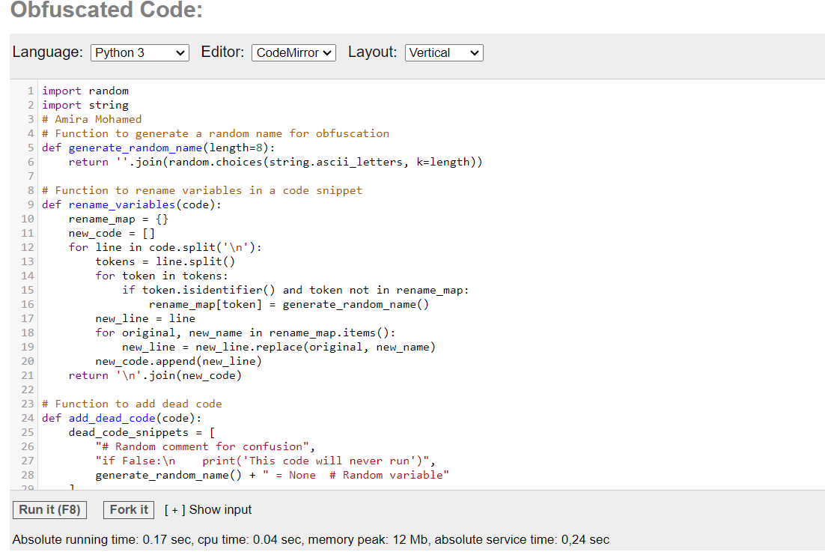
Here’s the full implementation of the obfuscation tool:
You can get the source code from the following link
https://rextester.com/ATLK18469

Slide 4
Explanation of Functions
generate_random_name: Generates a random string to replace variable names.
rename_variables: Finds and renames all variables in the code to random meaningless strings.
add_dead_code: Inserts random, unused lines of code or comments to make the code harder to follow.
compress_code: Removes unnecessary spaces and compresses the code into a single block.
hide_code_as_comments: Converts the entire code into comments, making it look like documentation instead of functional code.
obfuscate_code: Combines all the techniques to produce the obfuscated output.

Slide 5
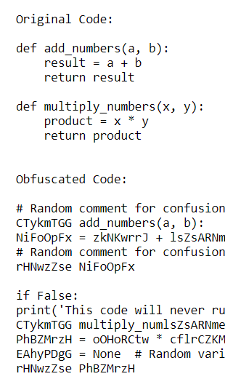
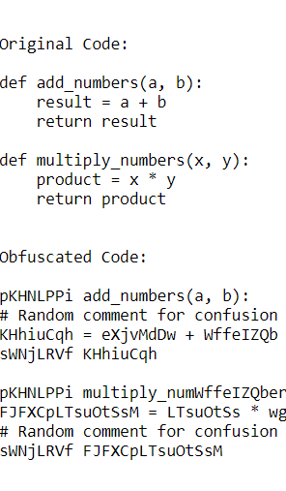
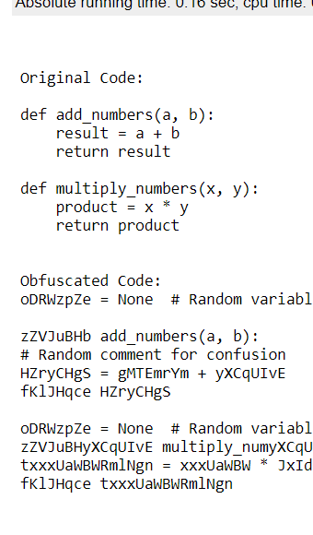
First Run Second Run Third Run

Slide 6
The Obfuscated Code provided is the result of applying the obfuscation techniques from your Python script to the Original Code. Let's break down the output to understand the various transformations and their effects:
1. Random Comments: # Random comment for confusion
This comment is randomly inserted before some lines of code to make it harder for someone to analyze the code quickly. These comments do not affect the program's behavior but increase the complexity.
2. Renaming Variables: CTykmTGG add_numbers(a, b):
Here, the function add_numbers has been renamed to CTykmTGG, and the original variable result (and any other variables) would also be renamed in the real obfuscation. The idea is to replace meaningful names with random strings, making it harder for someone to understand the purpose of the code.
Other renamed variables include: NiFoOpFx = zkNKwrrJ + lsZsARNm
Here, the result variable has been renamed to NiFoOpFx, and the a + b expression has been renamed to random variables (zkNKwrrJ and lsZsARNm).
3. Dead Code: if False: print('This code will never run’)
This is a piece of dead code: it will never run because the condition is False. The purpose is to add confusion without affecting the program's actual logic. These dead code snippets are inserted randomly at a 30% chance before each line.

Slide 7
4. Function Renaming: CTykmTGG multiply_numlsZsARNmers(x, y):
The function multiply_numbers has been renamed to CTykmTGG multiply_numlsZsARNmers. The function's name and any arguments are renamed similarly to make it harder to link back to the original function.
5. Hidden Code: EAhyPDgG = None # Random variable
This line is an additional random variable assignment that is inserted to confuse the reader. It doesn't affect the functionality of the code but increases its complexity.
6. Code Structure Alterations:
The format of the code is slightly altered due to random insertion of dead code, unnecessary new lines, and extra variables, making it more difficult to understand without careful analysis.
Lines like rHNwzZse NiFoOpFx don't serve any purpose but add extra complexity by confusing the flow of the program.
7. Key Points of Obfuscation:
Variable Renaming: This changes meaningful names to random strings, so understanding the purpose of each variable is harder.
Dead Code: Inserting code that doesn't affect functionality but makes the program more confusing to read.
Code Compression: Strips extra spaces, potentially making it denser and harder to decipher.
Commenting Code: Hiding actual code inside comments (#) to prevent execution while still keeping it in the file.

