Slide 1
Computational Exercise #1
August 30, 2018
Evolutionary Genetics 462

Slide 2
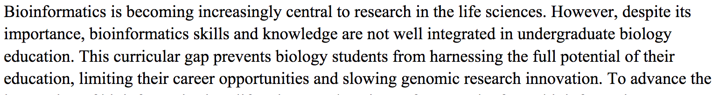
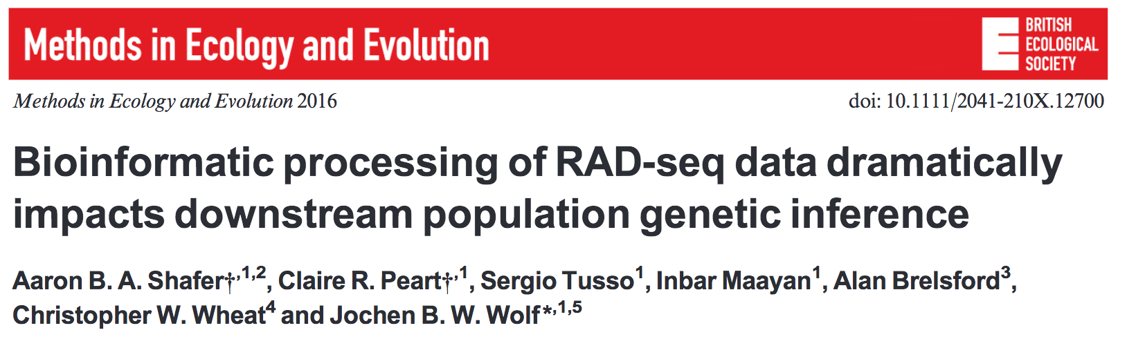
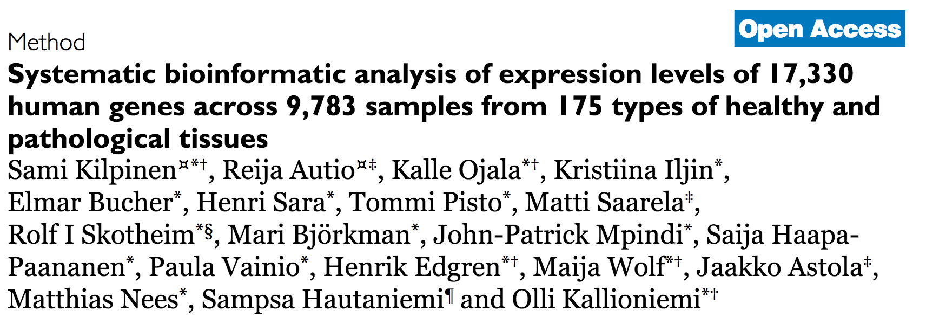
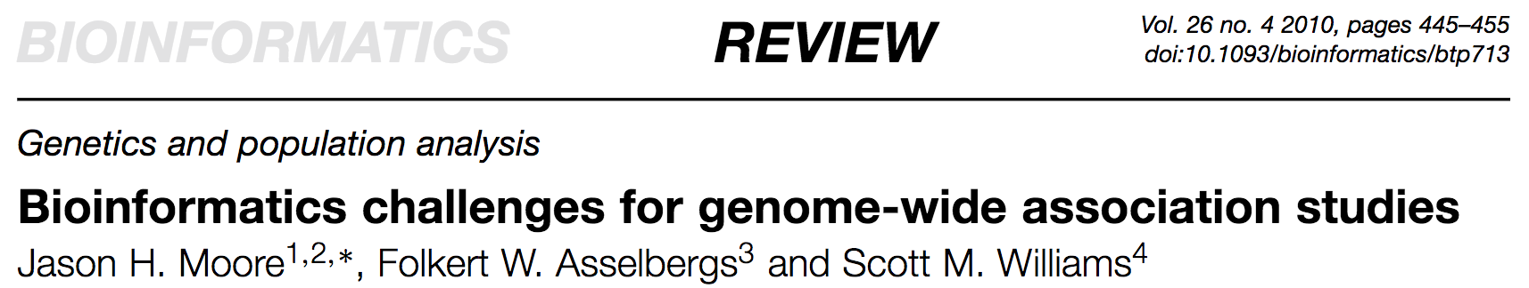
Why do we care about bioinformatics?
Genetic data
-Sayres et al. 2017

Slide 3
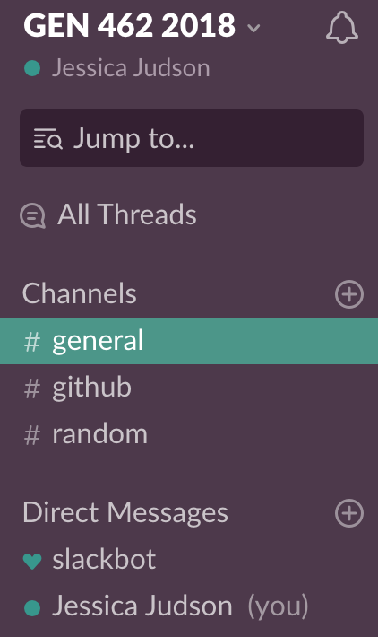

https://isu-gen-462-2018.slack.com/

Slide 4

https://github.com/jjudson28/GEN_462_2018
On your computer:
Move into the GEN_462_2018 Folder
cd GEN_462_2018
Type ls to list the folder’s contents
To update your repository to be consistent with what is online, type git pull and then press enter
If you are on a cart computer:
Go to the website for the github repository on your browser
Click the files you want to download

Slide 5
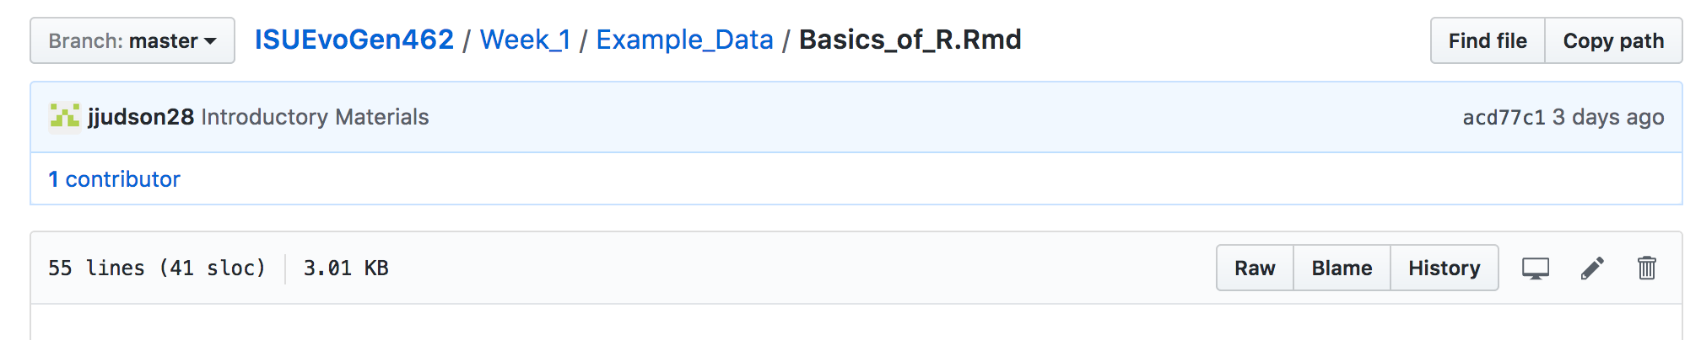
Go to File, Save as in your web browser
Choose location to save that you can find easily
Don’t append the “.txt” file ending

Slide 6
Objectives for Today
Basics of R Studio
Review different marker types and their pros/cons
Use R Studio and the packages ”adegenet” and “pegas” to generate basic statistics and HWE estimates
Interpret these values in a biological context

Slide 7

Discuss basics of R Studio: Open R Studio
Open file in Example Data called Basics_of_R.Rmd

Slide 8
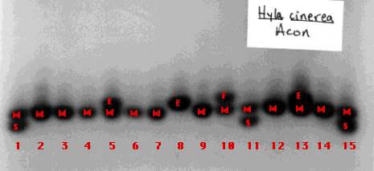
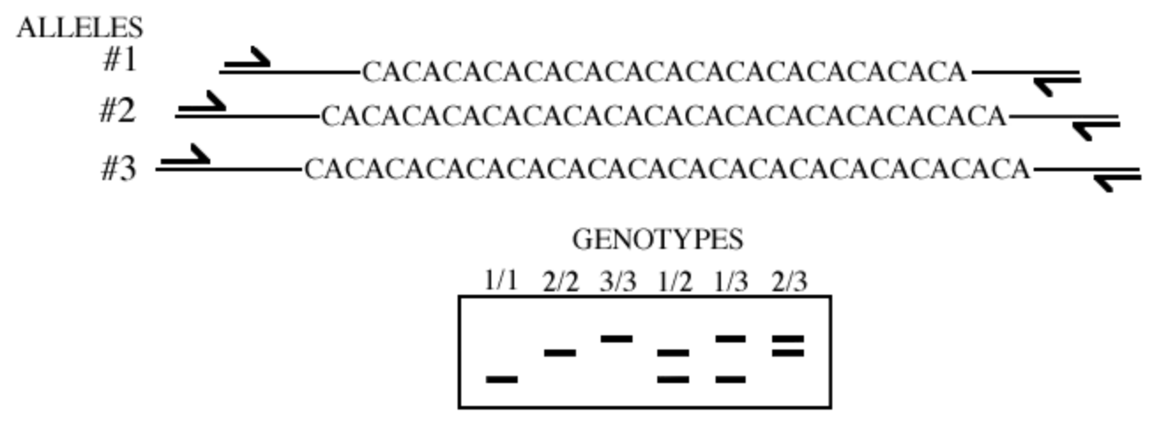
Common Marker Types
Allozymes
Different forms of an enzyme coded by different alleles at the same locus
Not very variable
Potentially under selection
Microsatellites
Tandem repeats in DNA sequence
Rapidly evolving
Neutral (?)

Slide 9
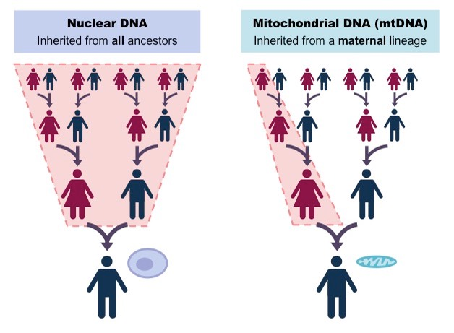
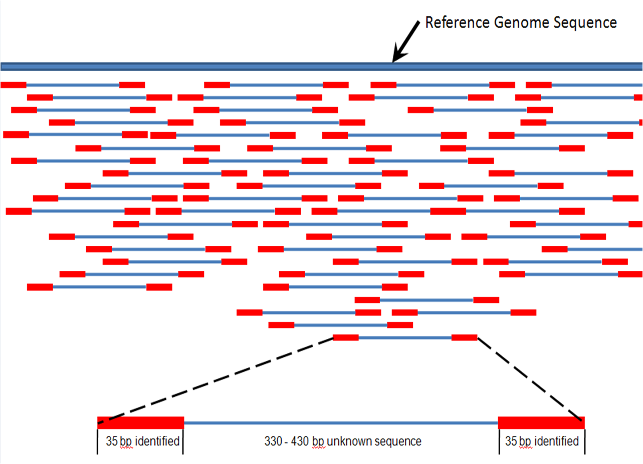
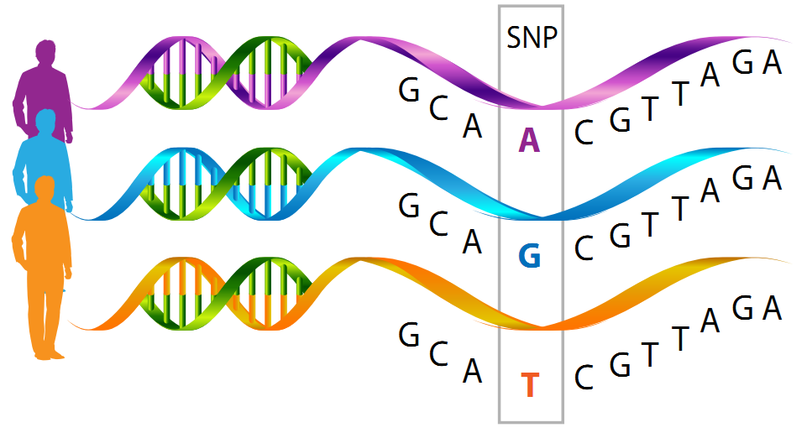
Sequence data (shorter or genomic sequence data)
Mitochondrial or Chloroplast
Full genome sequence data
Single Nucleotide
Polymorphisms (SNPs)
An example of use of sequence
data

Slide 10
SNPs
Can have lots of data for fine scale population structure
Not as rapidly evolving as microsatellites
Can be in coding regions (genes) or in neutral regions

Slide 11
References
Sayres, M. A. W. et al. Bioinformatics Core Competencies for Undergraduate Life Sciences Education. bioRxiv 170993 (2017).
http://www.biology-pages.info/P/Polymorphisms.html
http://www.informatics.jax.org/silver/figures/figure8-10.shtml
https://neuroendoimmune.wordpress.com/2014/03/27/dna-rna-snp-alphabet-soup-or-an-introduction-to-genetics/

