Slide 1

Massenger: a Messenger As a Service
framework
By: Mahrad Hanaforoosh & AmirAbbas Majd
Instructor: Dr. Mehrdad Ashtiani
Winter 2019

Slide 2

Agenda
Features Overview
Deployment view
Development view
Logical Views

Slide 3
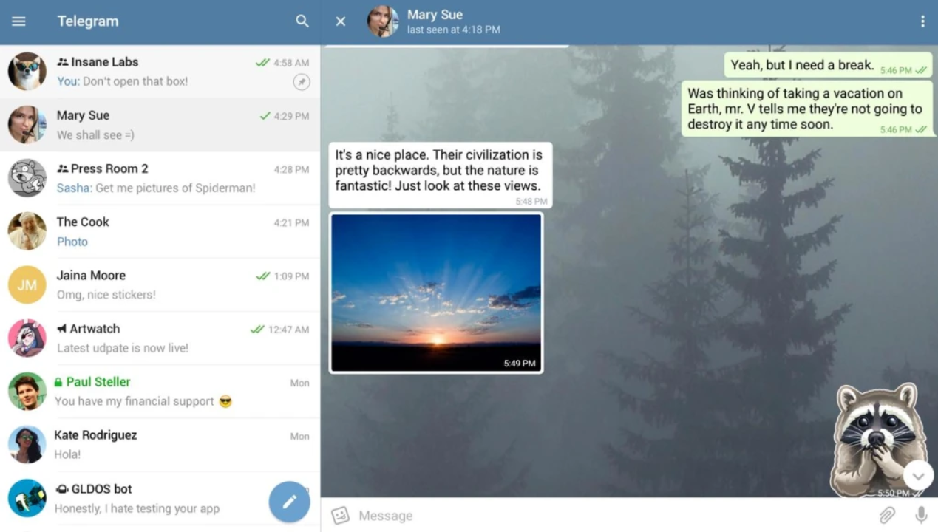
Overview
Account and profile settings
Double Chat
Group
Channels
Bots

Slide 4
Features List
Account Management
Users
Bots
Login
Log out
Conversations
Double Chats
Groups
Channels
Authentication
Notification
Groups
Channels
Profile Management
Bio
Avatar
Visible name
Contacts
Privacy Policies
The full list is available at
https://github.com/hanaforoosh/FinalSSA/blob/master/FeatureList.md

Slide 5
Essential Features
As a Service? | Important? | Essential? | Feature
 | ✔ | ✔ | Users
 |  |  | Bots
 | ✔ | ✔ | Double Chats
 | ✔ |  | Groups
 | ✔ |  | Channels
✔ |  | ✔ | Authentication
✔ | ✔ |  | Notification

Slide 6




Deployment View
Clients
Client
Server
Request
Response
FireWall
API Gateway
MAssenger
Controllers
Models
DAL
Data Layer

Slide 7
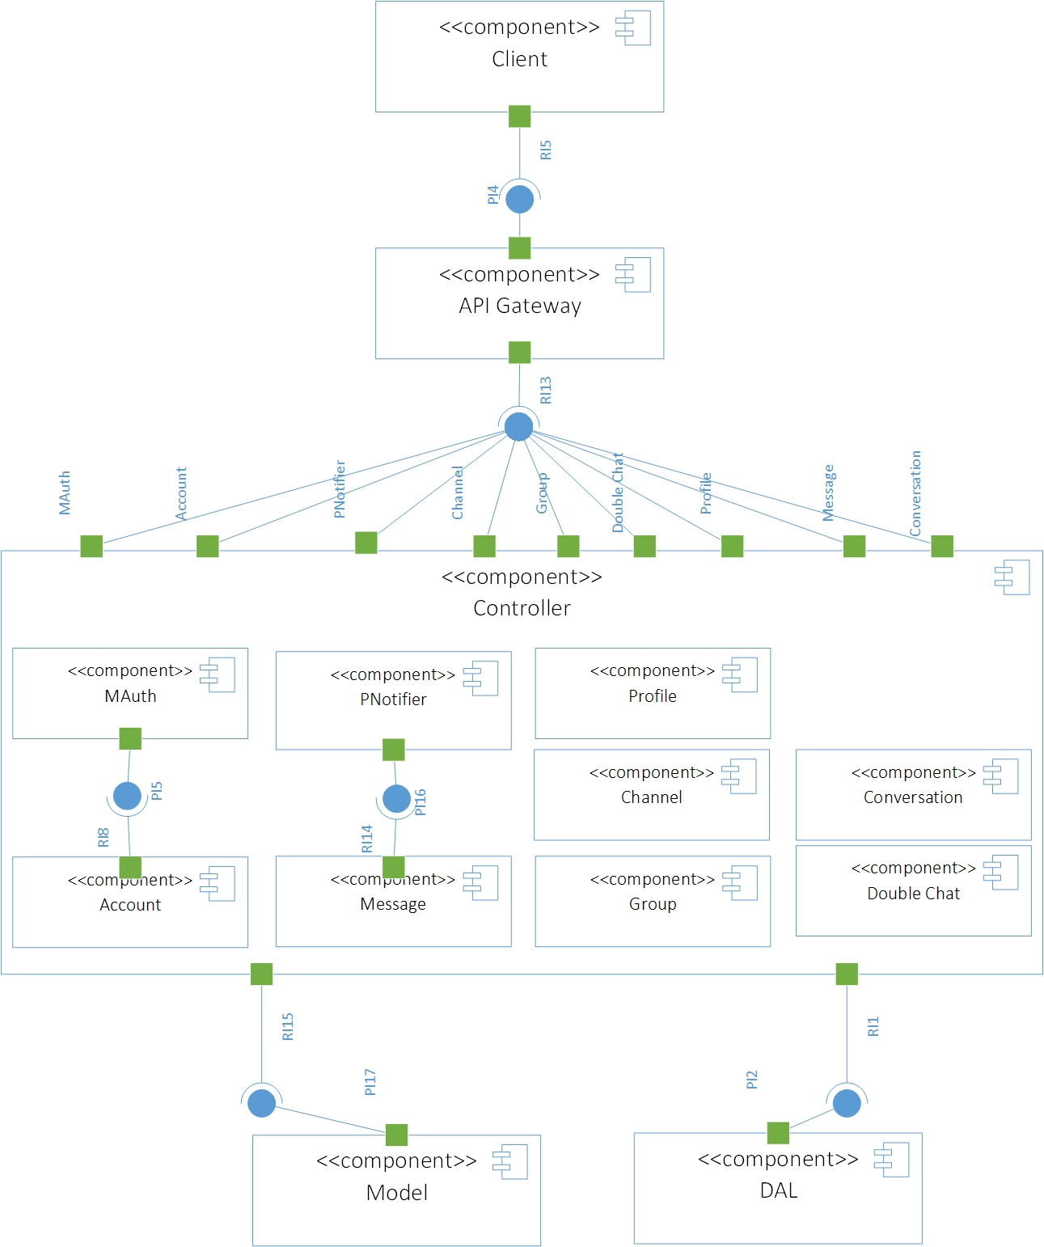
Development View

Slide 8
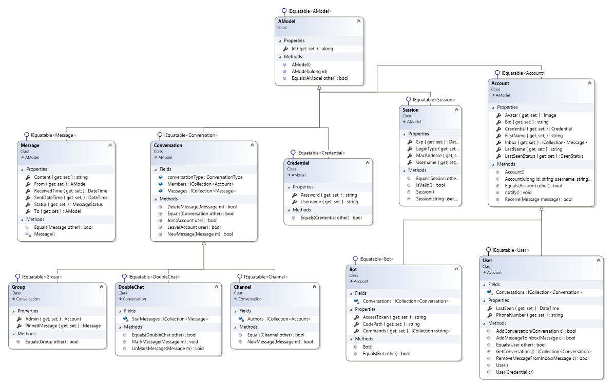
Models Big Picture
Cyclically-dependent Modularization
Observer Pattern
Missing Abstraction

Slide 9
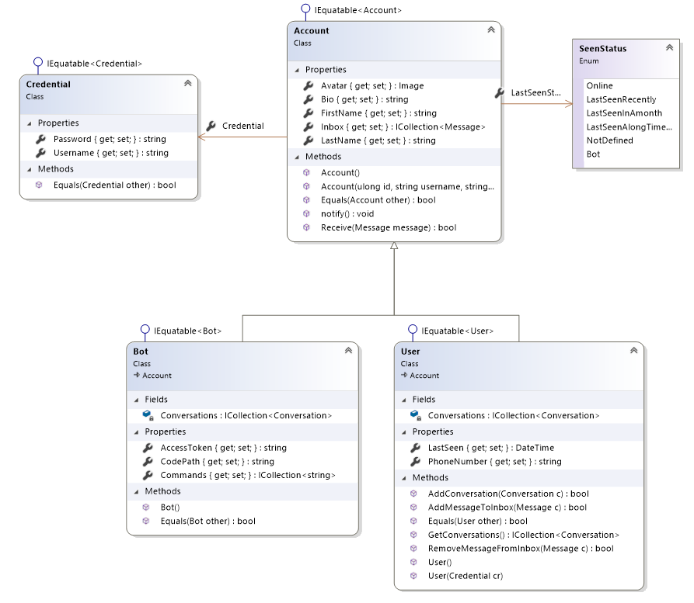
Models (Account)

Slide 10
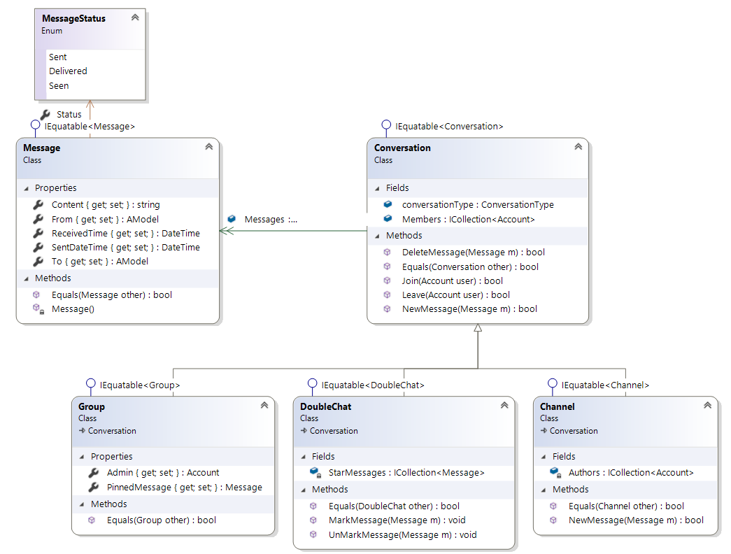
Models (Conversations)

Slide 11
Models (Conversations)

Slide 12
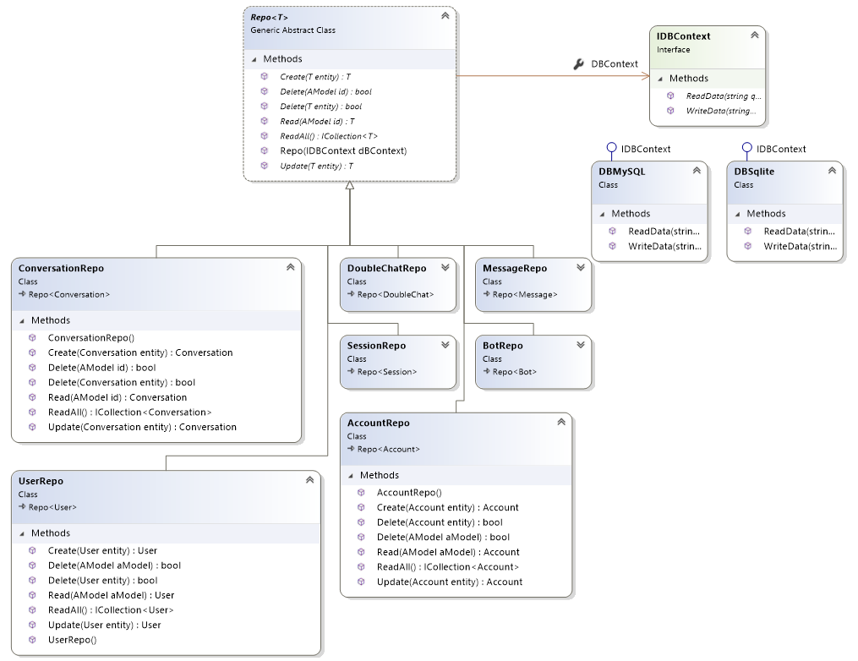
DAL
Repository Pattern
Bridge Pattern

Slide 13
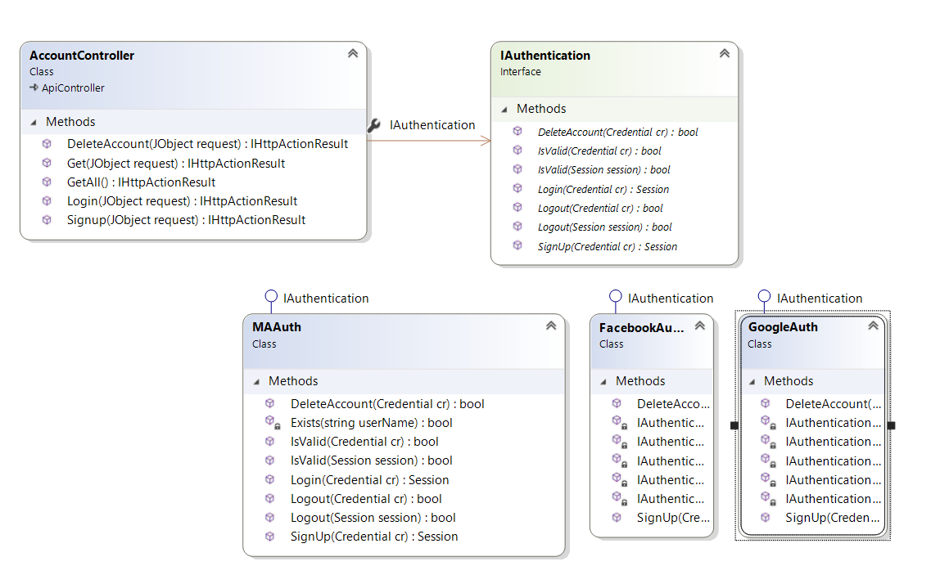
Controllers (Authentication)
Semi Decorator!
Todo : Decorator for SSO!

Slide 14
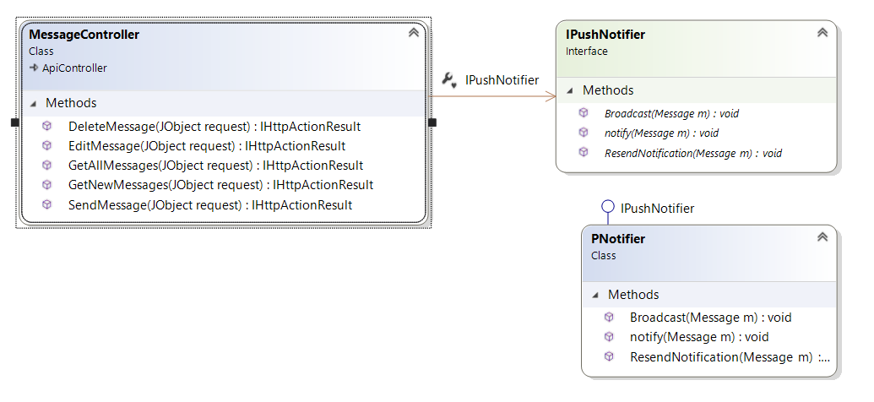
Controllers (Message)
Using Interfaces (Façade Pattern)

Slide 15
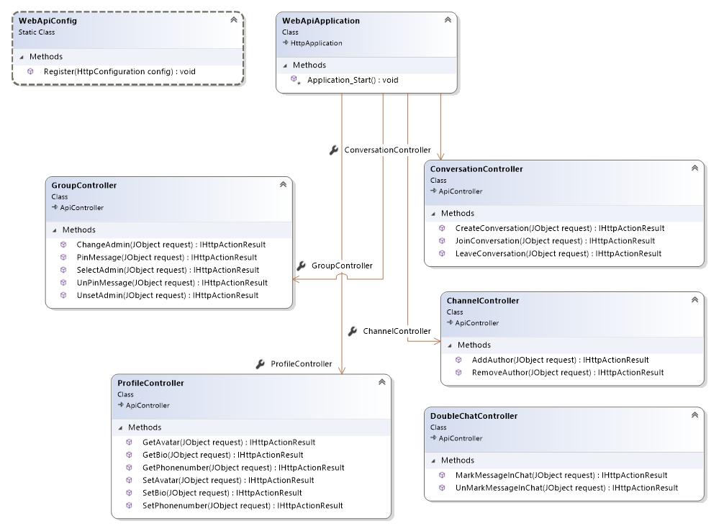
Controllers (The rests)
Single Responsibility
Separation of Concerns

Slide 16
Thank You
For your attention

Slide 17

Any Questions?

