Slide 1
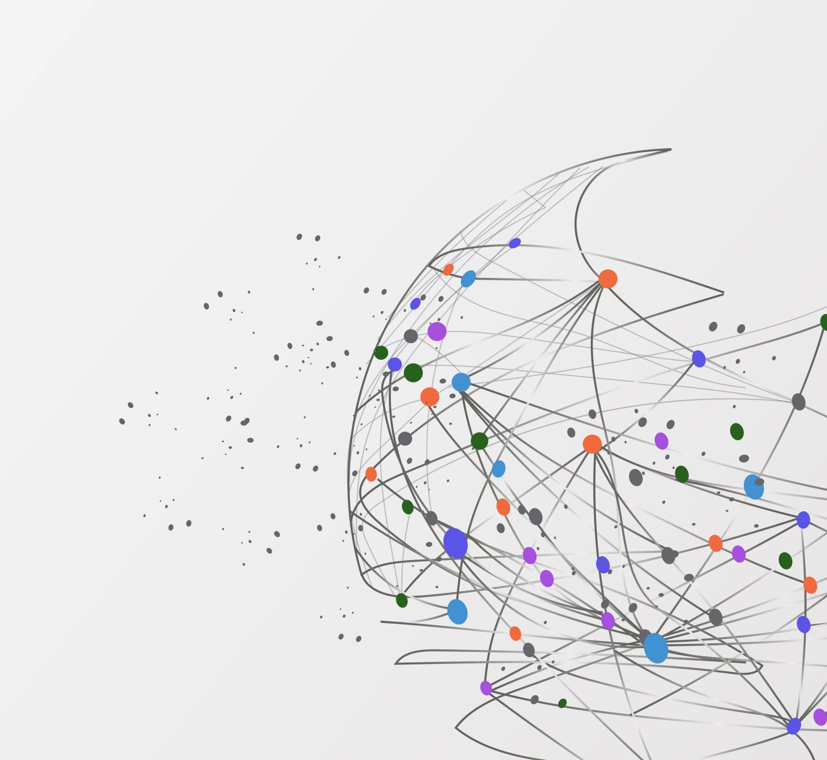
Social IS Project
______________________________________________

Slide 2
الاسماء :
1-
2-
3-
4-
5-
6-
7-

Slide 3
The Dataset :
contains network data for character relationships within George R. R. Martin's *A Storm of Swords*, the third novel in his series *A Song of Ice and Fire* (also known as the HBO television adaptation *Game of Thrones*). This data was originally compiled by [A. Beveridge and J. Shan, "Network of Thrones," Math Horizons Magazine , Vol. 23, No. 4 (2016), pp. 18-22](https://www.maa.org/sites/default/files/pdf/Mathhorizons/NetworkofThrones%20%281%29.pdf).
Nodes: 107; unimodal
Edges: 353; weighted; undirected

Slide 4
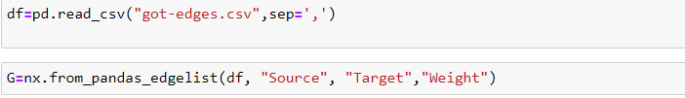
Read The Dataset

Slide 5
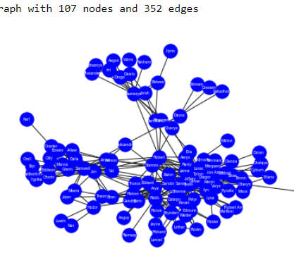
Visualization

Slide 6
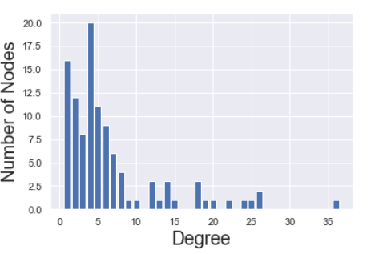
Degree Distribution

Slide 7
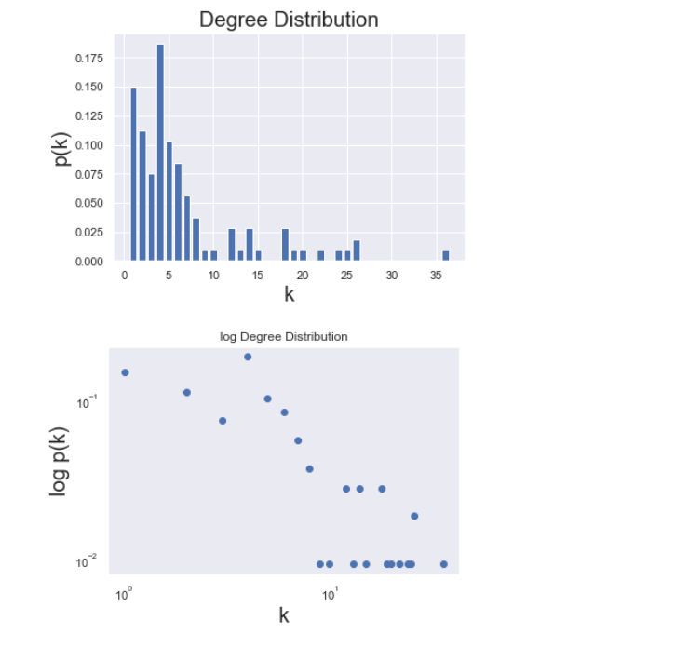
Degree Distribution

Slide 8
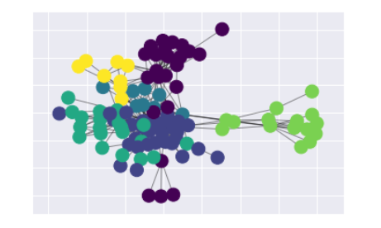
Community Detection

Slide 9
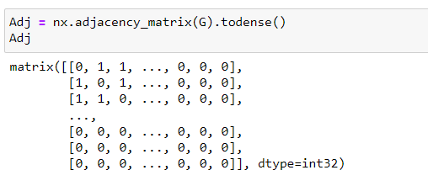
Adjacency matrix

Slide 10
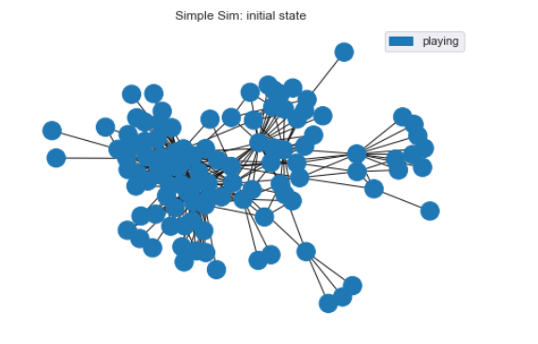
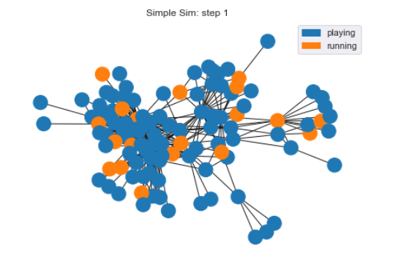
Simulation
_________________

Slide 11
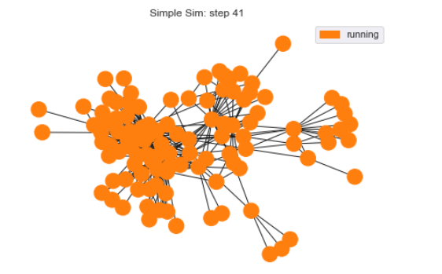
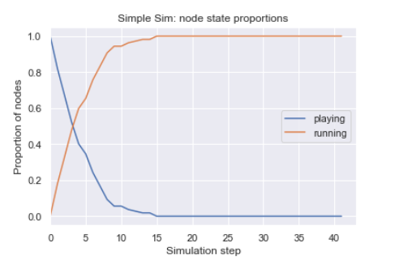
Simulation

Slide 12
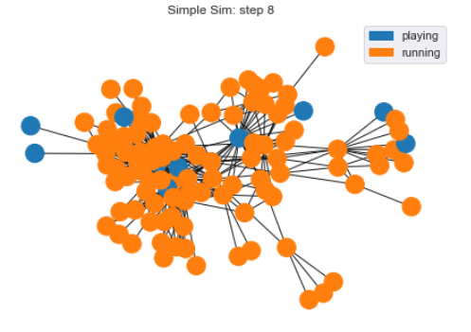
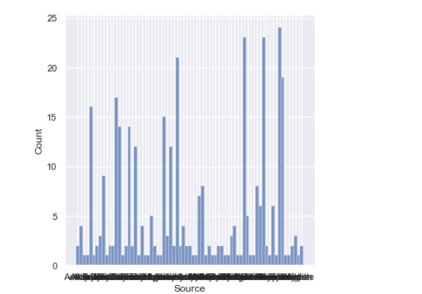
Simulation

Slide 13
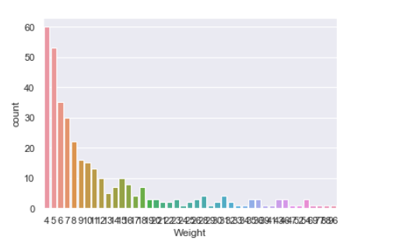
Simulation

Slide 14
THANX

