Slide 1
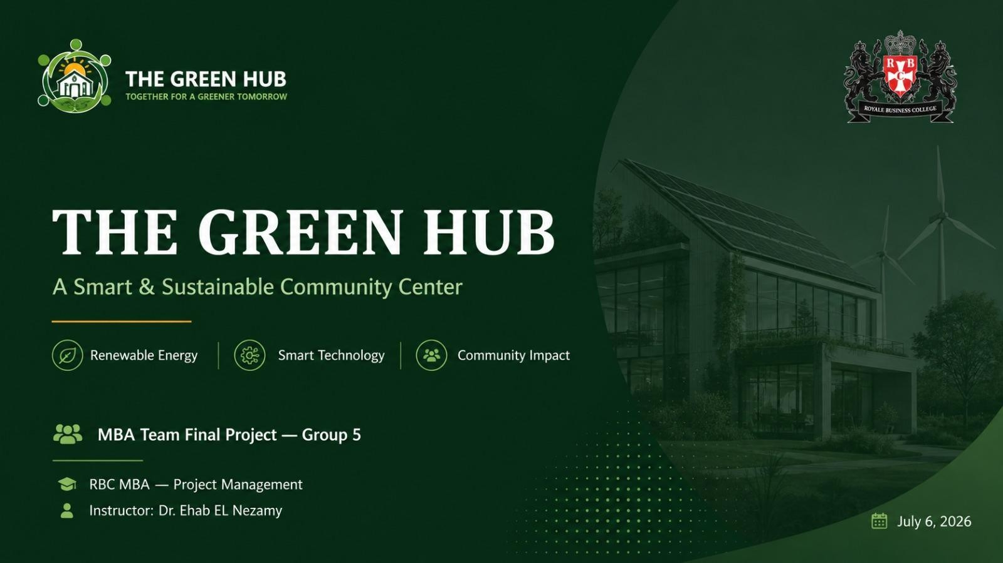

Slide 2



PROJECT OVERVIEW
About The Green Hub
The Green Hub is a community center project that runs entirely on renewable energy and combines construction, engineering, and sustainability.
It represents the successful integration of professional project management principles with sustainable development practices — delivering measurable environmental, social, and economic value by combining renewable energy, smart technologies, and environmentally responsible design to inspire greener communities and foster a culture of green living.
Renewable Energy
Solar PV, rainwater harvesting, smart systems
Community Impact
Education, coworking, training programs
LEED Certified
Environmentally responsible design standard
“The Green Hub is a living embodiment of how professional project management converges with a vision of environmental sustainability to achieve a real, lasting impact on the community.”
THE GREEN HUB · MBA TEAM FINAL PROJECT — GROUP 5
2

Slide 3






GOVERNANCE
Project Team
Dr. Ehab EL Nezamy
Instructor / Advisor
Armia Kamal
Mohamed Ahab
Michael Atef
Project Manager
Planning & Scheduling Lead
Scope & Risk Officer
Salwa Michel
Shehab Badr
Amira Gomaa
Finance & Partners Officer
QA & Governance Officer
QA & Audit Assistant
THE GREEN HUB · MBA TEAM FINAL PROJECT — GROUP 5
3

Slide 4
DELIVERABLE 1
1 of 2
Scope Statement
Description
Requirements
Sustainable community center promoting environmental awareness and green living: renewable-energy-powered facility with smart technologies, educational workshops, recycling programs, coworking spaces, community activities.
Solar PV system · smart lighting & HVAC controls · rainwater harvesting · recycling center · Building Management System (BMS).
Deliverables
Boundaries
Approved charter · architectural & engineering designs · completed sustainable building · renewable energy system · Smart BMS · community training program · final handover documentation.
IN: site prep, construction, solar PV, rainwater, smart lighting/HVAC, landscaping, recycling center, training rooms, grand opening. OUT: other cities, residential, commercial retail, post-handover operation.
THE GREEN HUB · MBA TEAM FINAL PROJECT — GROUP 5
4

Slide 5
DELIVERABLE 1
2 of 2
Scope Statement — Strategy, Criteria & Cost
Assumptions:
Funding approved · permits on time · materials available · skilled contractors available · stable weather.
COST BREAKDOWN
Constraints:
$1.2M budget · 40 weeks · LEED standards · local regulations · site limitations.
Design
$60K
Construction
$450–750K*
Strategy:
Sequential phases: Initiation (2wk) → Planning (3wk) → Design (6wk) → Procurement (4wk) → Construction (20wk) → Testing (3wk) → Handover (2wk).
Solar PV
$120K
Smart Systems
$80K
Acceptance Criteria:
≤ 40 weeks · budget variance < 5% · LEED certified · smart systems operational · client satisfaction ≥ 90% · zero lost-time accidents.
MEP
$140K
Landscape
$40K
Furniture
$70K
Contingency
$120K
TOTAL
$1.2M
*Construction range shown in the Scope Statement; resolved to $570K in the Budget deliverable (Slide 9).
THE GREEN HUB · MBA TEAM FINAL PROJECT — GROUP 5
5

Slide 6
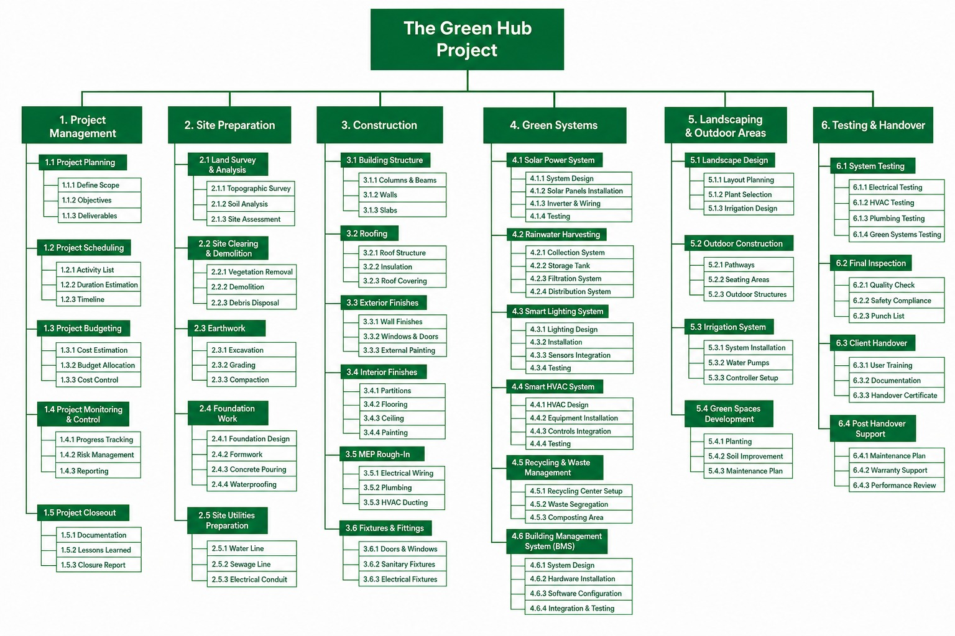
DELIVERABLE 2
Work Breakdown Structure (WBS)
THE GREEN HUB · MBA TEAM FINAL PROJECT — GROUP 5
6

Slide 7
DELIVERABLE 3
Organizational Breakdown Structure (OBS)
Per the instructor's rule: PM at the top, same horizontal level = same authority, titles not names.
Project Manager
Armia Kamal
Planning & Scheduling Lead
Scope & Risk Officer
Finance & Partners Officer
QA & Governance Officer
Mohamed Ahab
Micheal Atef
Salwa Michel
Shehab Badr
QA & Audit Assistant
Amira Gomaa
THE GREEN HUB · MBA TEAM FINAL PROJECT — GROUP 5
7

Slide 8
DELIVERABLE 4
1 of 2
Project Budget — PMBOK Cost Structure
PMBOK Framework case study: aggregating costs & allocating risk reserves for the Green Hub Project ($1,200K).
FINANCIAL OVERVIEW
1
Activity Cost Level
$1,080K
Direct costs — labor, equipment, professional services
$1,080K
90.0%
$1,080,000
Direct Activity Execution
2
Work Package Level
$38K
+ Activity Contingency Reserve ($38K)
$1,118K
6.5%
$78,000
3
Control Accounts
$40K
Contingency Reserves
+ Package Contingency ($40K) = Cost Baseline
$1,158K
3.5%
$42,000
4
Total Project Budget
$42K
+ Management Reserve ($42K)
$1,200K
Management Reserve
THE GREEN HUB · MBA TEAM FINAL PROJECT — GROUP 5
8

Slide 9
DELIVERABLE 4
2 of 2
Green Hub Budget Matrix
Budget Component | Amount | Reserve Ratio | Cumulative
Activity Cost (Direct Costs) | $1,080K | – | $1,080K
Activity Contingency Reserve | $38K | 3.6% | $1,118K (Work Package)
Contingency Reserve (Work Package) | $40K | 3.6% | $1,158K
Cost Baseline / Control Account | $1,158K | – | $1,158K
Management Reserve | $42K | 3.6% | $1,200K
Total Project Budget | $1,200K | 10.8% total | $1,200K
Steps: (1) direct activity costs → (2) + activity contingency → (3) + package contingency = Cost Baseline → (4) + management reserve = Total Budget.
THE GREEN HUB · MBA TEAM FINAL PROJECT — GROUP 5
9

Slide 10
DELIVERABLE 5
1 of 2
Stakeholder Analysis
Stakeholders were identified from the project participants list, evaluated on power and interest, and plotted on a Power/Interest grid to set the engagement strategy for each.
Stakeholder | Power | Interest | Engagement Strategy
Sponsor / Investor | High | High | Manage Closely
Municipality (Permits) | High | Medium | Keep Satisfied
Design Consultant | Med–High | High | Manage Closely
Contractor | High | High | Manage Closely
Suppliers | Medium | Medium | Keep Informed
Local Community | Low | High | Keep Informed
Environmental Authority | High | Medium | Keep Satisfied
THE GREEN HUB · MBA TEAM FINAL PROJECT — GROUP 5
10

Slide 11
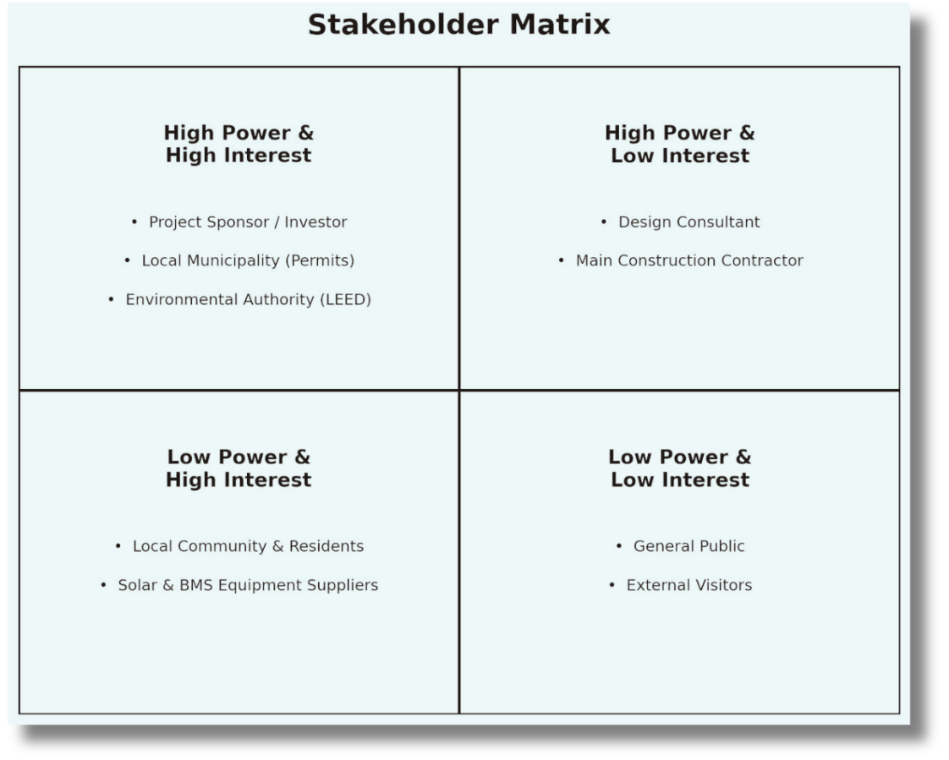
DELIVERABLE 5
2 of 2
Power / Interest Grid
MANAGE CLOSELY
Sponsor/Investor · Design Consultant · Contractor — the three relationships that most directly determine project success.
KEEP SATISFIED
Municipality · Environmental Authority — regulatory gatekeepers who can block progress without deep day-to-day involvement.
KEEP INFORMED
Local Community — affected by the project but with limited formal authority over it; managed through communication.
MONITOR
Suppliers — tracked primarily for delivery-schedule risk rather than active engagement.
THE GREEN HUB · MBA TEAM FINAL PROJECT — GROUP 5
11

Slide 12
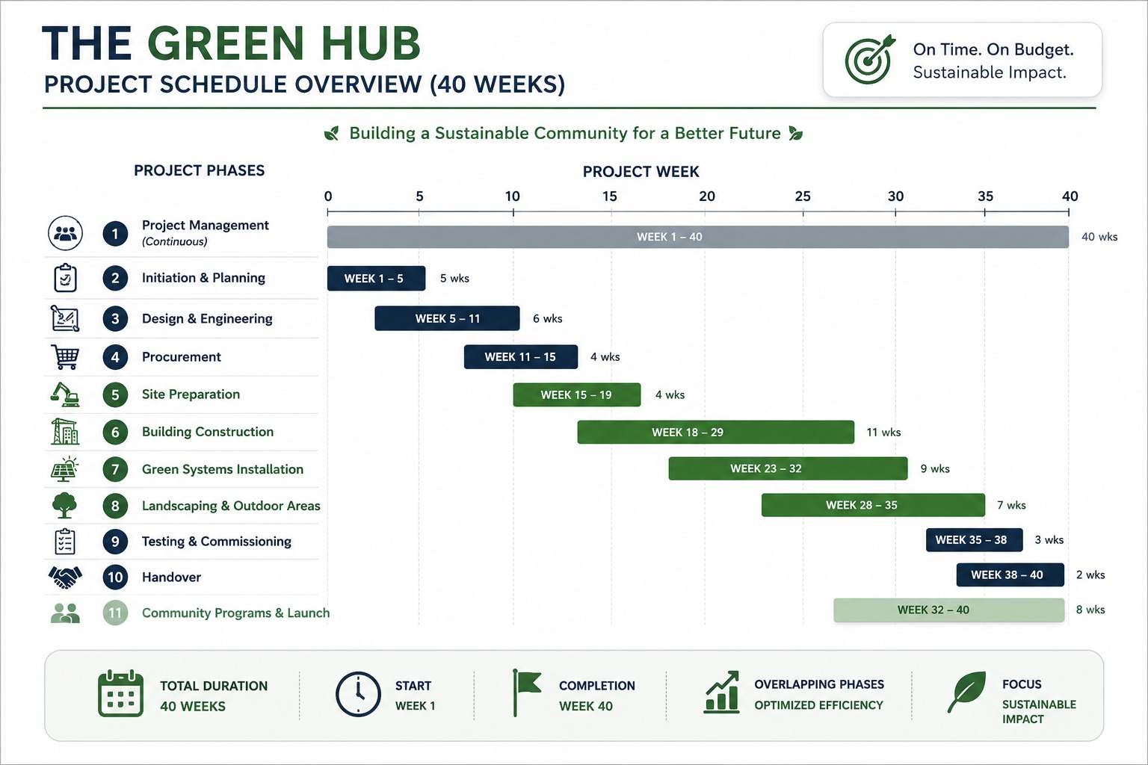
DELIVERABLE 6
1 of 2
Gantt Chart — 40-Week Schedule
Built from the Scope Statement's 7-phase strategy, with WBS branches mapped along the timeline. Construction (20 weeks) splits into four WBS sub-branches with realistic overlap.
THE GREEN HUB · MBA TEAM FINAL PROJECT — GROUP 5
12

Slide 13
DELIVERABLE 6
2 of 2
Project Schedule Overview
Full activity detail — owners, descriptions, and SS/SF/FF/FS dependencies — maintained in the companion Excel sheet.
Phase / WBS Branch | Start Wk | End Wk | Duration | WBS Ref
Project Management (continuous) | 1 | 40 | 40wk | Branch 1
Initiation | 1 | 2 | 2wk | 1.1
Planning | 3 | 5 | 3wk | 1.2–1.4
Design & Engineering | 6 | 11 | 6wk | Branch 7
Procurement | 12 | 15 | 4wk | Branch 8
Site Preparation | 16 | 19 | 4wk | Branch 2
Building Construction | 18 | 28 | 11wk | Branch 3
Green Systems Installation | 24 | 32 | 9wk | Branch 4
Landscaping & Outdoor Areas | 29 | 35 | 7wk | Branch 5
Testing | 36 | 38 | 3wk | 6.1–6.2
Handover | 39 | 40 | 2wk | 6.3–6.4
Community Programs & Launch | 33 | 40 | 8wk | Branch 9
THE GREEN HUB · MBA TEAM FINAL PROJECT — GROUP 5
13

Slide 14
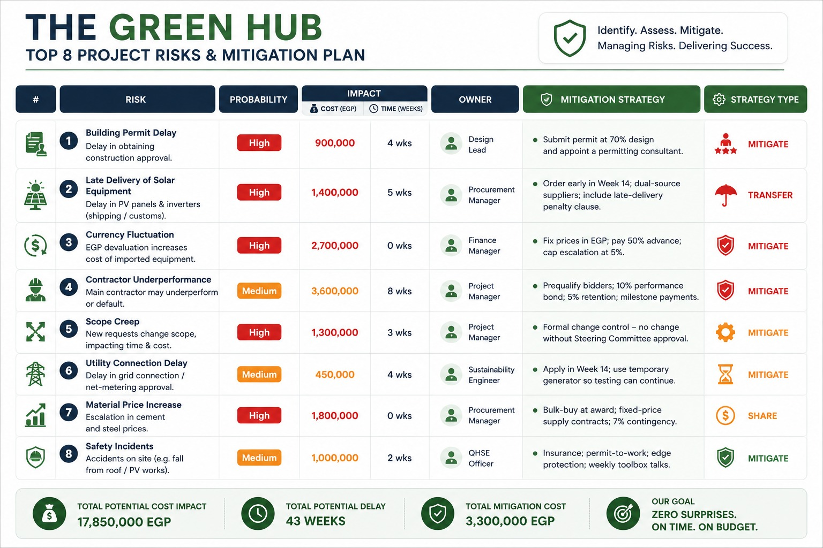
RISK MANAGEMENT
Top 8 Project Risks & Mitigation Plan
THE GREEN HUB · MBA TEAM FINAL PROJECT — GROUP 5
14

Slide 15






PROJECT IMPACT
Beyond Construction: Long-Term Sustainable Value
Reduce Carbon Emissions
Lower footprint through efficient design and clean energy.
A practical impact on the environment, the community, and future operations.
Renewable Energy
Solar PV and smart controls support green operations.
Water Conservation
Rainwater harvesting and recycling reduce waste.
Sustainable Impact
Community Development
Education, training, and shared spaces create social value.
Long-term Sustainability
A scalable model with lasting social and economic benefit.
THE GREEN HUB · MBA TEAM FINAL PROJECT — GROUP 5

Slide 16
