Slide 1


Amirah AlOtaibi - Founder
Amal AlTamran -Co F﻿ounder
AlAnoud AlHussain - Senior Data Engineer
Shahad AlMutairi - Senior AI Advisor
Hessa AlBulyhid - Senior AI Advisor

Slide 2

What is the Problem?
HR processes such as (Talent hiring and development, Resignation process, Performance report, Onboarding and Orientation ….etc) are manually implemented and governed which affects the efficiency, quality, and entire productivity of HR department and any related department across the organization.

Slide 3

Aman Provide Excellent services that will save time and present reports
Aman supports the decision maker and serves the human resources department and the finance department to display data efficiently

Slide 4
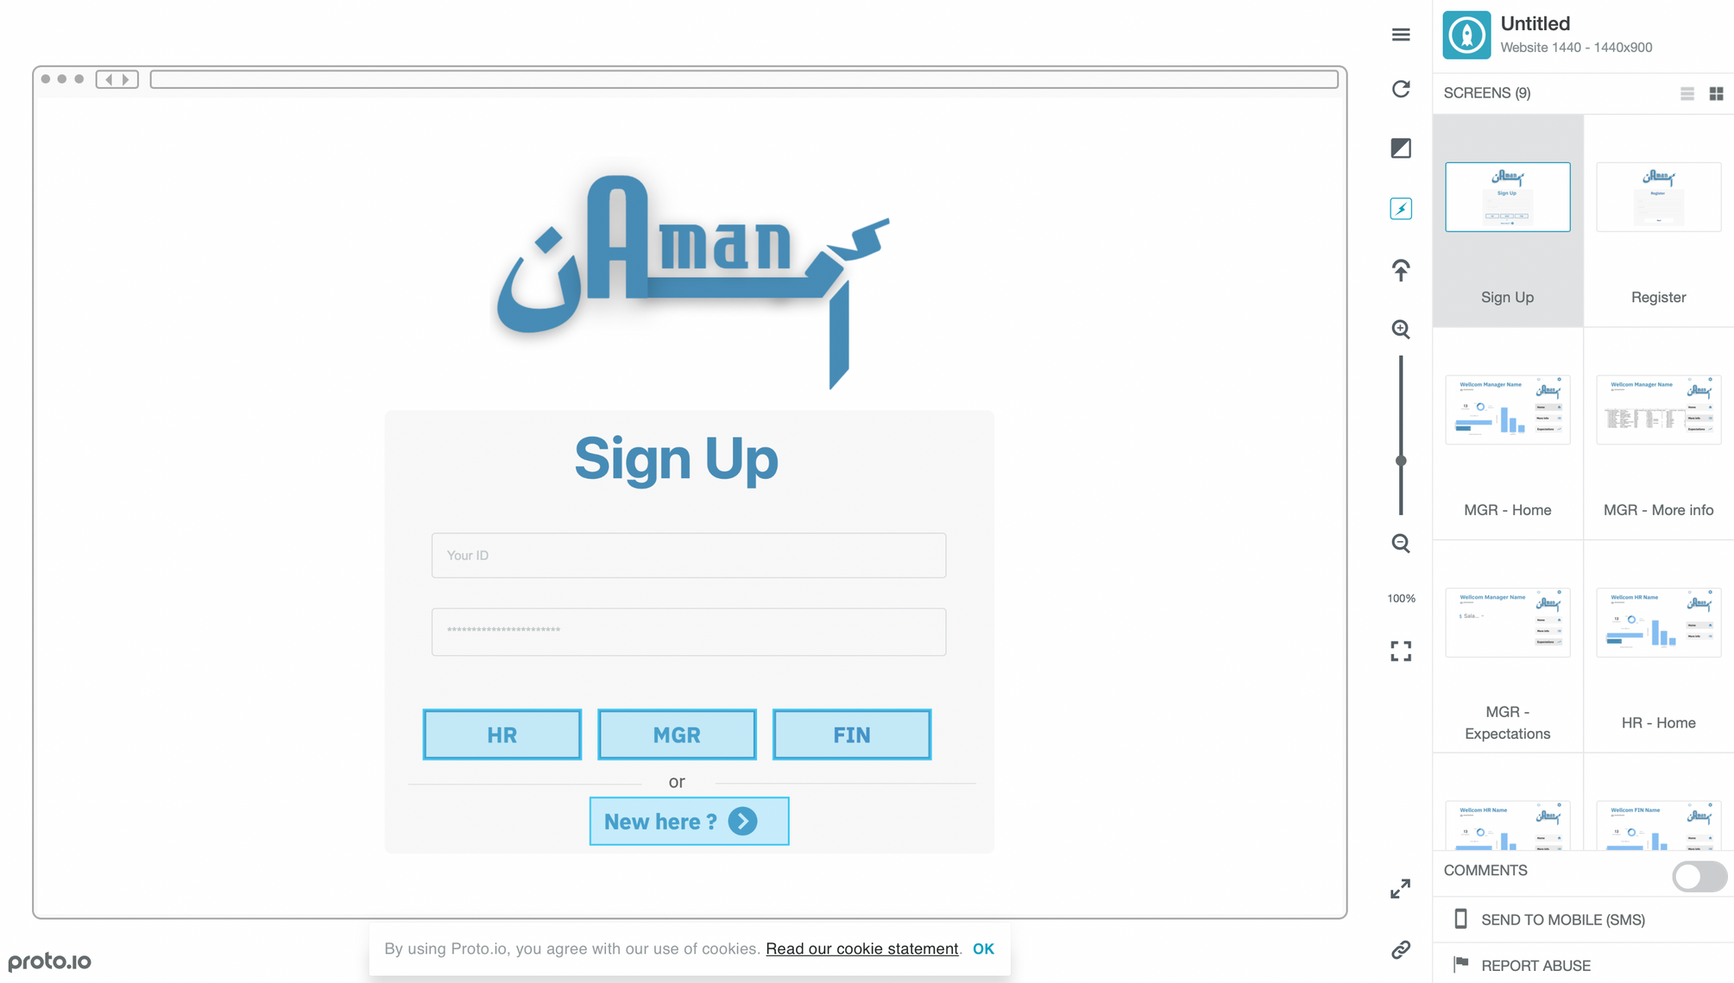

Slide 5

How Aman make money?
A website that collects employee data and provides forecasting of employee performance and salary could generate revenue :
1. Subscription model
2. Commission-based model
3. Data licensing model
4. Advertising model
5. Affiliate model

Slide 6

Future improvement Plan

Slide 7
Thank you

