Slide 1
Full battery.
No service.
The tower is standing. On dry ground.
ResiliNet
Flood-response planning for mobile networks
Notes:
TIMING: 0:00–0:25
Imagine being on a roof as floodwater rises. Your phone has a full battery, but no service. The tower is still standing on dry ground. A flood can cut its access, its power, or its connection to the rest of the network. ResiliNet helps emergency communications teams decide where to send a portable tower before the roads close.
SOURCES
Illustrative opening, not a documented account of a particular person or tower. Mechanism implemented in lib/network.ts.

Slide 2
Malaysia’s floods, December 2014
237,000
people displaced nationwide
In Kelantan, families pleaded for help when they found signal.
Malaysiakini, 30 Dec 2014. Kelantan reporting: The Malaysian Insider, 26 Dec 2014.
02
Notes:
TIMING: 0:25–0:50
This is rooted in a real emergency. On 30 December 2014, reporting put the nationwide number of displaced people at about 237,000. Kelantan was at the centre of that crisis. Families in cut-off communities pleaded for help through social media when they could connect. Communication mattered because it let people ask for help and tell others where they were. Our purpose is to make that connection more resilient.
Do not imply that all displaced people lost service. Do not claim every mast survived.
SOURCES
https://www.malaysiakini.com/news/284861 (237,037 nationally at 8:30 pm on 30 Dec; not a Kelantan-only count).
https://blog.limkitsiang.com/2014/12/27/kelantan-flood-victims-plead-for-aid-via-social-media/amp/ (reproduces The Malaysian Insider, 26 Dec).

Slide 3
Dry ground can still lose signal
19,595
people on dry ground, without signal
The water and the silence are not in the same place.
Illustrative scenario at +14 h. ResiliNet coverage model and WorldPop 2020.
03
Notes:
TIMING: 0:50–1:30
Here is the distinction that matters. The flood map and the communications map answer different questions. A flooded home under a working tower may still call for help. A dry village under a failed tower may not. In our demonstration scenario, 19,595 people occupy cells that remain dry but lose modelled coverage. That is a subset of the people we will see on the next slide. A map of water alone does not reveal that need. ResiliNet follows the dependencies that connect the rain, roads, towers, and people.
Counts represent estimated people living in modelled coverage areas, not measured phones, subscribers, calls, or lives saved.
SOURCES
ResiliNet scenario. Kelantan, gauge 27.0 m, planning hour +14 h. Model estimates, not observed outages.
Verified against coverageHole and the population-aligned HAND raster in the current repository. Dry means HAND is 255 or at least the simulated flood threshold at +14 h. App screenshots: ResiliNet local prototype. Terrain: NASA SRTM. Imagery: Sentinel-2 cloudless 2020, EOX IT Services GmbH, CC BY 4.0, based on modified Copernicus Sentinel data 2020. Roads and settlements: OpenStreetMap contributors, ODbL. Population: WorldPop 2020, CC BY 4.0.

Slide 4
Where should the portable tower go?
36,614
people projected to lose signal within 14 hours
One portable tower. Limited access. A decision before roads close.
Illustrative scenario. Kelantan gauge 27.0 m. Before any response.
04
Notes:
TIMING: 1:30–2:05
Across this valley, the scenario projects 36,614 people losing coverage by hour fourteen, including the dry-ground group. The operator has one portable tower to place. Which hill should it go to? A high hill is not enough if the truck cannot reach it, the terrain blocks the villages, or the tower has no working network to connect to. Our prototype examines fifteen candidate locations. Seven are reachable and have a usable link in this scenario. It gives the officer a specific place to investigate, rather than another layer to interpret.
The original draft’s 30 hills is not the current dataset. The four-hour deadline applies to a support convoy’s latest arrival, not a universal portable-tower departure deadline. Use relative hours, not a fixed 04:00 wall clock.
SOURCES
ResiliNet scenario. Kelantan, gauge 27.0 m, planning hour +14 h. Model estimates, not observed outages.
node scripts/check-sites.mjs kelantan 27
public/terrain/terrain.json: 15 candidate sites; 7 usable reachable sites.
WorldPop 2020.

Slide 5
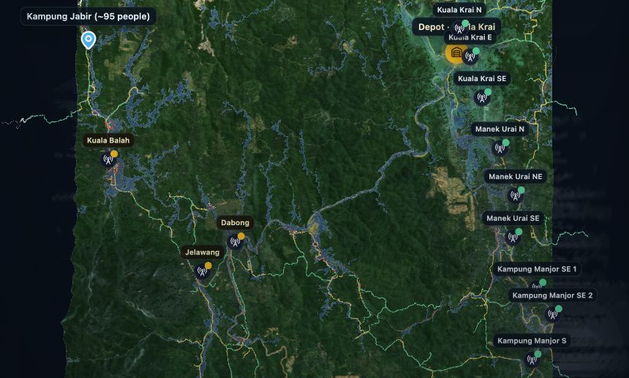
The right hill, before the road closes
Every location must pass
Reachable in time
Reaches people
Links to a
working tower
ResiliNet prototype. NASA SRTM, OpenStreetMap, WorldPop and OpenCellID.
05
Notes:
TIMING: 2:05–2:45
ResiliNet tests each location in three ways. Can the truck reach it before access closes? Can the tower see people who would otherwise lose signal? Can it connect back to a working part of the network? The model connects rainfall to river level, river level to road access, and tower failures to coverage loss. The map shows the reachable roads and compares candidate sites over real terrain. It uses elevation, a road graph, line-of-sight coverage, and population estimates. The innovation is bringing these dependencies into one decision that an officer can inspect.
Explain “links back” as the portable tower’s connection to the wider mobile network. The storm and several physical thresholds are illustrative.
SOURCES
ResiliNet scenario. Kelantan, gauge 27.0 m, planning hour +14 h. Model estimates, not observed outages.
Implementation: lib/forecast.ts, lib/routing.ts, lib/network.ts, lib/viewshed.ts, lib/sites.ts, lib/recommend.ts.
App screenshots: ResiliNet local prototype. Terrain: NASA SRTM. Imagery: Sentinel-2 cloudless 2020, EOX IT Services GmbH, CC BY 4.0, based on modified Copernicus Sentinel data 2020. Roads and settlements: OpenStreetMap contributors, ODbL. Population: WorldPop 2020, CC BY 4.0.

Slide 6
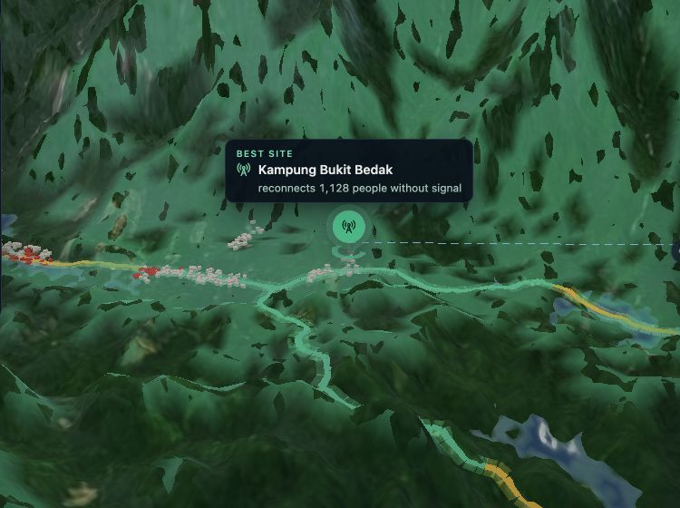
The plan: a tower at Bukit Bedak
8,604
people kept or brought
back on signal
of 13,811 still at risk
after routine support
Portable tower + network support
Combined-plan estimate at +14 h. Portable tower alone adds 1,128 people.
06
Notes:
TIMING: 2:45–3:20
For this scenario, the portable tower goes near Kampung Bukit Bedak. Routine support has already reduced the gap to 13,811 people. The recommended additional plan keeps or brings 8,604 of them onto signal. That result comes from the portable tower together with support for its network connection. The portable tower itself adds 1,128 people. The plan names a hill, its access route, and the working tower it links to. It also leaves a visible gap: 5,207 people still need another solution. These are modelled coverage estimates, not a claim that we have deployed or saved lives.
The guided demo displays 31,407 including routine support. The full app displays 8,604 additional to that baseline. Both reconcile to 36,614 initially at risk.
SOURCES
ResiliNet scenario. Kelantan, gauge 27.0 m, planning hour +14 h. Model estimates, not observed outages.
node scripts/check-sites.mjs kelantan 27: baseline keeps 22,803; residual 13,811; combined plan 8,604 = support at Kuala Balah 7,476 + portable tower 1,128; remaining 5,207.
App screenshots: ResiliNet local prototype. Terrain: NASA SRTM. Imagery: Sentinel-2 cloudless 2020, EOX IT Services GmbH, CC BY 4.0, based on modified Copernicus Sentinel data 2020. Roads and settlements: OpenStreetMap contributors, ODbL. Population: WorldPop 2020, CC BY 4.0.

Slide 7
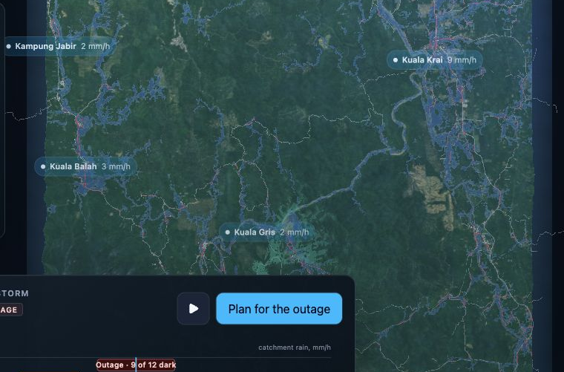
Public data. Transparent assumptions.
Terrain and roads
Population and towers
AI weather forecasts
The demo uses
a synthetic storm
2014 checks include
matches and misses
NASA, OSM, WorldPop, OpenCellID, Google DeepMind WeatherNext 3, ECMWF ERA5-Land.
07
Notes:
TIMING: 3:20–3:55
The geography comes from public data: NASA elevation, OpenStreetMap roads, WorldPop population, and open cell records. WeatherNext 3 supplies an AI forecast option with uncertainty estimates. This demonstration uses a synthetic storm so the full decision unfolds in one sitting. We also checked parts of the chain against December 2014. The bridge and town-access checks match, one village’s communications failure is missed, and the operator comparison is partial. The river model still needs calibration. We expose those limits because an operational decision needs traceable assumptions, not just an impressive map.
Historical checks are partial mechanism checks at a reported peak, not an end-to-end validated 2014 forecast. The shipped rainfall model does not reproduce the historical peak.
SOURCES
https://science.nasa.gov/mission/srtm/
https://www.openstreetmap.org/copyright
https://hub.worldpop.org/geodata/summary?id=49771
https://opencellid.org/
https://deepmind.google/science/weathernext/
https://cds.climate.copernicus.eu/datasets/reanalysis-era5-land
node scripts/check-hindcast.mjs; lib/method.ts; README.md
App screenshots: ResiliNet local prototype. Terrain: NASA SRTM. Imagery: Sentinel-2 cloudless 2020, EOX IT Services GmbH, CC BY 4.0, based on modified Copernicus Sentinel data 2020. Roads and settlements: OpenStreetMap contributors, ODbL. Population: WorldPop 2020, CC BY 4.0.

Slide 8
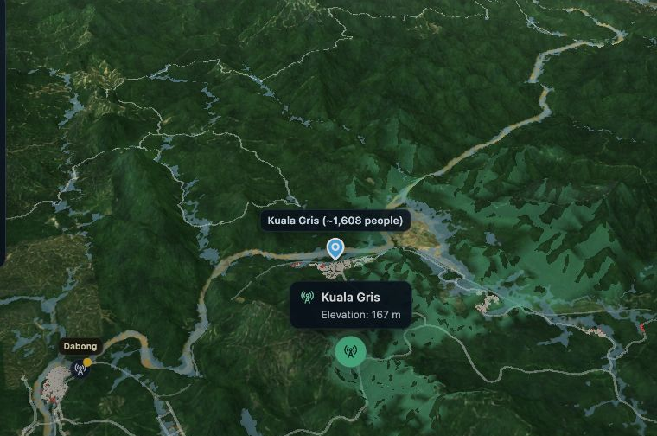
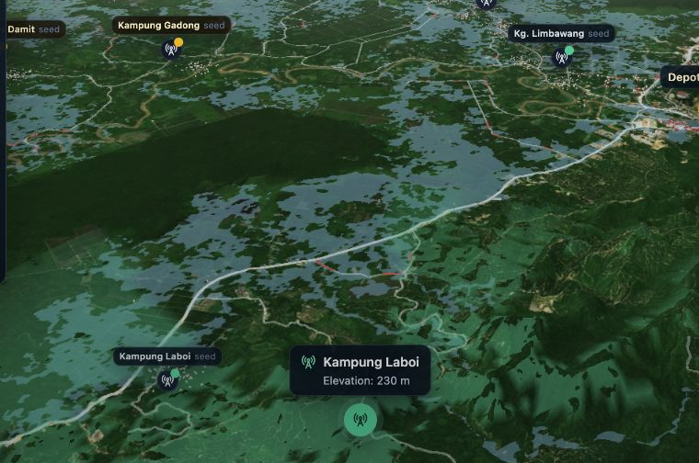
Two valleys. The same planning engine.
Galas, Kelantan
Padas, Sabah
No backend. Runs offline after setup.
ResiliNet prototype. Two prepared datasets. Operational use requires local validation.
08
Notes:
TIMING: 3:55–4:25
The same code already runs in two valleys: the Galas in Kelantan and the Padas in Sabah. Each has a prepared terrain and infrastructure dataset. Once the application and those assets are available locally, the demo needs no internet connection, API keys, or backend services to run. That makes it practical to demonstrate in an operations room. Expansion is repeatable, but it is not automatic validation. The next step is a pilot using an operator’s verified sites and failure reports, together with local hydrology and ground checks.
An initial download and local static serving/setup are required. Building or refreshing datasets can require online services and credentials. No claim of a completed operational deployment.
SOURCES
Repository: lib/maps.ts; public/terrain; public/terrain-padas; scripts/bake-terrain.mjs; next.config.ts; README.md.
App screenshots: ResiliNet local prototype. Terrain: NASA SRTM. Imagery: Sentinel-2 cloudless 2020, EOX IT Services GmbH, CC BY 4.0, based on modified Copernicus Sentinel data 2020. Roads and settlements: OpenStreetMap contributors, ODbL. Population: WorldPop 2020, CC BY 4.0.

Slide 9
When a tower fails, the plan changes
1
A new recommendation
Watch the two-minute live demo
new report
Next step: an operator-data pilot.
Interactive prototype. Replanning time depends on the device and scenario.
09
Notes:
TIMING: 4:25–4:50, then switch by 5:00
Floods change while you are making the decision. A new report says a tower you relied on has failed. The officer updates that site and the app recalculates the recommendation. Our next step is an operator-data pilot: verify the sites, validate the river response, and test the recommendations against actual access conditions. For now, let me show you the complete decision in two minutes, including what happens when the tower we counted on is reported lost.
LIVE DEMO 5:00–7:00
Use /explore for a controlled demonstration. The homepage loops automatically; pause it if using it instead.
5:00–5:20: Kelantan, Scenario, 27.0 m. Point to real terrain and the communities.
5:20–5:42: Forecast. Let the storm play, then select the default +14 h outage.
5:42–6:12: Site, Start. Explain the three location checks while the roads and candidates animate.
6:12–6:35: Show the Bukit Bedak recommendation and 8,604 additional people. Mention the separate routine-support baseline so the totals are clear.
6:35–6:55: Tap Kuala Balah once to report it down; show the changed plan. Say the number on screen rather than precommitting to one.
6:55–7:00: Close with the request for an operator-data pilot.
Rehearse the exact browser build and keep the result slide as the fallback if the live demo fails.
SOURCES
Implementation: components/resilinet-dashboard.tsx, onSiteTap and buildPlan. The draft’s 0.2-second claim is omitted because no reproducible device-specific benchmark was supplied.

