Slide 1
Traffic Grooming in OTN2
Comparing the performance of grooming at the original service-rate and at the lower granularity
Amirali Askari
Seyed Mohammad Tabatabaei
Zahra Nazar Zadeh Attar
Liwen cui
CND final project in coolabration with Nokia company
2024-2025
Telecommunication Engineering

Slide 2
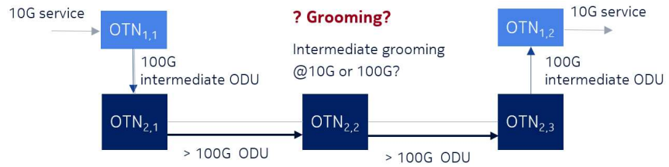
Introduction
Traffic Grooming
The process of aggregating multiple low-rate services into a single high-capacity optical lightpath to save spectrum and reduce the number of costly optical transponder.
Cascading Effect
An optical Transport Network (OTN) service can traverse multiple OTN switches before reaching the wavelength Division Multiplexing (WDM) network. It considers a scenario with two OTN switching levels.
Packet
Packet
Packet
Packet
Transport
BOX
Network

Slide 3
Problem Statement
Given
Decide
Original Service-Rate Grooming : Each OTN switch processes at its initial granularity.
Objective
It Compares the performance of grooming at different granularities and analyze the trade-offs between:
Constraints
Network topology
Set of traffic requests (traffic matrix)
Set of hierarchical OTN grooming boards and interfaces
Intermediate Granularity Grooming : Traffic is processed at an intermediate rate that matches the format of the previous OTN switch’s output.
OTN Matrix Capacity: Considering the effect of different granulation if services on capacity and ODU’s OTN1 & OTN2.
Fiber Saturation: How much of the fiber’s capacity is utilized, potentially affecting network congestion and scalability.
Traffic-processing capacity of OTN boards and interfaces
Maximum number of client interfaces per board
Wavelength capacity limits

Slide 4
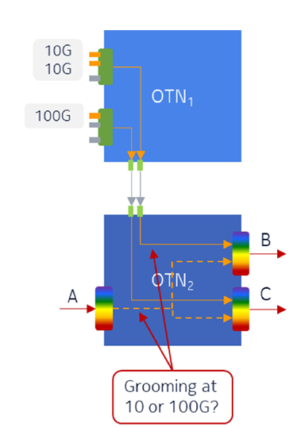
Example
Considering the effect of different granulation, if services on capacity and ODU’s of OTN1 & OTN 2
OTN2 | Used capacity, Gb/s | Occupied capacity, Gb/s | Number of used ports
OTN1-OTN2 I/O cards | 2*100 | 200 | 2
Optical transponders | 3*200 | 1500 | 3
OTN1 | Used capacity, Gb/s | Occupied Capacity, Gb/s | Number of used ports
Client I/O cards | 2*10 | 100 | 1
 | 1*100 | 100 | 1
OTN1-OTN2 I/O cards | 2*10 1*100 | 200 | 2
 | 10G grooming | 100G grooming
OTN1 | 3 | 3
OTN2 | 7 | 4

Slide 5
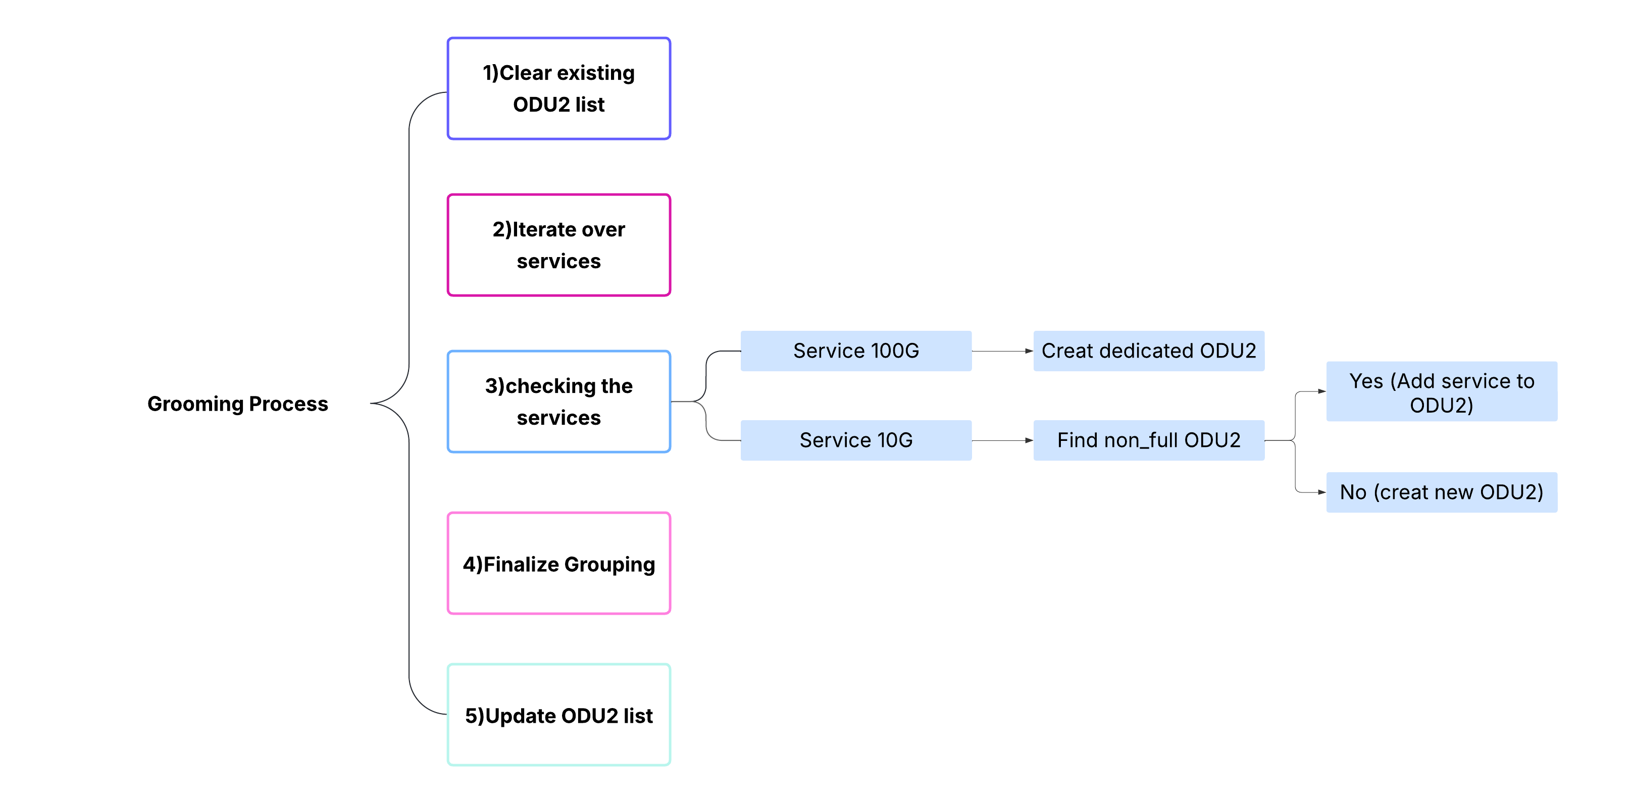
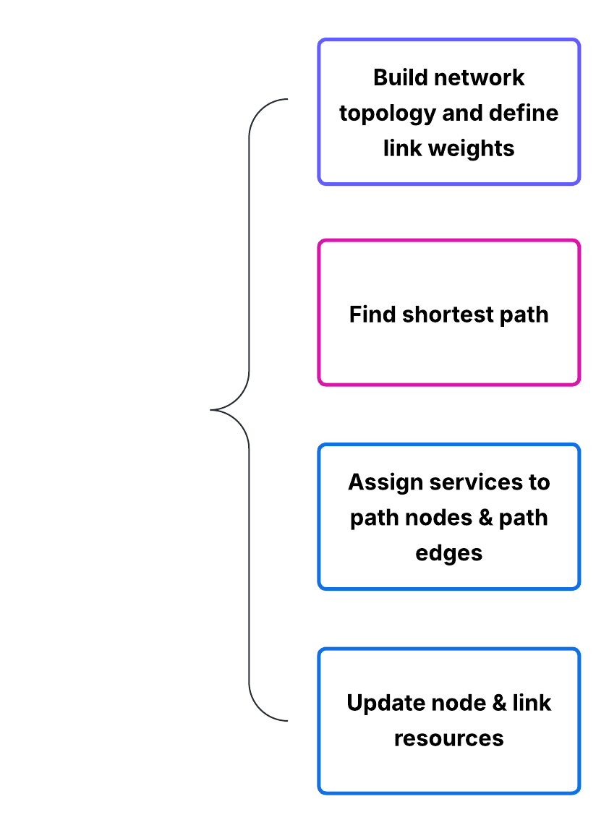
Methodology
Heuristic approach for routing services
Grooming Process

Slide 6
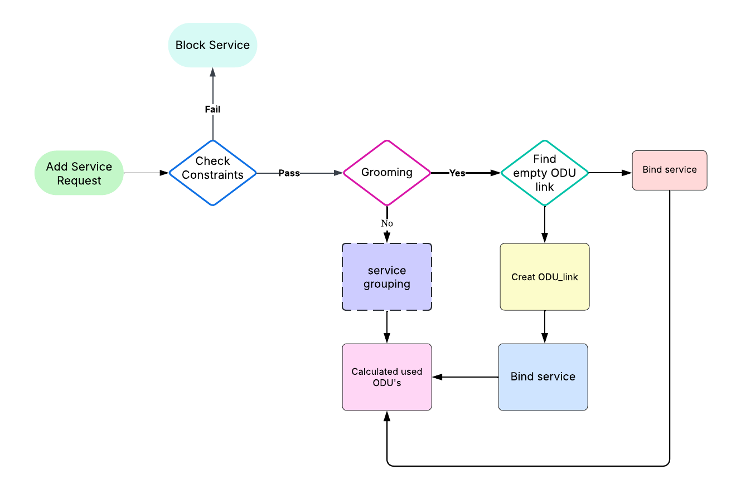
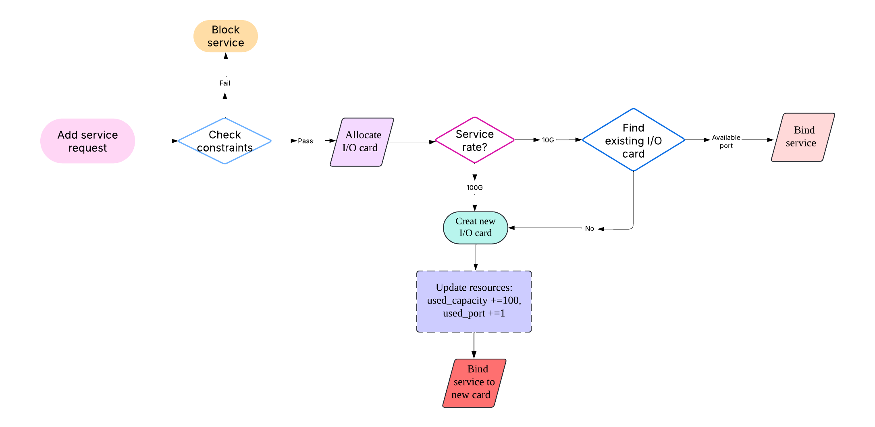
Structures
Node (OTN1 & OTN2 switches)
Add server to links

Slide 7
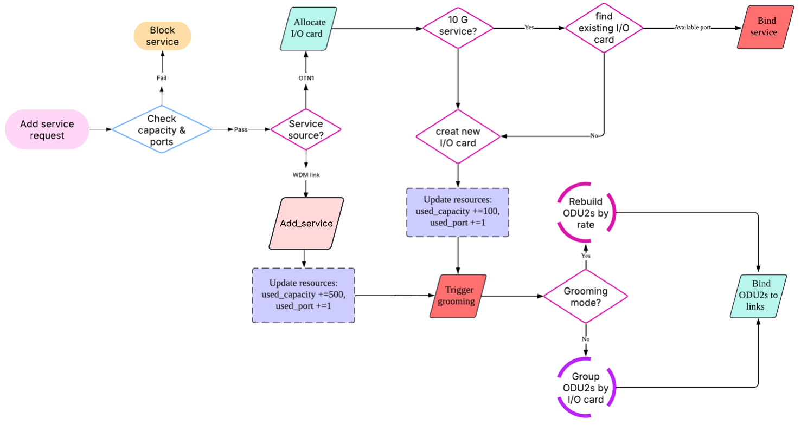
Structure
Model of OTN2 Processing

Slide 8
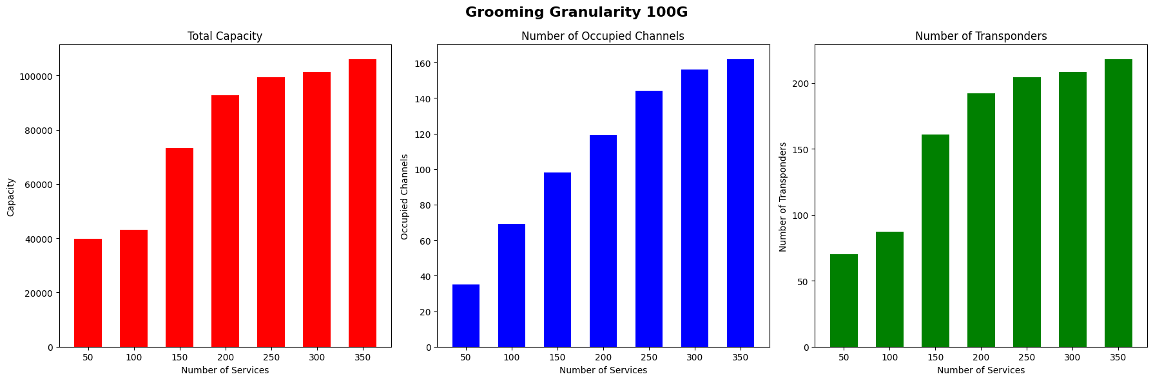
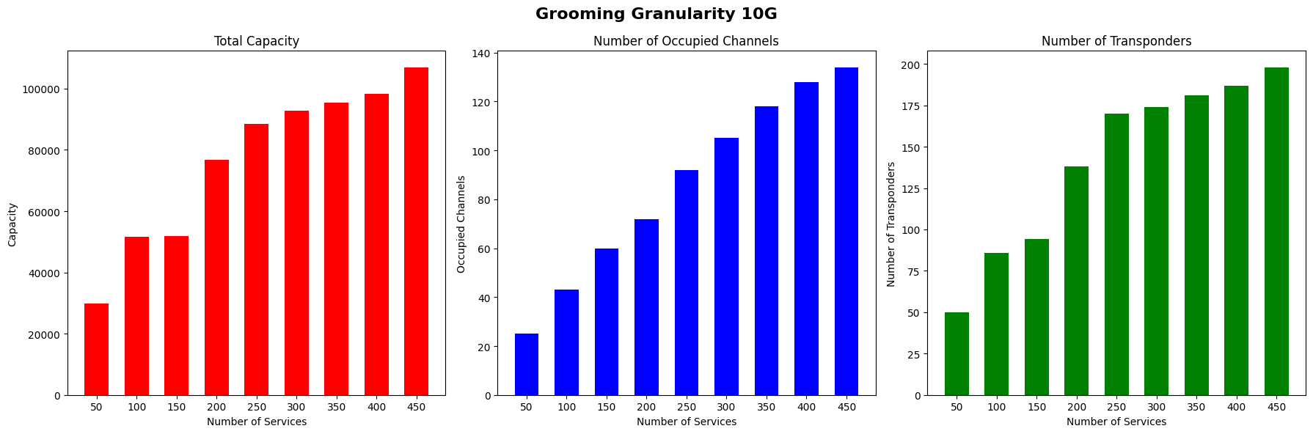
Results
National topology:
#nodes=10
#links=16

Slide 9
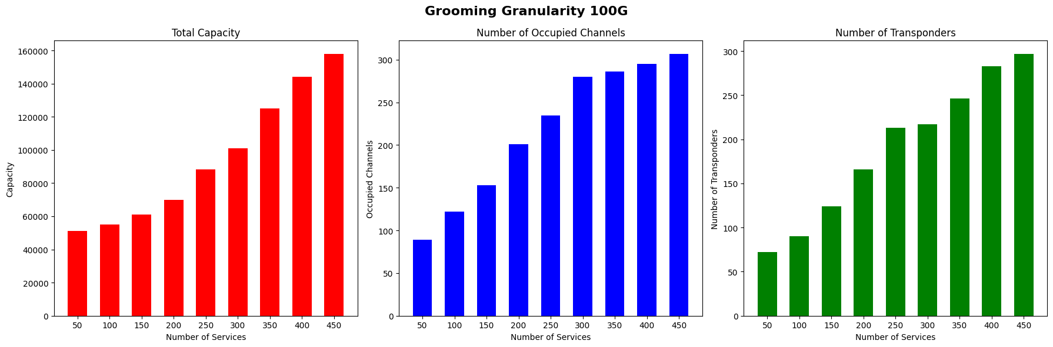
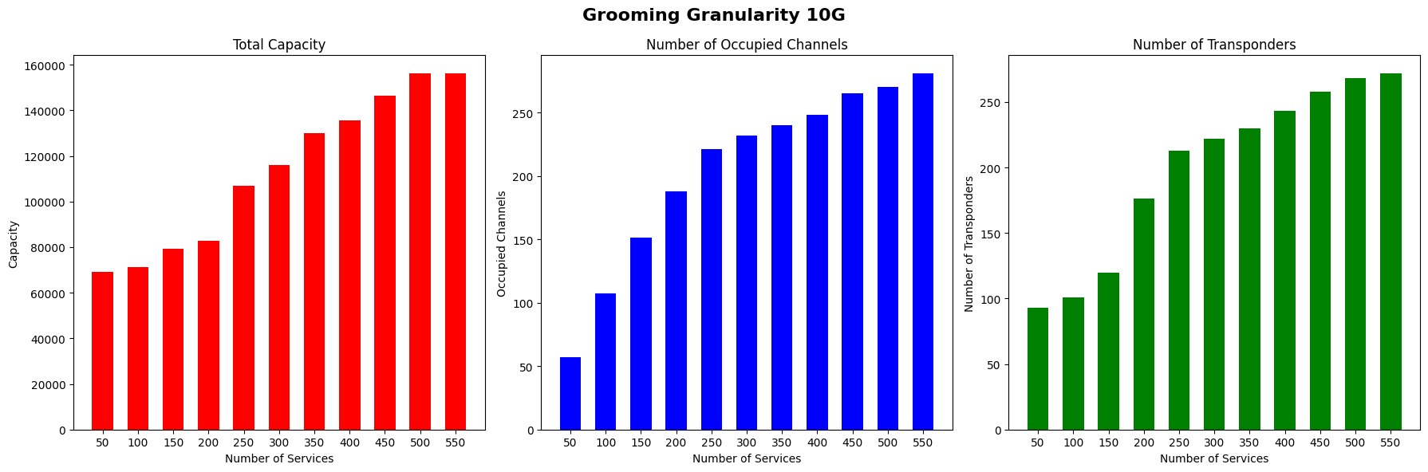
Results
Continental topology:
#nodes=14
#links=24

Slide 10
Results
National Graph | 100G grooming | 10G grooming
Number of services | 362 (3.77) | 453 (3.85)
Number of transponders | 218 (1.70) | 198 (1.13)
Number of occupied channels | 162 (2.02) | 134 (1.74)
Continental Graph | 100G grooming | 10G grooming
Number of services | 471 (4.50) | 557 (4.01)
Number of transponders | 297 (2.43) | 272 (1.77)
Number of occupied channels | 307 (1.97) | 281 (1.67)
Numbers in the table are mean value and numbers in the parenthesis are standard deviation

Slide 11
Future steps
Local search for improving heuristic routing of services
Optimizing capacity and bandwidth utilization by choosing each OTN2 node grooming separately

Slide 12
Thank You

