Slide 1




Real Estate Market Analysis
Zillow Data
Danica Rios
Daniel Ghaffarian
Anusha Ramachandran

Slide 2
Today’s Agenda
Describe Data Exploration
Showcase Visualizations
Overview of Summary

Slide 3


Where in the United States
Earn a decent living?
Afford to Rent?
Afford to Buy?
Or, Afford to Rent or Buy?

Slide 4

Princeton University Study
According to Daniel Kahneman & Angus Deaton:
“Emotional well-being also rises with log income, but there is no further progress beyond an annual income of
~ $75,000….
High incomes don’t bring you happiness, but they do bring you a life you think is better”

Slide 5
How much house can I afford?
Nerd Wallet & Bankrate.com recommend 36% of your gross income towards housing
Annual Income: $75,000
Affordable Home Amount: $300K

Slide 6



Data Used
Median Income by City/Metropolitan Area >= $75K
Home Sale Prices by City
Home Sale Price to Income Ratio by City
Rent to Income Ratio by City
Mortgage to Income Ratio by City
March Data (most recent is March 2018)

Slide 7
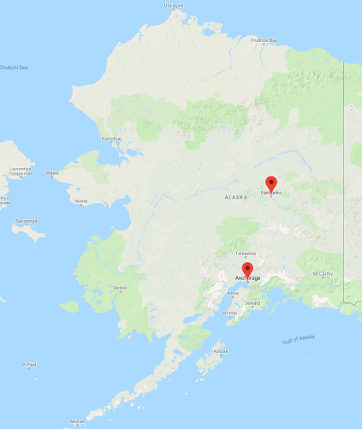
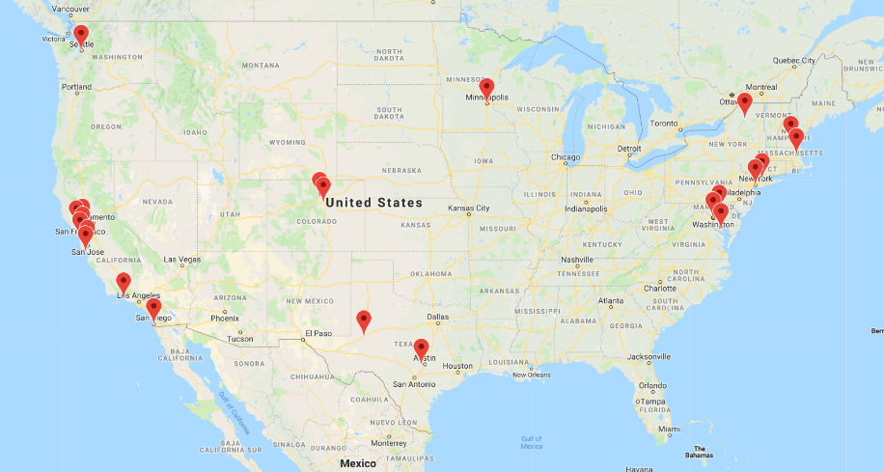



26 US Cities have median annual income of $75K or more

Slide 8
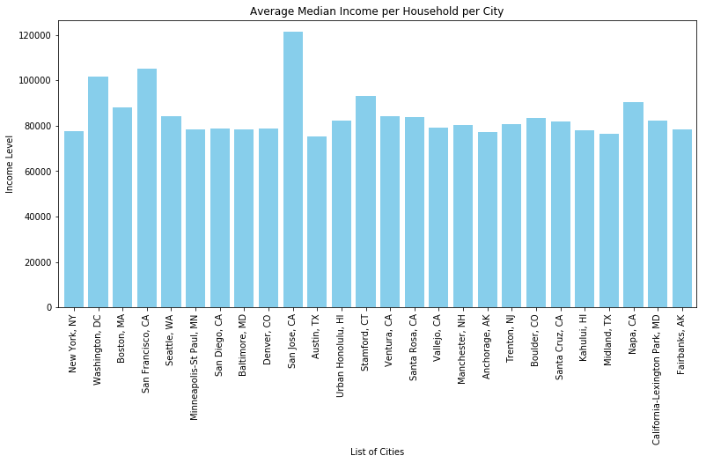
26 US Cities have median annual income of $75K or more

Slide 9
Rent vs. Buy?

Slide 10
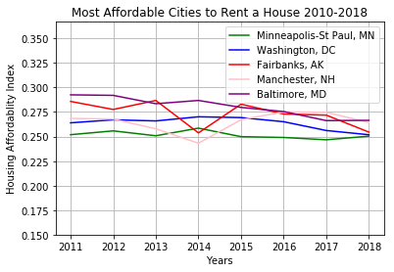
Top 5 Most Affordable – Rent to Income Ratio

Slide 11
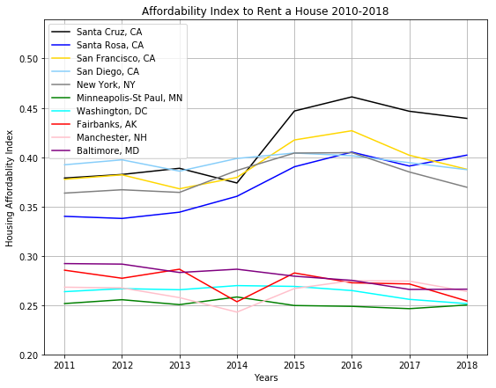
Top 5 Most Affordable & Least Affordable
Rent to Income Ratio

Slide 12
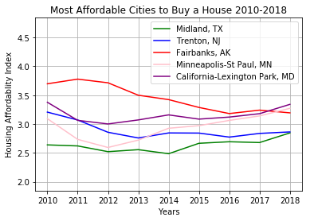
Top 5 Most Affordable – Purchase Price to Income Ratio

Slide 13
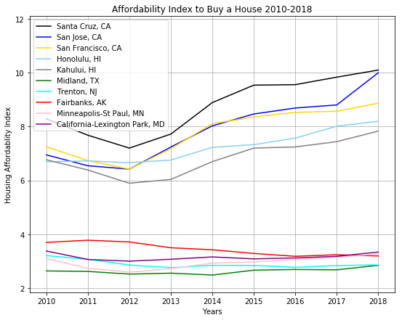
Top 5 Most Affordable & Least Affordable
Purchase Price to Income Ratio

Slide 14
Findings
Although income has increased significantly in certain cities like San Francisco and San Jose, renting AND purchasing a home over the last 10 years has become unaffordable overall in California
In certain cities like New York and Washington, D.C., home prices have increased but rent increases have stayed fairly flat. Therefore, it’s better to rent in those markets than it us to buy

Slide 15
Limitations
Our data doesn’t consider gentrification. That is, are incomes increasing because companies are paying more or are higher earners moving into these areas? Or both?
Our data does not include property taxes, insurance and HOAs, which significantly increases the cost of owning a home in places like New York and New Jersey
Our data does not include income taxes, which are significantly higher in cities like New York and San Francisco and are nonexistent in Austin, Texas and Seattle, Washington

Slide 16

Questions?

