Slide 1
All steps in the full Process
Create a GitHub Repo for your Project (choose a meaningful name)
Add the right things
Clone it locally
Add or remove some code (such as add a function or class in the program)
Test the code
Record the result in the commit
Push the commit
Make changes
Commit and push!

Slide 2
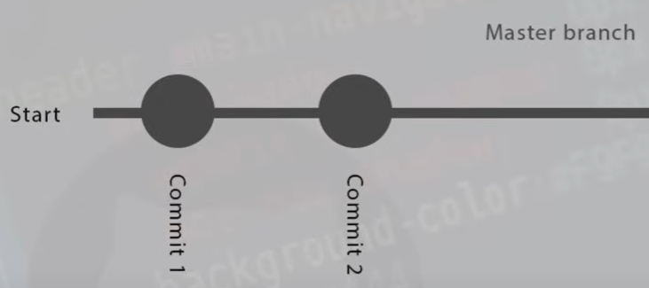
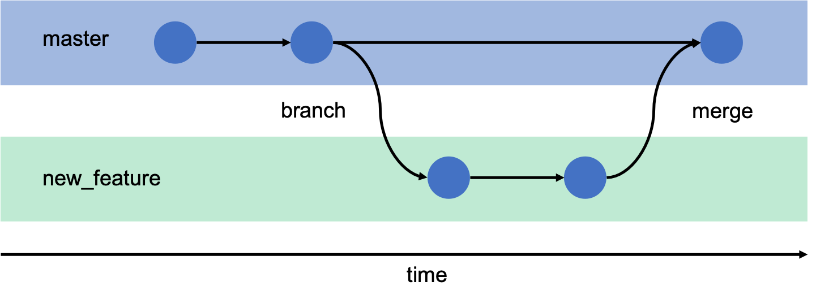
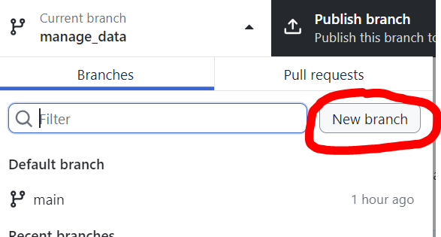
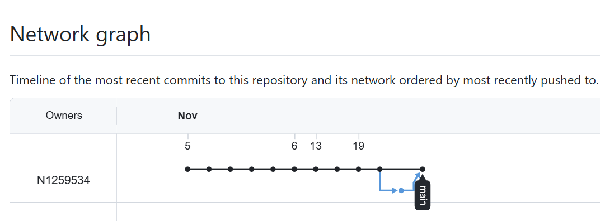
GitHub Master Branch and Feature Branch
Main or Master Branch:
Branches:
Add new Features
Several developers work on the same project
How to create:

Slide 3
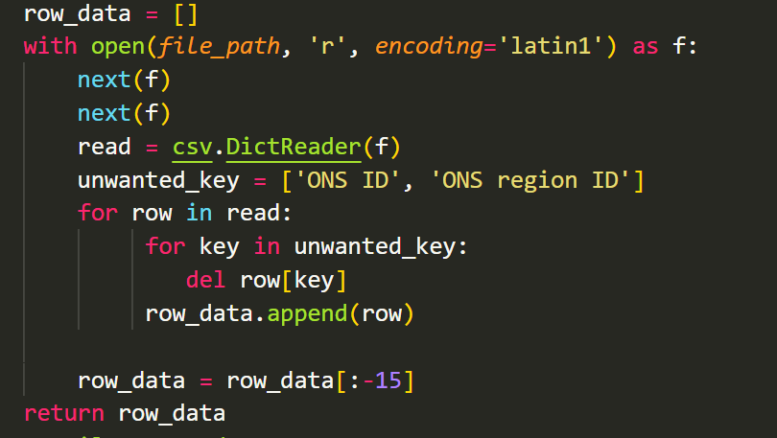
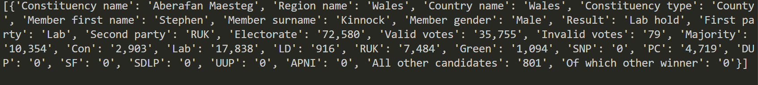
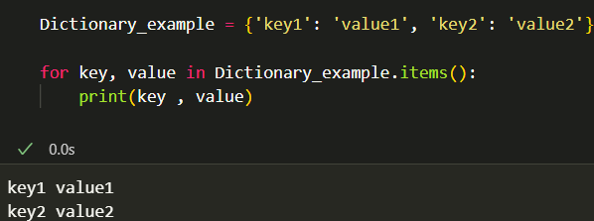
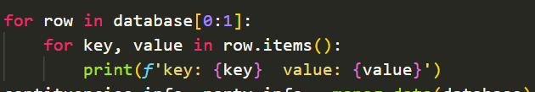
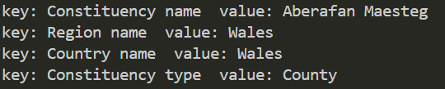
What we did so far
Read data from CSV and Store them in a list :
Data set will store data as a dictionary type

Slide 4
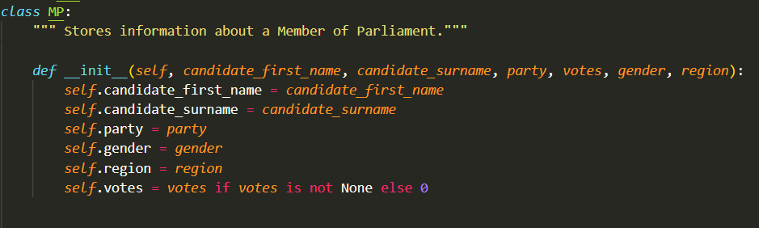
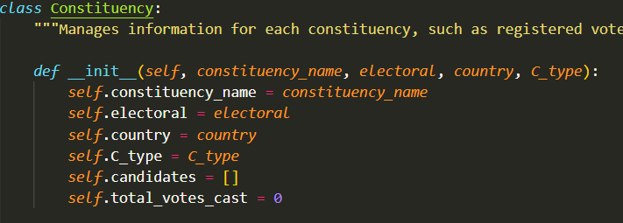
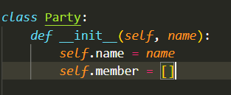
Created Classes:
Add methods:

Slide 5
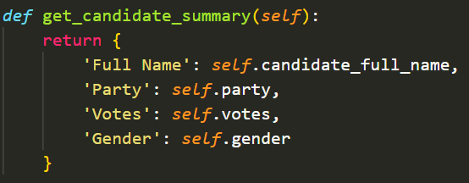
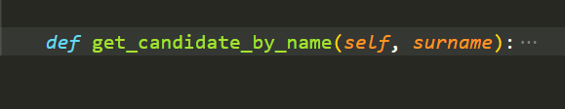
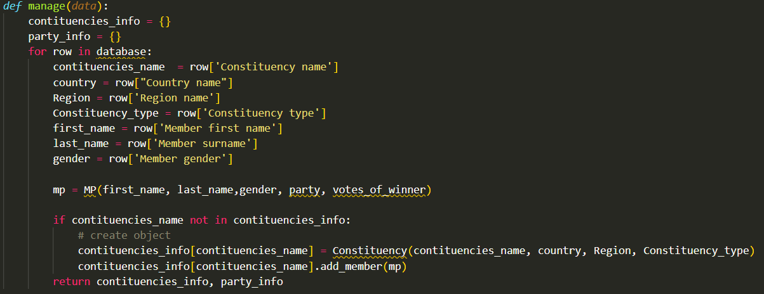
What other function do you need more
Create Objects and store them in a dictionary.

Slide 6
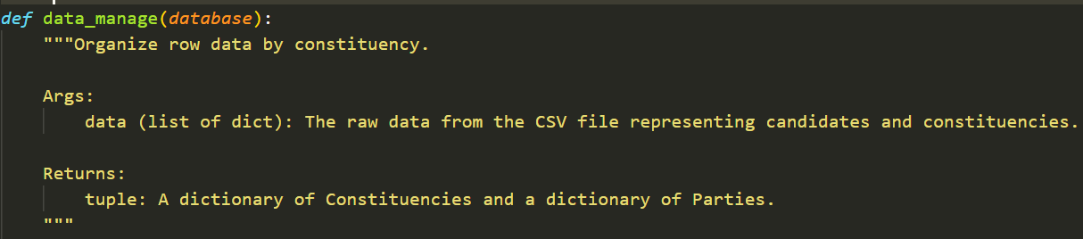
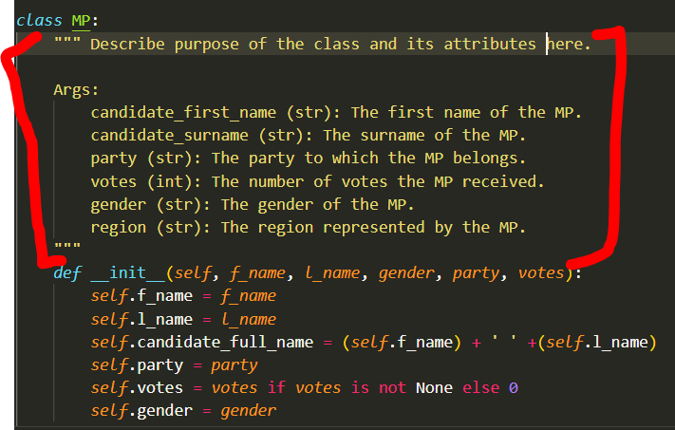
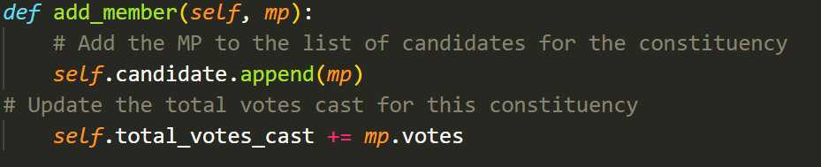
Docstrings for Classes and Functions:
Use triple quotes
purpose, inputs, and outputs of the function.
Inline comments:
Provide comments for individual lines of code
Avoid over commenting

Slide 7
