Slide 1


Debugging the backprop of the PEML-KWN model
Amir Alizadeh
Supervised by Hamid Assadi
13/1/2025

Slide 2




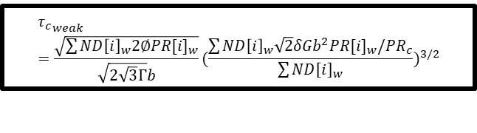


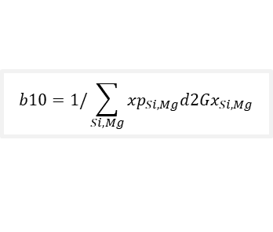




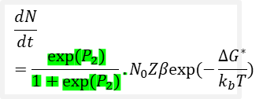
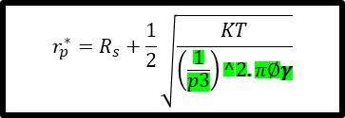





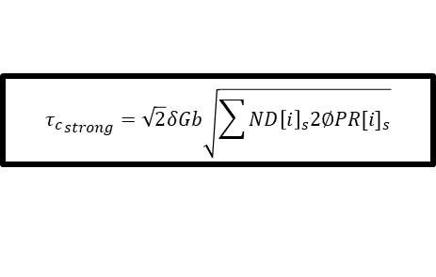
Backprop from YS to P1
$$σ_{ppt}=M_{ppt}\sqrt[q]{({{τ_{c}}_{weak}}^{q}+{{τ_{c}}_{weak}}^{q})}$$
$${τ_{c}}_{weak}=\frac{\sqrt{\sum{{ND\left[i\right]}_{w}2∅{PR[i]}_{w}}}}{\sqrt{2\sqrt{3}Γ}b}{(\frac{\sum{{ND\left[i\right]}_{w}\sqrt{2}δGb^{2}{PR[i]}_{w}/{PR}_{c}}}{\sum{{ND\left[i\right]}_{w}}})}^{3/2}$$
$${τ_{c}}_{strong}=\sqrt{2}δGb\sqrt{\sum{{ND\left[i\right]}_{s}2∅{PR[i]}_{s}}}$$
$${ND\left[i\right]}_{w},{PR[i]}_{w}$$
$${ND\left[i\right]}_{s},{PR[i]}_{s}$$
$${VF}_{total}$$
$PR\left[0:i\right]=PR\left[0:i\right]+$ $vel_{coarsening}$+ $vel_{growth}$
$$x_{Mg/Si}^{α}$$
$$ND\left[i\right], PR[i]$$
$$vel_{coarsening}=P_{5}b10.b6. coars/PR[i]$$
$$vel_{growth}=P_{4}b5.b6.b7$$
$$\frac{dN}{dt}={\frac{{exp⁡(P}_{2})}{1+{exp⁡(P}_{2})}.N}_{0}Zβexp⁡(−\frac{{∆G}^{∗}}{k_{b}T})$$
$$r_{p}^{∗}=R_{s}+\frac{1}{2}\sqrt{\frac{KT}{\begin{aligned}\left(\frac{1}{p3}\right)^2.π∅γ \\ \end{aligned}}}$$
$$b10=1/\sum_{Si, Mg}{{xp}_{Si,Mg}{d2Gx}_{Si,Mg}}$$
$b6=\frac{1}{PR[i]}$ $\frac{4γ_{0}∅v_{m}}{(3∅−1)R_{g}T}$
$${b5=\left\{\frac{{({rp}_{Si}−x_{Si}^{α})}^{2}}{{{d2Gx}_{Si}x}_{Si}^{α}}+\frac{{({rp}_{Mg}−x_{Mg}^{α})}^{2}}{{{d2Gx}_{Mg}x}_{Mg}^{α}}\right\}}^{−1}$$
$$b7=\frac{1}{Rs}−\frac{1}{PR[i]}$$
$${∆G}^{∗}=\frac{16πγ^{3}}{3{(∆G_{v}+∆G_{s})}^{2}}\frac{4∅^{3}}{{(3∅−1)}^{2}}$$
$$R_{s}=\frac{−2P_{1}γ}{∆G_{v}}\frac{2∅}{3∅−1}$$
$${d2Gx}_{Si/Mg}=RT/D_{Mg/Si}$$
Notes:
P3-p7 for gamma
P8-13

Slide 3
Successful vs Unsuccessful Backprops
Param2
Param3
YS
Param4
VF
Param5
TND
Param6
MPR
vel_total
Vel_growth
Rad_total

Slide 4
Problem: the rs and Rp’s in the denominator causes zero division. Meanwhile the Rp’s has to be zero for positive driving force in order to make the TVF and x_mg, x_si calculations accurate.
Make a Dgvol(i) and append it along the simulation. In the growth function, multiply the positive-dgvol Rp’s with a sigmoid function

