Slide 1
16.82 Miscellanea
Peter Sharpe

Slide 2
This Thursday (9/22) Brief Update
Each team will give an update briefing to the class
5 minutes, followed by questions from class + staff
A few slides
Informal
Topics:
Which concept(s) did you down-select to?
Note: if you’re stuck and can’t decide, contact course staff – you can carry multiple forward, but it’s more work
Why did you choose that one?
Napkin-sketch sizing numbers & methodology for chosen concept.
It’s okay if numbers aren’t final! Main purpose is to prepare you for CoDR.
Any other work you’d like to get more eyes on!
Any questions you have, places you’re stuck
Notes:
After 3 p.m.?

Slide 3
Conceptual Design Review (CoDR), Next Week
Schedule:
CoDR dry run: next Tuesday, September 27
CoDR: next Thursday, September 29
Format:
Each team talks for 20 minutes, followed by 10 minutes of Q&A.
Recommended: max of 3 people presenting
Reminder: everyone needs to present at least once during the semester; highest grade used.
As if you were presenting to a technical review board:
A friendly, but discerning audience – expect questions
Dry run:
Communications instructors will help you refine
Notes:
Mark’s cases:
Lay (SciAm reader)
Somewhere in the middle? (Technical managers)
Aero experts (jargon)

Slide 4
CoDR Topics (full details in Syllabus)
Market opportunity & strategy
Requirements analysis
CONOPS and/or OV-1 illustration
Vehicle illustration
Basic subsystem details (e.g., propulsion type, layout)
Key sizing numbers (dimensions, mass, power) and preliminary performance estimates
State assumptions used for these estimates

Slide 5
Quick Examples

Slide 6
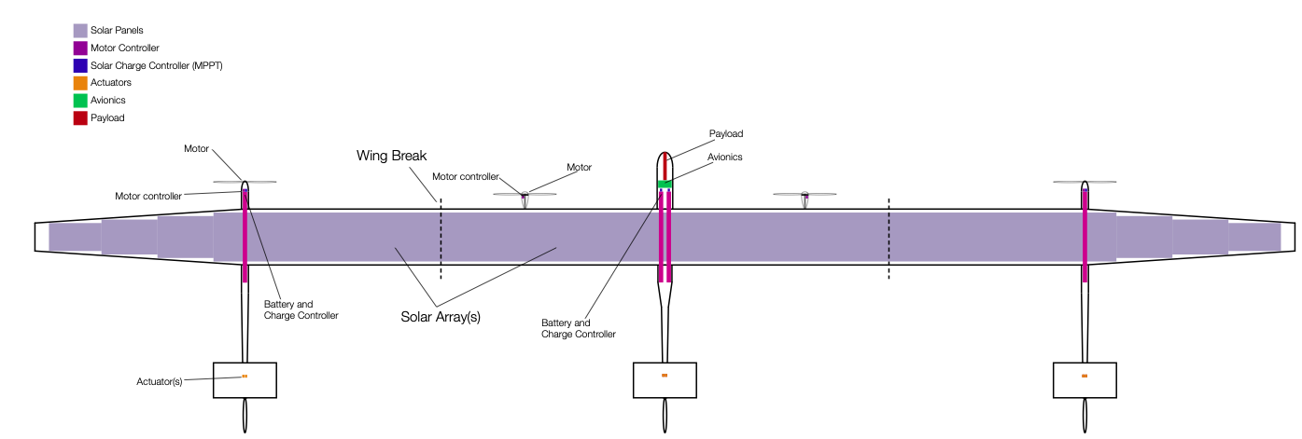
What’s a Vehicle Illustration?
Possible styles:
Internal view
Span: 44.3 m
TOGW: 390 kg
L/D: 35.8

Slide 7
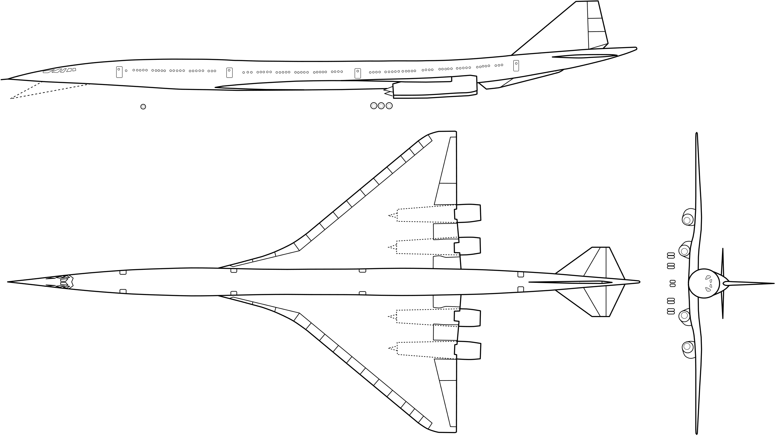
What’s a Vehicle Illustration?
Possible styles:
3-view

Slide 8
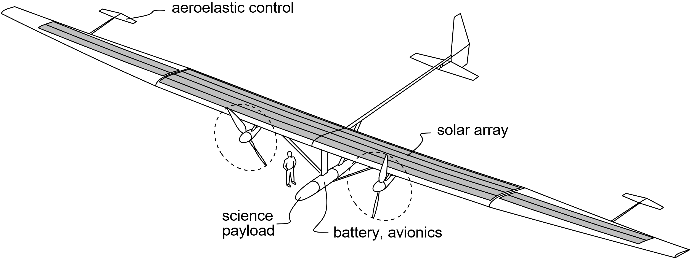
What’s a Vehicle Illustration?
Possible styles:
Isometric view
Drawn by Mark Drela

Slide 9
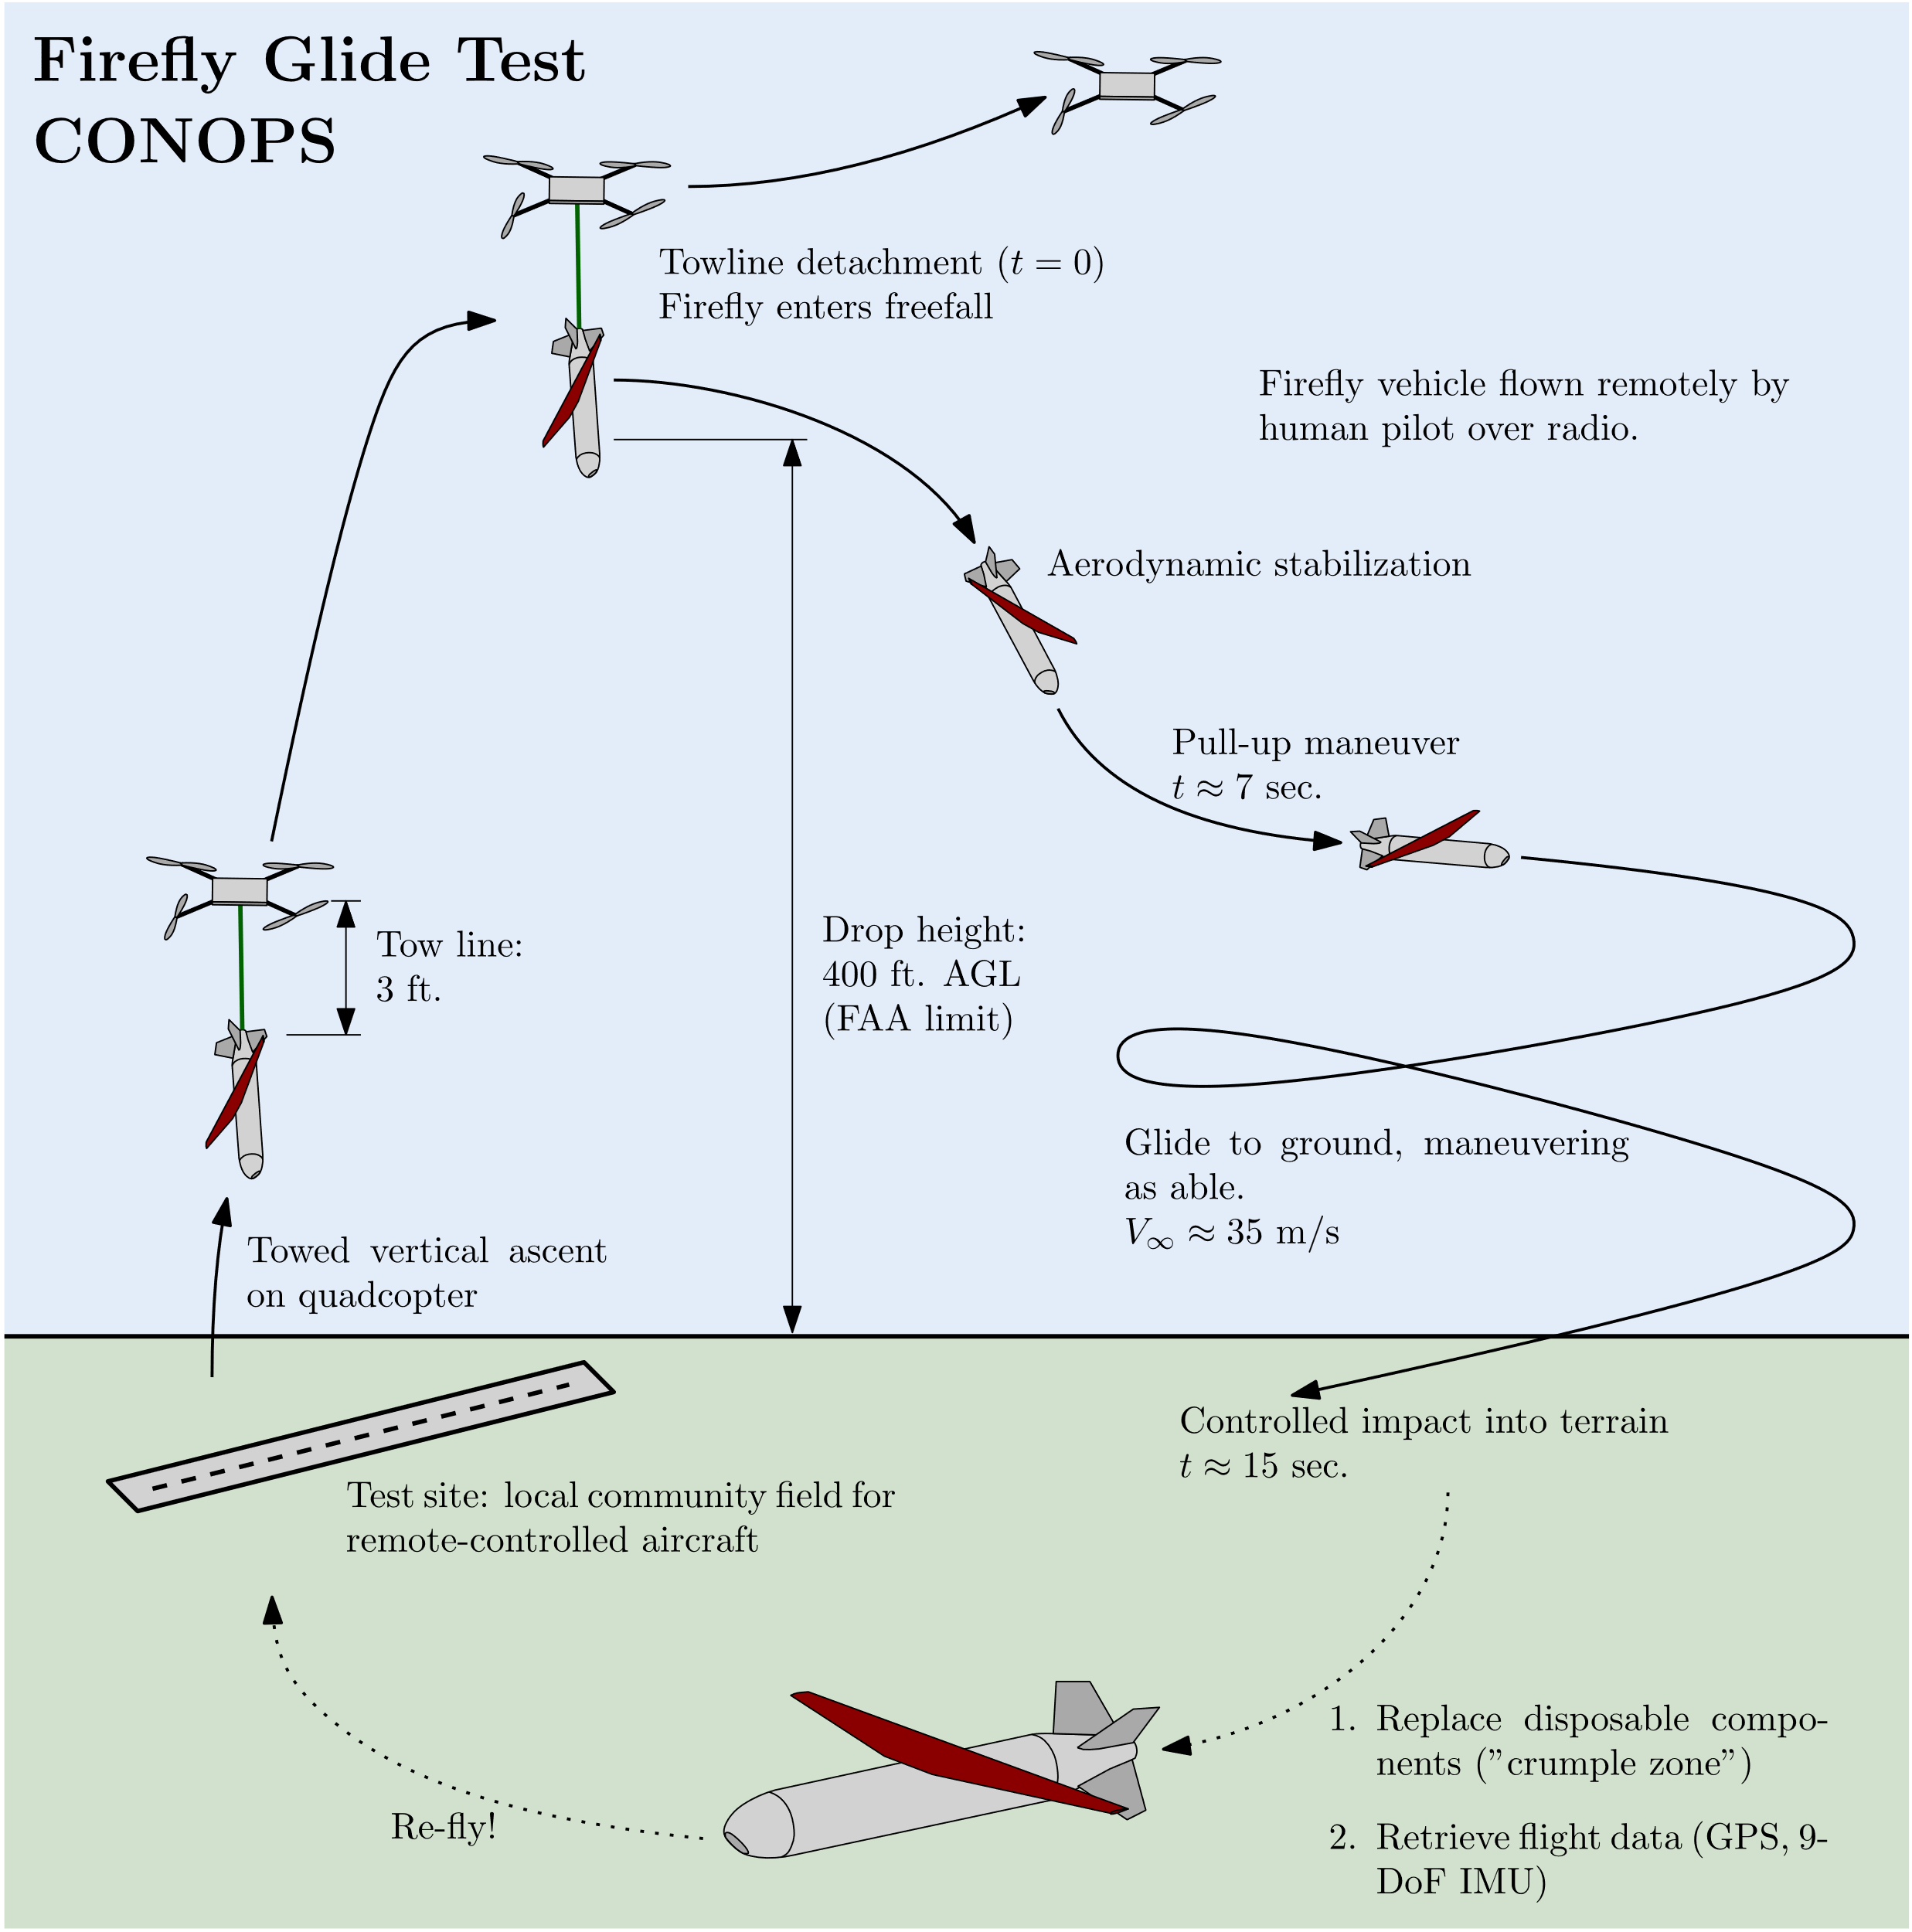
What is a CONOPS?

Slide 10
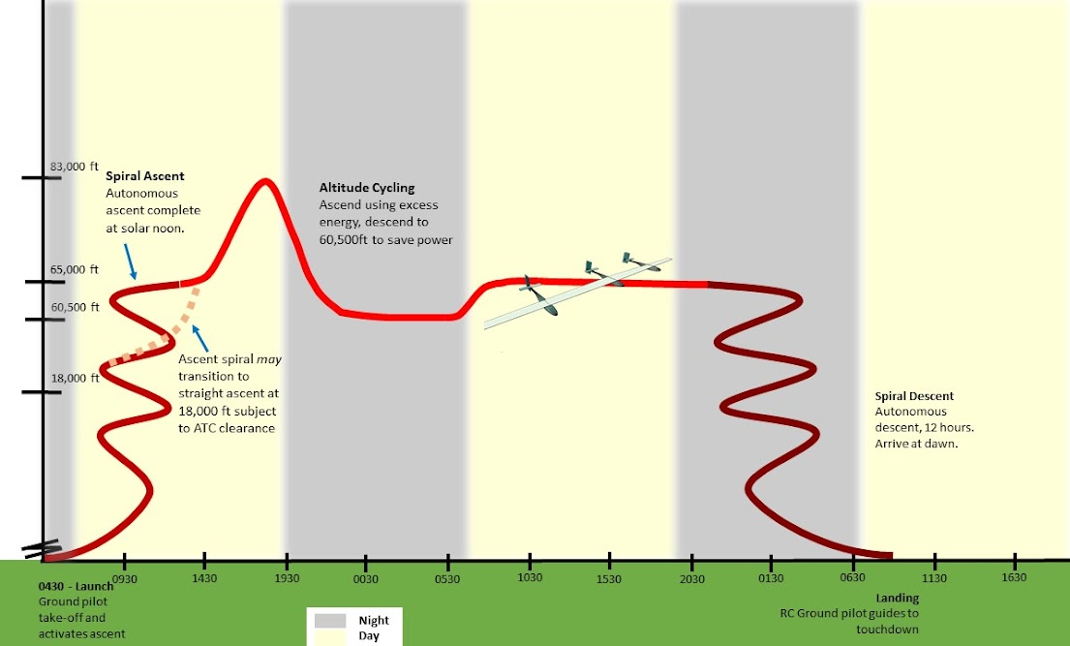
What is a CONOPS?

Slide 11
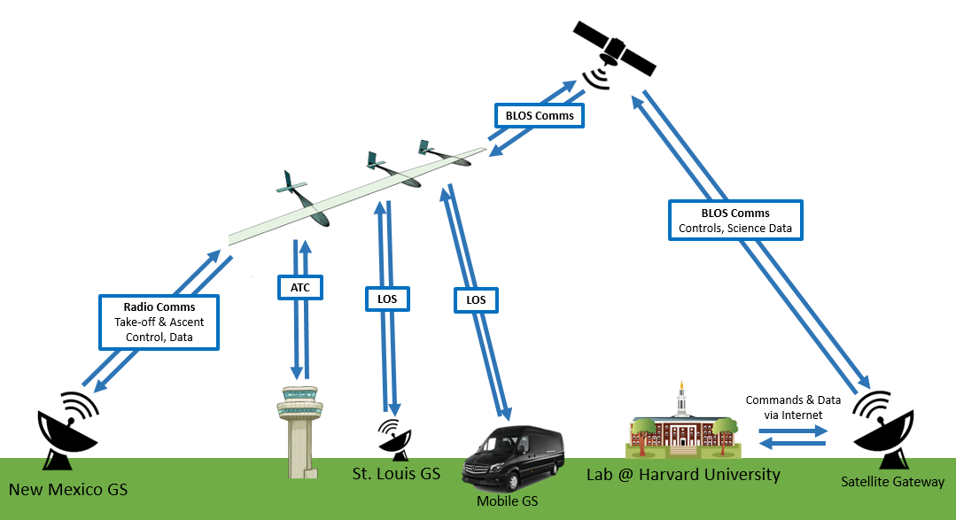
What is an OV-1?

Slide 12
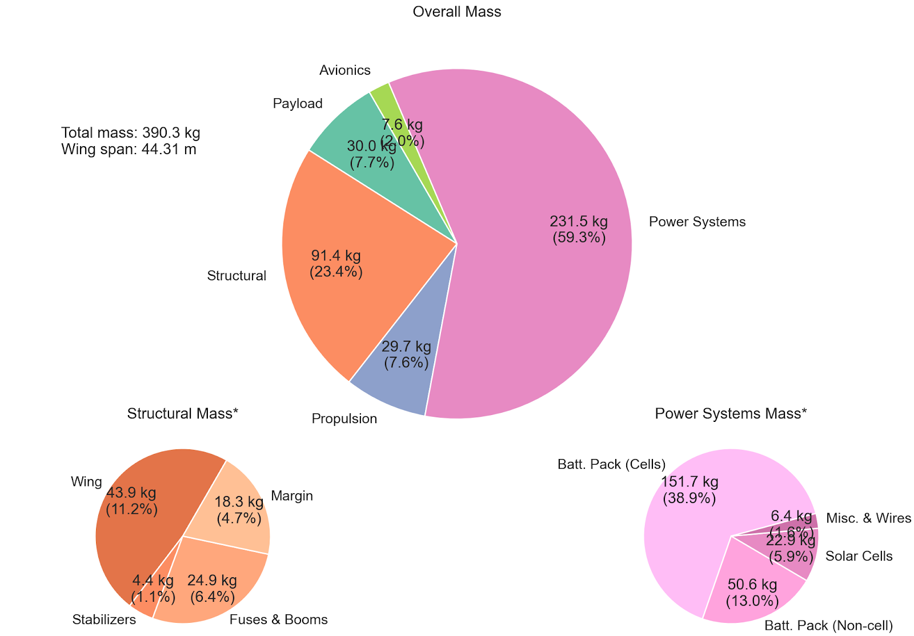
What is a Mass Budget?

Slide 13
Questions? Writing instructors are available to meet!

