Slide 1
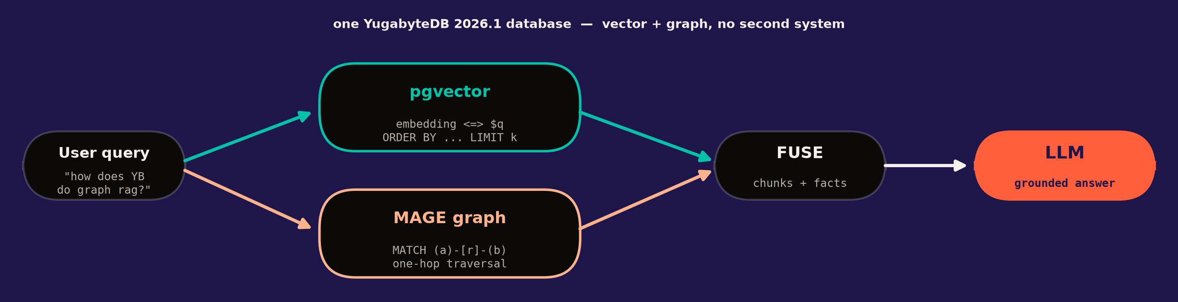
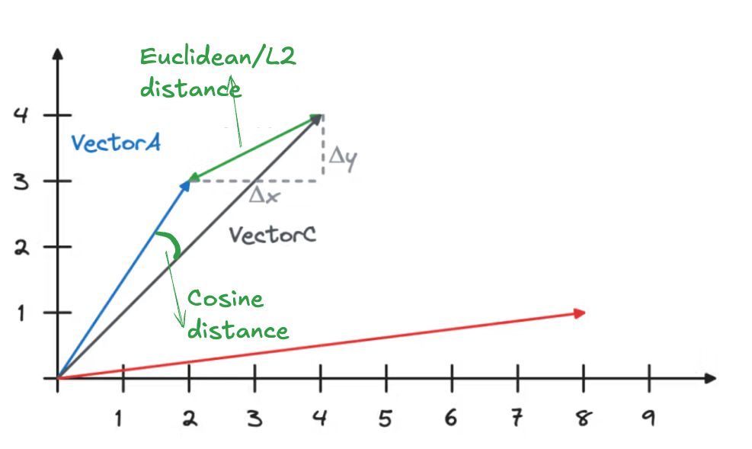
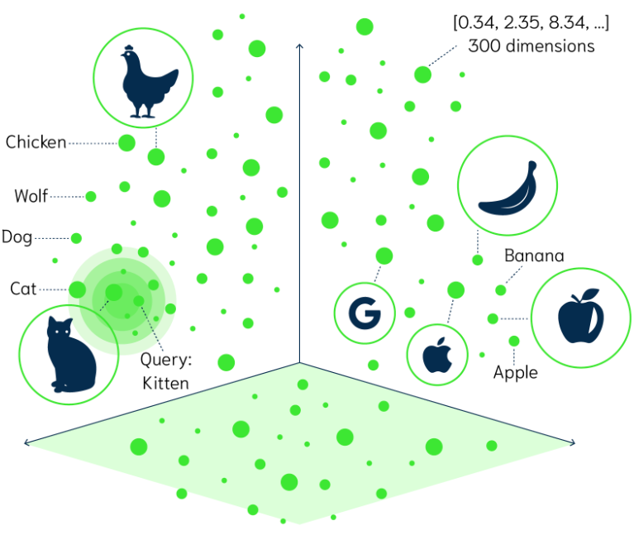
HYBRID GRAPH RAG
Hybrid Graph RAG: pgvector + MAGE in YugabyteDB 2026.1
1
Enable
2
Schema
3
Ingest
4
Hybrid query
CREATE EXTENSION vector;
CREATE EXTENSION mage CASCADE;
CREATE TABLE doc_chunks(
content TEXT,
embedding vector(1024));
SELECT create_graph(
'knowledge_graph');
INSERT INTO doc_chunks
(content, embedding);
cypher: MERGE (a:Entity)
-[:RELATED_TO]->(b)
-- A. vector top-k
ORDER BY embedding <=> $q
LIMIT k;
-- B. graph 1-hop
cypher: MATCH (a)-[r]-(b)
→ fuse for the LLM
▶
▶
▶
github.com/amiramm/graphrag-yugabytedb-mage
yugabyteDB

