Slide 1
Factory method

Slide 2
Factory method
Design logic is hidden from the client

Slide 3
Factory method
Design logic is hidden from the client
Many subclass types, only one instance required

Slide 4
Factory method
Design logic is hidden from the client
Many subclass types, only one instance required
Creation is removed from client

Slide 5
Factory method
Design logic is hidden from the client
Many subclass types, only one instance required
Creation is removed from client
Useful for frequent code changes

Slide 6
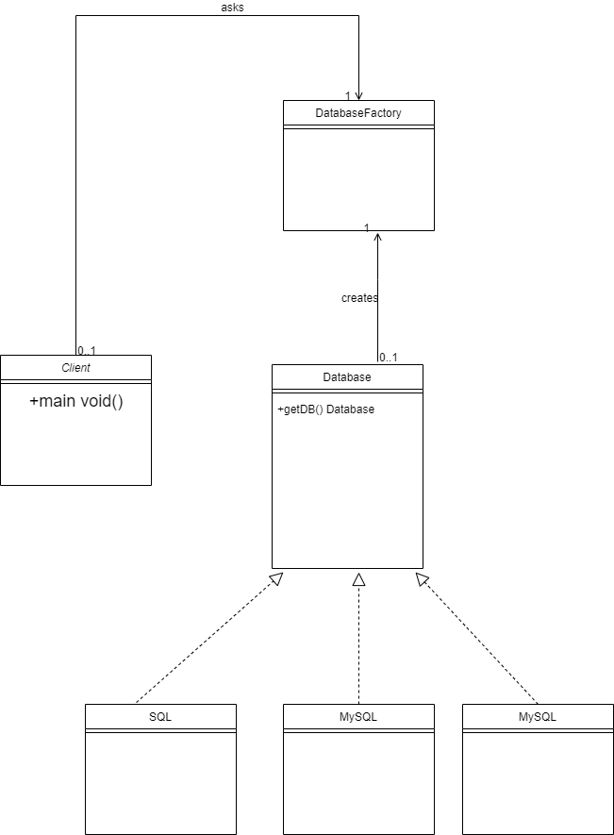
Factory method

Slide 7
Factory method
Interface or abstract class that defines the common functionality

Slide 8
Factory method
Interface or abstract class that defines the common functionality
Interface implementations

Slide 9
Factory method
Interface or abstract class that defines the common functionality
Interface implementations
Factory class that instantiates the right implementation

