Slide 1

AirBedandBreakfast Company

Slide 2
Agenda
01
02
03
04
05
06
Introduction
Data Overview
EDA & Insights
Recommendation
Data
Pre-processing
Conclusion

Slide 3

Introduction
Airbnb, is an American company that operates an online marketplace for homestays for vacation rentals, and tourism activities.
Based in San Francisco, the platform is accessible via website and mobile app.
The company was founded in 2008.
Airbnb is a shortened version of its original name, AirBedandBreakfast.com.

Slide 4
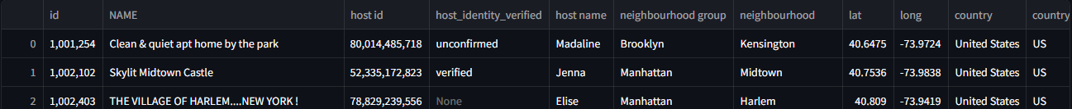
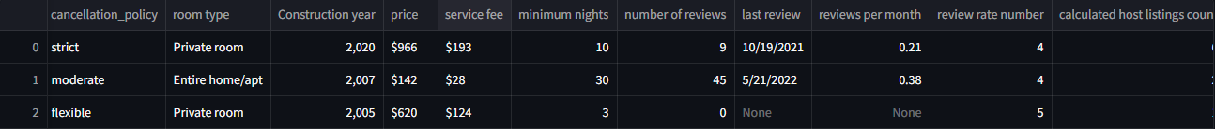
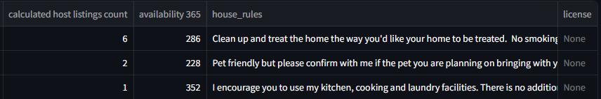
Data Overview

Slide 5

EDA & Insights

Slide 6
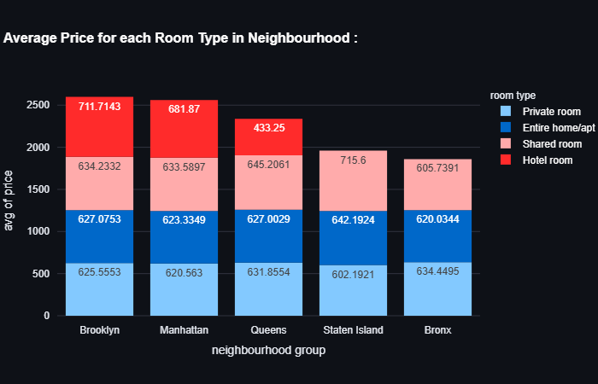
Insights : - Hotel rooms in (Brooklyn and Manhattan) have the highest avg prices. - Shared rooms in (Staten Island) have the highest avg prices. - Private rooms in Bronx has the highest avg prices.

Slide 7
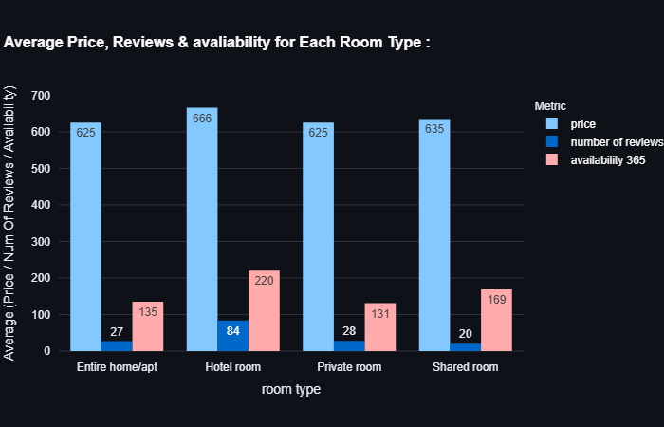
Insights : - As we see that shared and hotel room has the least occurence but they have the highest avg price , which means that they are much expensive than others room types. - Hotel room has the highest avg reviews , inspite of lowest occurence. - Hotel room available more than others.

Slide 8
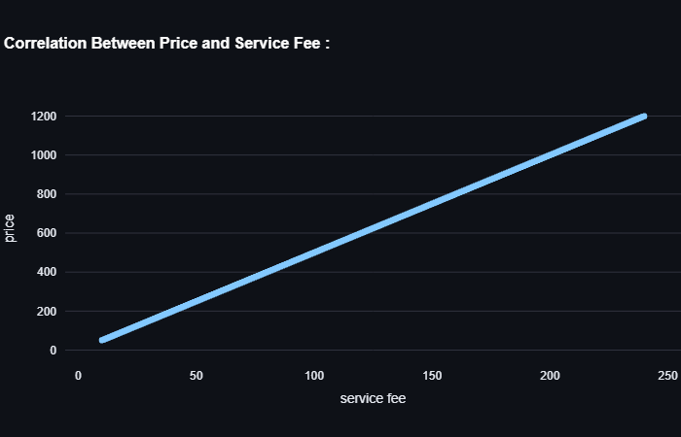
Insights : - There is strong positive correlation between price and service fee.

Slide 9
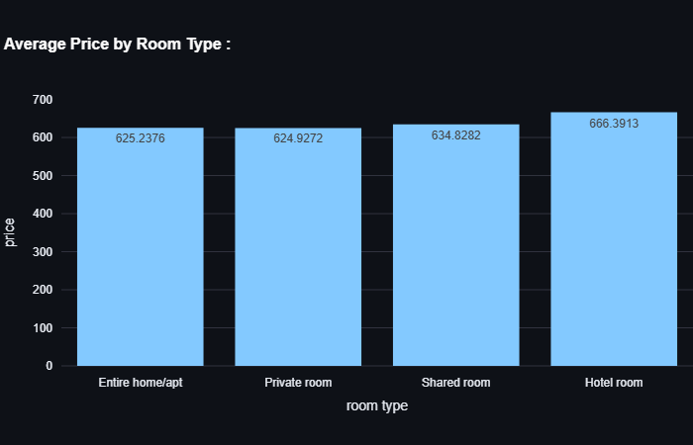
Insights : - Hotel Room has the highest average price. - Private Room has the lowest average price.

Slide 10
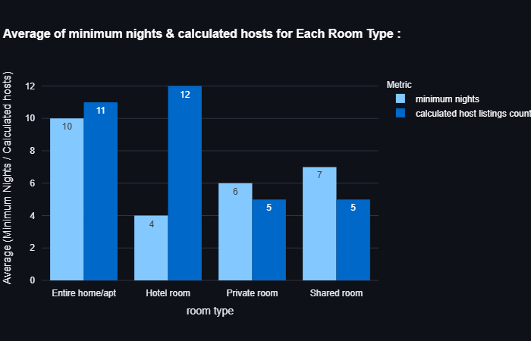
Insights : - Highest avg minimum nights is in entire home type. - Highest avg of hosts are in hotel room type.

Slide 11
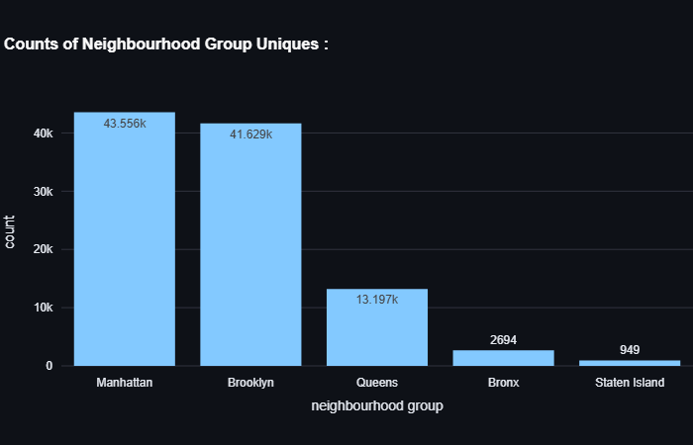
Insights : - Manhattan has highest number of listings. - Staten Island has lowest number of listings.

Slide 12
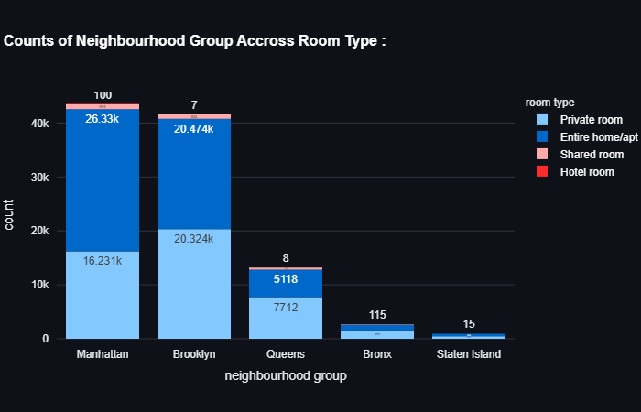
Insights : - Most of Entire home exist in Manhattan. - Most of Private rooms exist in Brooklyn. - Most of Shared rooms exist in Manhattan. - Hotel rooms exist only in Manhattan.

Slide 13
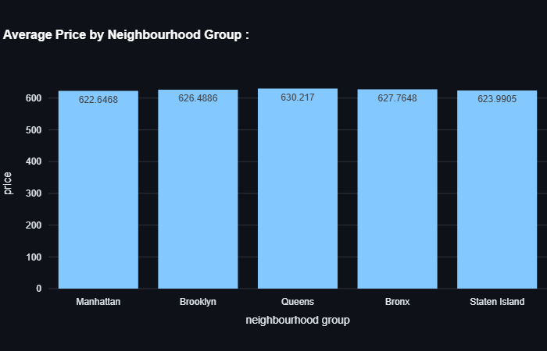
Insights : - Queens has the highest avg price of Airbnb listings - Manhattan has the lowest average price of Airbnb listings.

Slide 14
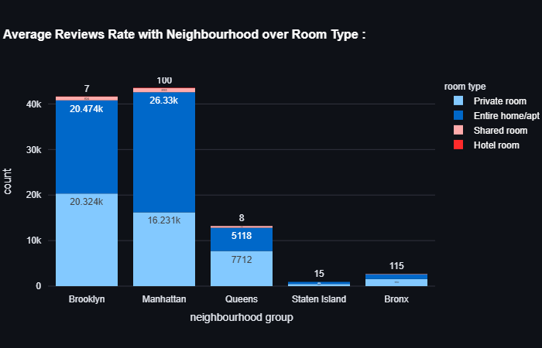
Insights : - Entire homes in (Manhattan and Brooklyn) have largest numbers of reviews. - Shared and Hotel Rooms have the lowest average reviews due to it’s low frequency.

Slide 15
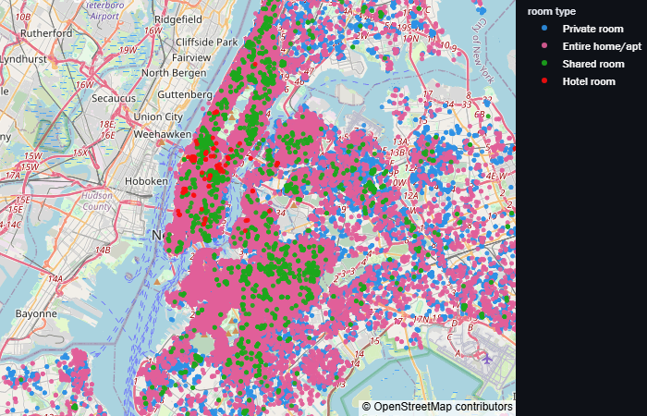
Insights : - Entire homes is more spread out , appearing in the map.
Map to visualize neighbourhood group with room type.

Slide 16
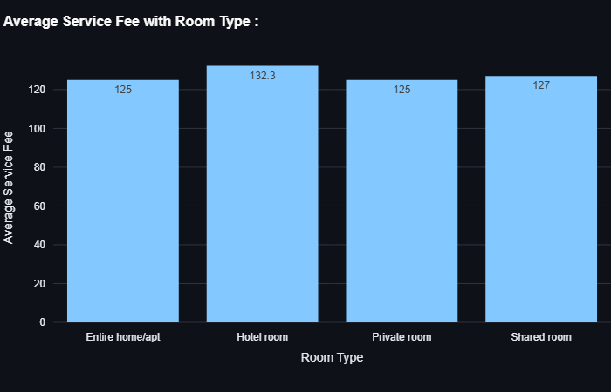
Insights : - Hotel rooms have highest avg service fees. - Entire homes & private rooms have lowest avg service fees.

Slide 17
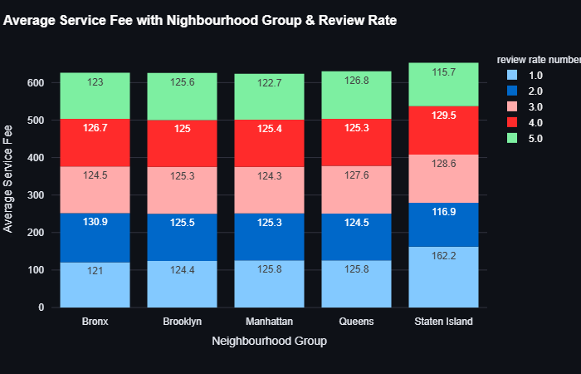
Insights : - The highest avg service fees in all neighbourhoods is in staten island which have review rate : 1 . - The lowest avg service fees in all neighbourhoods is also in staten island inspite of having review rate : 5 .

Slide 18
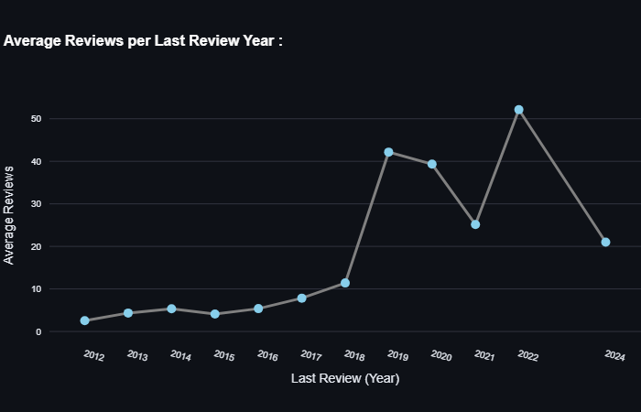
Insights : - Highest reviews was in 2022. - Lowest reviews was in 2012.

Slide 19
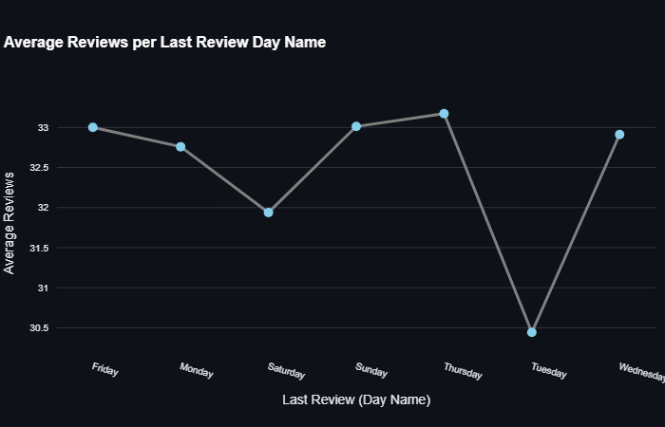
Insights : - Thursday and Friday having the highest average number of reviews. - But Tuesday has the lowest average of reviews.

Slide 20

Recommendations
Increase listings in Bronx and Staten Island.
Increase number of Shared and Hotel Rooms as they are expensive and will increase the profit
Be careful about service fee .
AS, highest average service fee was in staten island and having review rate : 1

Slide 21
Data Pre-processing

Slide 22

Error Correction
Price , Service fee , last review are objects
Drop Duplicates.
Check Unique values and edit them if needed.
Check Outliers.
Getting absolute values of minimum nights and availability 356.
Replace error in availability column with nan .
Drop reviews in years > 2024.

Slide 23
Handling Outliers
All values are real values which could be occur so , I use Logarithmic transformation
Spliting Data
Split data into train , test before filling missing values.

Slide 24
Handling Missing values
I fill missing in ( neighbourhood group , cancellation_policy , room type , last_review_(day_name)) with mode
I fill a little missing values in numeric columns with the mean..
I fill missing in (last_review_(month) , last_review_(year)) columns with KNN imputer.
I Fill missing in target (price) with mean.

Slide 25
Encoding
columns contains Nominal data.
so, i would use one hot encoder for (cancellation_policy , , room type) cols.
And Binary encoder for (neighbourhood group ,last_review_(day_name)) cols.

Slide 26
Feature Scaling
I used StandardScaler()

Slide 27

Conclusion

Slide 28
In conclusion, this project has provided a comprehensive analysis of the New York City Airbnb dataset. Through data wrangling, exploratory data analysis (EDA), and interpretation of summary statistics, we've uncovered valuable insights into listing distribution, pricing dynamics, host, and review analysis.
Key findings include the dominance in counts of Entire home/apt listings, the variability in listing counts across neighborhood groups, and the downward trend between property construction year and price. Additionally, the analysis highlighted the significance of strong correlation between listing price and service fee.
Furthermore, analysis on guest reviews to understand factors driving customer satisfaction and preferences could inform targeted marketing strategies and product improvements for Airbnb.

Slide 29

Thanks

