Slide 1

TIC (Information and Communication Technologies)

Slide 2
,
Fatima zohra attigui
Messabis Sarah nesrine
Chamma malak
Amira kemli
Manal Mansour
Section : B
grp 37

Slide 3
.
01
02
03
04
,
,
intoduction
,
technologies are included in ICT
the components of ICT
the importantance of tci in businesses
,

Slide 4
,
05
06
07
08
,
,
Challenges ICT creates
ICT, the digital age and digital divide
Thecnological advancement of ICT
conclusion
’
,

Slide 5
,
01
02
03
04
,
,
intoduction
,
technologies are included in ICT
the components of ICT
the importantance of tci in businesses
,

Slide 6

,
ICT, or information and communications technology (or technologies), is the infrastructure and components that enable modern computing. Among the goals of IC technologies, tools and systems is to improve the way humans create, process and share data or information with each other. Another is to help them improve their abilities in numerous areas, including business; education; medicine; real-world problem-solving; and even leisure activities related to sports, music, and movies.
There is no single, universal definition of ICT because the technologies, devices and even ideas related to ICT are constantly evolving. However, the term is generally accepted to mean all devices, networking components and applications. When combined, these help people and organizations interact in the digital world.
Here, organizations also has a broad definition since it encompasses businesses and nonprofit agencies, governments and even criminal enterprises
,

Slide 7
,
01
02
03
04
,
,
intoduction
,
technologies are included in ICT
the components of ICT
the importantance of tci in businesses
,

Slide 8
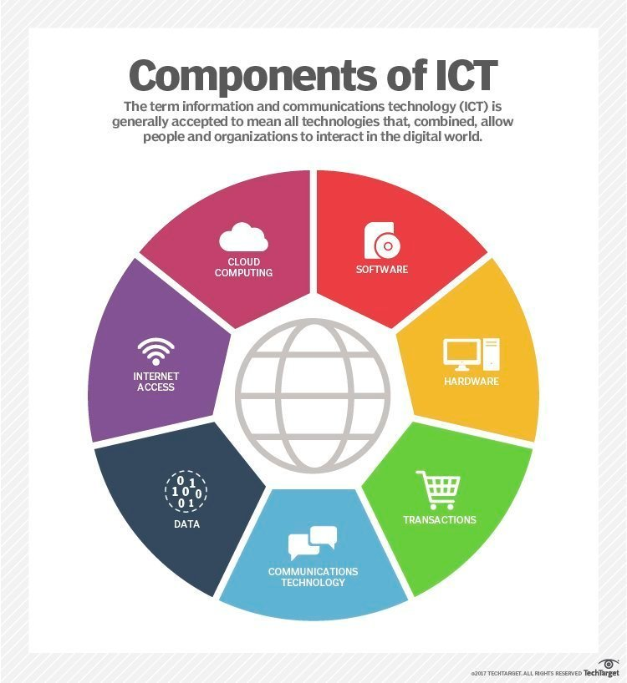
,
ICT encompasses the internet-enabled sphere and the mobile one powered by wireless networks. It includes antiquated technologies, such as landline telephones, radio and television broadcast -- all of which remain widely used alongside today's cutting-edge ICT pieces, such as artificial intelligence and robotics.
The internet, internet of things, metaverse, virtual reality and social media are also part of ICT, as are cloud computing services, video conferencing and collaboration tools, unified communications systems and mobile communication networks. Emerging, work-in-progress or still-nascent technologies like 5G/6G, Web3, and quantum computing are also in the ICT universe.
Any technology, infrastructure, component, or device that enables communications, data sharing, and global connectivity between humans and between humans and machines is included in the umbrella term ICT.
’

Slide 9
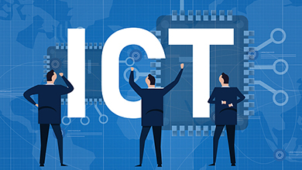
ICT vs. IT The acronym ICT is sometimes used synonymously with IT. However, ICT is generally used to represent a more comprehensive list of all components related to computer and digital technologies. IT is more about managing the technologies related to information, and its various technical aspects, including software, hardware, and networking. IT management does not include considerations of telecommunications devices and technologies while ICT does. IT can be considered a subset of ICT.
.

Slide 10
,
01
02
03
04
.
,
intoduction
,
technologies are included in ICT
the components of ICT
the importantance of tci in businesses
’

Slide 11








,
Devices (hardware).
Software.
Data.
middleware
,
,
Wired networks
Wireless networks
Communication technologies
The cloud.
,
,
,
,

Slide 12
,
01
02
03
04
,
intoduction
,
technologies are included in ICT
,
the components of ICT
the importantance of tci in businesses
,

Slide 13
.
For businesses, advances within ICT have brought a slew of cost savings, opportunities and conveniences. They include the following:
Highly automated businesses processes that have cut costs.
The big data revolution, where organizations are turning the vast trove of data generated by ICT into insights that drive new products and services.
ICT-enabled transactions such as internet shopping and telemedicine and social media that give customers more choices in how they shop, communicate and interact.
.

Slide 14
.
05
06
07
08
.
.
.
Challenges ICT creates
,
ICT, the digital age and digital divide
Thecnological advancement of ICT
conclusion

Slide 15
.
.
Its many benefits notwithstanding, ICT has also created problems and challenges for organizations, individuals and society. The digitization of data, the expanding use of the high-speed internet and the growing global network together have created new opportunities for crime. Increasingly, bad actors leverage these opportunities to hatch new schemes to gain unauthorized access to enterprise or government systems. They do so to steal money, intellectual property or private information. Many cybercrimes are also aimed at disrupting systems that control critical infrastructure and, ultimately, creating widespread chaos and panic.
Developments in ICT have also brought new automation technologies and robots that sometimes displace workers, especially workers involved in repetitive, low-value tasks. In some cases, ICT has let more people limit their face-to-face interactions with others, creating or exacerbating social issues such as trolling, cyberbullying, isolation, loneliness and depression.

Slide 16
.
05
06
07
08
.
.
.
Challenges ICT creates
,
ICT, the digital age and digital divide
Thecnological advancement of ICT
conclusion

Slide 17
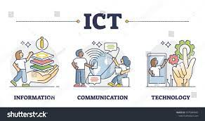
.
For all its revolutionary aspects, ICT capabilities aren't evenly distributed, with richer countries and richer individuals getting to enjoy more access to ICT technologies. These entities are better able to seize the advantages offered by and the opportunities powered by ICT. This discrepancy in access to ICT has created what is now known as the digital divide.
Numerous governmental authorities and non-government organizations advocate policies and programs that aim to bridge the digital divide by providing greater access to ICT among those individuals and populations struggling to afford it.
ICT has changed drastically how people work, communicate, learn and live. It continues to revolutionize all parts of the human experience as first computers and now robots do many tasks humans once handled.
ICT's importance to economic development and business growth has been so monumental that it's often credited with ushering in the Fourth Industrial Revolution. ICT also underpins broad shifts in society, as individuals en masse are moving from personal, face-to-face interactions to ones in the digital space. This new era is frequently termed the digital age.

Slide 18
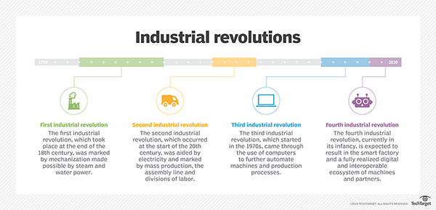
.
.

Slide 19
.
05
06
07
08
.
.
Challenges ICT creates
,
ICT, the digital age and digital divide
.
Thecnological advancement of ICT
conclusion

Slide 20
.
1837 | Morse code and telegraph
1876 | Telephone
1895 | Wireless telegraphy
1927 | Television
1947 | Transistor
1951 | UNIVAC I (First commercial computer)
1969 | ARPANET (Foundation of the Internet)
1971 | First email
1990 | World Wide Web
1991 | GSM (Global System for Mobile communication)
1994 | Netscape Navigator (Widely-used web browser)
1998 | Google
2001 | Commercial 3G networks
2004 | Facebook
2007 | iPhone
2008 | Bitcoin (First blockchain-based cryptocurrency)
2010 | 4G networks
2016 | AlphaGo (AI system defeating world champion Go player)
2020 | 5G networks
2023 | Zoom (350 million daily meeting attendees)
.

Slide 21
.
05
06
07
08
.
.
.
Challenges ICT creates
,
ICT, the digital age and digital divide
Thecnological advancement of ICT
conclusion

Slide 22
In summary,ICT is an integral part of the modern world ,influencing how information is created,shared,and accessed.Its impact extends across various sectors,contributing to economic development ,innovation ,an improved communication on a globale scale.

