Slide 1
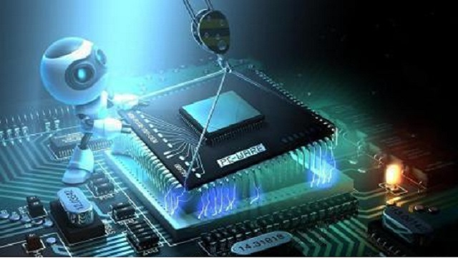
What is the embedded system?
Embedded system is a system that has embedded software and hardware, which makes it a system dedicated for an application or product or a part of a larger system.
Embedded system are electronic systems contain a microprocessor and microcontroller.
3 main components :
1. Hardware
2. Application Software
3. RTOS (Real Time Operating System)

Slide 2
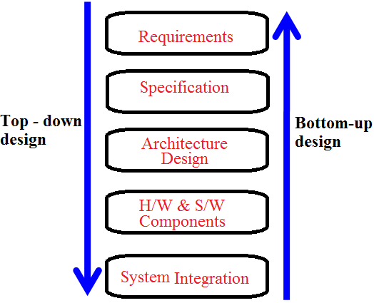

Slide 3
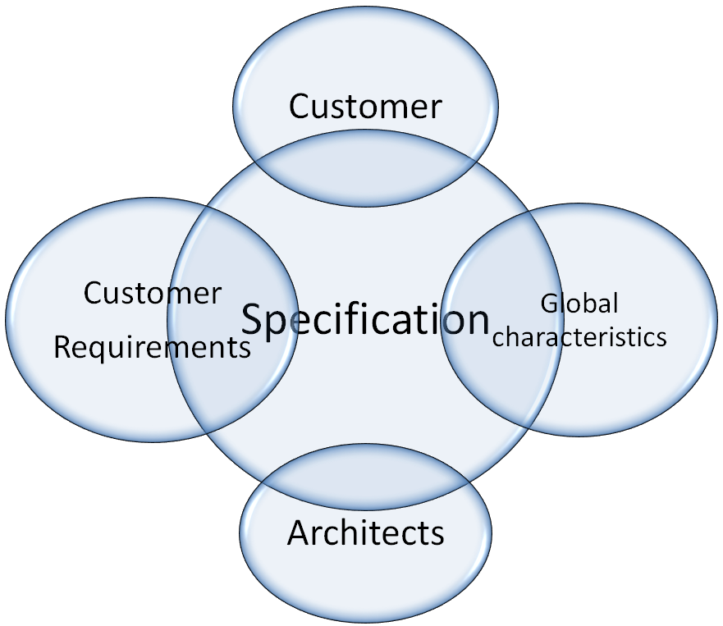

Slide 4

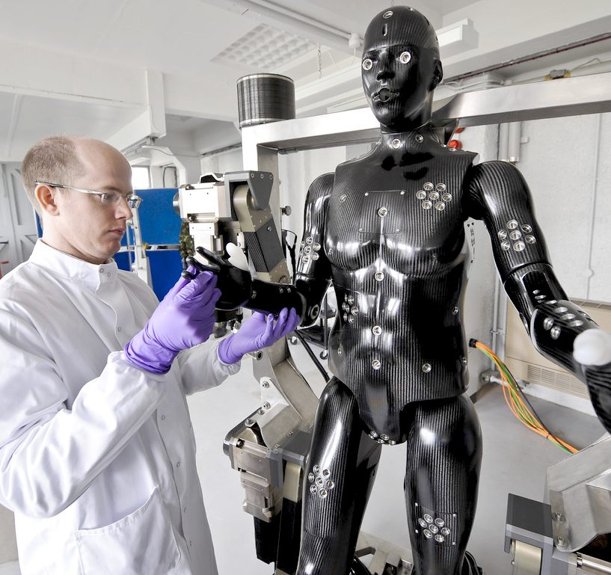
Architecture Design & Designing H/W & S/W Components
Architectural tells the components required
Components include
both H/W & S/W.

Slide 5
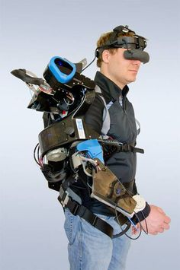
System Integration
Designers seeing a working system.
Bugs are been rectified only in this period.

Slide 6
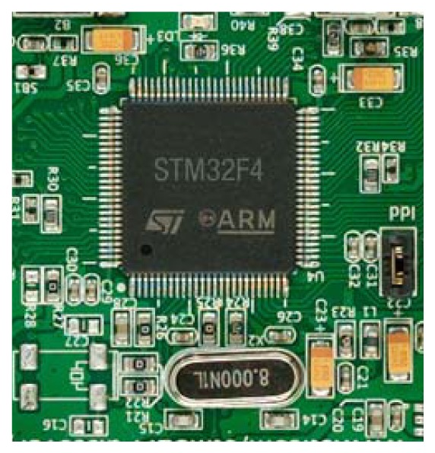
Selection of Processors
High Clock speed.
High Computing performance – Pipeline
Processors with registers - multitasking
Power – efficient – auto shutdown
Processors –Burst mode - external memory.
Processor – Atomic Operation
Processor – coding – Big Endian, Little Endian

Slide 7
Selection Of Memory Devices
Actual memory requirement is known only after coding.
ROM & RAM allocation for various segments, data & structures will be available from the software design.
Prior estimate of memory type and size can be made.

Slide 8
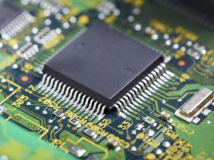
MICROCONTROLLER
It has a CPU in, addition with a fixed amout of ram,rom and other peripherals all on a single chip.
Other peripherals like TIMER, ADC, DAC, I/P O/P PORTS
It is also called as a mini computer or computer on single chip.

Slide 9
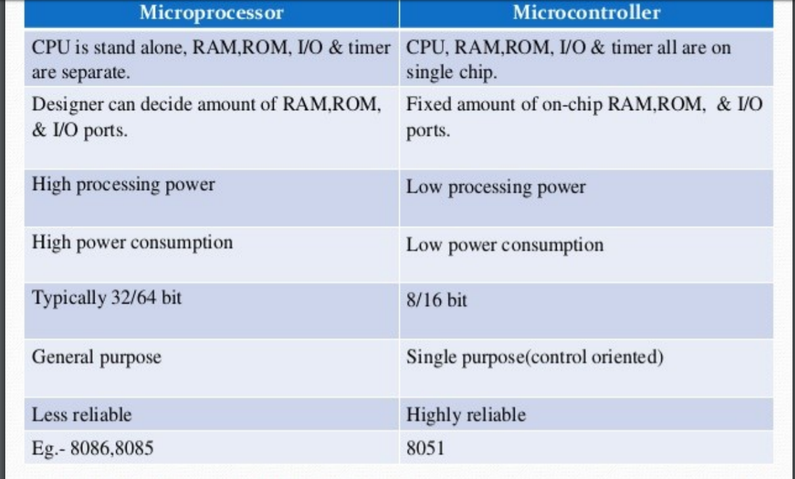

Slide 10
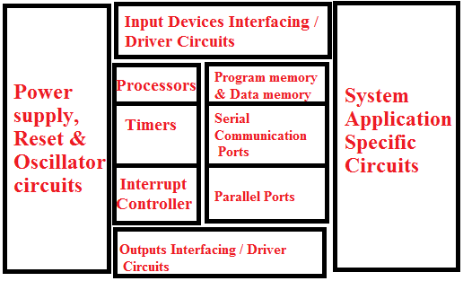
Components of embedded system hardware:

Slide 11
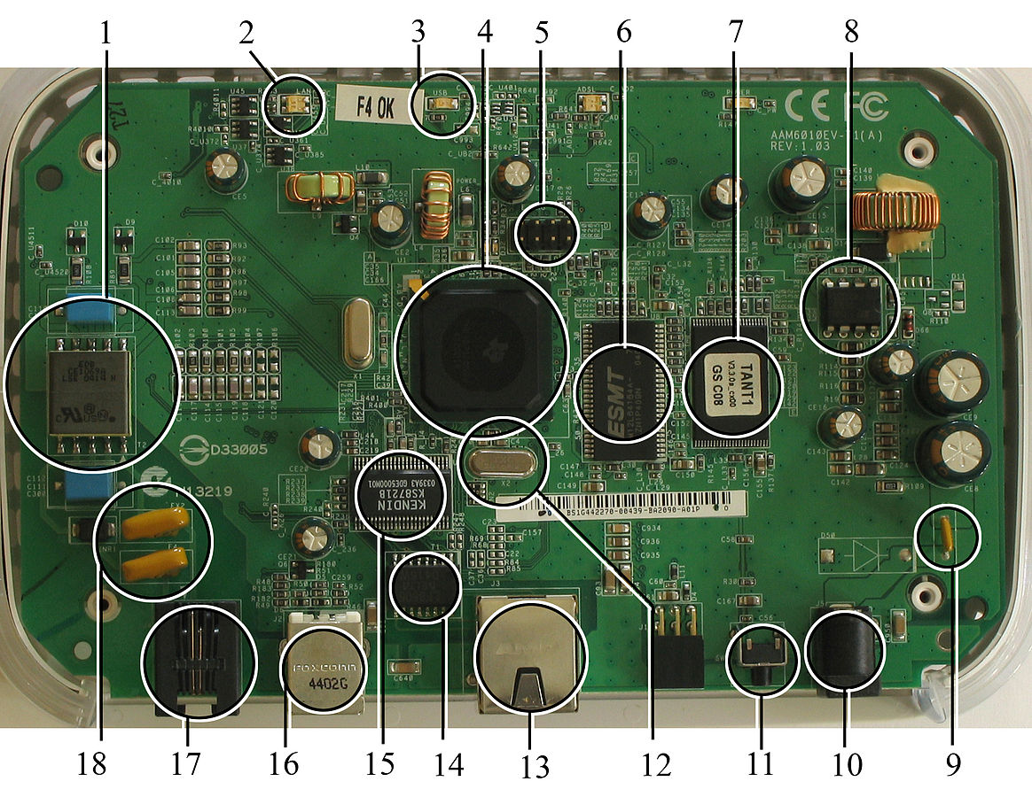
Telephone decoupling electronics (for ADSL)
Multicolor LED (displaying network status)
Single color LED (displaying USB status)
Main processor, a TNETD7300GDU, a member of Texas Instruments' AR7 product line
JTAG (Joint Test Action Group) test and programming port
RAM, a single ESMT M12L64164A 8 MB chip
Flash memory, obscured by sticker
Power supply regulator
Main power supply fuse
Power connector
Reset button
Quartz crystal
Ethernet port
Ethernet transformer, Delta LF8505
KS8721B Ethernet PHY transceiver
USB port
Telephone (RJ11) port
Telephone connector fuses

Slide 12
Thank you for your attention

