Slide 1
BLUESTOCK FINTECH • CAPSTONE PROJECT
Mutual Fund Analytics, Risk
Modeling & Business Intelligence
End-to-end analytics pipeline: data ingestion, EDA, performance &
risk analytics, and an interactive Power BI dashboard
Amir Bensekar
Data Analyst Intern, Bluestock Fintech | MCA, MES IMCC Pune

Slide 2
PROBLEM & OBJECTIVE
Turning fragmented mutual fund data into investable insight
The Problem
Project Objectives
Mutual fund data is scattered across NAV feeds, AMFI statistics, portfolio holdings and investor records — hard to compare on a like-for-like, risk-adjusted basis.
Investors and analysts need a single view of performance, risk, and investor behaviour to make informed decisions.
Without a structured pipeline, insights stay siloed in spreadsheets and one-off scripts.
Build a scalable, reproducible analytics pipeline for MF data
Analyze fund performance via return & risk metrics
Study SIP and investor behaviour patterns
Measure downside risk (VaR, CVaR, drawdown)
Develop interactive BI dashboards
Generate risk-adjusted fund recommendations
Bluestock MF Capstone | Amir Bensekar
2

Slide 3
DATA SOURCES
10 datasets, ~80,000 records, 1 unified warehouse
01
Fund Master
06
Industry Folio Count
40-scheme reference data (AMC, category, expense ratio, risk)
Total / equity / debt / hybrid folio trends
02
NAV History
07
Scheme Performance
Live MFAPI data, 6 schemes, Jan 2022–May 2026 (~46K rows)
Returns, alpha, beta, Sharpe/Sortino for 40 schemes
03
AUM by Fund House
08
Investor Transactions
AMC-level Assets Under Management over time
~32,800 SIP / Lumpsum / Redemption records
04
Monthly SIP Inflows
09
Portfolio Holdings
Industry SIP inflow, accounts, AUM, YoY growth
Stock-level holdings, sector & weight per scheme
05
Category Inflows
10
Benchmark Indices
Monthly net fund flows by category
Historical benchmark index levels
Bluestock MF Capstone | Amir Bensekar
3

Slide 4
ARCHITECTURE
From raw CSVs and live NAV feeds to a star-schema warehouse
1. Ingestion
2. Cleaning
3. EDA
4. Performance
5. Risk Analytics
6. BI & Reco
10 raw CSVs + live MFAPI NAV pulls
Type casts, de-dup, validation
clean_*.csv + SQLite DB
17 visualizations across
trends & demographics
CAGR, Sharpe, Sortino,
alpha/beta, Scorecard
VaR, CVaR, rolling Sharpe,
sector HHI
Power BI dashboard +
recommendation engine
run_pipeline.py orchestrates stages 1–5 end-to-end with a single command, ensuring EDA, performance, and risk
outputs are always derived from a freshly cleaned dataset. Cleaned data is stored in a SQLite star-schema warehouse
(dim_fund, fact_nav, fact_transactions, fact_performance) that powers SQL analytics and the Power BI dashboard.
Bluestock MF Capstone | Amir Bensekar
4

Slide 5
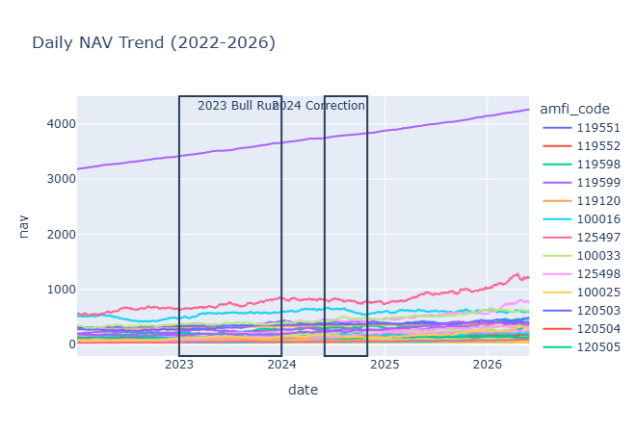
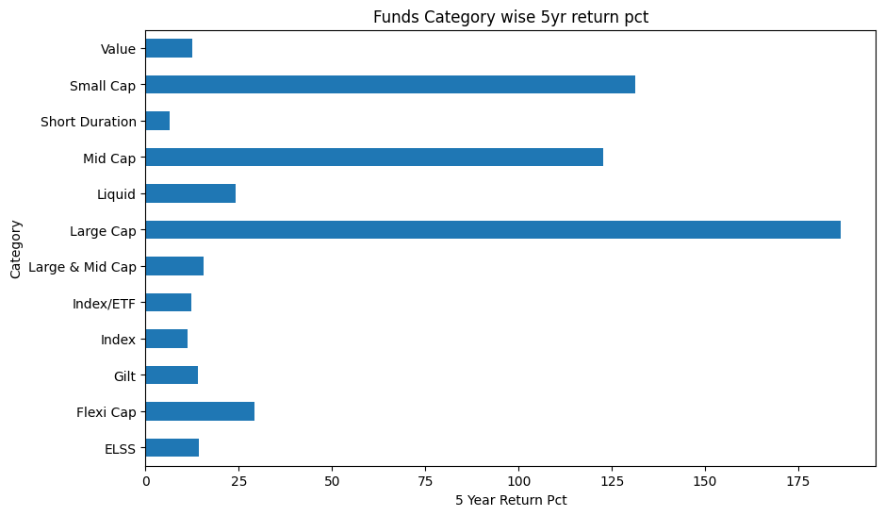
EDA HIGHLIGHTS
NAV trends, fund universe & category-level returns
All 6 tracked large-cap schemes show steady NAV growth (2022–26) with a mid-period drawdown and recovery.
Small Cap (21.9%) and Mid Cap (17.5%) lead 5-year category returns; debt categories cluster at 6–7%.
Bluestock MF Capstone | Amir Bensekar
5

Slide 6
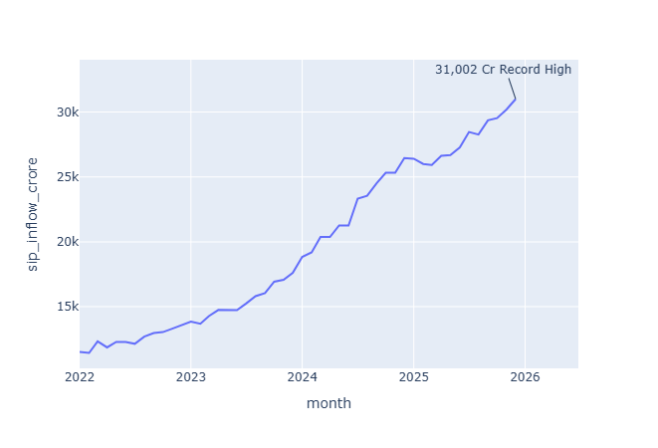
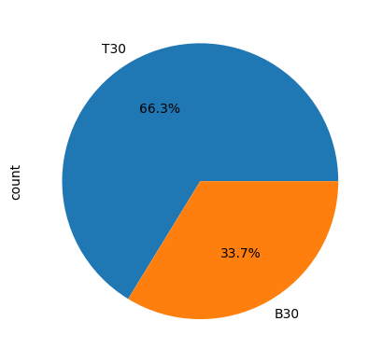
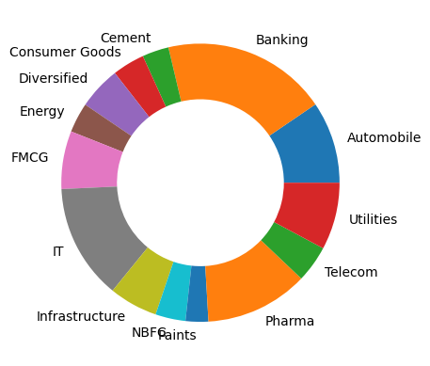
EDA HIGHLIGHTS
SIP momentum, investor demographics & sector mix
Monthly SIP inflows trend steadily upward with positive YoY growth — systematic investing keeps gaining share.
Tier-1 cities lead investor count, but Tier-2/3 contribute a meaningful and growing share — deepening retail penetration.
Aggregate portfolio holdings are diversified across sectors, with a few schemes showing higher single-sector concentration (see HHI, next).
Bluestock MF Capstone | Amir Bensekar
6

Slide 7
PERFORMANCE METRICS
Fund Scorecard — top ranked schemes (risk-adjusted)
Rank | Scheme | Category | 5Y Return | Sharpe | Risk Grade | Score
1 | SBI Small Cap Fund (Direct) | Small Cap | 21.82% | 0.93 | Very High | 100.0
2 | Kotak Flexicap Fund (Regular) | Flexi Cap | 13.50% | 0.98 | Mod. High | 97.4
3 | Kotak Emerging Equity (Regular) | Mid Cap | 17.75% | 0.96 | High | 95.4
4 | ABSL Small Cap Fund (Regular) | Small Cap | 23.80% | 0.90 | Very High | 90.7
5 | SBI Small Cap Fund (Regular) | Small Cap | 20.67% | 0.94 | Very High | 82.7
Small Cap and Flexi Cap schemes dominate the top of a composite 0–100 scorecard blending 5Y return, Sharpe, alpha, expense ratio and drawdown ranks.
Category averages: Small Cap 5Y return 21.9% (Sharpe 0.87); Flexi Cap 14.6% (Sharpe 0.97); Large Cap 13.3% (Sharpe 0.93).
Liquid / Short Duration debt funds show very high Sharpe (6.33 / 1.84) due to extremely low volatility — a capital-preservation profile, not high absolute return.
Bluestock MF Capstone | Amir Bensekar
7

Slide 8
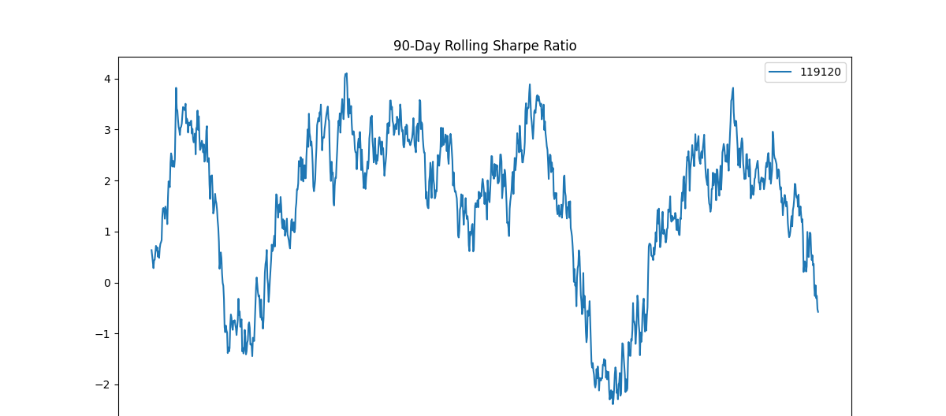
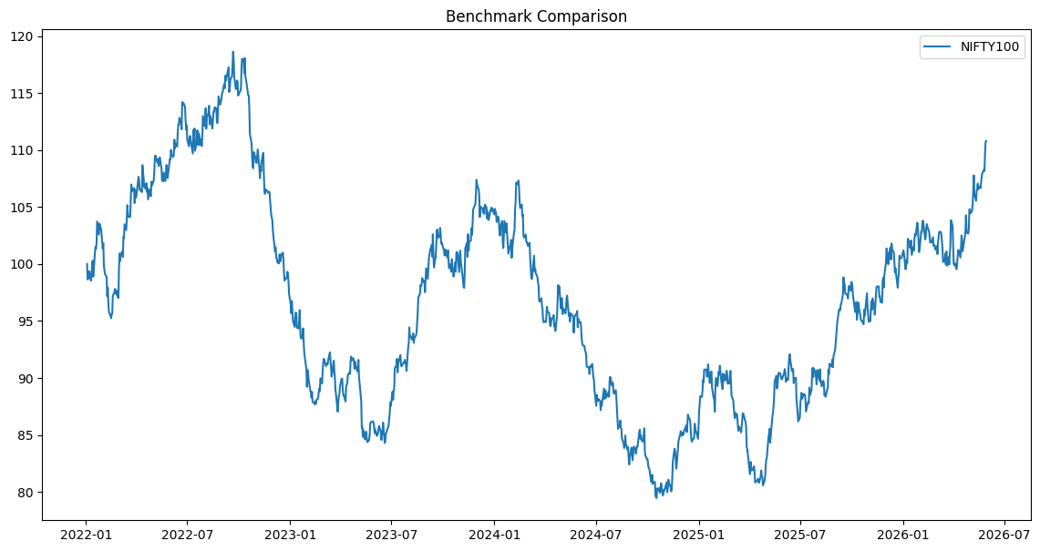
PERFORMANCE METRICS
Risk analytics — VaR, CVaR, alpha/beta & concentration
-1.47%
-1.86%
+15.9%
0.206
Avg 1-Day VaR (95%)
Avg 1-Day CVaR (95%)
Avg Alpha vs Benchmark
Highest Sector HHI
(Axis Bluechip)
Bluestock MF Capstone | Amir Bensekar
8

Slide 9
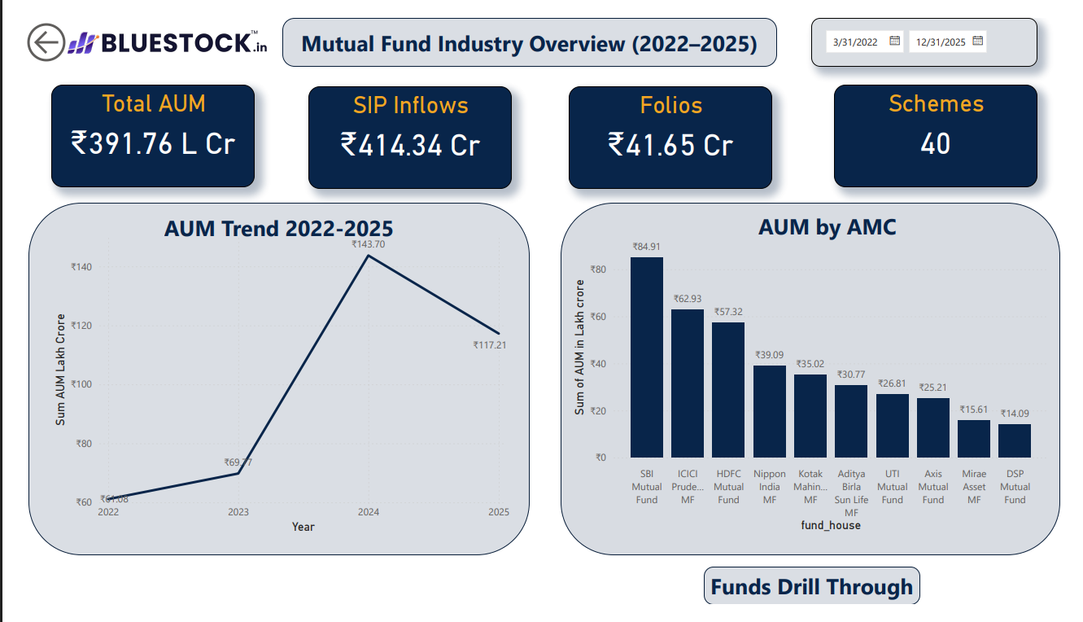
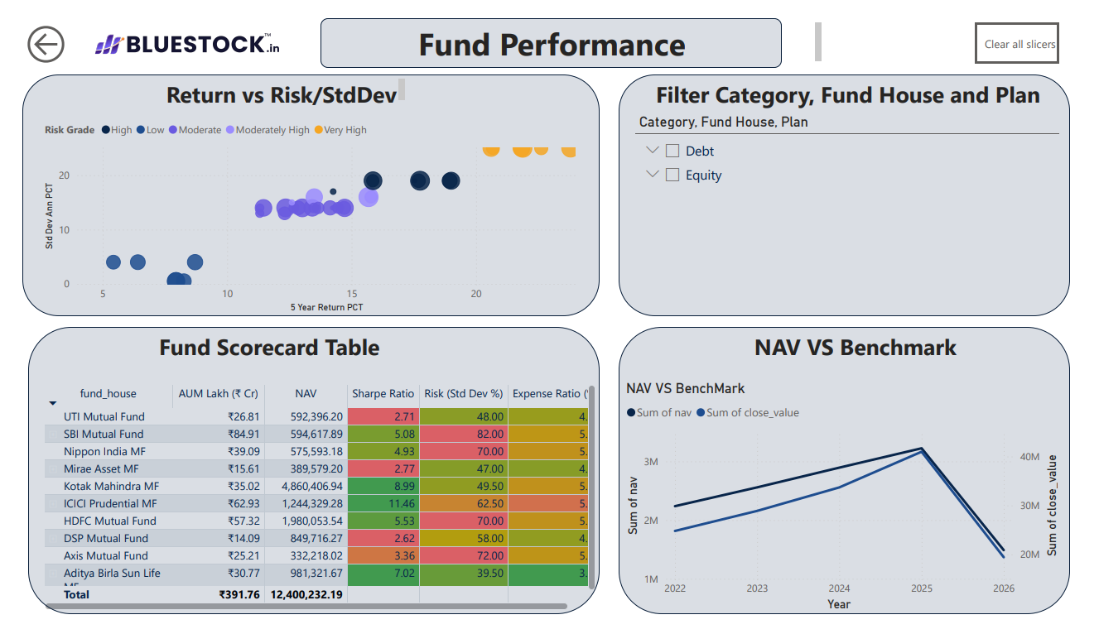
DASHBOARD
Power BI — Industry Overview & Fund Performance
Industry Overview — AUM trends, SIP inflows, fund-house
analysis and headline industry KPIs
Fund Performance — risk vs. return, fund scorecard,
benchmark comparison and performance ranking
Bluestock MF Capstone | Amir Bensekar
9

Slide 10
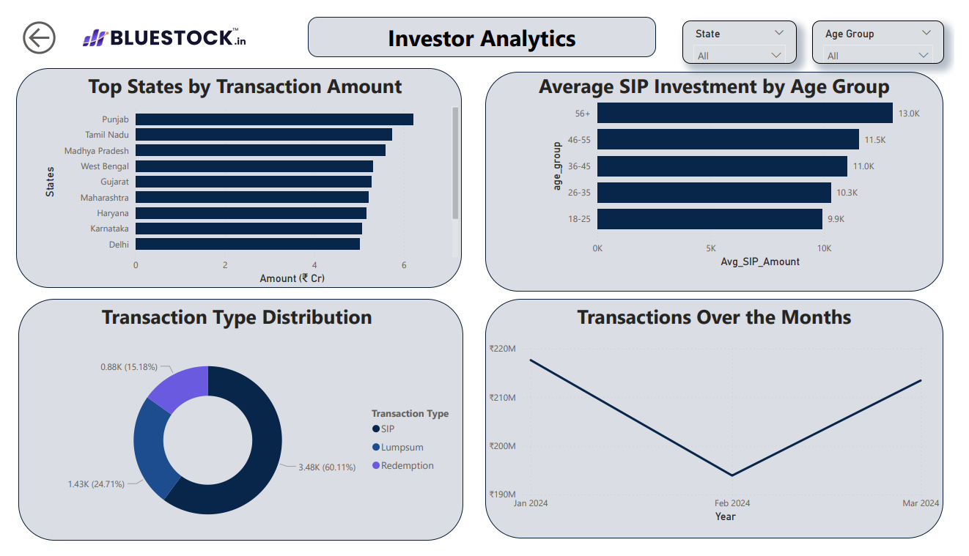
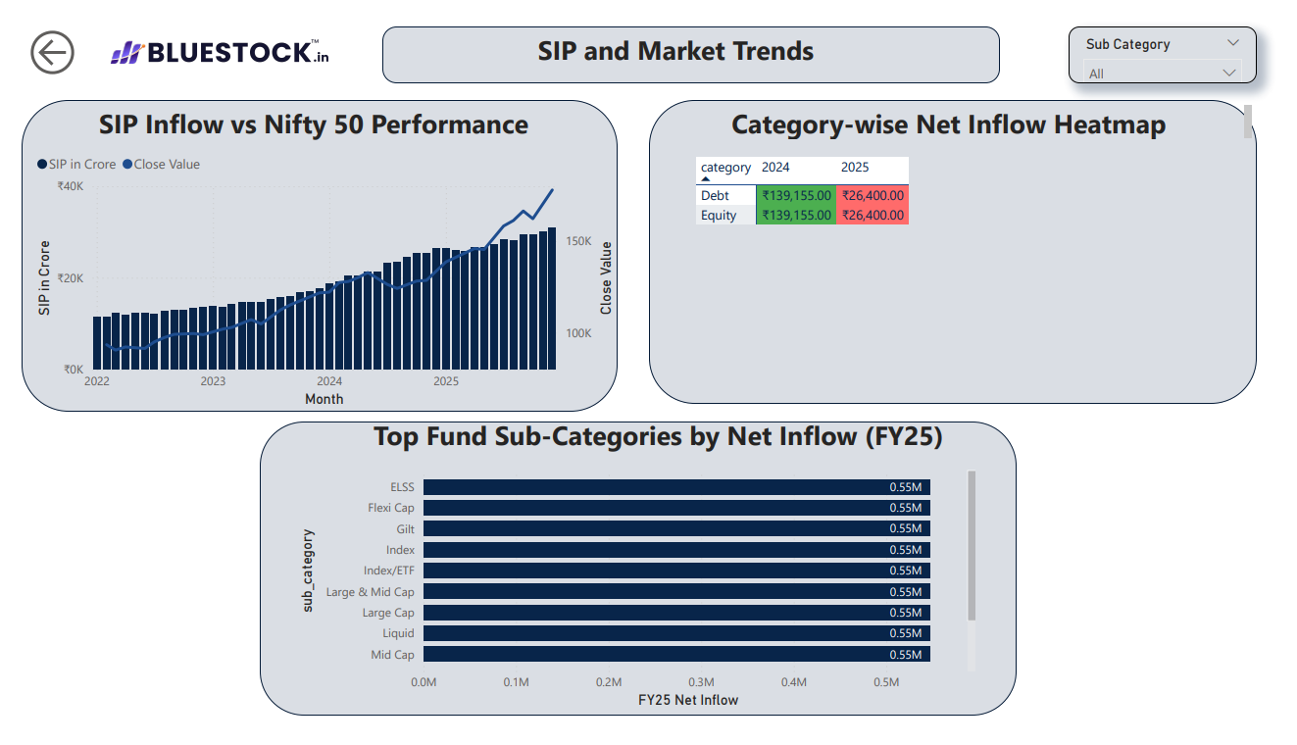
DASHBOARD
Power BI — Investor Analytics & SIP/Market Trends
Investor Analytics — demographics, geographic
distribution and transaction insights
SIP & Market Trends — SIP inflow vs. Nifty, category
inflow heatmaps and market trend analysis
Bluestock MF Capstone | Amir Bensekar
10

Slide 11
KEY FINDINGS
What the data tells us
1
2
3
Risk-Return Ladder Holds
Clear Scorecard Leaders
SIP Momentum Continues
Small Cap (21.9%) > Mid Cap (17.5%) > Large Cap (13.3%) > Debt (6–7%) on 5-year returns — with volatility rising in step.
SBI Small Cap (Direct), Kotak Flexicap, and Kotak Emerging Equity top the risk-adjusted Fund Scorecard.
Monthly SIP inflows and folio counts trend upward across Tier-1/2/3 cities — systematic investing is broad-based.
4
5
6
Tail Risk Is Quantified
Concentration Flags
Recommendation Engine Works
Avg 1-day VaR(95%) of -1.47% and CVaR of -1.86% across 40 schemes give a concrete downside-risk baseline.
Axis Bluechip and similar large-cap mandates show the highest sector HHI — a diversification signal for investors.
A simple risk-grade + Sharpe filter reliably surfaces a top-3 shortlist per risk appetite, ready for productization.
Bluestock MF Capstone | Amir Bensekar
11

Slide 12
Thank You
Amir Bensekar
Data Analyst Intern, Bluestock Fintech
github.com/amirb17/Mutual_Fund_Analysis

