Slide 1
Saga Pattern
ikubINFO Agile Software Development Lifecycle by Amir Buzo

Slide 2
Outline
What’s next?
Saga
Choregraphy, Orchestration
Spring Cloud
JDK17, Spring Cloud 2023.0.3 Mongo,Temporal,
Microservices
Infrastructure
Temporal, Orchestrator, Build, Jira, Sonar Service
Orchestration IADL
Saga
Concept Discussion

Slide 3
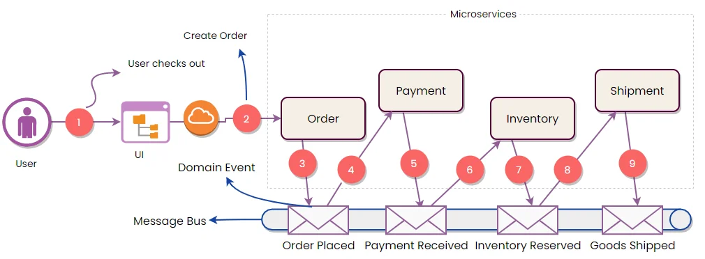
Choreography

Slide 4
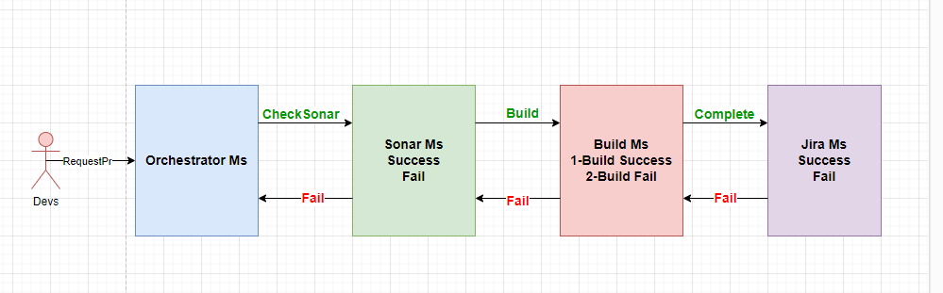
IADL Fulfillment Workflow Orchestrator

Slide 5
Mircroservices
Build, Orchestrator, Sonar, Bitbucket
Orchestration
Temporal
Hexagonal/Clean Architecture
LRA(long running actions)

Slide 6
SAGA BENEFITS ACD
The Saga pattern provides transaction management using a sequence of local transactions. A local transaction is the atomic work effort performed by a saga participant.
Guarantee Transactional operation by local step (transcations) in distributed environment.
Atomicity: Either all transactions are executed, or all are compensated
Consistent: Referential integrity is given by both local databases and the application code
The saga pattern cannot give isolation guarantees, meaning that countermeasures must be made for anomalies
Durability: This is guaranteed by message brokers and databases

Slide 7
Temporal
https://temporal.io/
Temporal Server
Temporal Client (.NET, JAVA)
Client: Netflix, Postman
Waiting Configuration Policy
Docker

