Slide 1
BS-JS
VS 5
To use bs.js : requests :
Popper.js
<script src=“popper.js”></script> maintain position for components like : dropdown menus
<script src=“bs.js”></script>
VS 3
To use bs.js : requests :
Jq
Popper.js
<script src=“jq.js”></script>
<script src=“popper.js”></script> maintain position for components like : dropdown menus
<script src=“bs.js”></script>
VS 5
To use bs.js : requests :
Popper.js
<script src=“bs.bundle.js”></script>
VS 4
To use bs.js : requests :
Popper.js
<script src=“popper.js”></script> maintain position for components like : dropdown menus
<script src=“bs.js”></script>
BS.js : you have to link with pooper.js
BS.min.js
BS.bundle.js : don’t need to include popper
Bs.bundle.min.js

Slide 2
Structure For BS File
<!DOCTYPE html>
<html>
<head>
<meta name=“viewport” …. />
<title></title>
<link href=“bs.css”/>
<link href=“font awesome cdn”/>
</head>
<body>
<!– option one -- >
<script src=“popper.js”></script>
<script src=“bs.js”></script>
<!– option two -- >
<script src=“bs.bundle.js”></script>
</body>
</html>

Slide 3
Js : components
Login component
Name
Pass
Component : consist of 3 parts
Html
CSS
Js
Login
Cancel
Index page
Contact page
Login component
Login component
Name
Name
Pass
Pass
Login
Cancel
Login
Cancel

Slide 4
BS Components :
DropDown Menues
Slide Show : Carousel
Form
Alerts
Cards
Modal | Modal Dialogue

Slide 5
Data-dismiss=“alert | modal”
Data-toggle
Data-slide-to
Data-slide

Slide 6
Alerts
Html: p or div
CSS: alert , alert-success | alert-warning |…….
Js :
ITI Mansoura Branch
Attributes started with prefix data- use it bs js to register events
data-dismiss : close
data-toggle:
data-slide
data-slide-to

Slide 7
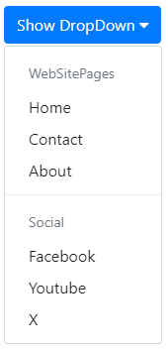
Task Lab
1- how to change direction of dropdown : display dropdown menue right togglere
2- change social words : with fa icons : links to social pages

Slide 8
Alert using dismissing

Slide 9
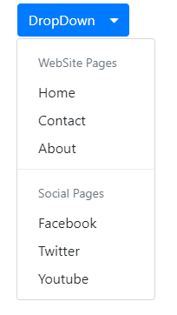
Drop Down Menues
Drop-down
Dropdown-item
Dropdown-header
Dropdown-divider
-
Data-toggle=“dropdown”
Lab Task :
Change text to icons :
Icons : links for websites

Slide 10
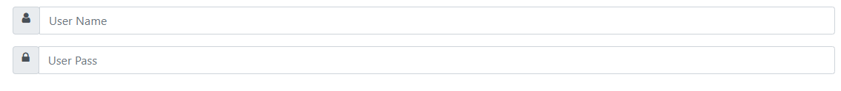
forms
icon
Form-group
Form-control
Input-group
Input-group-append
Input-group-prepend
Input-group-text
Lab Task :
Bootstrap form validation :
Dummy example for
Inline forms

Slide 11
Cards : container organized : consist of three parts - card header - card body -card footer card card-header card-title card-body card-footer
Card Header
Card body
Card footer

Slide 12
Card Task : from getbootstrap .con
Lab Task
Card-tabs
Card-pills

Slide 13
Collapase
ClickMe
data-toggle=“collapse”
Card

Slide 14
Modal and modal-dialoges
M

Slide 15
modal : container organized : consist of three parts - modal header - modal body - modal footer modal modal -header modal -title modal -body modal -footer
modal Header
modal body
modal footer

Slide 16
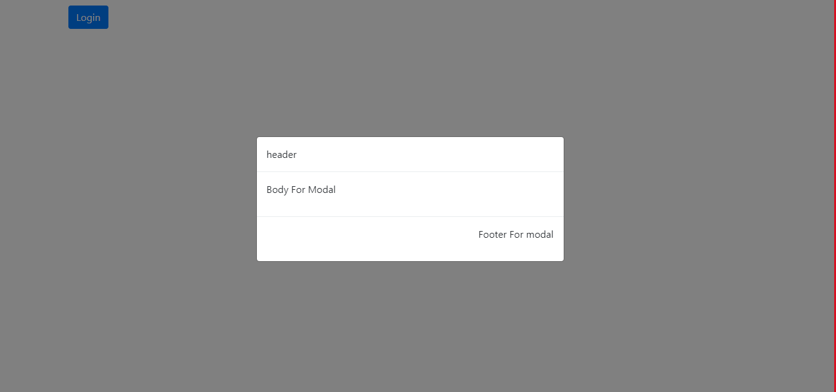
Modal and modal dialoge task
Lab Task
Form : receive : username and userpass
Display user name and userpass
After modal dialoge close
Close

Slide 17
Carousel : slide show
carousel
Carousel-inner :
Carousel-item
Contains image
Carousel-controls
Image
Text ,………
Carousel-indicators

Slide 18
Carousel classes and attributes
Carousel
Carousel-inner
Carousel-item
Carousel-indicators
Carousel-control-next
Carousel-control-prev
Version 4
Data-target
Data-slide-to
Data-slide
Data-interval
Data-ride
Version 5
Data-bs-target
Data-bs-slide-to
Data-bs-slide
Data-bs-interval
Data-bs-ride

Slide 19
Navbar : scrollspy , fixrd top
carousel
Version 5 bootstrap :
Data-bs-target
Version 4 bootstrap
Data-target

