Slide 1

soilice: An Introduction

Slide 2
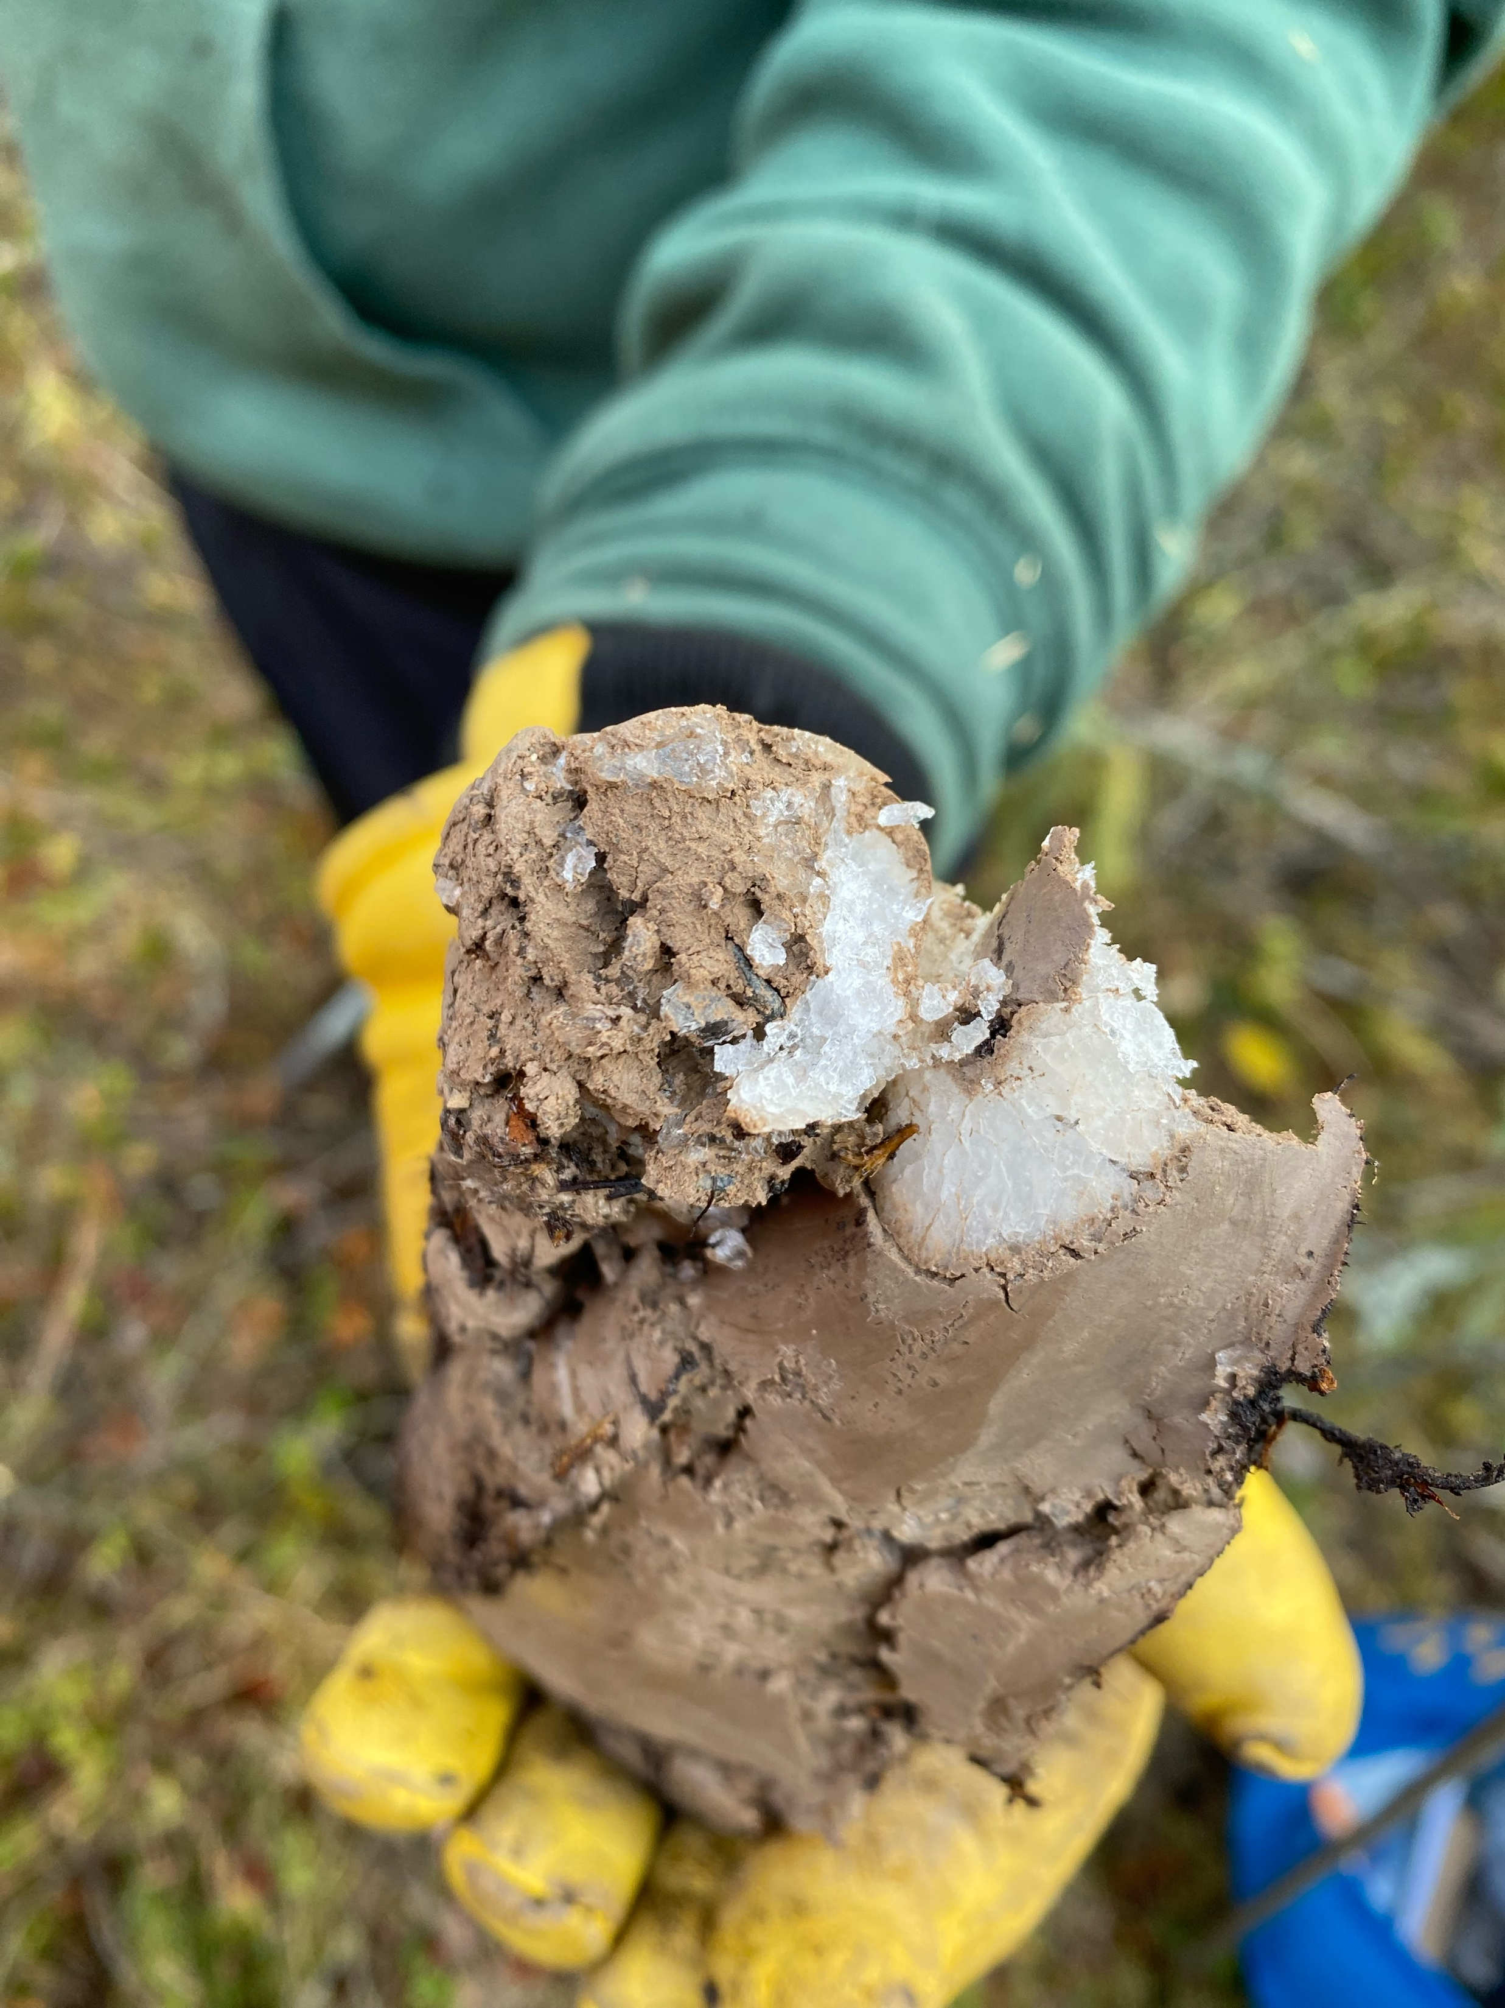
Understanding of freeze-thaw processes is fraught by “experimental vagaries and theoretical imponderables”
Miller (1980, Applications of soil physics)

Slide 3
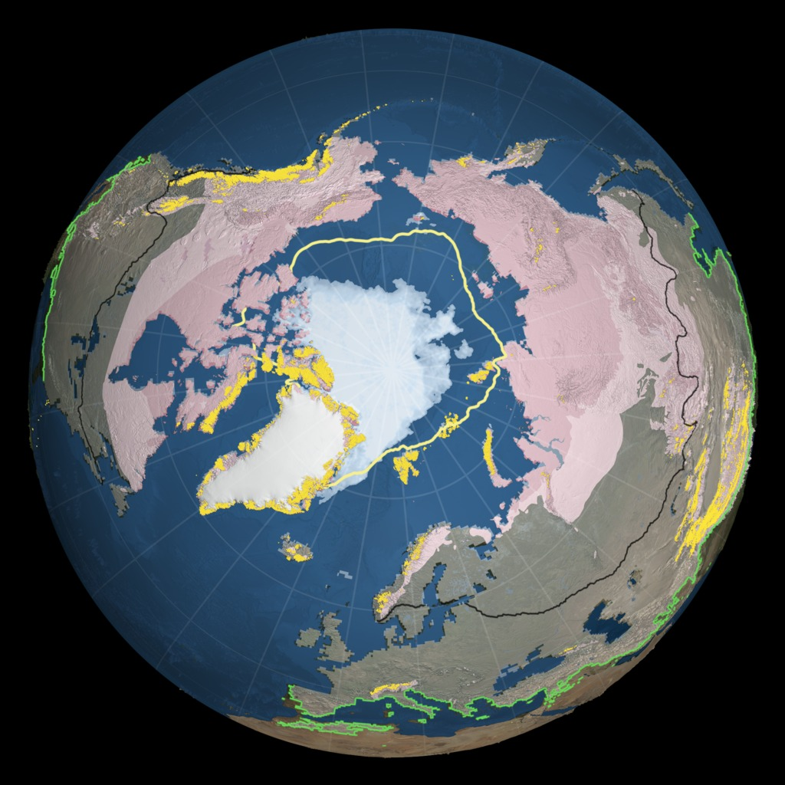
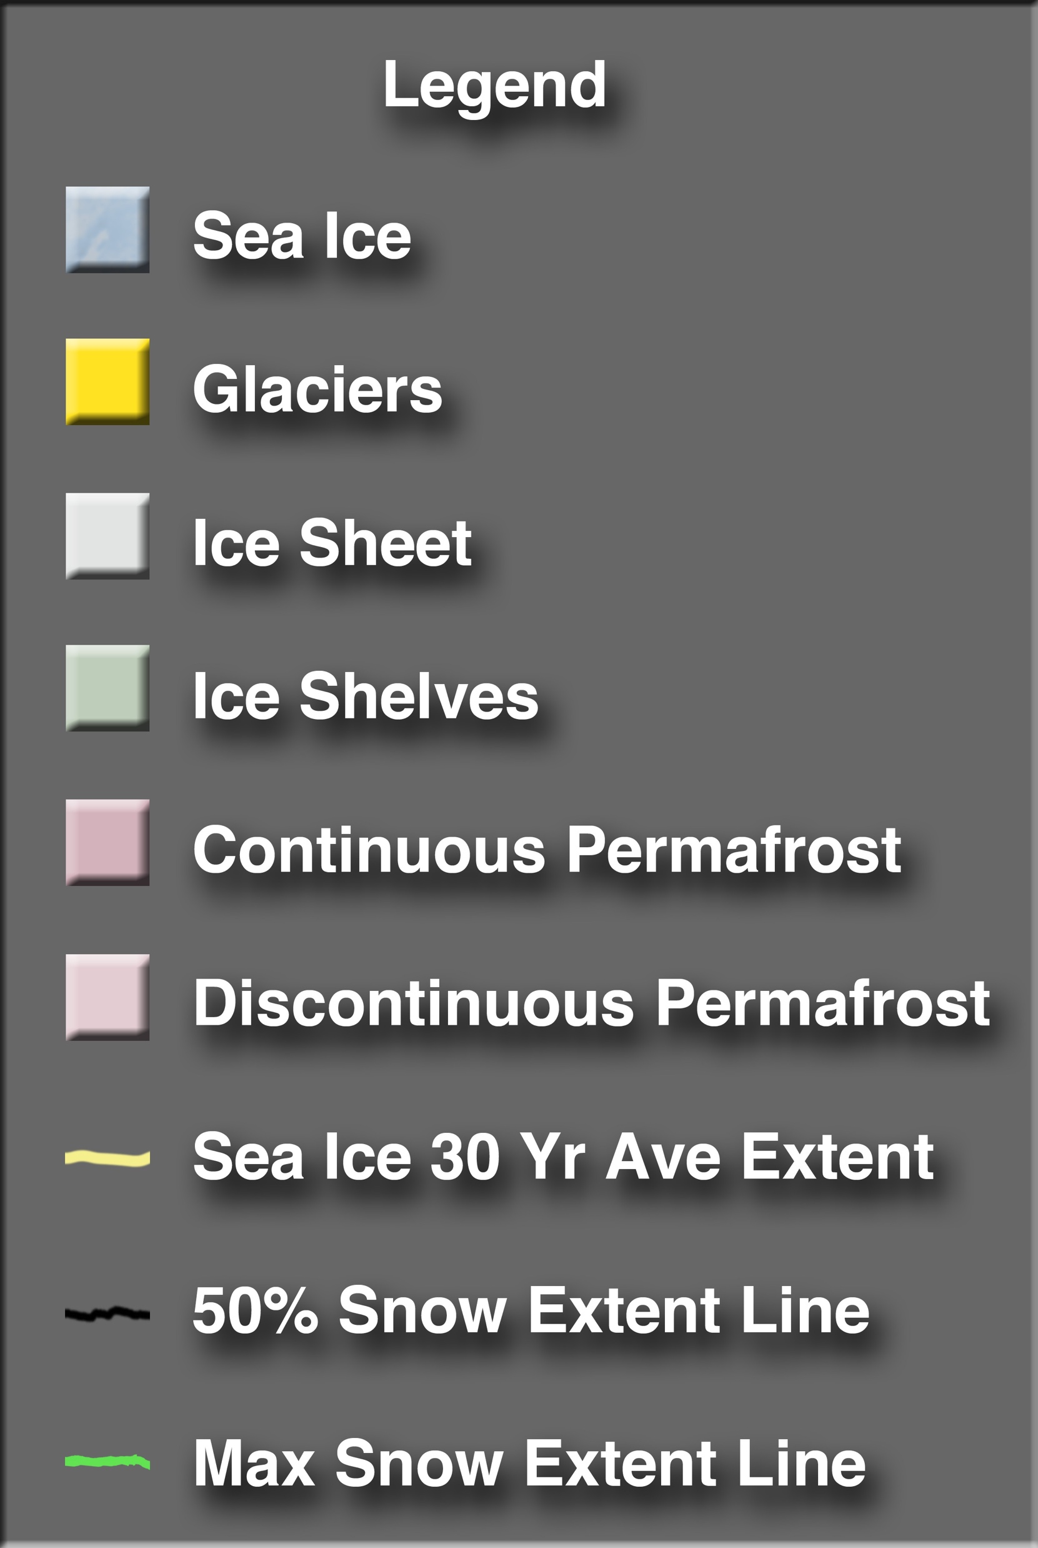
Frozen soils - globally
Unfrozen
Frozen
High northern latitude
Continuous permafrost
spatial
seasonal
summer
Depth
Discontinuous permafrost
spatial
seasonal
summer
Depth
Seasonally frozen soils
spatial
seasonal
winter
Depth
NASA/Goddard Space Flight Center Scientific Visualization Studio
http://svs.gsfc.nasa.gov/3885
Mid-northern latitudes
Unfrozen soils
spatial
seasonal
Depth

Slide 4
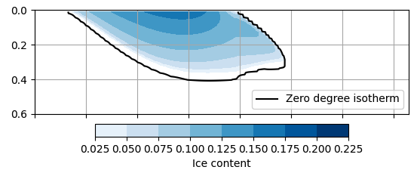
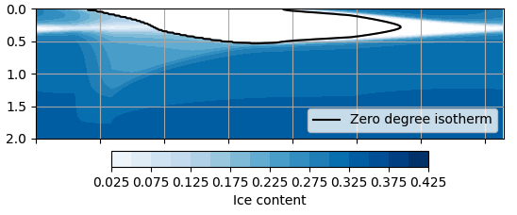
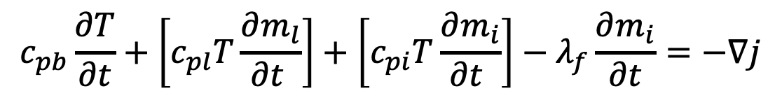

soilice : A coupled heat-mass transport solver for variably frozen soils
$$\frac{∂m_{l}}{∂t}+\frac{∂m_{i}}{∂t}={−ρ}_{l}∇.q_{l}$$
Mass transport:
$$c_{pb}\frac{∂T}{∂t}+\left[c_{pl}T\frac{∂m_{l}}{∂t }\right]+\left[c_{pi}T\frac{∂m_{i}}{∂t }\right]−λ_{f}\frac{∂m_{i}}{∂t}=−∇j$$
Heat transport:
Seasonally frozen soil simulation
Permafrost/active layer simulation

