Slide 1
Deep learning-based transformation of H&E stained tissues into special stains
Kevin de Haan, Yijie Zhang, Jonathan E. Zuckerman, Tairan Liu, Anthony E. Sisk, Miguel F. P. Diaz, Kuang-Yu Jen, Alexander Nobori, Sofia Liou, Sarah Zhang, Rana Riahi, Yair Rivenson, W. Dean Wallace & Aydogan Ozcan
Presenter: Amir Ezzati

Slide 2
Table of contents
Intoduction
01
Architecture
02
Evaluation
03
Intro to histological analysis
Architectue of models which are used
Evaluation of generated special stains

Slide 3
01
Introduction

Slide 4
Introduction
Histological analysis of stained human tissue samples is the gold standard for evaluation of many diseases.
The most common stain (otherwise referred to as the routine stain) is the hematoxylin and eosin (H&E), covering ~80% of all the human tissue staining performed globally.
H&E stain is relatively easy to perform and is widely used across the industry.

Slide 5
Introduction
There are a variety of other histological stains with different properties.
Some type staining:
Masson’s trichrome (MT) stain is used to view connective tissue.
periodic acid-Schiff (PAS) can be used to better scrutinize basement membranes.
Jones methenamine silver (JMS) stain offers a sharp contrast to visualize glomerular architecture.
These features have importance for certain disease types such as nonneoplastic kidney disease.
These non-H&E stains are also called special stains

Slide 6
Introduction
While H&E staining is performed using a streamlined staining procedure, the special stains often require more preparation time, effort, and monitoring by a histotechnologist, which increases the cost of the procedure and takes additional time to produce.
More recently, computational staining techniques known as virtual staining have been developed. Using deep learning, virtual staining has been applied on label-free. (such as autofluorescence)
An alternative approach that can be used to bypass histochemical tissue staining is to computationally transform the WSI of an already stained tissue into another stain

Slide 7
02
Architecture

Slide 8
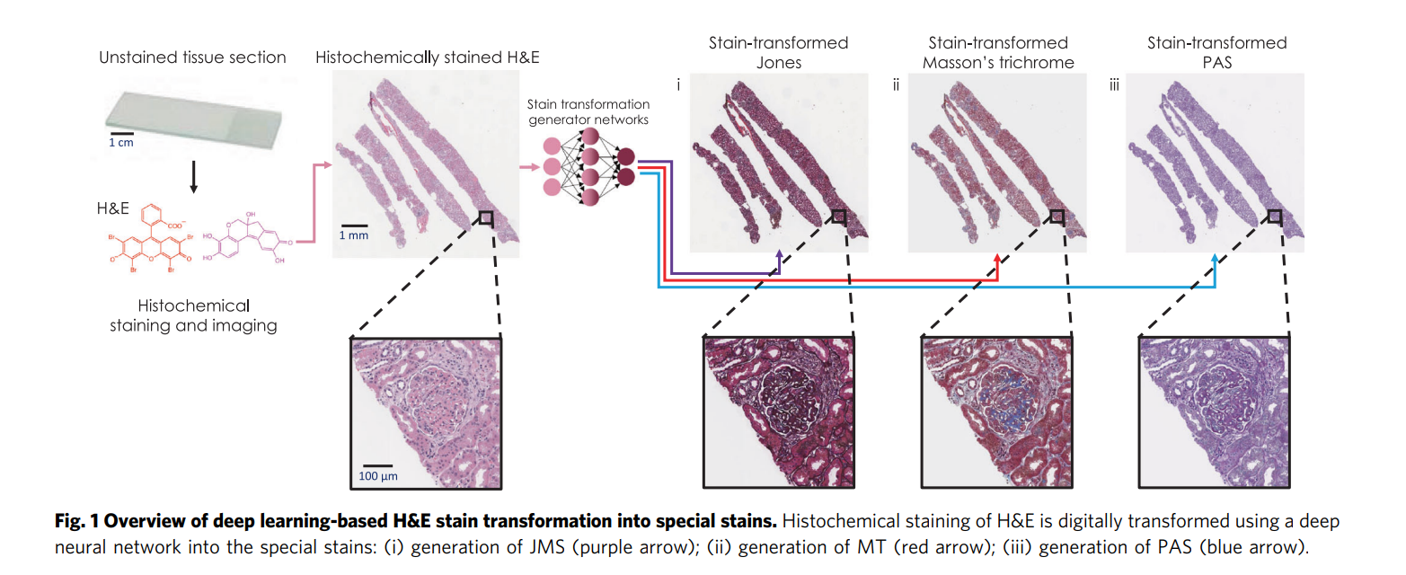
Stain Transformation Network
In this paper, we present a supervised deep learning-based stain transformation framework, outlined in Fig. 1. The training of this technique is based on spatially-registered. ~minimum matching loss (perfectly paired)

Slide 9
Stain Transformation Network
It uses GANs. Each of these GANs consists of a generator (G) and a discriminator (D).
This GAN loss is used in conjunction with two additional losses: a mean absolute error (L1) loss and a total variation (TV) loss.
L1 loss is used to ensure that the transformations are performed accurately in space and color.
the TV loss is used as a regularizer, and reduces noise created by the GAN loss.
Generator: a modified U-net neural network
Discriminator: a VGG-style network

Slide 10
Style Transfer Network (Augmentation)
The H&E stain images must be augmented with additional staining styles to ensure generalization. In other words, we designed our network to be able to handle inevitable variability in histochemical H&E staining.
(i) differing staining procedures and reagents among histotechnologists and pathology labs.
(ii) differences among digital WSI scanners that are being used.
CycleGAN ~ unpaired data

Slide 11
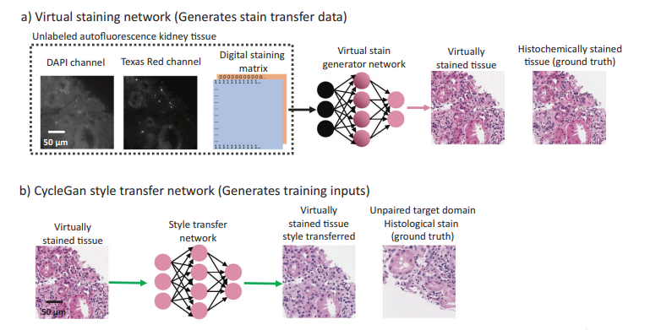
Style Transfer Network (Augmentation)

Slide 12
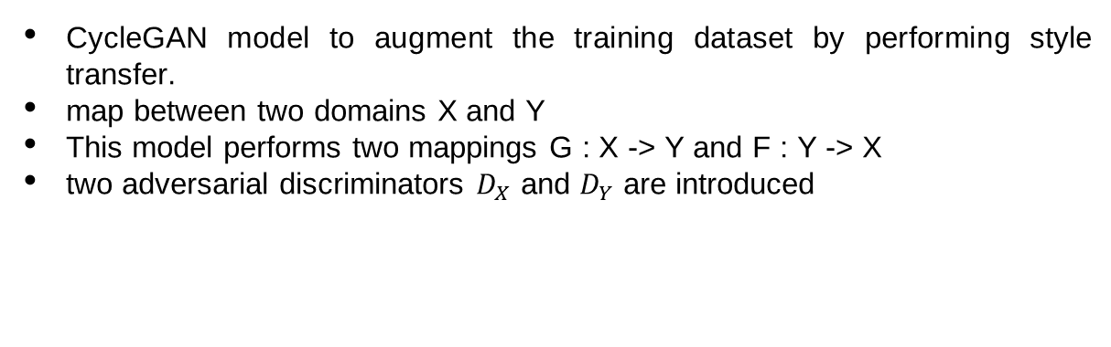
Style Transfer Network (Augmentation)
CycleGAN model to augment the training dataset by performing style transfer.
map between two domains X and Y
This model performs two mappings G : X -> Y and F : Y -> X
two adversarial discriminators $D_{X}$ and $D_{Y}$ are introduced

Slide 13
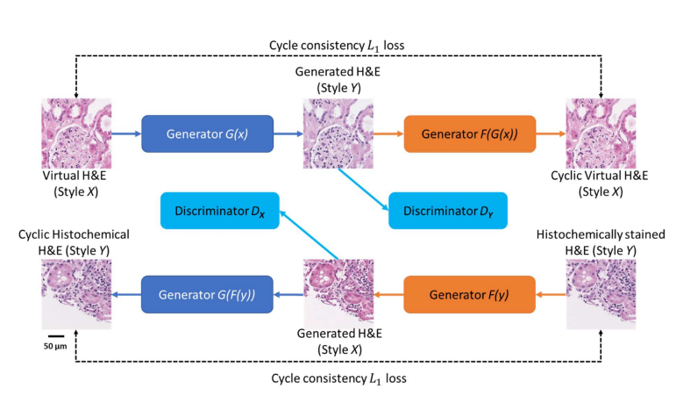
Style Transfer Network (Augmentation)

Slide 14
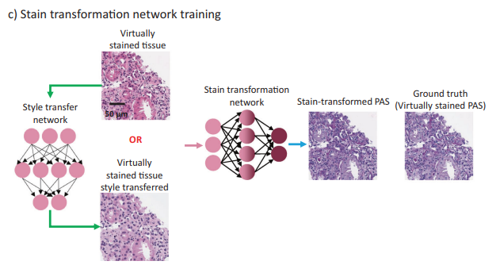
Stain Transformation Network

Slide 15
03
Evaluation

Slide 16
Evaluation
Three pathologists filled out diagnostic information.
Pahse1: diagnosis based on H&E only
3 weeks later
Phase2: diagnosis based on H&E and stain-transformed special stains
3 weeks later
Phase3: diagnosis based on H&E and histochemical special stains

Slide 17
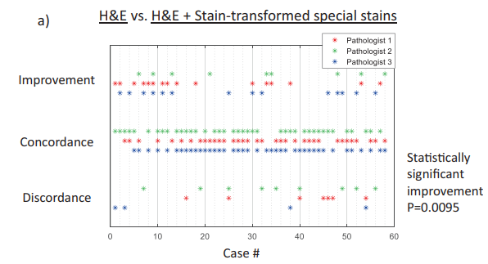
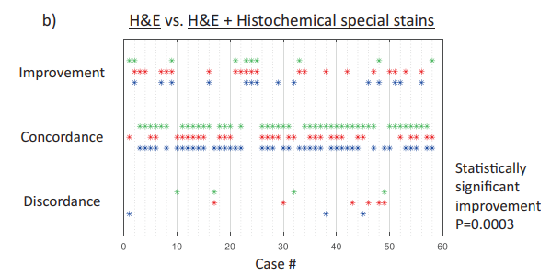
Evaluation

Slide 18
Evaluation of the quality of stain-transformed
3 pathologists rated the quality of various aspects of the stains generated using the stain transformation network as well as the images of histochemically stained tissue from serial tissue sections.
The pathologists scored four aspects of each FOV on a scale from 1 to 4, where 4 is perfect, 3 is very good, 2 is good enough (passable), and 1 is not acceptable

Slide 19
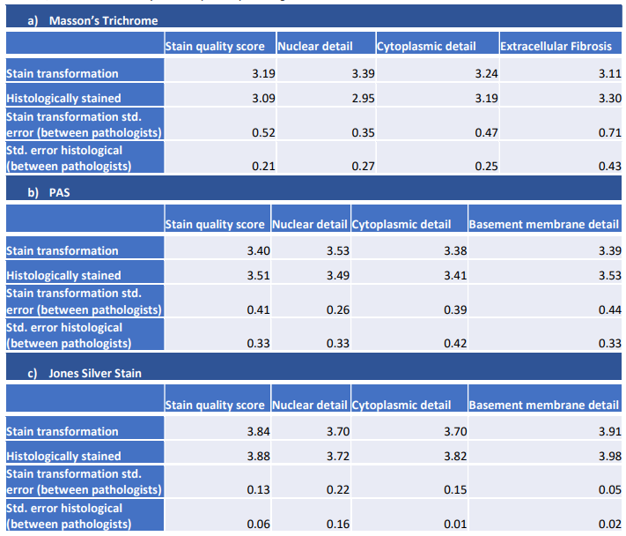
Evaluation of the quality of stain-transformed

Slide 20
Resources
de Haan, K., Zhang, Y., Zuckerman, J.E. et al. Deep learning-based transformation of H&E stained tissues into special stains. Nat Commun 12, 4884 (2021). https://doi.org/10.1038/s41467-021-25221-2

