Slide 1
BITCOIN
Historical Data Analysis Over The Last 14 Years
By “Lisbon Consulting Agency”
Amir & Aru

Slide 2
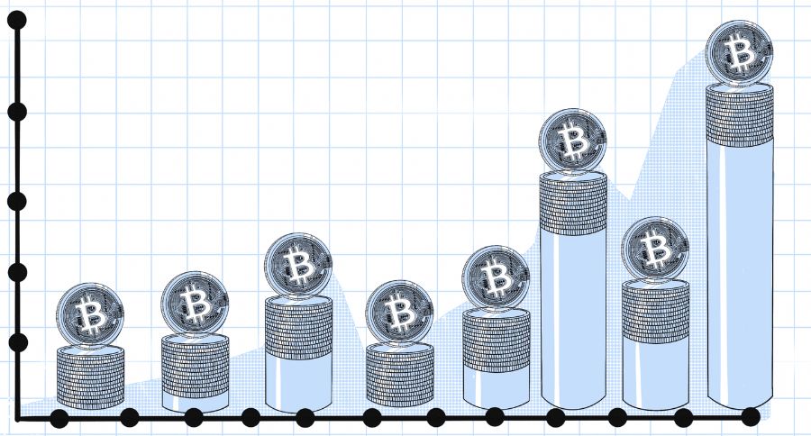
Project Overview
Why Bitcoin?
Bitcoin, as a digital currency, has emerged as one of the most popular and volatile investment assets. Its market attracts both investors and speculators, making it a critical subject for financial analysis.
The purpose of this project is to investigate the volatility and risk associated with Bitcoin by analyzing market data over a span of several years.

Slide 3

Data Structure
The final dataset is a merged collection of two sources: Historical Bitcoin prices (from the CryptoCompare API) and additional enriched data sourced from Kaggle.
Datasets were combined by aligning the dates and ensuring consistent formatting across all observations.
Challenges arose with inconsistent dates, including missing trading volume data and incomplete date formats.
The dataset was enhanced by adding new columns for year, season (derived from the date), and weekend/weekday indicators to analyze volatility trends.
The biggest challenge was working with and integrating data from the API.

Slide 4
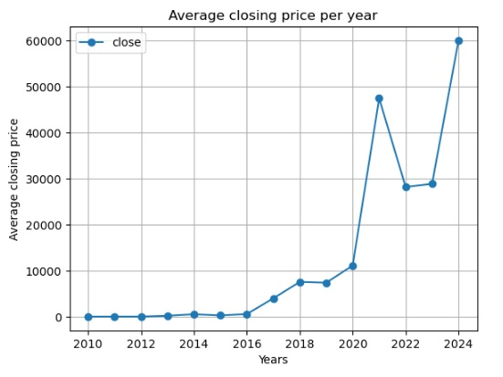
Market Overview over the last 14 years
Bitcoin's average closing price per year has experienced a significant rise, especially after 2017. The sharp spikes in 2021 and 2024 are particularly notable.
This graph highlights that while Bitcoin has experienced explosive growth, it has also been marked by substantial price volatility. This inherent volatility presents both opportunities for high returns and risks for investors.

Slide 5

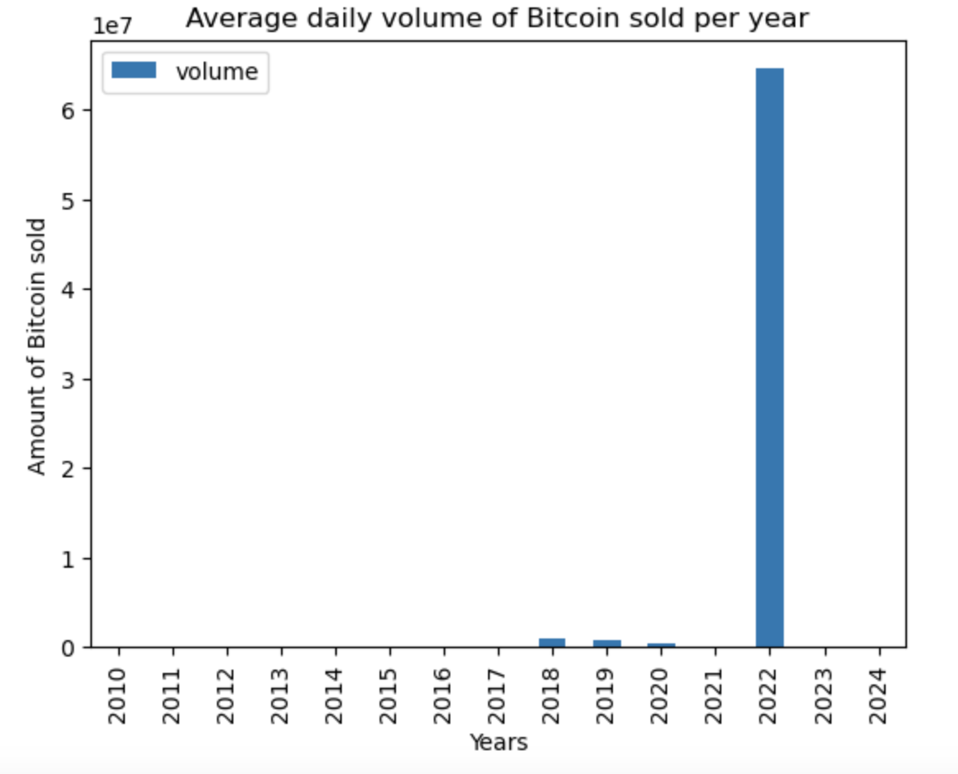
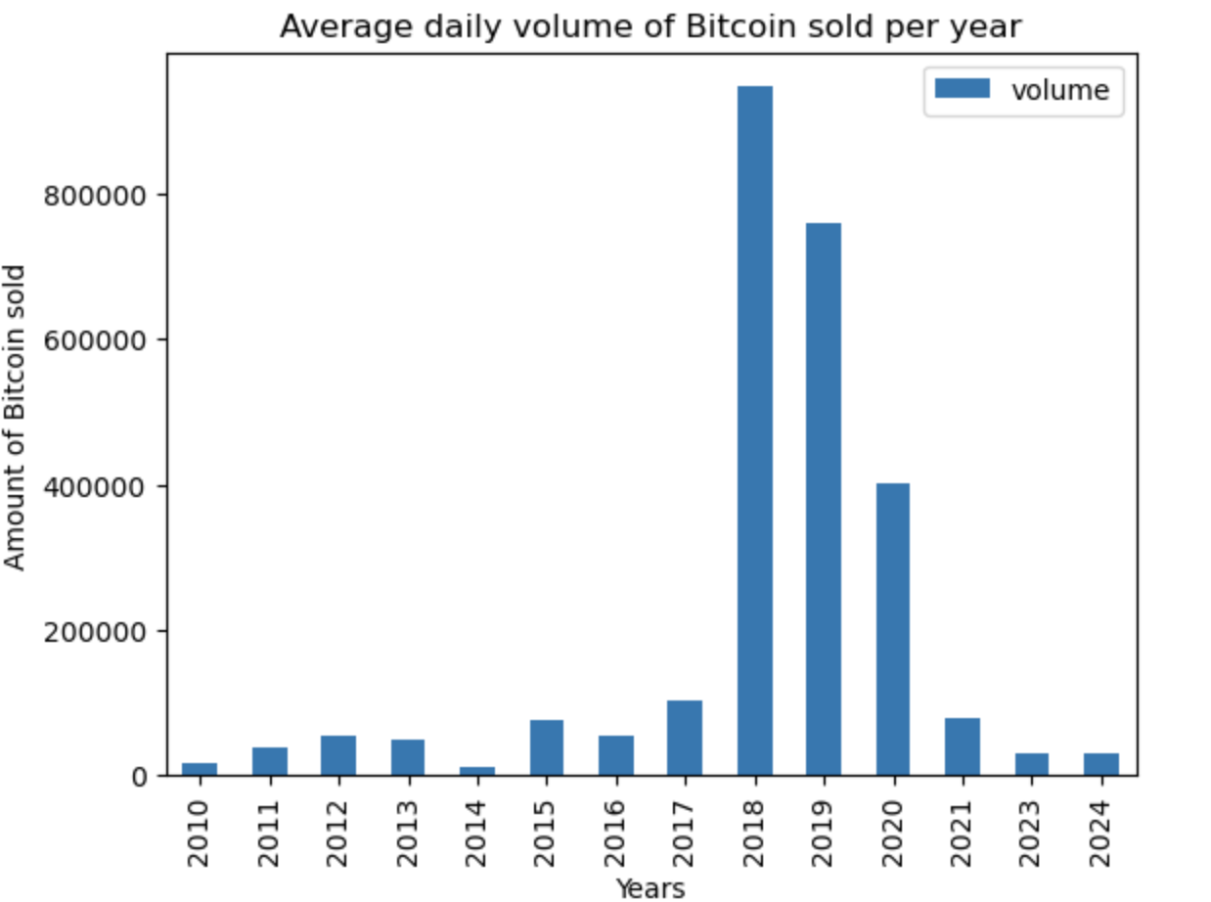
Market Overview over the last 14 years
High Volume in 2022: The high average volume for 2022 suggests that there may have been extremely large 'volume' values in that year compared to other years.
Terra/Luna Crash: In May 2022, the collapse of the Terra blockchain's stablecoin UST and its native token LUNA caused a massive sell-off in the crypto markets.
FTX Collapse: Later in November 2022, the collapse of one of the largest crypto exchanges, FTX, after it was revealed that the company was insolvent, led to further panic.

Slide 6
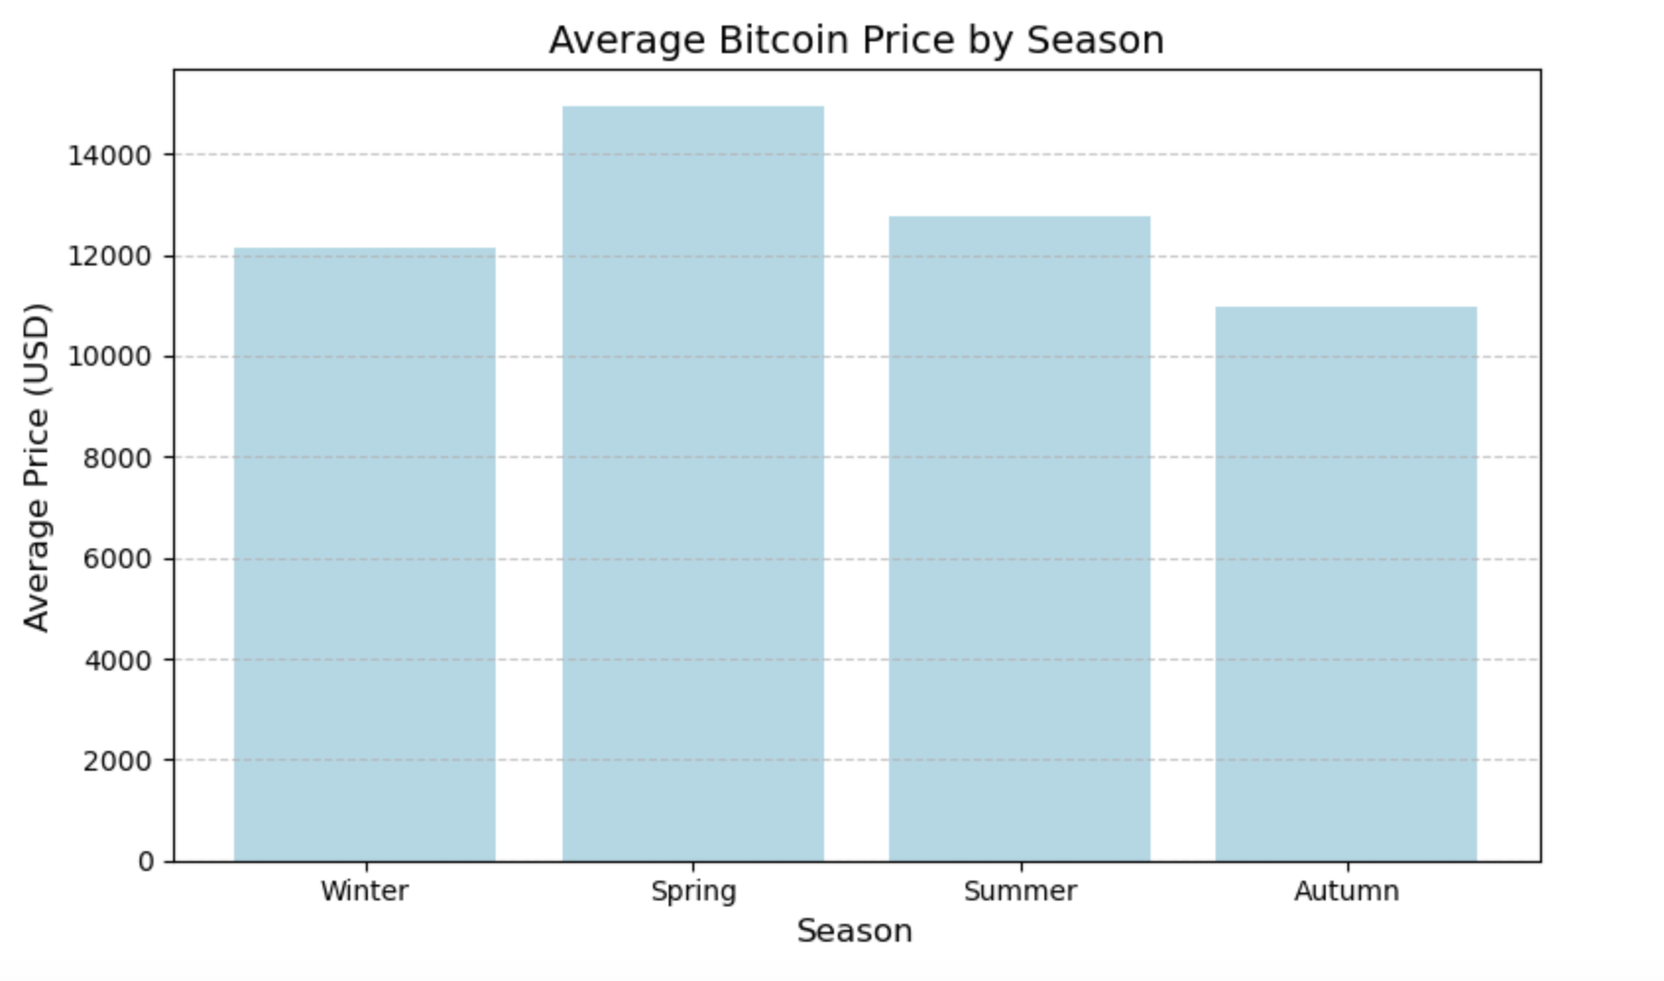
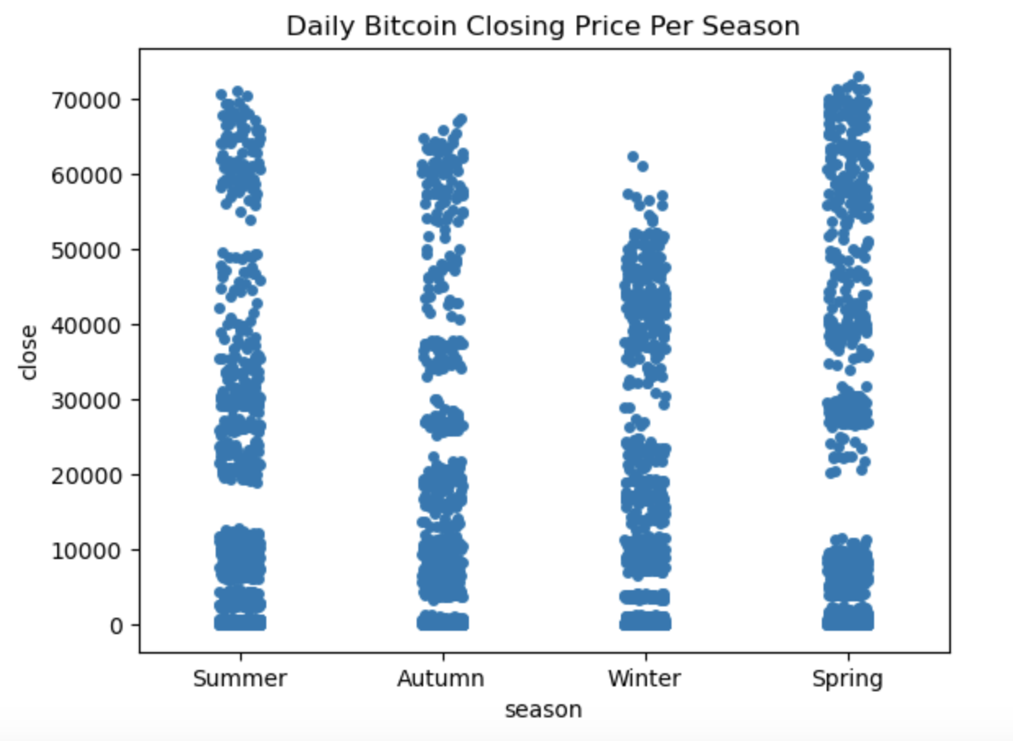
Seasonal Trends in Bitcoin Prices: Spring Surge
While this pattern is present, it's important to explore additional factors like market volume, global events, or regulatory changes to fully understand why spring shows higher prices.
Possible Explanations:
Market Sentiment
Historical Cycles
External Factors

Slide 7
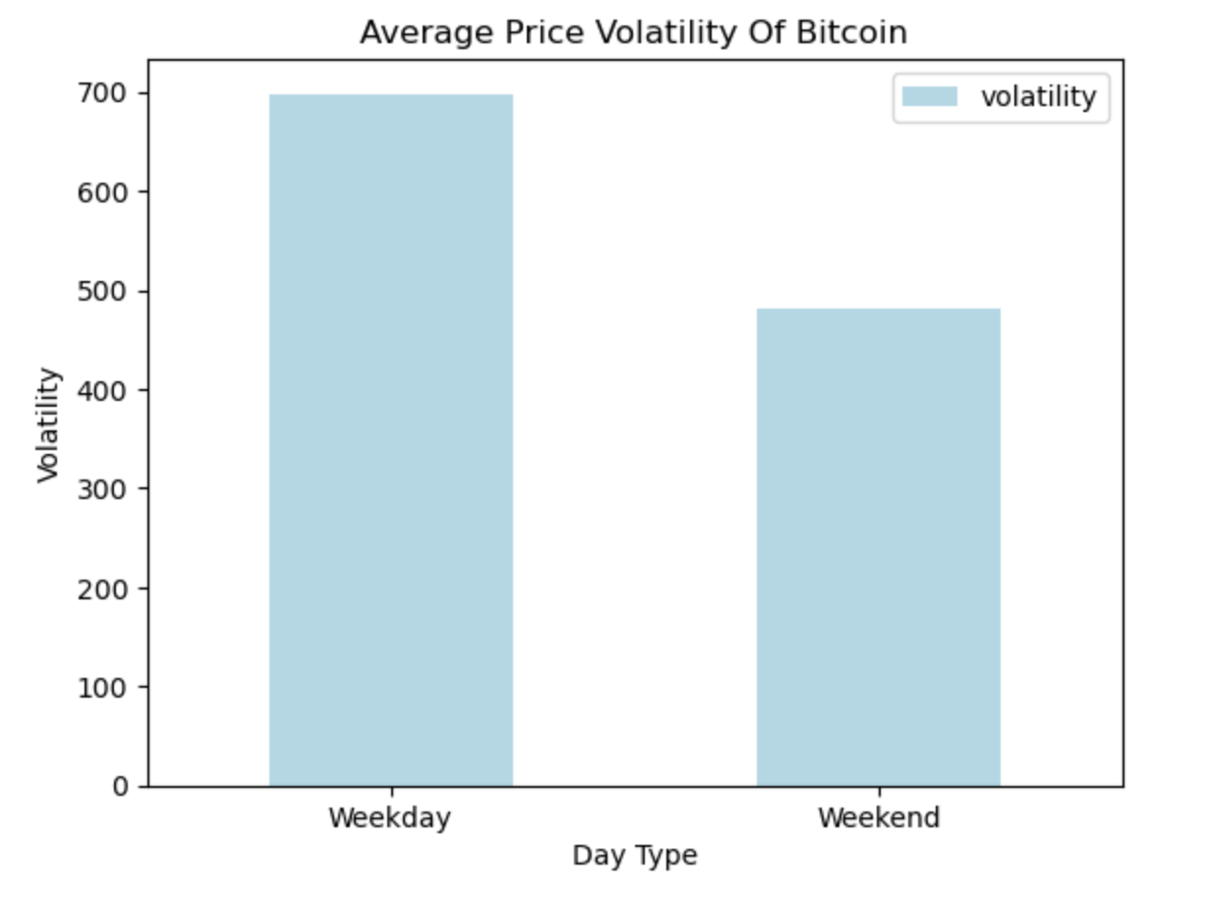
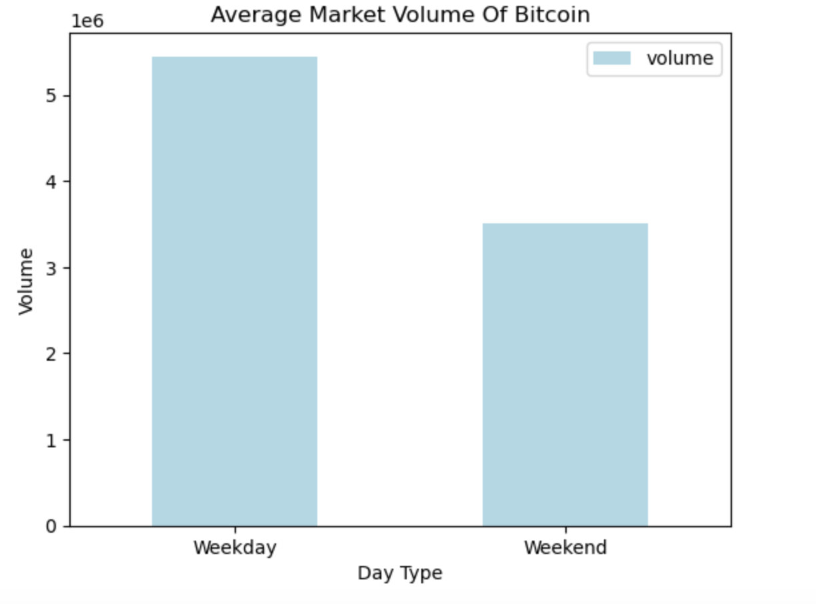
Is Bitcoin More Volatile During Weekdays?
Possible Explanations:
Reduced Trading Activity
Lower Market Participation
Absence of Major Market News
*Price Volatility - difference between the highest price and the lowest price of the day
* Market Volume - amount of Bitcoin traded

Slide 8
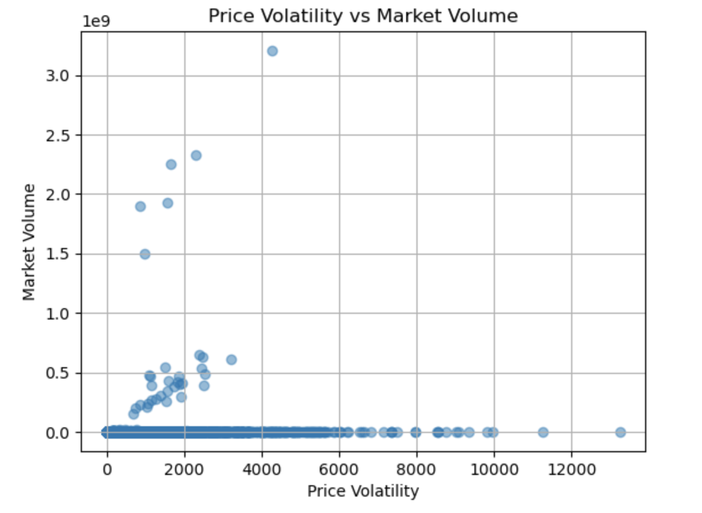
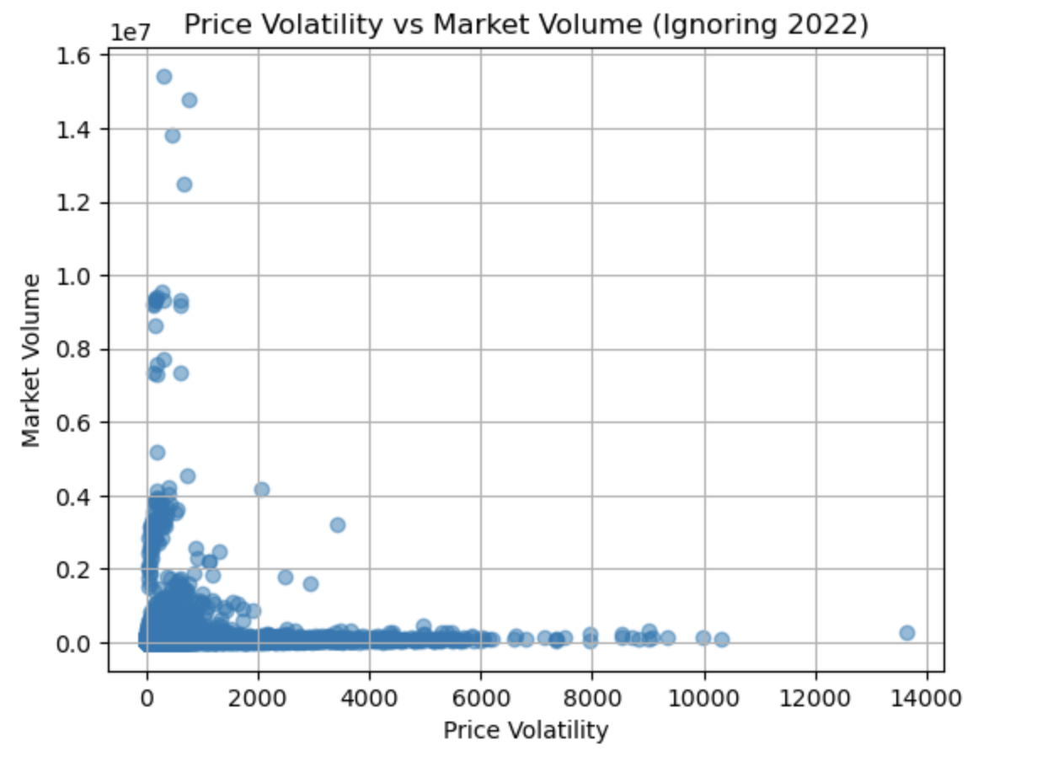
Does Price Volatility Affect Trading Volume?
Key Finding:
Price Volatility and Volume: You might expect higher volatility to increase trading activity, as traders capitalize on price swings, but the data shows that Bitcoin trading volume does not significantly rise in response to volatility.
*Price Volatility - difference between highest price and lowest price of the day.

Slide 9
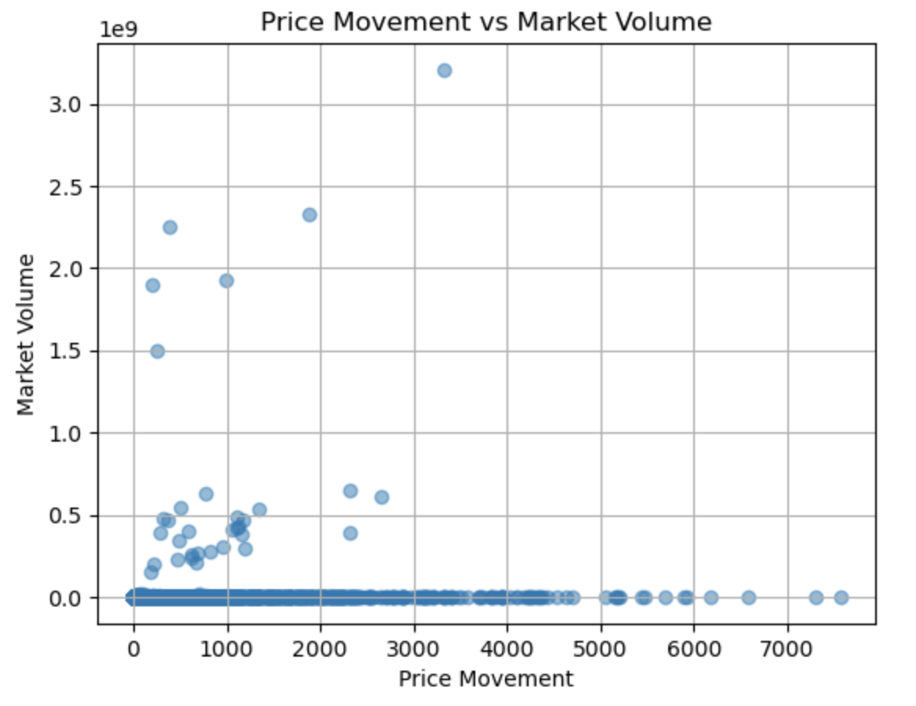
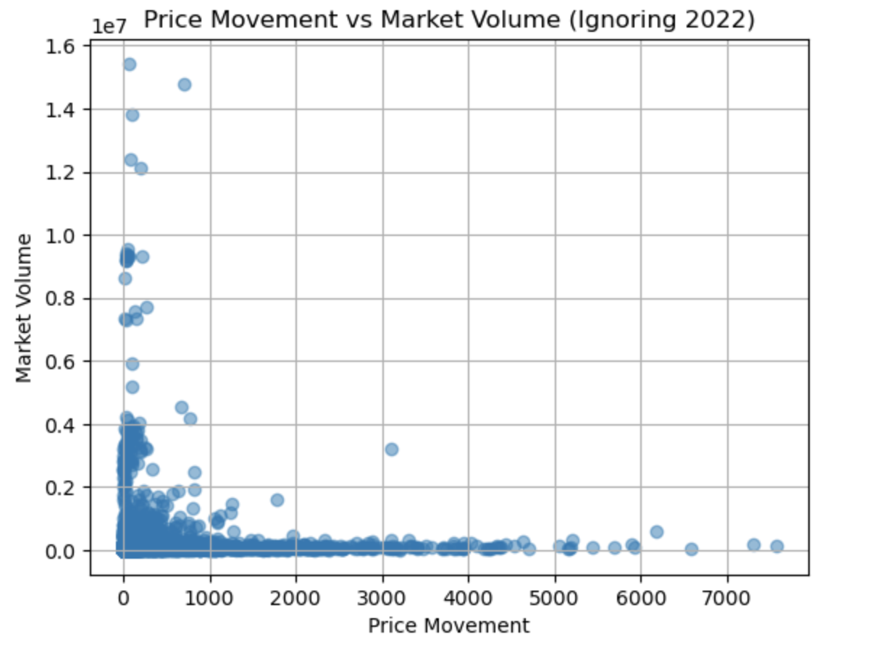
Does Price Movement Affect Trading Volume?
Key Finding:
Price Movement and Volume: Bitcoin trading Volume does not significantly rise in response to Price Movement
*Price Movement - difference between opening price and closing price of the day.

Slide 10
Conclusion
Bitcoin’s current status:
Despite the significant market crash in 2022 and the fluctuations in Bitcoin’s price, including both sharp drops and subsequent recoveries, the current price of Bitcoin stands at approximately $60,000 USD.
Price volatility is independent of trading volume:
Bitcoin may exhibit high levels of volatility due to factors other than trading volume. These could include external market news, regulatory updates, global macroeconomic events, or even speculative trading behavior.
High volatility and risk:
The high standard deviation of 1400 for daily volatility suggests that Bitcoin remains a highly volatile asset. This inherent volatility represents a risk for traders and investors, as prices can swing unpredictably, making Bitcoin both a risky and potentially lucrative asset.

Slide 11

Thank you for your attention!
Analysis done by “Lisbon Consulting Agency”
Amir & Aru

