Slide 1
Real-Time Multi-Sport Scoreboard
A Streaming Data Engineering Platform
NBA | NFL | Premier League | La Liga | Champions League
Apache Kafka + PySpark Structured Streaming + PostgreSQL + Flask + Docker Compose
14 services | 5 Kafka topics | 4 database tables | 3 parallel pipelines

Slide 2
Problem & Goals
The Problem
Sports data generated in real time across multiple leagues, APIs, and formats
Different consumers need different views: fans want live scores, analysts want SQL-queryable data
Must decouple producers from consumers and handle bursty concurrent updates
APIs have rate limits -- need caching, deduplication, and smart polling
Three Parallel Pipelines
Pipeline 1 -- Live Scoreboard UI
Sources -> Kafka -> Flask -> Browser (3s refresh)
Pipeline 2 -- Streaming Analytics
Sources -> Kafka -> PySpark -> PostgreSQL (3 tables)
Pipeline 3 -- Batch Player Stats
ESPN/nba_api -> psycopg2 -> PostgreSQL (every 6h)

Slide 3
Supported Leagues & Data Sources
League
Sport
Data Source
Cost
NBA
Basketball
nba_api Python SDK + ESPN
Free
NFL
American Football
ESPN REST API
Free
Premier League
Soccer (England)
ESPN REST API
Free
La Liga
Soccer (Spain)
ESPN REST API
Free
Champions League
Soccer (Europe)
ESPN REST API
Free
All data sources are FREE with no API keys required
ESPN endpoints: site.api.espn.com/apis/site/v2/sports/{sport}/{league}/scoreboard
Match details: .../summary?event={id} -- goals, cards, subs, commentary, lineups, 20+ stats
Dynamic cache TTL: 3s for live soccer, 5s for live NFL, 30s for finished games

Slide 4
System Architecture
DATA SOURCES nba_api ESPN NFL ESPN PL ESPN Liga ESPN UCL | | | | | v v v v v KAFKA PRODUCERS (Python, 3-10s intervals) Enriched messages: scores + events + stats + lineups | | | | | v v v v v [nba_scores] [nfl_scores] [pl_scores] [liga_scores] [cl_scores] | +---------------+----------------+ v v FLASK SCOREBOARD UI PYSPARK STRUCTURED STREAMING + Match Trackers foreachBatch -> 3 JDBC tables + Tabs: Live/Stats/Lineups | | v v PostgreSQL :5433 Web Browser :5050 (game_scores, match_events, period_scores) PLAYER STATS BATCH FETCHER (every 6 hours) nba_api + ESPN -> psycopg2 -> PostgreSQL (player_season_stats)

Slide 5
Technology Stack
Python 3.11
All producers, UI, Spark job, stats fetcher
Apache Kafka 3.7.0 (KRaft)
Event streaming, topic-based pub/sub, no ZooKeeper
Apache Spark 3.5.0
Structured Streaming, micro-batch to PostgreSQL
PostgreSQL 16
Persistent analytics store (4 tables)
Flask 3.x
Scoreboard UI backend with background Kafka consumer
kafka-python-ng 2.x
Producer + consumer library with retry/backoff
Docker Compose v2
Full-stack orchestration -- 14 services
Kafka UI 0.7.2
Topic and consumer group monitoring

Slide 6
Kafka Layer & Enriched Message Schema
5 Kafka Topics
nba_scores
nfl_scores
premier_league_scores
la_liga_scores
champions_league_scores
Fingerprint Deduplication
Only publishes when scores, statuses,
or play counts actually change
Avoids flooding Kafka with identical data
{ "league": "premier_league", "games": [{ "gameId": "672341", "statusText": "Second Half - 67'", "homeTeam": {"teamName": "Liverpool", "score": 2}, "awayTeam": {"teamName": "Man City", "score": 1}, "periods": [...], "events": [{"type":"goal","minute":23, "player":"Salah","team":"Liverpool"}], "stats": {"possession":["62.3","37.7"], "shots":["15","7"], ...20+ fields}, "plays": [{"minute":"67'", "text":"Goal! Salah header...", "type":"goal"}], "lineups": [{"team":"Liverpool", "color":"#C8102E", "formation":"4-3-3", "players":[...]}] }] }

Slide 7
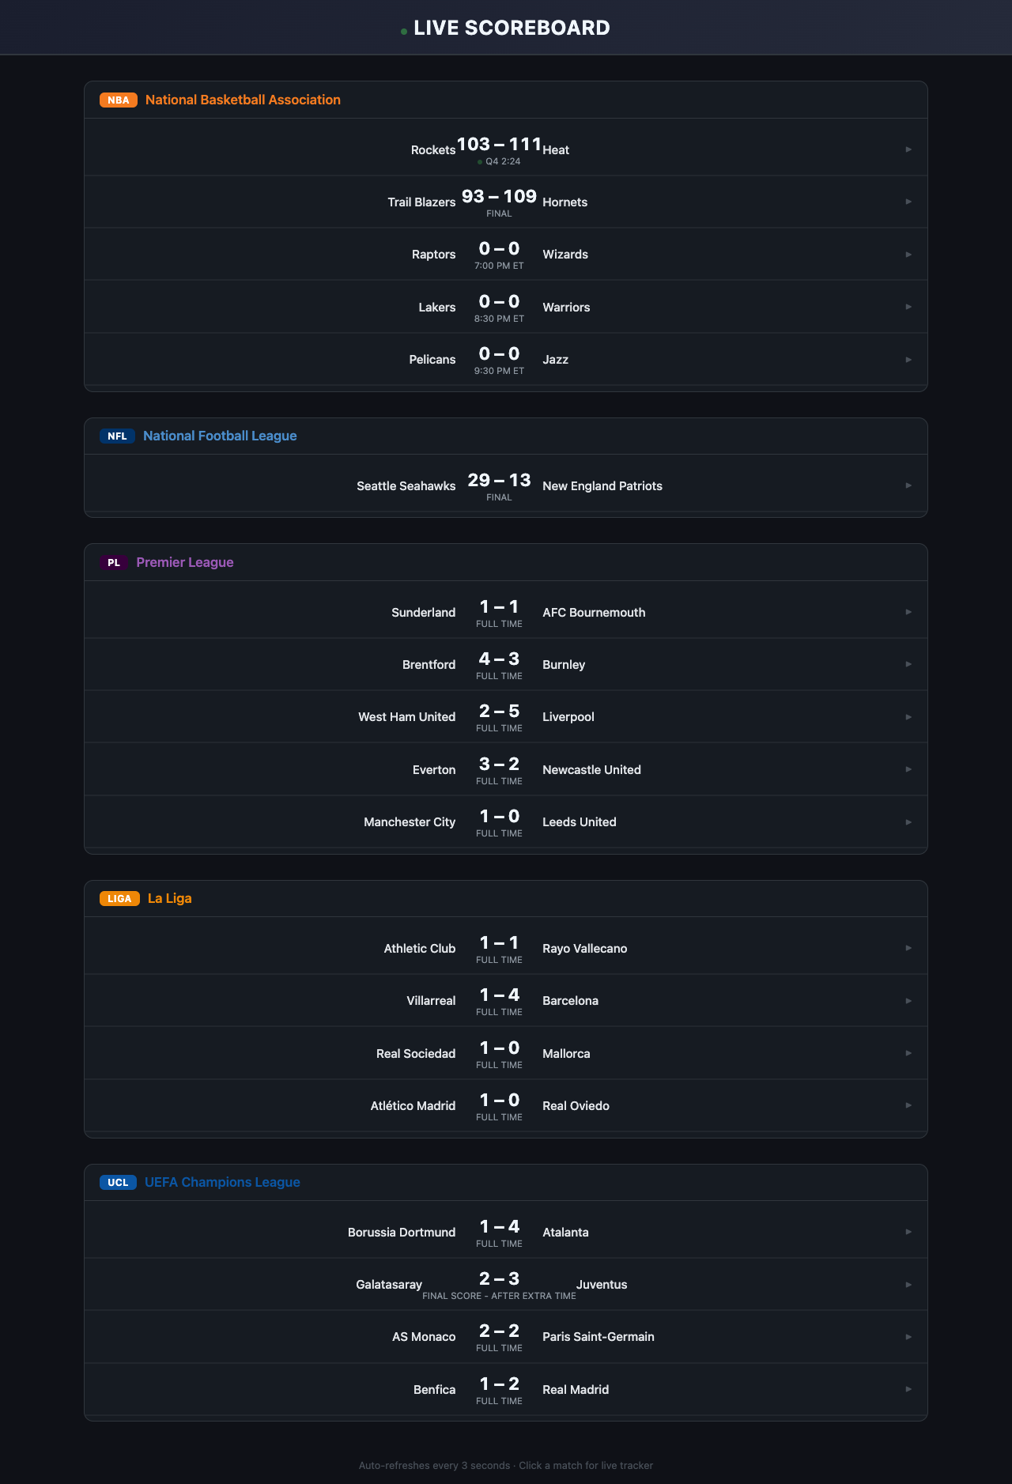
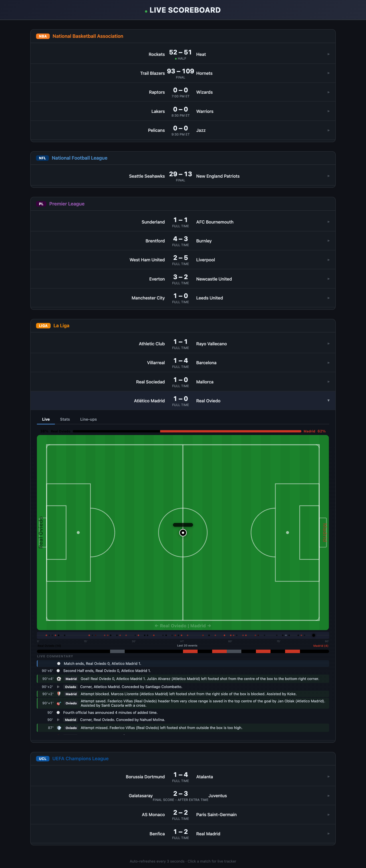
Live Scoreboard UI
Dark-themed web interface at localhost:5050 | Auto-refreshes every 3 seconds | Click any match for live tracker

Slide 8

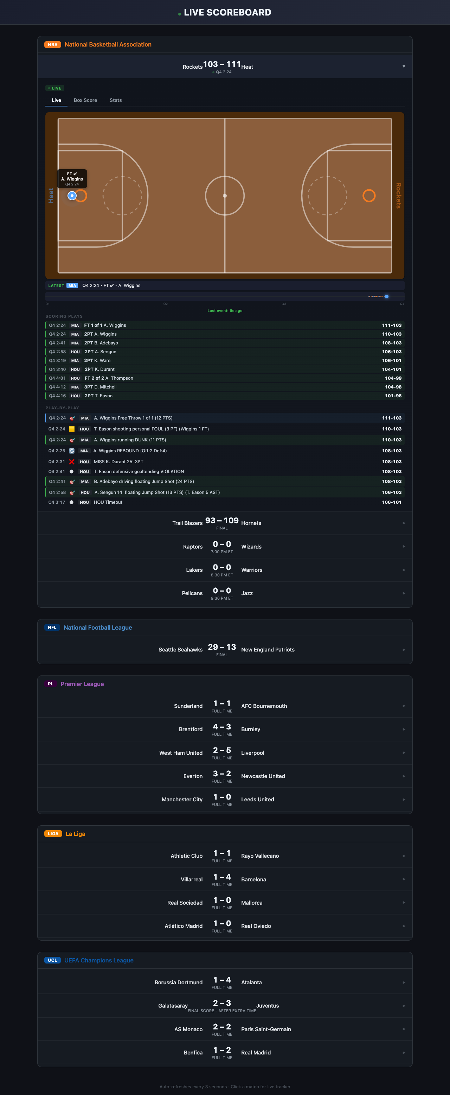
Live Match Tracker Deep Dive
SVG pitch/court/field with animated ball (BallController)
Smooth CSS cubic-bezier transitions between positions
Possession indicator, momentum timeline, live commentary feed
Text-based position inference from ESPN commentary data
Free Data Limitation
ESPN text data: ~60-70% accuracy
Paid feeds (Sportradar/Opta):
100% accuracy, sub-second updates

Slide 9
Spark Streaming to PostgreSQL
Pipeline Stages
1. Read
Spark Structured Streaming subscribes to all 5 Kafka topics
2. Parse
JSON deserialized with enhanced schema (games + events + periods)
3. Transform
explode() flattens into rows for each destination table
4. Write
foreachBatch writes to 3 PostgreSQL tables via JDBC
Target Tables
game_scores
Score snapshots (append-only time series)
match_events
Goals, cards, substitutions (soccer)
period_scores
Quarter/half score breakdowns
Configuration
Trigger: processingTime = 10 seconds
Checkpoint: /tmp/spark_checkpoint/scoreboard_v2
Spark Master: spark://spark-master:7077
JARs: Pre-downloaded at Docker build time (no Maven at runtime)

Slide 10
Code Quality & Engineering Practices
Shared Soccer Engine (DRY)
3 league producers are 12-line wrappers around shared/soccer_producer.py -- eliminates ~500 lines of duplication
HTML Escaping (XSS)
escapeHtml() applied to 40+ dynamic content insertions in the frontend
Structured Logging
All Python files use the logging module with timestamps and severity levels instead of print()
Kafka Retry with Backoff
Consumer wraps in while-True with exponential backoff (3s to 30s max)
Docstrings & Constants
Every public function documented; magic numbers extracted to named constants (MAX_DRIVES, SUMMARY_TTL_LIVE, etc.)
Specific Exception Handling
requests.RequestException, json.JSONDecodeError, KeyError instead of bare except
Pinned Dependencies
All 8 requirements.txt files use version range pins (>=x,<y) for reproducible builds
Docker Image Pinning
kafka:3.7.0, kafka-ui:v0.7.2, postgres:16, spark:3.5.0 -- no :latest tags
Code Review Score: 8.5 / 10

Slide 11
Production Scaling & Future Work
Production Requirements
Future Development
Paid Data Providers
Sportradar, Opta, Genius Sports for real-time x,y coordinate tracking and sub-second updates
ML Predictions
Win probability models trained on historical score progression data
WebSocket / SSE
Replace HTTP polling with push-based updates for lower latency delivery to browser
Horizontal Scaling
Kafka partitions, Spark workers, load-balanced Flask instances
Redis State Store
Cache live match state for instant reads, pub/sub fanout to multiple UI instances
CI/CD Pipeline
GitHub Actions: lint, test, build images, push to container registry
Grafana Dashboards
Connect to PostgreSQL for real-time analytics visualization and alerting
More Leagues
Bundesliga, Serie A, MLS, MLB, NHL -- architecture supports any league with a public API
Key Insight: The #1 bottleneck for live tracker quality is the data source, not the code.
Free ESPN text data achieves ~60-70% tracker accuracy. Paid coordinate feeds (Sportradar/Opta) would bring it to 100%.

Slide 12
Summary
Event-driven architecture with Kafka decouples 5 producers from 3 consumers
Unified enriched JSON schema normalizes heterogeneous data sources
Live match tracker with animated ball, possession, momentum, and commentary
PySpark Structured Streaming writes to PostgreSQL in 10-second micro-batches
Code quality score: 8.5/10 -- logging, docstrings, DRY, pinned deps, XSS prevention
14 Docker Compose services, single command to run the entire platform
Free data sources reach ~60-70% tracker accuracy; paid feeds unlock 100%
How to Run
docker compose up -d --build
Scoreboard: localhost:5050 | Kafka UI: localhost:8080 | PostgreSQL: localhost:5433
GitHub: github.com/dreamgroup-il/nba-proj

