Slide 1

AIRPORT INVESTMENT INTELLIGENCE
Find the next
airport diligence lead
A conversational screen for US airport modernization
Gate 1: identify leads worth the next diligence step
Interview take-home · FDE
Notes:
Open with the customer outcome: the system helps an analyst decide which US airport deserves the next diligence step.
Set the boundary early. The product does not claim terminal ROI or prove the terminal is the binding constraint.

Slide 2
02
The first job is a defensible shortlist
The costly failure is funding a terminal when the binding constraint sits elsewhere.
01
02
03
Find leads
›
Test the constraint
›
Underwrite returns
Quantify demand signals
Terminal, runway, airspace, weather
CAPEX, contribution, NPV
This product owns Gate 1
Every high score remains a lead until separate diligence confirms the intervention and the economics.
Airport Investment Intelligence
02
Notes:
A terminal expansion can fail economically even when passenger growth is real. The pressure may come from runway capacity, airspace, weather, operating agreements, or airline economics.
The three-gate framing converts a broad AI request into a bounded product decision. Gate 1 generates defensible leads. Gate 2 tests the bottleneck. Gate 3 underwrites incremental returns.
Source: DESIGN.md, section 5.

Slide 3
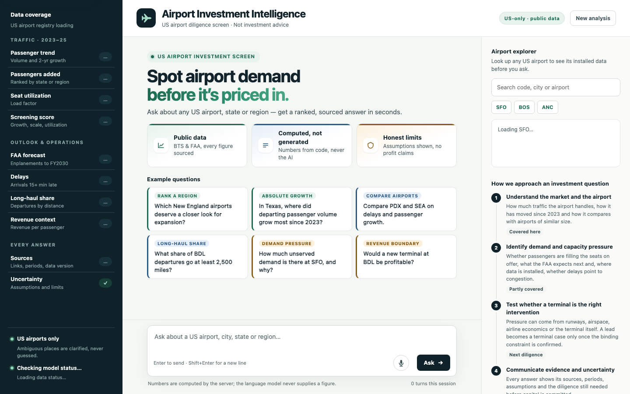
03
One interface supports several diligence questions
The same planner resolves scope, metrics and qualifiers before deterministic tools run.
RANK
Which New England airports deserve a closer look?
COMPARE
Compare PDX and SEA on delays and growth.
ROUTES
What share of BDL departures go 2,500+ miles?
DEMAND
How much demand pressure is visible at SFO?
Live product screenshot · localhost demo
03
Notes:
Use the screenshot to orient the audience before opening the live product.
The browser keeps rendered turns in the current tab. SQLite retains only typed follow-up slots for 24 hours, not full chat history.
The question examples are probes for generic capabilities. The implementation is not hardcoded to the brief's airports.

Slide 4
04
Coverage is broad, but each metric has its own footprint
The system checks airport, metric and period coverage before it calculates.
Coverage rule
Missing is never zero.
An uncovered airport returns a named evidence gap. A comparison proceeds only when both sides use the same definition and period.
BTS + FAA public data
2023–2025 traffic
Installed data coverage · 2026-10-11
04
Notes:
Coverage counts: 1,005 US airports in the registry; 712 airports with FAA TAF outlook; 635 origins with T-100 route coverage; 354 airports with delay coverage; 226 airports eligible for the screening score.
The counts describe the installed snapshot, not daily freshness. The product refuses to substitute a different metric when coverage is missing.
Source: served product coverage panel and DESIGN.md, section 1.

Slide 5
05
The score balances momentum with investable scale
Three deterministic percentiles produce a 0–100 lead score.
40%
35%
25%
Growth
Scale
Utilization
Growth
Scale
Utilization
2-year CAGR vs same-size peers
Annual passengers added vs the US market
Seat load vs same-size peers
Eligibility
36 complete months · ≥100K departing passengers · valid seats · ≥12 cohort peers
Notes:
Growth gets the largest weight because momentum is the primary opportunity signal. Scale is nearly as important because investors monetize volume. Utilization receives the lowest weight because it is only a proxy for service pressure.
Growth and utilization are percentiled within size cohorts. Incremental passengers are percentiled nationally. CAGR is clamped to plus or minus 20 percent before scoring.
The weights are a documented prior, not a fitted truth. Historical deal outcomes would support learning the weights later.
Source: DESIGN.md, section 1.

Slide 6
06
The leading candidates survive reasonable weight changes
PDX remains first while the growth weight moves from 0.30 to 0.50.
Growth 0.30
#1
#2
#3
#4
#5
PDX
GRR
SFO
ORD
TYS
Growth 0.40
#1
#2
#3
#4
#5
PDX
GRR
SFO
ORD
TYS
Growth 0.50
#1
#2
#3
#4
#5
PDX
ORD
GRR
SFO
PVD
4 of the top 5 remain in every run. Each airport also carries a counterfactual score if growth reverts to its cohort median.
Weight sensitivity · scale fixed at 0.35
06
Notes:
The sensitivity varies the growth weight from 0.30 to 0.50, keeps scale at 0.35, and assigns the remaining weight to utilization.
PDX remains first in every run. Four of the top five airports remain in the top five. This tests robustness, but it does not prove the weights are optimal.
The UI does not yet expose the sensitivity view. The calculation and tests already exist.

Slide 7
07
AI interprets the question. Code owns the answer
The model proposes a bounded plan and never sees source data or computes a figure.
01
02
03
04
05
Question
›
LLM plan
›
Validation
›
Tools
›
Answer
Free text + typed follow-up context
Intent, entities, metrics, qualifiers
Schema, allowlist, grounding, bounds
Resolver, coverage gate, SQLite facts
Deterministic analytics + citations
≤ 3 operations
≤ 10 entities
15s timeout
one call per turn
fallback labeled
Any invalid field rejects the whole plan. The server re-resolves every airport and selects the function from a fixed metric map.
Notes:
The LLM receives the question, a typed summary of prior context, and the JSON schema. It never receives the data tables or tool output.
The server validates the full proposal, resolves entities against the US registry, maps metrics to allowed operations, and rejects malformed or ungrounded plans as a whole.
If the model is unavailable or the proposal fails validation, a narrow keyword planner runs and the trace labels the fallback.
Source: DESIGN.md, section 3.

Slide 8
08
A data gap becomes a typed result, not a fabricated answer
The client sees exactly how much evidence supports the response.
computed
partial
insufficient
clarify
out of scope
Full evidence
Useful facts + named gap
Source absent for scope
Ambiguous place or qualifier
Foreign or unsupported metric
No fabricated number
Every visible figure must trace to a structured field, a user input, or a documented template constant.
Airport Investment Intelligence
08
Notes:
A partial answer preserves valid evidence instead of discarding it. For example, a comparison can keep passenger growth while naming a missing delay series.
Demand pressure is partial by design because public sources do not measure turned-away passengers. The answer separates observed facts, analyst-set scenarios, and bottleneck hypotheses.
Unsupported qualifiers are rejected or flagged rather than silently ignored.

Slide 9
09
Versioned source runs keep the demo reproducible
A refresh validates a candidate dataset before one atomic pointer switch.
1
2
3
4
5
Official source
›
Candidate run
›
Validation
›
Active pointer
›
Scoped facts
BTS / FAA export or API
URL, period, SHA-256, rows
Schema, floors, duplicates
One transaction
Parameterized reads
Failed refresh
The last-good run stays active and /health reports the failure.
SQLite is the system of record. snapshot.json only bootstraps the first run.
Airport Investment Intelligence
09
Notes:
Each source import creates a run keyed by source, retrieval time, period and content checksum. Data rows carry run_id. active_source_runs selects the published version.
The importer validates a complete candidate, then switches the active pointer in one transaction. A failed refresh keeps the last-good run.
SQLite fits a single-node take-home: zero service setup, inspectable relational facts, atomic writes and restart continuity. Revisit Postgres when multi-instance writes or remote retention controls appear.
Source: DESIGN.md, section 4.

Slide 10
10
The design favors traceability and a dependable demo
Each shortcut has a clear trigger for replacement.
Decision
Why now
Replacement trigger
Workflow over autonomous agent
Keeps every number reproducible
Revisit for multi-step research
Bundled official exports
Avoids fragile demo-time scraping
Revisit when freshness matters
SQLite on one node
Inspectable, atomic, zero setup
Revisit for multi-instance writes
No answer cache
Queries are cheap; stale context is costly
Revisit with latency evidence
Time-boxed architecture decisions
10
Notes:
The US-only scope matches the investment mandate and avoids spending the time budget on global entity resolution.
The keyword fallback is intentionally narrow. It asks for a simpler phrasing when it cannot resolve safely.
A second model provider sits behind a small interface, but provider selection is configuration rather than a user-facing feature.
Source: DESIGN.md, section 2.

Slide 11
11
Evaluation measures planning and numeric faithfulness
Deterministic behavior passes 32/32. The live model passes the smoke gate at 14/15.
32/32
deterministic runs
PASS ≥ 13
16 cases across missing and full coverage
0
untraceable numbers
0
safety violations
Groq · openai/gpt-oss-120b · median 0.97s
Notes:
The deterministic evaluator runs 16 predeclared cases against both the bootstrap snapshot and the full served dataset. All 32 case runs pass every applicable check.
The live model runs improved from 3 to 12 to 15 correct plans, then 14 on a stability rerun. The smoke gate requires 13. Median end-to-end latency is 0.97 seconds and the maximum is 1.76 seconds.
Fixes changed the system, not the expected labels: add a metric glossary, let the server derive operations from metrics, and reject empty plans so the bounded fallback can run.
Four runs are a smoke test, not an accuracy estimate. Next step: paraphrase variants and repeated trials.
Source: EVALUATION.md, generated 2026-10-11.

Slide 12
12
The lead screen works. The pilot tests business value
The next investment is either safer deployment or richer revenue evidence.
PROVEN
OPEN GAPS
Evidence-first answers
Revenue evidence
Every number is computed and source-backed.
FAA CATS data is not installed for real airports.
Generic question routing
Deployment controls
Novel US airports and regions use the same tools.
Localhost has no user auth or rate limiting.
Measured fallback behavior
Causal capacity diagnosis
The product keeps working when the model fails.
Gate 2 still requires airport-specific diligence.
Pilot metrics
Time to shortlist
Analyst correction rate
Unsupported terminal / profit claims
Shadow pilot against the current manual workflow
12
Notes:
Close on the business hypothesis: reduce time to a defensible shortlist while maintaining zero unsupported terminal-constraint or profit claims.
Pilot the tool in shadow mode against the current manual workflow. Measure time to shortlist, analyst correction rate, and how often users misread a high opportunity score as proof of a terminal bottleneck.
The most valuable next data addition is verified FAA CATS revenue context. The most important deployment addition is authentication and rate limiting.
Current automated verification: 265 unit tests plus the 32 deterministic evaluation runs reported in README.md and EVALUATION.md.

