Slide 1
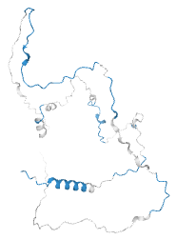
How Sororin controls sister-chromatid cohesion
A floppy (intrinsically disordered) protein switched on and off by phosphate tags and degrons
Sororin (CDCA5) • UniProt Q96FF9 • 252 residues
Amirhossein Rezaei
University of Padova
https://amirh0ss3in.github.io/
AlphaFold model: mostly extended, unfolded chain

Slide 2
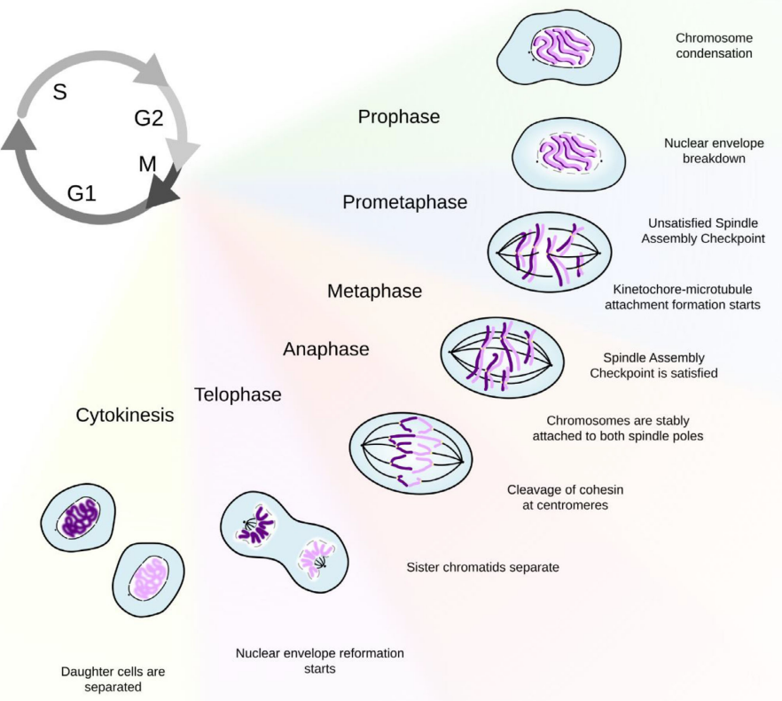
The setup: a competition for the PDS5 seat
SORORIN — the lock
grabs PDS5 via its FGF motif (aa 166–168) → blocks WAPL → ring stays CLOSED → cohesion protected
Cohesin ring
SMC1A · SMC3 · RAD21 · STAG1/2
PDS5
compete for the seat
the docking 'seat'
WAPL — the release factor
when Sororin is switched off, WAPL takes the seat → opens the ring → Cohesin falls off → sisters can separate
2 sister
chromatids
Whoever wins the PDS5 seat decides: Sororin on = glued; WAPL on = released.

Slide 3
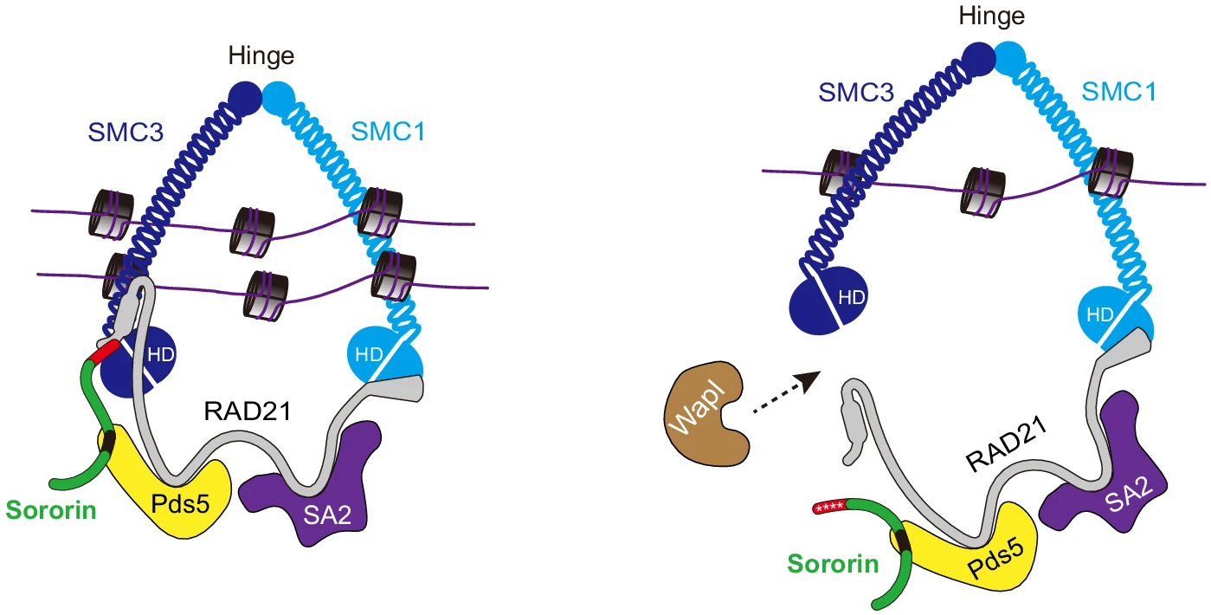
The real structure: Sororin locks the ring; phosphorylation lets WAPL in
LEFT: Sororin (green) docks on Pds5 → Cohesin ring CLOSED, sisters glued. RIGHT: mitotic phosphorylation (red ✱) displaces Sororin → WAPL opens the ring.
Image: Nature Communications, Fig. 9 (see 'PPT images/ref.txt' for full citation) — used for study purposes.

Slide 4
The mechanism, step by step
Kinases (CDK1 & ERK2/MAPK1) Proteins that add phosphate groups to control other proteins. (to our 7 S/T-P sites).
KEN box → APC/C A signal that marks a protein for destruction by APC/C (a protein complex).
SPOP degron → SPOP A signal that allows SPOP (a protein) to recognize and remove a protein.
Motif (Short Linear Motif, SLiM) A short sequence pattern (typically 3–10 amino acids) that provides a specific interaction site for proteins. Motifs act as molecular “docking sites” for regulators, enzymes, or binding partners. They can control processes such as signaling, localization, degradation, and protein–protein interactions.
Cohesin ring traps the two sister chromatids
SMC1A · SMC3 · RAD21 · STAG1/2 + PDS5 (docking subunit)
Sororin binds PDS5 via its FGF motif (aa 166–168)
→ blocks WAPL → ring stays CLOSED → cohesion protected
Two ways to switch Sororin OFF
① PHOSPHORYLATION
temporary · reversible
Kinases CDK1 (on schedule) & ERK2/MAPK1 add PO₄ to 7 proline-directed sites (Ser/Thr–Pro):
Ser21, Ser75, Ser79, Thr111, Thr115, Thr159, Ser209
→ negative charge disrupts the FGF–PDS5 grip → Sororin displaced (a phosphatase can remove it)
ERK2 → Ser209 drives lung cancer
② DEGRADATION
permanent · irreversible
Degrons (short 'destroy-me' motifs) are read by shredding machines:
KEN box (aa 88–90) → APC/C
SPOP degron → SPOP
→ add ubiquitin tag → proteasome destroys the whole Sororin protein
SPOP loss → Sororin piles up (prostate cancer)
Sororin OFF → WAPL binds PDS5 → Cohesin ring OPENS
Sister chromatids separate (mitosis / anaphase)
KEY INSIGHT — every switch element (FGF motif, KEN box, SPOP degron, all 7 phospho-sites) sits in an intrinsically DISORDERED region (61.5% of Sororin; only the C-terminal domain aa 230–252 is folded). Floppy chain + short motifs = easy to switch → Sororin is a “fuzzy hub.”

Slide 5
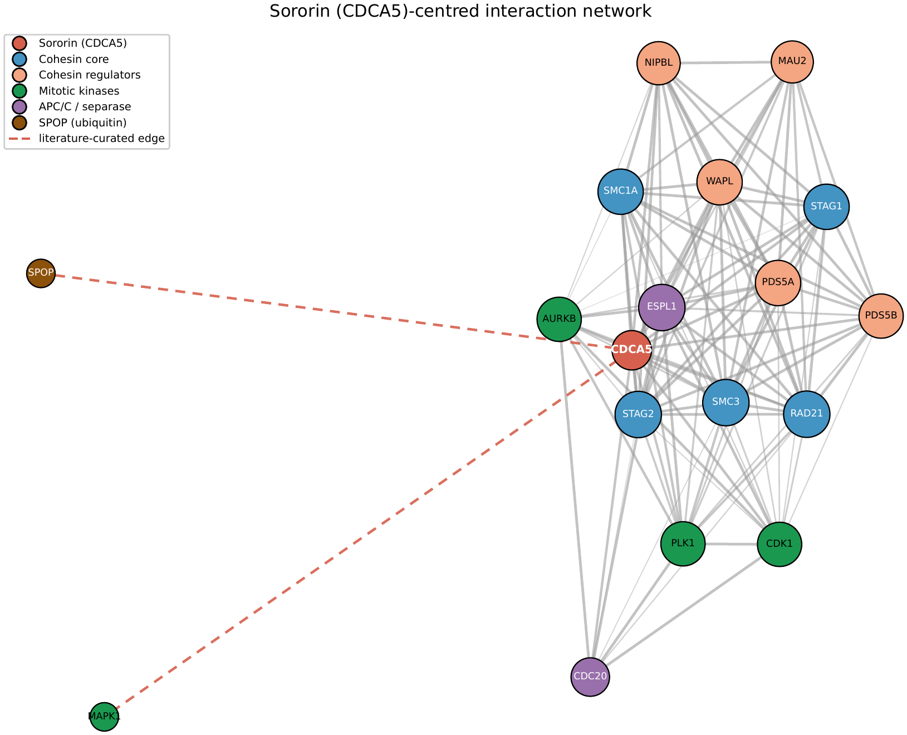
Result 1: Sororin sits in a dense Cohesin network
16 nodes · 107 edges · density 0.89
Sororin degree = 15 of 15 (a hub)
Partner | Functional class | STRING
PDS5A | Cohesin regulator | 0.999
WAPL | Cohesin (release) | 0.998
SMC3 | Cohesin core | 0.994
RAD21 | Cohesin core (kleisin) | 0.988
CDK1 | Mitotic kinase | 0.979
CDC20 | APC/C activator | 0.938
ESPL1 | Separase | 0.930
( … 15 high-confidence partners total )
ERK2 / SPOP | literature edges (dashed) | —
Complete Cohesin regulatory pathway
Figure 1 — STRING interaction network (dashed red = literature-curated ERK2/SPOP).
loading (NIPBL·MAU2) → the ring (SMC1A/3 · RAD21 · STAG) → maintain/release (PDS5 · WAPL · Sororin) → mitotic control (CDK1 · PLK1 · AURKB) → destruction & cut (APC/C·CDC20 · separase ESPL1).
Sororin's high-confidence partners form one tight cluster — the Cohesin machine. Density of 89% of all possible links are present; Sororin touches all 15 others (degree 15/15 = a hub), with its strongest edges to exactly the expected partners (PDS5A, WAPL, the Cohesin core, CDK1). → the network indicates Sororin is the central hub of a tightly-coupled physical complex.
Honest point: density is high partly because I curated the Cohesin proteins. So, density describes the module, it doesn't prove it. The network here isn't really where the new result is. It reproduces biology that's already established experimentally, which tells me the pipeline works, and it gives me the ranked partner list I need later to filter motifs.
How obtained: UniProt (sequence) → STRING API (network) → networkx (metrics, code) → Cytoscape + stringApp (independent check + enrichment, desktop)

Slide 6
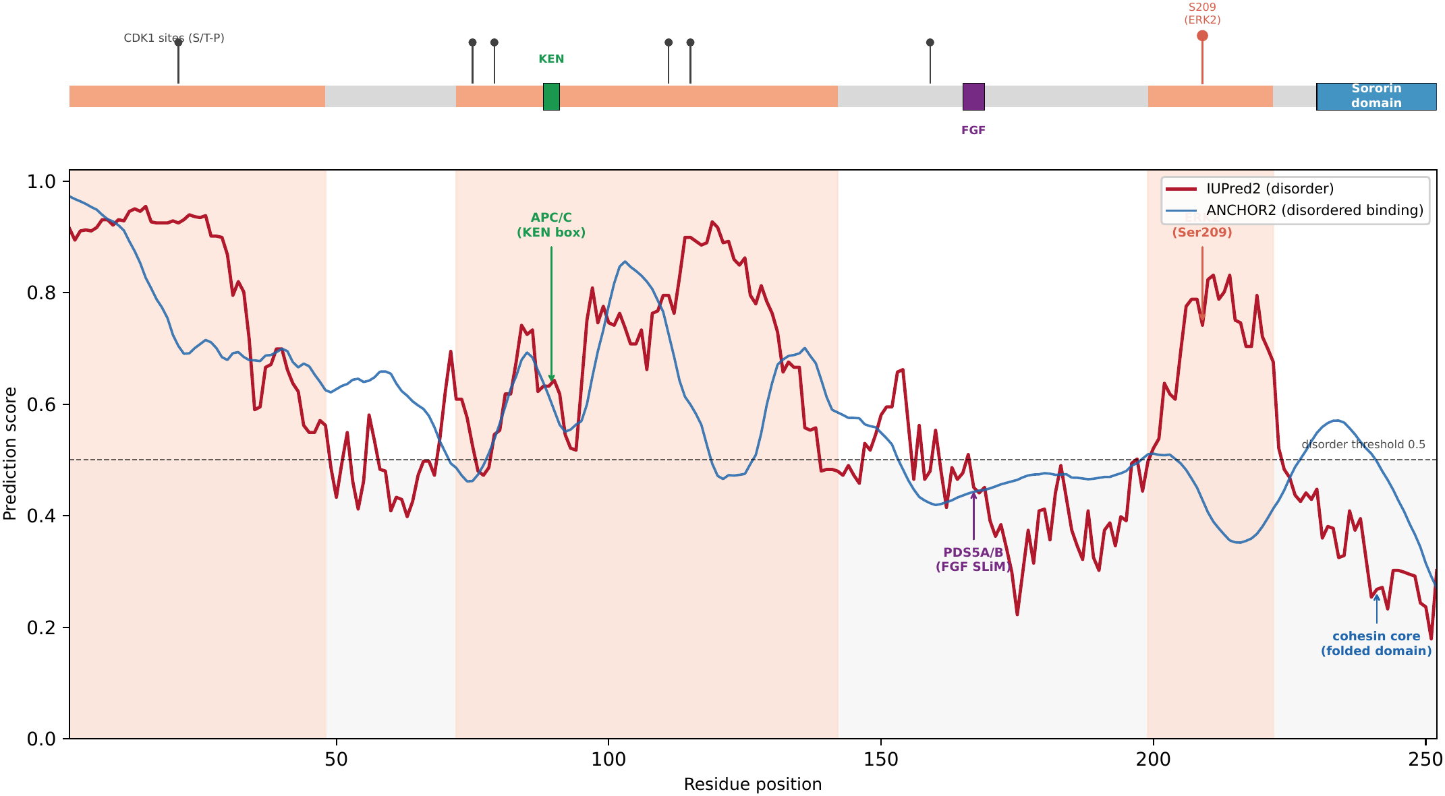
Seeing it: Sororin is mostly disordered
UniProt — the annotation
(the orange-red bands)
Curated, experimentally supported regions. For Sororin: three IDRs (1–48, 72–142, 199–222) and the folded C-terminal Sororin domain (230–252), shown as the reference annotations on the disorder map.
IUPred2 — disorder prediction
(the red curve)
A per-residue score from 0 to 1; > 0.5 = predicted disordered. 61.5% of Sororin scores above 0.5. The prediction uses only the amino acid sequence, without needing a known structure or similar protein.
ANCHOR2 — disordered binding
(the blue curve)
A per-residue score from 0 to 1; > 0.5 = predicted disordered binding region. 63.1% of Sororin scores above 0.5, covering the KEN box, the phospho-cluster and the approach to the FGF motif (almost). These regions are disordered when alone, but fold into a stable shape when they bind a partner; showing where the flexible chain actually does its interacting.
IUPred disorder profile: 61.5% disordered (red curve above 0.5). Only the C-terminal domain (aa 230–252) folds; the KEN box, FGF motif and Ser209 all sit in disordered regions.
Every binding handle and switch lives in these disordered regions → Sororin is a “fuzzy hub.”

Slide 7
The determinants sit in disorder — the numbers behind the map (Table 3)
Determinant | Residues | Partner / role | Mean IUPred2 (% dis.) | Structural context
N-terminal IDR | 1–48 | loading / regulation | 0.82 (100%) | disordered
KEN box | 88–90 | APC/C (degradation) | 0.64 (100%) | disordered
Central IDR | 72–142 | phospho-cluster | 0.70 (90%) | disordered
FGF motif | 166–168 | PDS5A/B (cohesion) | 0.47 (33%) | SLiM / ordered dip in IDR
Ser209 site | 199–222 | ERK2 (phosphorylation) | 0.71 (96%) | disordered
Sororin domain | 230–252 | cohesin core association | 0.31 (0%) | folded
Only the C-terminal Sororin domain is folded (0.31, 0% disordered) — the Cohesin anchor. Every other determinant sits in disorder.
The apparent exception — the FGF motif (0.47) — is a short-ordered dip inside disorder: the classic Short-Linear-Motif (SLiM) signature — it becomes structured locally only to grab PDS5, which supports the fuzzy-hub picture rather than contradicting it.
→ Sororin engages multiple partners through short linear motifs (SLiMs) embedded within intrinsically disordered regions = a fuzzy interaction hub.
Superimposing the experimentally-defined interaction determinants onto the disorder profile revealed that they lie — almost without exception — in disordered segments.

Slide 8
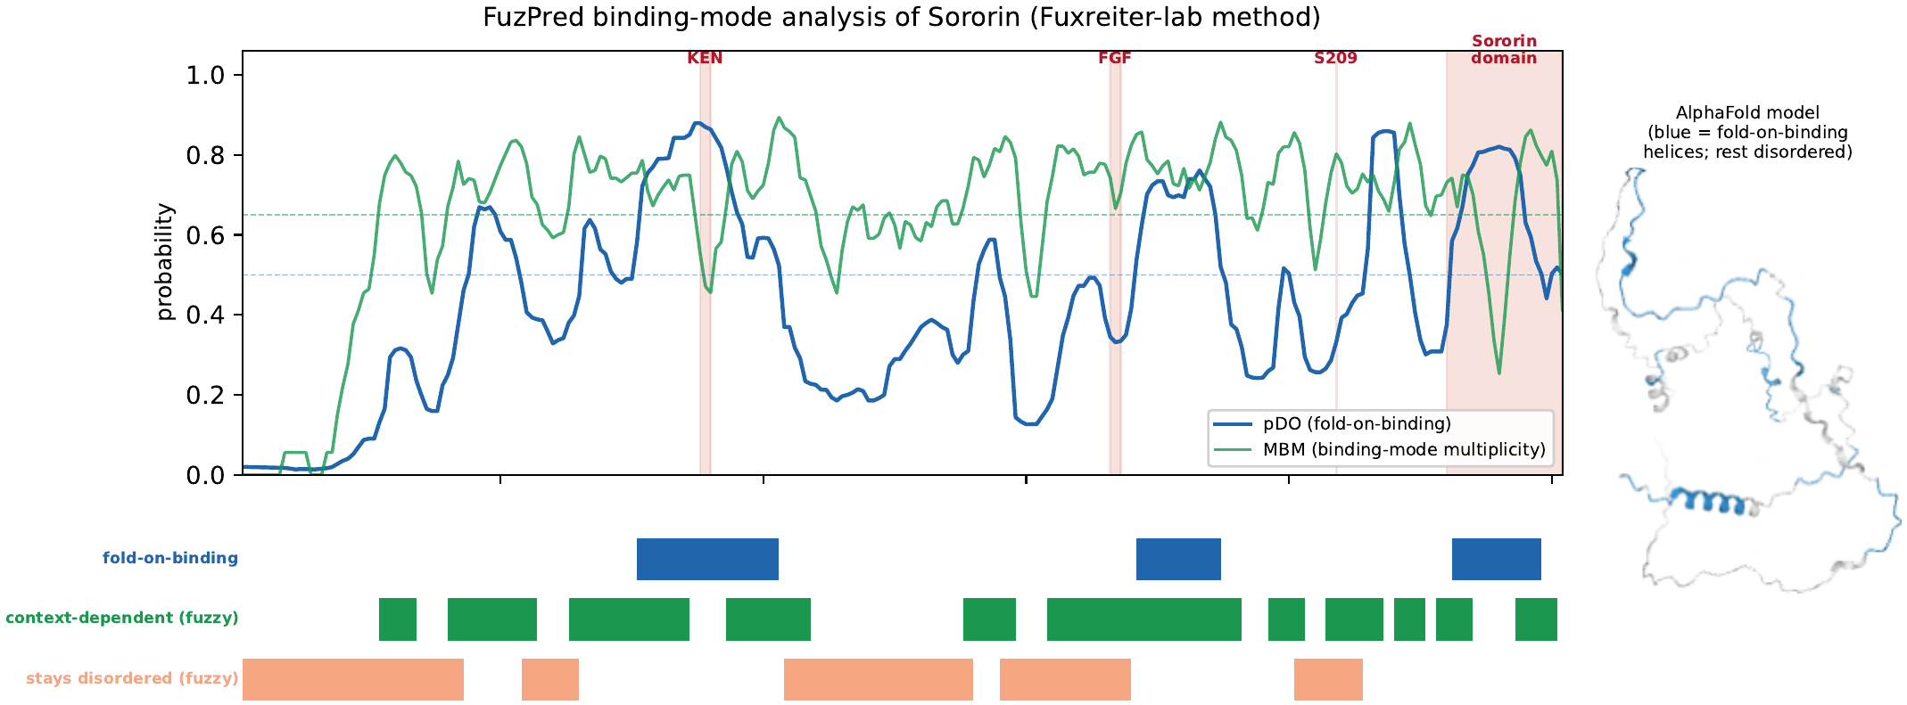
FuzPred — does each region fold, or stay fuzzy, when it binds?
pDO :
the probability that a residue folds when it binds (disorder-to-order); its complement, pDD, is the probability it stays disordered while bound.
MBM:
multiplicity of binding modes: the probability that a residue can bind in several different conformations rather than one fixed way.
Figure 4 (FuzPred): pDO blue · MBM green · region tracks · AlphaFold model
The direct test of ‘fuzzy’
FuzPred (Fuxreiter's lab) predicts, per residue, whether a region folds on binding (pDO) or stays fuzzy, and how many binding modes it can adopt (MBM).
median pDO 0.40 · 68% multi-mode
63% context-dependent · only 25% fold-on-binding
→ Sororin binds predominantly fuzzy & multi-mode = a fuzzy hub, confirmed by her own method.
IUPred vs FuzPred — two different questions
IUPred asks: is this region disordered on its own (free)?
FuzPred (pDO) asks: when it binds, does it fold?
So the KEN box is disordered when free (IUPred 0.64) but folds when bound (pDO 0.87) — a disorder-to-order (fold-upon-binding) element. No contradiction.
→ disorder = the free state; FuzPred = the binding mode. Sororin's disordered regions aren't all alike: most stay fuzzy, the KEN degron folds.
What each determinant does when it binds
FGF motif — pDO 0.34, MBM 0.70 → stays fuzzy, multi-mode
Ser209 (ERK2) — pDO 0.33, MBM 0.80 → stays fuzzy, multi-mode
KEN box — pDO 0.87 → folds on binding (degron grabbed by a folded machine)
C-terminal domain — pDO 0.66 → folds (the one folded element)
→ most sites bind fuzzy; only the KEN degron and the folded domain fold.

Slide 9
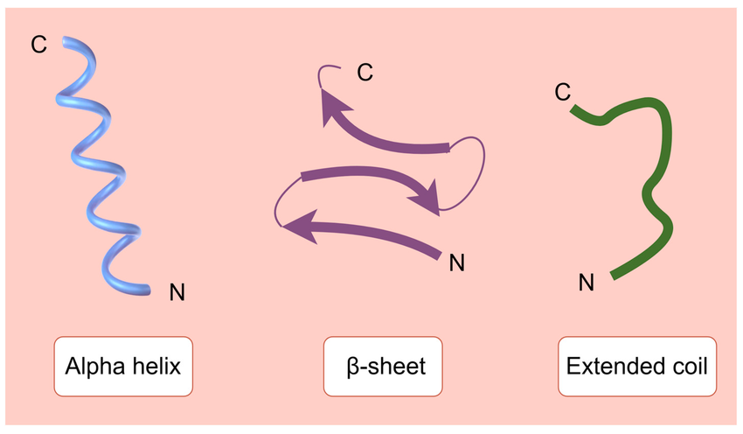
Result 4 - robustness: three more methods, one architecture (the disorder is not an artifact of analysis method)
IUPred2 + ANCHOR2
disorder — our §3.2 baseline
61.5%
disordered
DISOPRED3
2nd disorder predictor — different algorithm
63.9%
disordered
PSIPRED 4.0
secondary structure — uses an evolutionary profile (MSA)
78.2% coil
18.7% helix · 3.2% strand
GOR IV
secondary structure — single sequence only
58.3% coil
34.9% helix · 6.7% strand
≈
2.4%
All four converge on one ordered element → the C-terminal Sororin domain (230–252). PSIPRED 70% helix (83% H/E) · GOR IV 83% helix, only 4% coil (its longest helix, 223–248, is that domain) · DISOPRED3 0% disordered.
Per region — PSIPRED vs GOR IV, with DISOPRED3 disorder (Table 6)
Region | Residues | PSI %H | PSI %C | GOR %H | GOR %C | % dis.
N-terminal IDR | 1–48 | 0 | 100 | 0 | 94 | 100
Central IDR | 72–142 | 21 | 79 | 39 | 58 | 85
C-terminal IDR | 199–222 | 8 | 92 | 38 | 62 | 46
KEN box (APC/C) | 88–90 | 0 | 100 | 0 | 100 | 100
MAPK docking (ERK2) | 77–84 | 12 | 88 | 38 | 62 | 100
SPOP degron 1 | 122–126 | 0 | 100 | 40 | 60 | 100
FGF motif (PDS5) | 166–168 | 0 | 100 | 0 | 67 | 0
PLK1 motif | 201–207 | 0 | 100 | 0 | 100 | 0
Sororin domain | 230–252 | 70 | 17 | 83 | 4 | 0
What they label — helix / strand / coil
Illustration: Molecules 2024, DOI 10.3390/molecules30010128

Slide 10
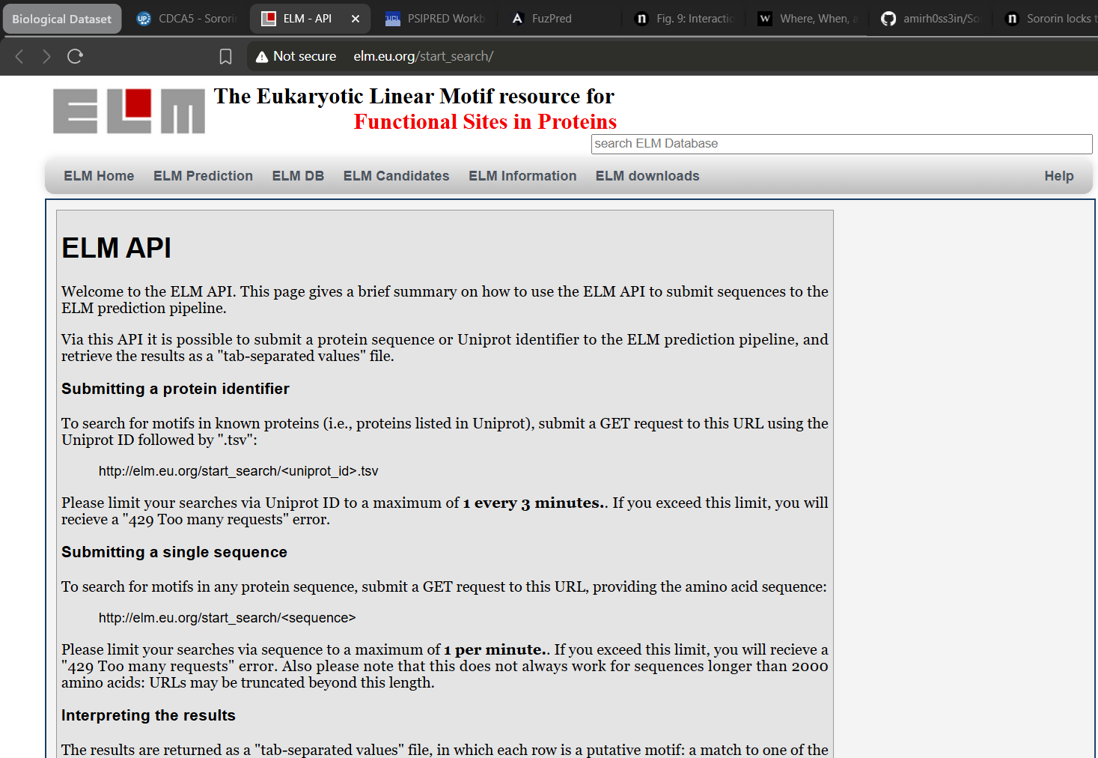
The Eukaryotic Linear Motif resource for Functional Sites in Proteins (ELM)
1 · Scan the sequence
ELM matches its ~350 known motif patterns against all 252 residues.
→ 159 hits, 53 classes
Patterns 3–10 residues long match by chance constantly, so most of these are noise.
2 · Filter by partner
Every motif class is read by a known protein. Keep a hit only if that protein is in my cohesin network.
→ 159 cut down to 14
4 · How much is proven?
Exactly one of the 14 is experimentally documented — the KEN box. UniProt has it at 88–90; ELM flags it as a known instance and matched 87–91.
A sanity check that the screen finds the known case, not a blind discovery. The other 13 are predictions.
3 · What the 14 are
9 CDK1 proline-directed sites
2 SPOP degrons (122–126, 155–159)
1 MAPK docking motif (77–84)
1 PLK1 site (201–207)
1 KEN box (87–91)
Five partners, one sequence address each.
Why this matters here: 11 of the 14 motifs are majority disordered (mean IUPred2 0.65). So it is not just that Sororin is floppy — the specific sequences that specific partners read sit inside the floppy regions.
↓
Conclusion — Sororin is a fuzzy cohesin hub.
A mostly disordered chain carrying short linear motifs interleaved with phospho-sites, so kinases and ubiquitin ligases can switch individual contacts on and off without remodelling a folded core — an efficient, multiply-regulated switchboard for cohesin.

Slide 11
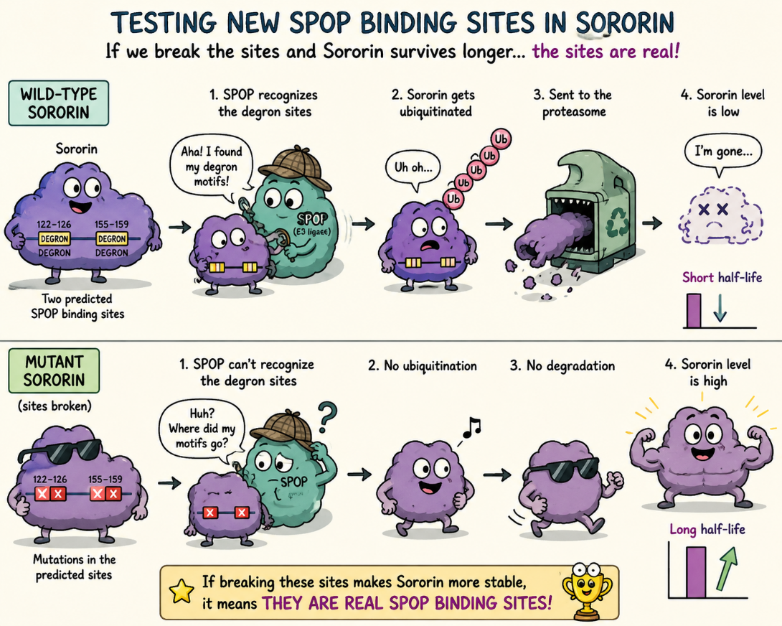
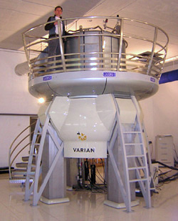
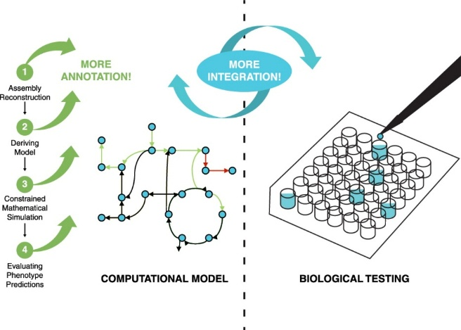
Future directions — testing the predictions
This is a computational study — everything here is a prediction. The natural next step is to test those predictions in the lab, rather than only predicting them.
1 · See it directly
Solve the real 3-D structure of Sororin bound to its partner PDS5, to confirm with your own eyes that it stays disordered when it binds — instead of only predicting it.
2 · Test the new binding sites
The two predicted SPOP sites (residues 122–126 and 155–159) are the novel finding. Break them by mutation and check whether Sororin then survives longer — if it does, the sites are real.
3 · Back the predictions up
Apart from the KEN box, the motifs found here are predictions, not confirmed results — they remain hypotheses still to be tested experimentally.
A 900 MHz Nuclear Magnetic Resonance instrument with a 21.1 T magnet at HWB-NMR, Birmingham, UK
In one sentence: the study is computational, so the honest next step is experimental confirmation of what it predicts.

Slide 12
Thank you for your attention!

Slide 13
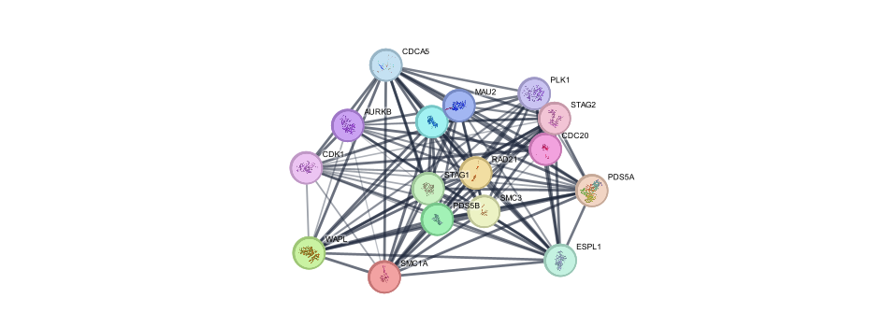
Confirmed independently: Cytoscape + functional enrichment
Source | Enriched term | FDR
GO Process | Sister chromatid cohesion | 1.4e-24
GO Process | Sister chromatid segregation | 2.3e-24
GO Process | Mitotic cell cycle | 1.2e-18
GO Component | Chromosomal region | 7.0e-15
KEGG | Cell cycle (hsa04110) | 6.1e-14
Reactome | Resolution of sister-chr. cohesion | 1.7e-23
Reactome | Establishment of sister-chr. cohesion | 4.4e-22
Figure 2 — the same module rebuilt in Cytoscape (stringApp): 16 nodes, 107 edges, density 0.892, clustering coefficient 0.925, one connected component. Same result, second tool.
Table 2 — representative enriched terms (all point to cohesion / cell cycle).
Enrichment is a sanity check, not the evidence. Because I curated a cohesin module, cohesion terms must come out enriched — that part is circular. The non-circular result is upstream: STRING's unfiltered top partners of Sororin (no function filter, ranked by score) are PDS5A, WAPL, SMC3, PDS5B, RAD21 — the cohesion machinery, unprompted. Enrichment confirms the module is coherently annotated; the partner ranking is what shows it's real.
FDR = significance corrected for testing many terms; the lower it is, the more reliable.
STRING PPI enrichment: p < 10⁻¹⁶ — far more connected than random
how it is computed:
Hypergeometric ('urn') test: $P\left(X≥k\right)=\sum_{i=k}^{\min\left(n,K\right)}{\frac{\left({K \atop i}\right)\left({N−K \atop n−i}\right)}{\left({N \atop n}\right)}}.$ e.g. 12 of my 16 proteins are among the only 42 cohesion genes in the whole genome (N ≈ 19,000) → p = 8.6×10⁻²⁹. Benjamini–Hochberg correction: FDR = p × (M / rank), M = number of terms tested.

Slide 14
Key terms (Result 1)
Node / edge — a protein / a STRING interaction between two proteins.
Substrate — the molecule an enzyme acts on (Sororin is an APC/C substrate = its target).
Degree — how many interactions a protein has (Sororin: 15/15 = hub).
Oncogenic — cancer-promoting (ERK2 via overactivity; SPOP is a tumour suppressor whose loss is oncogenic → both 'cancer-relevant').
Density — fraction of all possible links present (0.89 = very tightly connected).
PPI enrichment — statistical test: is the set more interconnected than random? (here p < 10⁻¹⁶).
Clustering coefficient — how interconnected a node's neighbours are (0.925).
KEGG — database of curated pathway maps (e.g. 'Cell cycle', hsa04110).
Separase (ESPL1) — the protease ('scissors') that cuts RAD21 to open the ring at anaphase.
FDR — false-discovery rate: significance corrected for testing many terms; lower = more reliable.

Slide 15
How we measure disorder — UniProt · IUPred2 · ANCHOR2
UniProt — the annotation
(the orange bands)
Curated, experimentally-supported disordered-region annotations. For Sororin: three IDRs (1–48, 72–142, 199–222) plus the folded C-terminal Sororin domain (230–252). These fixed blocks are the 'ground truth' shaded on the disorder map.
IUPred2 — disorder prediction
(the red curve)
A per-residue score from 0 to 1; > 0.5 = predicted disordered. 61.5% of Sororin scores above 0.5. Sequence-only and energy-based — no structure or homology needed.
ANCHOR2 — disordered binding
(the blue curve)
Flags disordered stretches that can still bind a partner (fold-upon-binding) — 'binding-competent disorder.' It marks where the floppy chain actually does its interacting, not just where it is floppy.
how IUPred2 works (reference):
For each residue it estimates the stabilising pairwise contact energy that residue could gain by folding into a compact structure, from a statistical 20×20 amino-acid energy matrix applied over the local sequence composition:
E(i) ≈ Σ over pairs (a,b) of M(a,b) · cₐ · c_b
Residues that cannot gather enough stabilising energy to fold are predicted disordered (high score). It is a mean-field energy estimate from sequence — the physics-flavoured part.
how ANCHOR2 works (reference):
It asks a second energy question: a residue that cannot fold on its own — could it gain enough favourable energy by binding a generic globular partner? If yes, it is flagged as a disordered binding region.
disordered on its own + energetically favourable to bind → binding-competent disorder
This is how a floppy region that looks 'structureless' is still identified as a functional interaction site (e.g. the KEN box, the phospho-cluster).
How obtained: UniProt REST API (region annotations, script 01) → IUPred2A reference implementation + energy matrices, downloaded and run locally (script 03) → per-residue disorder + binding profile → the disorder map.

Slide 16
Result 3: regulation runs on the disordered chain — the switches flank the handles
The 7 proline-directed (S/T-P) phospho-sites — candidate CDK1 / ERK targets (Table 4)
Site | S/T-P | Region | Role / kinase
Ser21 | SP | 1–48 (N-term IDR) | CDK1
Ser75 | SP | 72–142 (central IDR) | CDK1
Ser79 | SP | 72–142 (central IDR) | ERK/MAPK
Thr111 | TP | 72–142 (central IDR) | CDK1
Thr115 | TP | 72–142 (central IDR) | CDK1
Thr159 | TP | linker (pre-FGF) | CDK1
Ser209 | SP | 199–222 (C-term IDR) | ERK2 · lung cancer
The switches flank the handles
The phospho-sites sit right next to the motifs they control: central cluster (Ser75–Thr115) surrounds the KEN box · Thr159 abuts the FGF motif · Ser209 sits in the C-terminal IDR.
Why it matters — fuzzy switching
The FGF handle is a short motif floating in a disordered, heavily-phosphorylatable stretch. So CDK1 (assisted by Aurora B) switches the Sororin–PDS5 grip OFF just by tagging the nearby chain — no need to disrupt a folded domain. That charge-based, no-fold switch is only possible because the region is disordered = a fuzzy complex.
6 of 7 sit in the disordered regions; Thr159 is the one exception (the pre-FGF linker). None is in the folded C-terminal domain.
The mitotic switch this drives:
CDK1 (+ Aurora B) phosphorylates Sororin → it lets go of PDS5 → WAPL takes the seat → cohesin ring opens → sisters separate.
Reversible: a phosphatase can strip the tag back off (unlike degron destruction, which is permanent).
Same disordered scaffold in cancer
ERK2 → Ser209 (lung) — one of the most exposed positions; SPOP degron (prostate) — a short motif that works only in accessible, disordered sequence.
→ mitotic inactivation, oncogenic ERK phosphorylation and SPOP turnover are all concentrated on the disordered regions.
Cross-check — short linear motifs (paper §3.4): an independent ELM scan of the raw sequence recovers this very same CDK1 cluster — nine proline-directed (S/T-P) motifs — and re-finds the KEN box, so the phospho-sites are confirmed by a second, pattern-based method (it also flags candidate SPOP degrons).

Slide 17
How this was done — the tool chain, and what each claim rests on
This is a computational study. Everything comes from public databases and sequence-based prediction — no experiments were performed. So I separate below what is curated data, what is prediction cross-checked by several methods, and what remains a hypothesis to be tested.
The pipeline
UniProt
sequence, IDRs,
motifs, phospho-sites
STRING
+ Cytoscape
network, topology,
GO/KEGG enrichment
IUPred2
+ ANCHOR2
per-residue disorder
& binding regions
ELM
short linear motifs,
filtered by partner
GOR IV · PSIPRED
DISOPRED3
secondary structure
+ 2nd disorder check
FuzPred
binding mode:
folds or stays fuzzy
→
→
→
→
→
What each result rests on
1 · Curated data — not predicted
The 252-residue sequence, the annotated IDRs, the KEN box and FGF motif, the 13 phospho-sites, and the STRING confidence scores.
These come from UniProt/STRING and the primary literature — experimentally supported, not my inference.
2 · Prediction — cross-checked
61.5% disordered (IUPred2), independently 63.9% (DISOPRED3). One folded element, the C-terminal domain, recovered by PSIPRED and GOR IV alike.
Predictions — but reproduced by methods that work on different principles, so not an artifact of one tool.
3 · Hypotheses — still to be tested
The two candidate SPOP degrons (122–126, 155–159), the MAPK docking motif (77–84) and the PLK1 site (201–207).
Sequence-based predictions with no experimental validation in Sororin. I label these “candidate” throughout.
The one motif that is both predicted and already validated is the KEN box — ELM re-found it independently, which is what gives confidence in the rest of the screen.

