Slide 1
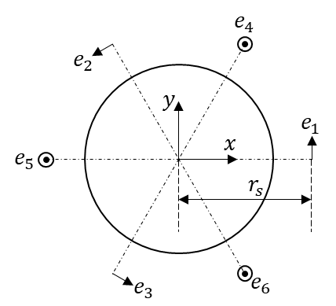
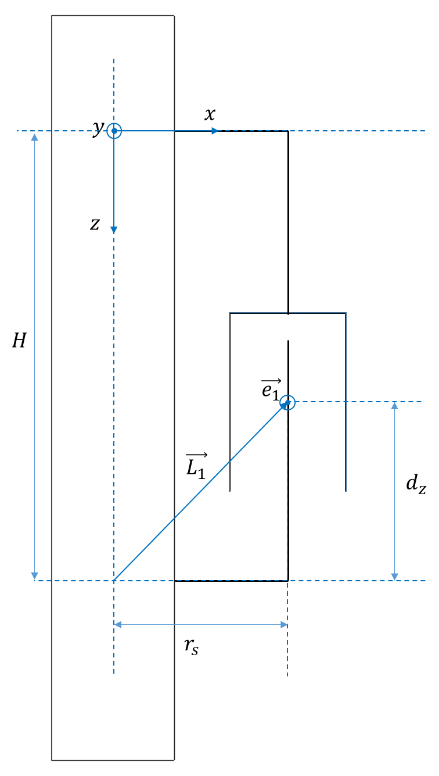
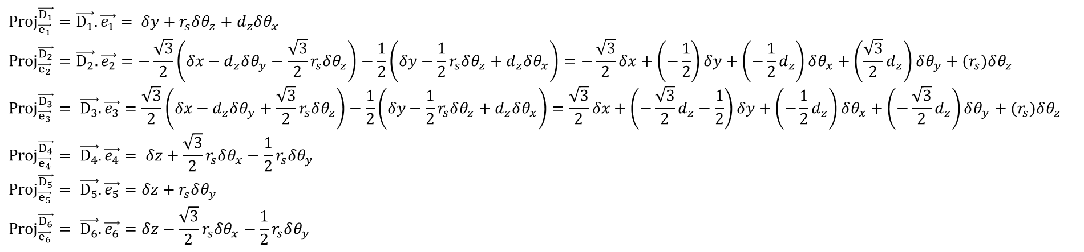
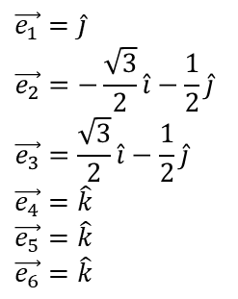
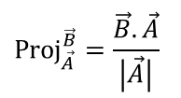
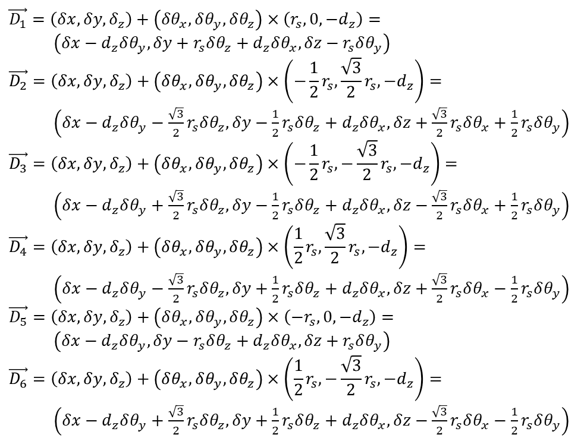

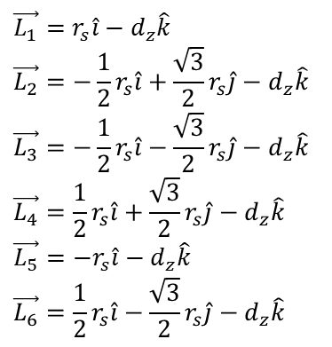
$$\vec{D_{i}}=\vec{ΔD}+\vec{Δθ}×\vec{L_{i}}$$
$$\vec{D_{1}}=\left(δx,δy,δ_{z}\right)+\left(δθ_{x},δθ_{y},δθ_{z}\right)×\left(r_{s},0,−d_{z}\right)=$$ $\left(δx−d_{z}δθ_{y},δy+r_{s}δθ_{z}+d_{z}δθ_{x}, δz−r_{s}δθ_{y}\right)$
$$\vec{D_{2}}=\left(δx,δy,δ_{z}\right)+\left(δθ_{x},δθ_{y},δθ_{z}\right)×\left(−\frac{1}{2}r_{s},\frac{\sqrt{3}}{2}r_{s},−d_{z}\right)=$$ $\left(δx−d_{z}δθ_{y}−\frac{\sqrt{3}}{2}r_{s}δθ_{z},δy−\frac{1}{2}r_{s}δθ_{z}+d_{z}δθ_{x}, δz+\frac{\sqrt{3}}{2}r_{s}δθ_{x}+\frac{1}{2}r_{s}δθ_{y}\right)$
$$\vec{D_{3}}=\left(δx,δy,δ_{z}\right)+\left(δθ_{x},δθ_{y},δθ_{z}\right)×\left(−\frac{1}{2}r_{s},−\frac{\sqrt{3}}{2}r_{s},−d_{z}\right)=$$ $\left(δx−d_{z}δθ_{y}+\frac{\sqrt{3}}{2}r_{s}δθ_{z},δy−\frac{1}{2}r_{s}δθ_{z}+d_{z}δθ_{x}, δz−\frac{\sqrt{3}}{2}r_{s}δθ_{x}+\frac{1}{2}r_{s}δθ_{y}\right)$
$$\vec{D_{4}}=\left(δx,δy,δ_{z}\right)+\left(δθ_{x},δθ_{y},δθ_{z}\right)×\left(\frac{1}{2}r_{s},\frac{\sqrt{3}}{2}r_{s},−d_{z}\right)=$$ $\left(δx−d_{z}δθ_{y}−\frac{\sqrt{3}}{2}r_{s}δθ_{z},δy+\frac{1}{2}r_{s}δθ_{z}+d_{z}δθ_{x}, δz+\frac{\sqrt{3}}{2}r_{s}δθ_{x}−\frac{1}{2}r_{s}δθ_{y}\right)$
$$\vec{D_{5}}=\left(δx,δy,δ_{z}\right)+\left(δθ_{x},δθ_{y},δθ_{z}\right)×\left(−r_{s},0,−d_{z}\right)=$$ $\left(δx−d_{z}δθ_{y},δy−r_{s}δθ_{z}+d_{z}δθ_{x}, δz+r_{s}δθ_{y}\right)$
$$\vec{D_{6}}=\left(δx,δy,δ_{z}\right)+\left(δθ_{x},δθ_{y},δθ_{z}\right)×\left(\frac{1}{2}r_{s},−\frac{\sqrt{3}}{2}r_{s},−d_{z}\right)=$$ $\left(δx−d_{z}δθ_{y}+\frac{\sqrt{3}}{2}r_{s}δθ_{z},δy+\frac{1}{2}r_{s}δθ_{z}+d_{z}δθ_{x}, δz−\frac{\sqrt{3}}{2}r_{s}δθ_{x}−\frac{1}{2}r_{s}δθ_{y}\right)$
$$\vec{e_{1}}=\hat{j}$$
$$\vec{e_{2}}=−\frac{\sqrt{3}}{2}\hat{i}−\frac{1}{2}\hat{j}$$
$$\vec{e_{3}}=\frac{\sqrt{3}}{2}\hat{i}−\frac{1}{2}\hat{j}$$
$$\vec{e_{4}}=\hat{k}$$
$$\vec{e_{5}}=\hat{k}$$
$$\vec{e_{6}}=\hat{k}$$
$$\vec{L_{1}}=r_{s}\hat{i}−d_{z}\hat{k}$$
$$\vec{L_{2}}=−\frac{1}{2}r_{s}\hat{i}+\frac{\sqrt{3}}{2}r_{s}\hat{j}−d_{z}\hat{k}$$
$$\vec{L_{3}}=−\frac{1}{2}r_{s}\hat{i}−\frac{\sqrt{3}}{2}r_{s}\hat{j}−d_{z}\hat{k}$$
$$\vec{L_{4}}=\frac{1}{2}r_{s}\hat{i}+\frac{\sqrt{3}}{2}r_{s}\hat{j}−d_{z}\hat{k}$$
$$\vec{L_{5}}=−r_{s}\hat{i}−d_{z}\hat{k}$$
$$\vec{L_{6}}=\frac{1}{2}r_{s}\hat{i}−\frac{\sqrt{3}}{2}r_{s}\hat{j}−d_{z}\hat{k}$$
$${Proj}_{\vec{A}}^{\vec{B}}=\frac{\vec{B}.\vec{A}}{\left|\vec{A}\right|}$$
$${Proj}_{\vec{e_{1}}}^{\vec{D_{1}}}=\vec{D_{1}}.\vec{e_{1}}= δy+r_{s}δθ_{z}+d_{z}δθ_{x}$$
$${Proj}_{\vec{e_{2}}}^{\vec{D_{2}}}=\vec{D_{2}}.\vec{e_{2}}=−\frac{\sqrt{3}}{2}\left(δx−d_{z}δθ_{y}−\frac{\sqrt{3}}{2}r_{s}δθ_{z}\right)−\frac{1}{2}\left(δy−\frac{1}{2}r_{s}δθ_{z}+d_{z}δθ_{x}\right)=−\frac{\sqrt{3}}{2}δx+\left(−\frac{1}{2}\right)δy+\left(−\frac{1}{2}d_{z}\right)δθ_{x}+\left(\frac{\sqrt{3}}{2}d_{z}\right)δθ_{y}+(r_{s})δθ_{z}$$
$${Proj}_{\vec{e_{3}}}^{\vec{D_{3}}}= \vec{D_{3}}.\vec{e_{3}}=\frac{\sqrt{3}}{2}\left(δx−d_{z}δθ_{y}+\frac{\sqrt{3}}{2}r_{s}δθ_{z}\right)−\frac{1}{2}\left(δy−\frac{1}{2}r_{s}δθ_{z}+d_{z}δθ_{x}\right)=\frac{\sqrt{3}}{2}δx+\left(−\frac{\sqrt{3}}{2}d_{z}−\frac{1}{2}\right)δy+\left(−\frac{1}{2}d_{z}\right)δθ_{x}+\left(−\frac{\sqrt{3}}{2}d_{z}\right)δθ_{y}+(r_{s})δθ_{z}$$
$${Proj}_{\vec{e_{4}}}^{\vec{D_{4}}}= \vec{D_{4}}.\vec{e_{4}}= δz+\frac{\sqrt{3}}{2}r_{s}δθ_{x}−\frac{1}{2}r_{s}δθ_{y}$$
$${Proj}_{\vec{e_{5}}}^{\vec{D_{5}}}= \vec{D_{5}}.\vec{e_{5}}=δz+r_{s}δθ_{y}$$
$${Proj}_{\vec{e_{6}}}^{\vec{D_{6}}}= \vec{D_{6}}.\vec{e_{6}}=δz−\frac{\sqrt{3}}{2}r_{s}δθ_{x}−\frac{1}{2}r_{s}δθ_{y}$$

Slide 2
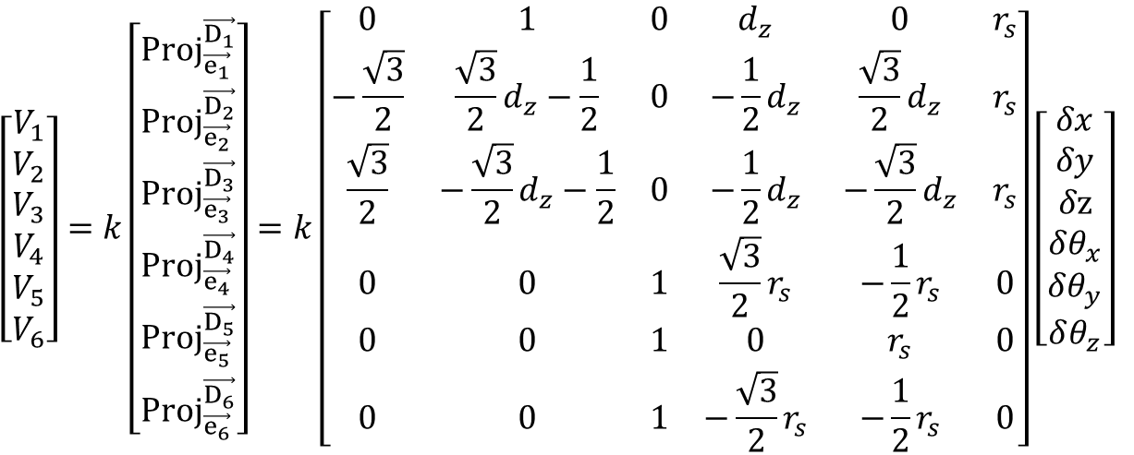
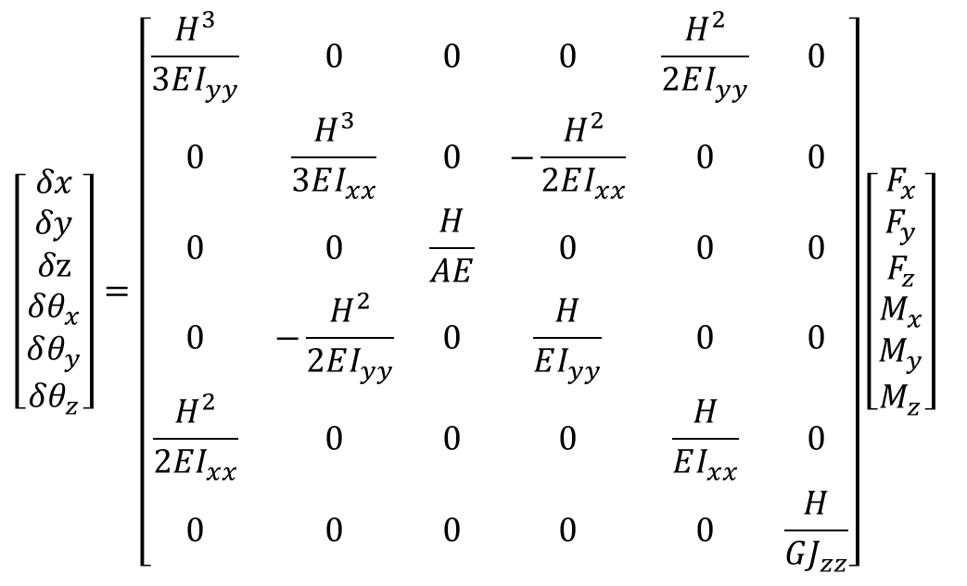


$$V_{i}=k×{Proj}_{\vec{e_{i}}}^{\vec{D_{i}}}$$
$G=\frac{E}{2\left(1+v\right)}$
$$\left[\begin{aligned}V_{1} \\ V_{2} \\ V_{3} \\ V_{4} \\ V_{5} \\ V_{6}\end{aligned}\right]=k\left[\begin{aligned}{Proj}_{\vec{e_{1}}}^{\vec{D_{1}}} \\ {Proj}_{\vec{e_{2}}}^{\vec{D_{2}}} \\ {Proj}_{\vec{e_{3}}}^{\vec{D_{3}}} \\ {Proj}_{\vec{e_{4}}}^{\vec{D_{4}}} \\ {Proj}_{\vec{e_{5}}}^{\vec{D_{5}}} \\ {Proj}_{\vec{e_{6}}}^{\vec{D_{6}}}\end{aligned}\right]=k\left[\begin{matrix}0 & 1 & 0 & d_{z} & 0 & r_{s} \\ −\frac{\sqrt{3}}{2} & \frac{\sqrt{3}}{2}d_{z}−\frac{1}{2} & 0 & −\frac{1}{2}d_{z} & \frac{\sqrt{3}}{2}d_{z} & r_{s} \\ \frac{\sqrt{3}}{2} & −\frac{\sqrt{3}}{2}d_{z}−\frac{1}{2} & 0 & −\frac{1}{2}d_{z} & −\frac{\sqrt{3}}{2}d_{z} & r_{s} \\ 0 & 0 & 1 & \frac{\sqrt{3}}{2}r_{s} & −\frac{1}{2}r_{s} & 0 \\ 0 & 0 & 1 & 0 & r_{s} & 0 \\ 0 & 0 & 1 & −\frac{\sqrt{3}}{2}r_{s} & −\frac{1}{2}r_{s} & 0\end{matrix}\right]\left[\begin{matrix}\begin{aligned}δx \\ δy \\ δz \\ δθ_{x}\end{aligned} \\ δθ_{y} \\ δθ_{z}\end{matrix}\right]$$
$$\left[\begin{matrix}\begin{aligned}δx \\ δy \\ δz \\ δθ_{x}\end{aligned} \\ δθ_{y} \\ δθ_{z}\end{matrix}\right]=\left[\begin{matrix}\frac{H^{3}}{3EI_{yy}} & 0 & 0 & 0 & \frac{H^{2}}{2EI_{yy}} & 0 \\ 0 & \frac{H^{3}}{3EI_{xx}} & 0 & −\frac{H^{2}}{2EI_{xx}} & 0 & 0 \\ 0 & 0 & \frac{H}{AE} & 0 & 0 & 0 \\ 0 & −\frac{H^{2}}{2EI_{yy}} & 0 & \frac{H}{EI_{yy}} & 0 & 0 \\ \frac{H^{2}}{2EI_{xx}} & 0 & 0 & 0 & \frac{H}{EI_{xx}} & 0 \\ 0 & 0 & 0 & 0 & 0 & \frac{H}{GJ_{zz}}\end{matrix}\right]\left[\begin{aligned}F_{x} \\ F_{y} \\ F_{z} \\ M_{x} \\ M_{y} \\ M_{z}\end{aligned}\right]$$

Slide 3



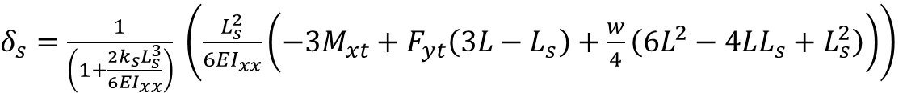




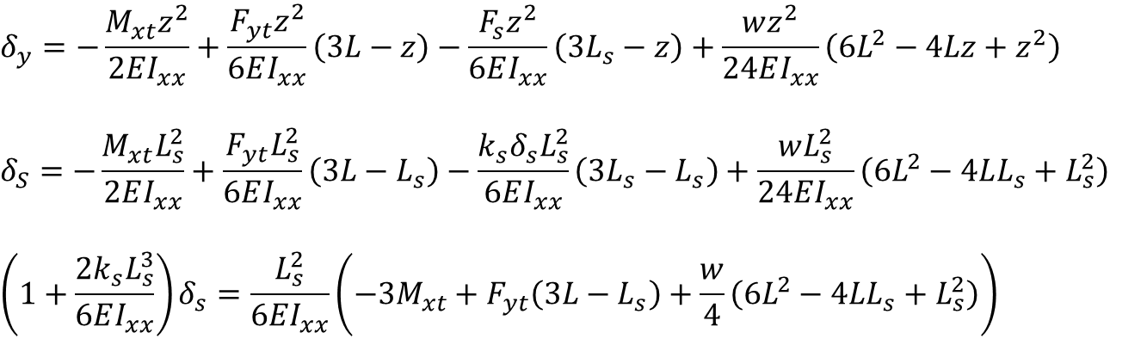







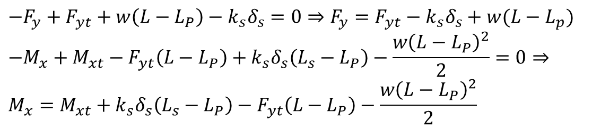



$$y$$
Calculation of the required stiffness: $δ=\frac{(F−kδ)L^{3}}{3EI}, δ=1.5 mm→k=\frac{F}{δ}−\frac{3EI}{L^{3}}=\frac{10}{1.5×{10}^{−3}}−\frac{3×102×{10}^{9}×1.7658×{10}^{−10}}{{0.43}^{3}}=5.987\frac{N}{mm}$
Calculation of the required length of the spring steel arms:
E for 1095 spring steel = 207 Gpa
$$I_{xx}=\frac{1}{12}{bh}^{3}=\frac{1}{12}×4×{\left(1.0668\right)}^{3}×{10}^{−12}=4.047×{10}^{−13}$$
$$k=\frac{3EI_{xx}}{L^{3}}→L=\sqrt[3]{\frac{3EI_{xx}}{k}}= \sqrt[3]{\frac{3×207×{10}^{9}×4.047×{10}^{−13}}{5.987×{10}^{3}}}=33.1 mm$$
$$x$$
$$z$$
$$F_{s}=k_{s}δ_{s}$$
$$L_{P}$$
$$P$$
$$s$$
$$M_{xt}$$
$$w$$
$$F_{yt}$$
$$L_{s}$$
$$L$$
$$F_{y}$$
$$F_{s}=k_{s}δ_{s}$$
$$M_{x}$$
$$P$$
$$s$$
$$M_{xt}$$
$$δ_{y}=−\frac{M_{xt}z^{2}}{2EI_{xx}}+\frac{F_{yt}z^{2}}{6EI_{xx}}\left(3L−z\right)−\frac{F_{s}z^{2}}{6EI_{xx}}\left(3L_{s}−z\right)+\frac{wz^{2}}{24EI_{xx}}\left(6L^{2}−4Lz+z^{2}\right)$$
$$δ_{S}=−\frac{M_{xt}L_{s}^{2}}{2EI_{xx}}+\frac{F_{yt}L_{s}^{2}}{6EI_{xx}}\left(3L−L_{s}\right)−\frac{k_{s}δ_{s}L_{s}^{2}}{6EI_{xx}}\left(3L_{s}−L_{s}\right)+\frac{wL_{s}^{2}}{24EI_{xx}}\left(6L^{2}−4LL_{s}+L_{s}^{2}\right)$$
$$\left(1+\frac{2k_{s}L_{s}^{3}}{6EI_{xx}}\right)δ_{s}=\frac{L_{s}^{2}}{6EI_{xx}}\left(−3M_{xt}+F_{yt}\left(3L−L_{s}\right)+\frac{w}{4}\left(6L^{2}−4LL_{s}+L_{s}^{2}\right)\right)$$
$$w$$
$$F_{yt}$$
$$L_{s}−L_{P}$$
$$L−L_{P}$$
$δ_{s}=\frac{1}{\left(1+\frac{2k_{s}L_{s}^{3}}{6EI_{xx}}\right)} \left(\frac{L_{s}^{2}}{6EI_{xx}}\left(−3M_{xt}+F_{yt}\left(3L−L_{s}\right)+\frac{w}{4}\left(6L^{2}−4LL_{s}+L_{s}^{2}\right)\right)\right)$
$$−F_{y}+F_{yt}+w\left(L−L_{P}\right)−k_{s}δ_{s}=0⇒F_{y}={F_{yt}−k}_{s}δ_{s}+w(L−L_{p})$$
$$−M_{x}+M_{xt}−F_{yt}\left(L−L_{P}\right)+k_{s}δ_{s}\left(L_{s}−L_{P}\right)−\frac{w{\left(L−L_{P}\right)}^{2}}{2}=0⇒ \\ M_{x}=M_{xt}+k_{s}δ_{s}\left(L_{s}−L_{P}\right)−F_{yt}\left(L−L_{P}\right)−\frac{w{\left(L−L_{P}\right)}^{2}}{2}$$

Slide 4
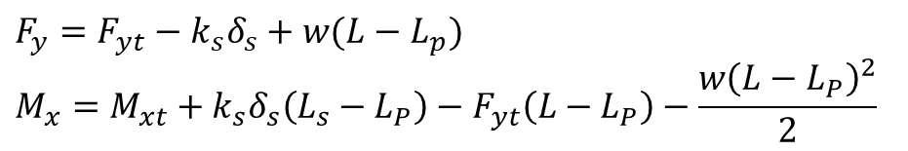

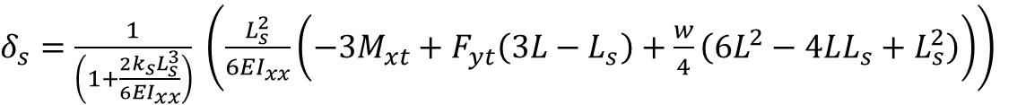
$$y$$
$$x$$
$$z$$
$$F_{s}=k_{s}δ_{s}$$
$δ_{s}=\frac{1}{\left(1+\frac{2k_{s}L_{s}^{3}}{6EI_{xx}}\right)} \left(\frac{L_{s}^{2}}{6EI_{xx}}\left(−3M_{xt}+F_{yt}\left(3L−L_{s}\right)+\frac{w}{4}\left(6L^{2}−4LL_{s}+L_{s}^{2}\right)\right)\right)$
$$L_{P}$$
$$P$$
$$s$$
$$M_{xt}$$
$$w$$
$$F_{yt}$$
$$F_{y}={F_{yt}−k}_{s}δ_{s}+w(L−L_{p})$$
$$M_{x}=M_{xt}+k_{s}δ_{s}\left(L_{s}−L_{P}\right)−F_{yt}\left(L−L_{P}\right)−\frac{w{\left(L−L_{P}\right)}^{2}}{2}$$
$$L_{s}$$
$$L$$
$$F_{y}$$
$$F_{s}=k_{s}δ_{s}$$
$$M_{x}$$
$$P$$
$$s$$
$$M_{xt}$$
$$F_{y}= \\ \frac{3k_{s}L_{s}^{2}}{6EI_{xx}+2k_{s}L_{s}^{3}}M_{xt} \\ +\left(1−\frac{k_{s}\left(3L−L_{s}\right)L_{s}^{2}}{6EI_{xx}+2k_{s}L_{s}^{3}}\right)F_{yt} \\ +\left(\left(L−L_{P}\right)−\frac{k_{s}L_{s}^{2}\left(6L^{2}−4LL_{s}+L_{s}^{2}\right)}{4\left(6EI_{xx}+2k_{s}L_{s}^{3}\right)}\right)w$$
$$M_{x}= \\ \left(1−\frac{3k_{s}L_{s}^{2}(L_{s}−L_{p})}{6EI_{xx}+2k_{s}L_{s}^{3}}\right)M_{xt} \\ +\left(\frac{k_{s}\left(3L−L_{s}\right)L_{s}^{2}(L_{s}−L_{P})}{6EI_{xx}+2k_{s}L_{s}^{3}}−\left(L−L_{P}\right)\right)F_{yt} \\ +\left(\frac{k_{s}L_{s}^{2}\left(6L^{2}−4LL_{s}+L_{s}^{2}\right)(L_{s}−L_{P})}{4\left(6EI_{xx}+2k_{s}L_{s}^{3}\right)}−\frac{{\left(L−L_{P}\right)}^{2}}{2}\right)w$$
$$w$$
$$F_{yt}$$
$$L_{s}−L_{P}$$
$$L−L_{P}$$

Slide 5


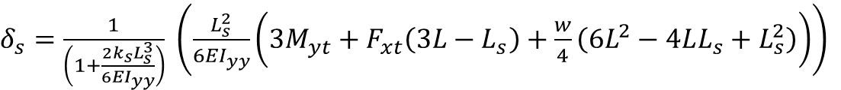

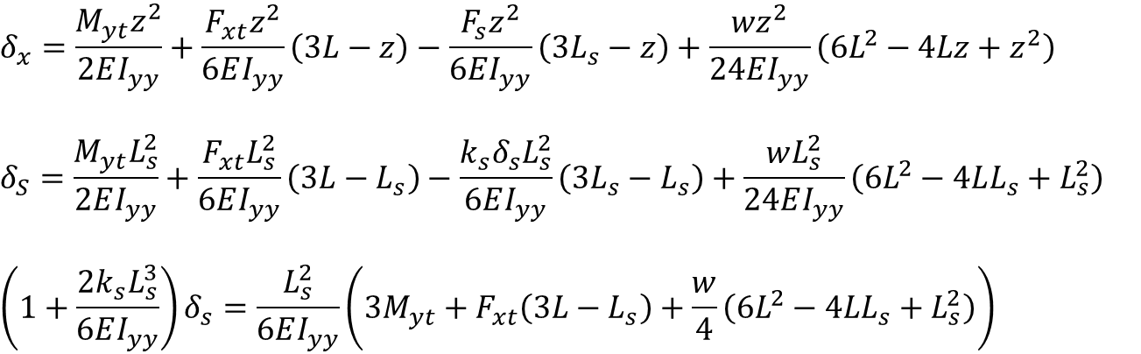



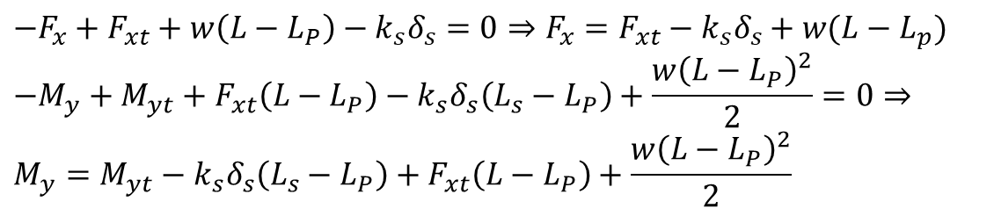
$$x$$
$$y$$
$$z$$
$$F_{s}=k_{s}δ_{s}$$
$$L_{P}$$
$$δ_{x}=\frac{M_{yt}z^{2}}{2EI_{yy}}+\frac{F_{xt}z^{2}}{6EI_{yy}}\left(3L−z\right)−\frac{F_{s}z^{2}}{6EI_{yy}}\left(3L_{s}−z\right)+\frac{wz^{2}}{24EI_{yy}}\left(6L^{2}−4Lz+z^{2}\right)$$
$$δ_{S}=\frac{M_{yt}L_{s}^{2}}{2EI_{yy}}+\frac{F_{xt}L_{s}^{2}}{6EI_{yy}}\left(3L−L_{s}\right)−\frac{k_{s}δ_{s}L_{s}^{2}}{6EI_{yy}}\left(3L_{s}−L_{s}\right)+\frac{wL_{s}^{2}}{24EI_{yy}}\left(6L^{2}−4LL_{s}+L_{s}^{2}\right)$$
$$\left(1+\frac{2k_{s}L_{s}^{3}}{6EI_{yy}}\right)δ_{s}=\frac{L_{s}^{2}}{6EI_{yy}}\left(3M_{yt}+F_{xt}\left(3L−L_{s}\right)+\frac{w}{4}\left(6L^{2}−4LL_{s}+L_{s}^{2}\right)\right)$$
$$P$$
$$s$$
$$M_{yt}$$
$$w$$
$$F_{xt}$$
$$L_{s}$$
$$L$$
$$F_{x}$$
$$F_{s}=k_{s}δ_{s}$$
$$M_{y}$$
$$P$$
$$s$$
$$M_{yt}$$
$$w$$
$$F_{xt}$$
$$L_{s}−L_{P}$$
$$L−L_{P}$$
$δ_{s}=\frac{1}{\left(1+\frac{2k_{s}L_{s}^{3}}{6EI_{yy}}\right)} \left(\frac{L_{s}^{2}}{6EI_{yy}}\left(3M_{yt}+F_{xt}\left(3L−L_{s}\right)+\frac{w}{4}\left(6L^{2}−4LL_{s}+L_{s}^{2}\right)\right)\right)$
$$−F_{x}+F_{xt}+w\left(L−L_{P}\right)−k_{s}δ_{s}=0⇒F_{x}={F_{xt}−k}_{s}δ_{s}+w(L−L_{p})$$
$$−M_{y}+M_{yt}+F_{xt}\left(L−L_{P}\right)−k_{s}δ_{s}\left(L_{s}−L_{P}\right)+\frac{w{\left(L−L_{P}\right)}^{2}}{2}=0⇒ \\ M_{y}=M_{yt}−k_{s}δ_{s}\left(L_{s}−L_{P}\right)+F_{xt}\left(L−L_{P}\right)+\frac{w{\left(L−L_{P}\right)}^{2}}{2}$$

Slide 6
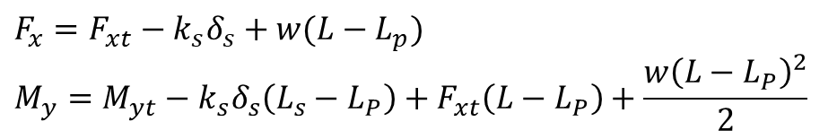

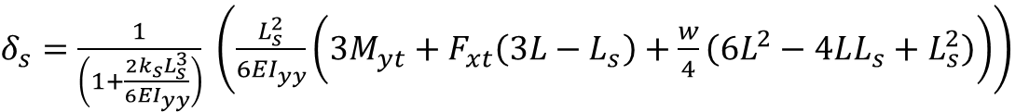
$$x$$
$δ_{s}=\frac{1}{\left(1+\frac{2k_{s}L_{s}^{3}}{6EI_{yy}}\right)} \left(\frac{L_{s}^{2}}{6EI_{yy}}\left(3M_{yt}+F_{xt}\left(3L−L_{s}\right)+\frac{w}{4}\left(6L^{2}−4LL_{s}+L_{s}^{2}\right)\right)\right)$
$$y$$
$$z$$
$$F_{s}=k_{s}δ_{s}$$
$$L_{P}$$
$$P$$
$$s$$
$$M_{yt}$$
$$w$$
$$F_{xt}$$
$$F_{x}={F_{xt}−k}_{s}δ_{s}+w(L−L_{p})$$
$$M_{y}=M_{yt}−k_{s}δ_{s}\left(L_{s}−L_{P}\right)+F_{xt}\left(L−L_{P}\right)+\frac{w{\left(L−L_{P}\right)}^{2}}{2}$$
$$L_{s}$$
$$L$$
$$F_{x}$$
$$F_{s}=k_{s}δ_{s}$$
$$F_{x}= \\ \frac{−3k_{s}L_{s}^{2}}{6EI_{yy}+2k_{s}L_{s}^{3}}M_{yt} \\ +\left(1−\frac{k_{s}\left(3L−L_{s}\right)L_{s}^{2}}{6EI_{yy}+2k_{s}L_{s}^{3}}\right)F_{xt} \\ +\left(\left(L−L_{P}\right)−\frac{k_{s}L_{s}^{2}\left(6L^{2}−4LL_{s}+L_{s}^{2}\right)}{4\left(6EI_{yy}+2k_{s}L_{s}^{3}\right)}\right)w$$
$$M_{y}= \\ \left(1−\frac{3k_{s}L_{s}^{2}(L_{s}−L_{p})}{6EI_{yy}+2k_{s}L_{s}^{3}}\right)M_{yt} \\ +\left(\left(L−L_{P}\right)−\frac{k_{s}\left(3L−L_{s}\right)L_{s}^{2}(L_{s}−L_{P})}{6EI_{yy}+2k_{s}L_{s}^{3}}\right)F_{xt} \\ +\left(\frac{{\left(L−L_{P}\right)}^{2}}{2}−\frac{k_{s}L_{s}^{2}\left(6L^{2}−4LL_{s}+L_{s}^{2}\right)(L_{s}−L_{P})}{4\left(6EI_{yy}+2k_{s}L_{s}^{3}\right)}\right)w$$
$$M_{y}$$
$$P$$
$$s$$
$$M_{yt}$$
$$w$$
$$F_{xt}$$
$$L_{s}−L_{P}$$
$$L−L_{P}$$

Slide 7




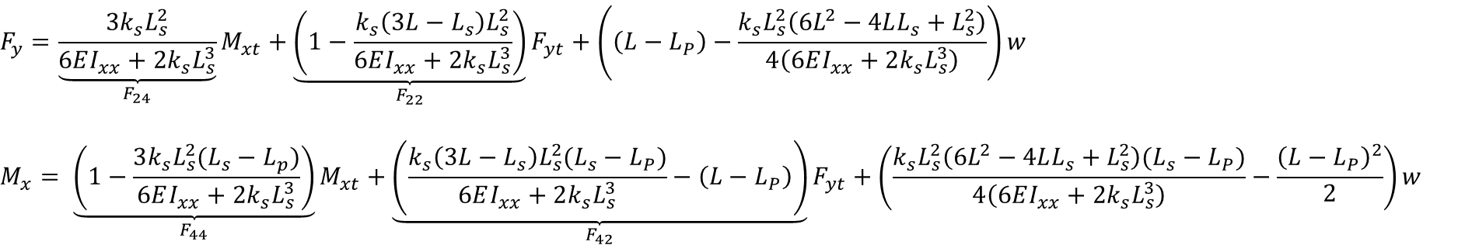



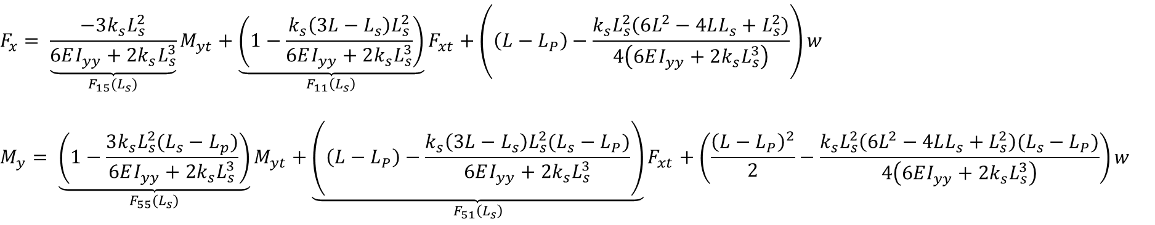















$$y$$
$$x$$
$$x$$
$$z$$
$$F_{s}=k_{s}δ_{s}$$
$$y$$
$$z$$
$$F_{s}=k_{s}δ_{s}$$
$$L_{P}$$
$$L_{P}$$
$$P$$
$$s$$
$$M_{xt}$$
$$P$$
$$s$$
$$M_{yt}$$
$$w$$
$$F_{yt}$$
$$w$$
$$F_{xt}$$
$$L_{s}$$
$$L_{s}$$
$$L$$
$$L$$
$$F_{y}$$
$$F_{s}=k_{s}δ_{s}$$
$$F_{x}$$
$$F_{s}=k_{s}δ_{s}$$
$$M_{x}$$
$$P$$
$$s$$
$$M_{xt}$$
$$M_{y}$$
$$P$$
$$s$$
$$M_{yt}$$
$$w$$
$$F_{yt}$$
$$w$$
$$F_{xt}$$
$$L_{s}−L_{P}$$
$$L_{s}−L_{P}$$
$$L−L_{P}$$
$$L−L_{P}$$
$$F_{x}= \underset{F_{15}(L_{s})}{\underbrace{\frac{−3k_{s}L_{s}^{2}}{6EI_{yy}+2k_{s}L_{s}^{3}}}}M_{yt}+\underset{F_{11}\left(L_{s}\right)}{\underbrace{\left(1−\frac{k_{s}\left(3L−L_{s}\right)L_{s}^{2}}{6EI_{yy}+2k_{s}L_{s}^{3}}\right)}}F_{xt}+\left(\left(L−L_{P}\right)−\frac{k_{s}L_{s}^{2}\left(6L^{2}−4LL_{s}+L_{s}^{2}\right)}{4\left(6EI_{yy}+2k_{s}L_{s}^{3}\right)}\right)w$$
$$M_{y}= \underset{F_{55}(L_{s})}{\underbrace{\left(1−\frac{3k_{s}L_{s}^{2}(L_{s}−L_{p})}{6EI_{yy}+2k_{s}L_{s}^{3}}\right)}}M_{yt}+\underset{F_{51}\left(L_{s}\right)}{\underbrace{\left(\left(L−L_{P}\right)−\frac{k_{s}\left(3L−L_{s}\right)L_{s}^{2}(L_{s}−L_{P})}{6EI_{yy}+2k_{s}L_{s}^{3}}\right)}}F_{xt}+\left(\frac{{\left(L−L_{P}\right)}^{2}}{2}−\frac{k_{s}L_{s}^{2}\left(6L^{2}−4LL_{s}+L_{s}^{2}\right)(L_{s}−L_{P})}{4\left(6EI_{yy}+2k_{s}L_{s}^{3}\right)}\right)w$$
$$F_{y}=\underset{F_{24}}{\underbrace{\frac{3k_{s}L_{s}^{2}}{6EI_{xx}+2k_{s}L_{s}^{3}}}}M_{xt}+\underset{F_{22}}{\underbrace{\left(1−\frac{k_{s}\left(3L−L_{s}\right)L_{s}^{2}}{6EI_{xx}+2k_{s}L_{s}^{3}}\right)}}F_{yt}+\left(\left(L−L_{P}\right)−\frac{k_{s}L_{s}^{2}\left(6L^{2}−4LL_{s}+L_{s}^{2}\right)}{4\left(6EI_{xx}+2k_{s}L_{s}^{3}\right)}\right)w$$
$$M_{x}= \underset{F_{44}}{\underbrace{\left(1−\frac{3k_{s}L_{s}^{2}(L_{s}−L_{p})}{6EI_{xx}+2k_{s}L_{s}^{3}}\right)}}M_{xt}+\underset{F_{42}}{\underbrace{\left(\frac{k_{s}\left(3L−L_{s}\right)L_{s}^{2}(L_{s}−L_{P})}{6EI_{xx}+2k_{s}L_{s}^{3}}−\left(L−L_{P}\right)\right)}}F_{yt}+\left(\frac{k_{s}L_{s}^{2}\left(6L^{2}−4LL_{s}+L_{s}^{2}\right)(L_{s}−L_{P})}{4\left(6EI_{xx}+2k_{s}L_{s}^{3}\right)}−\frac{{\left(L−L_{P}\right)}^{2}}{2}\right)w$$

Slide 8
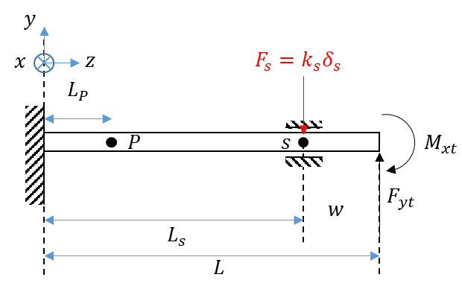
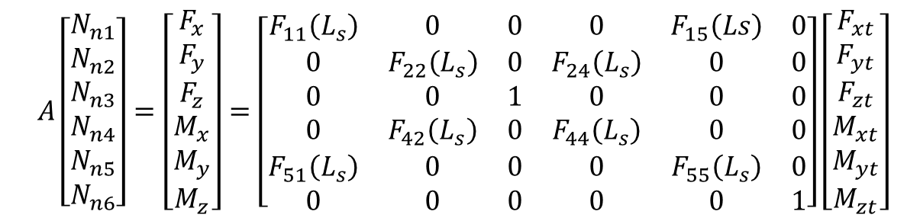
$$A\left[\begin{aligned}N_{n1} \\ N_{n2} \\ N_{n3} \\ N_{n4} \\ N_{n5} \\ N_{n6}\end{aligned}\right]=\left[\begin{aligned}F_{x} \\ F_{y} \\ F_{z} \\ M_{x} \\ M_{y} \\ M_{z}\end{aligned}\right]=\left[\begin{matrix}F_{11}\left(L_{s}\right) & 0 & 0 & 0 & F_{15}\left(Ls\right) & 0 \\ 0 & F_{22}\left(L_{s}\right) & 0 & F_{24}\left(L_{s}\right) & 0 & 0 \\ 0 & 0 & 1 & 0 & 0 & 0 \\ 0 & F_{42}\left(L_{s}\right) & 0 & F_{44}\left(L_{s}\right) & 0 & 0 \\ F_{51}\left(L_{s}\right) & 0 & 0 & 0 & F_{55}\left(L_{s}\right) & 0 \\ 0 & 0 & 0 & 0 & 0 & 1\end{matrix}\right]\left[\begin{aligned}\begin{aligned}F_{xt} \\ F_{yt} \\ F_{zt} \\ M_{xt} \\ M_{yt} \\ M_{zt}\end{aligned}\end{aligned}\right]$$
Input force profile loaded from the
ATI force sensor readings of the force
sensor calibration in TRO paper
The calibration matrix calculated in the
TRO paper when the sensor is mounted on a steel shaft

Slide 9
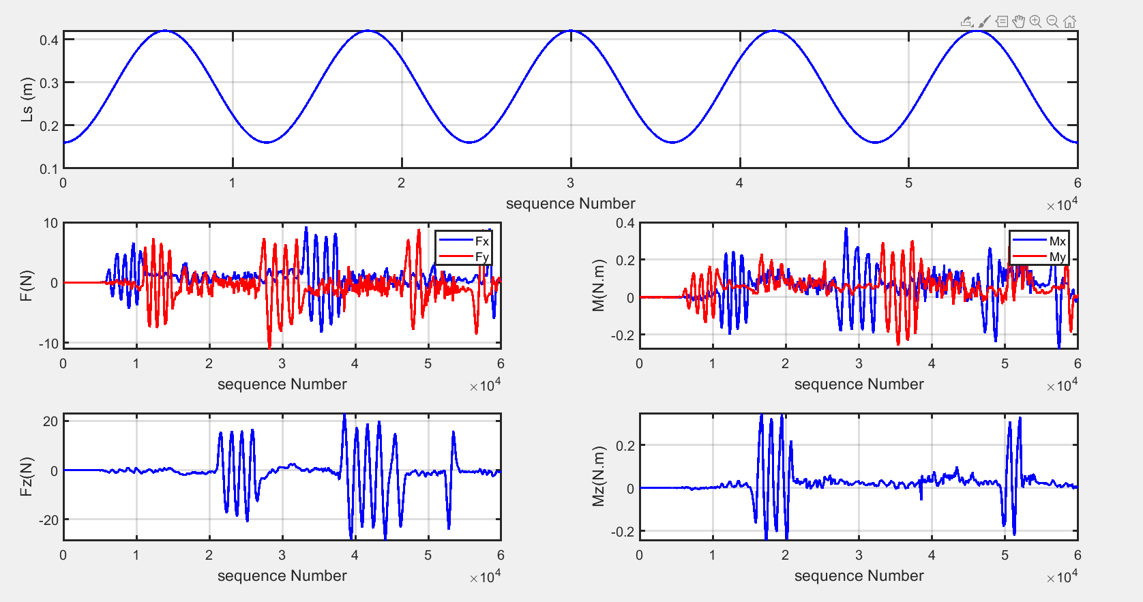
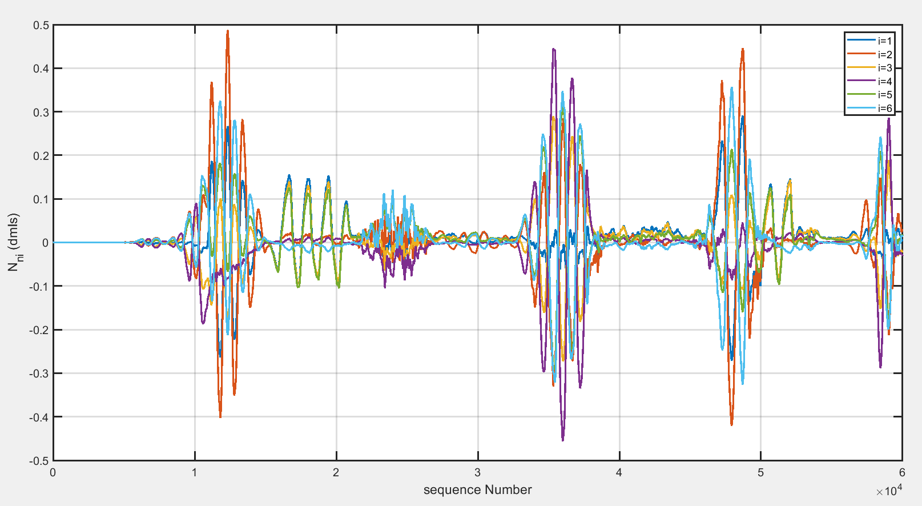
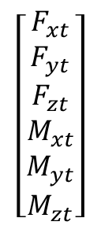
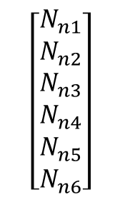
$$\left[\begin{aligned}\begin{aligned}F_{xt} \\ F_{yt} \\ F_{zt} \\ M_{xt} \\ M_{yt} \\ M_{zt}\end{aligned}\end{aligned}\right]$$
$$\left[\begin{aligned}N_{n1} \\ N_{n2} \\ N_{n3} \\ N_{n4} \\ N_{n5} \\ N_{n6}\end{aligned}\right]$$

Slide 10
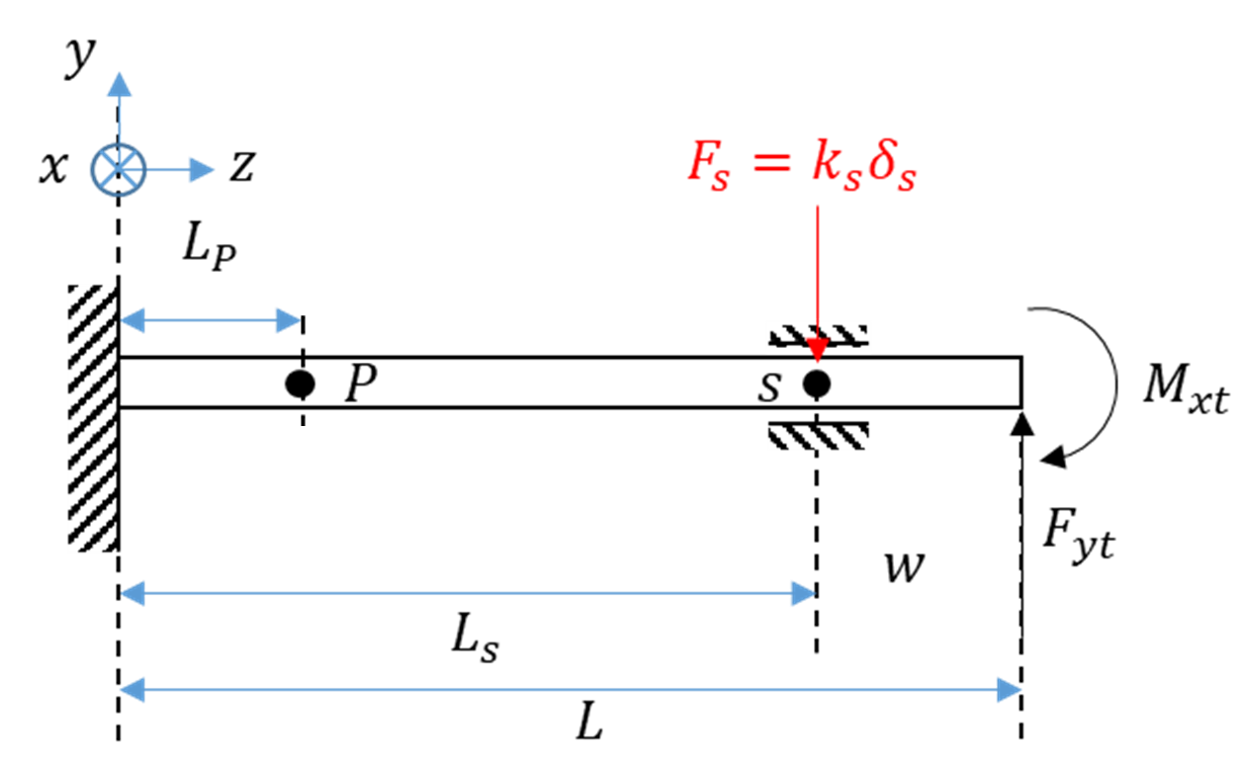
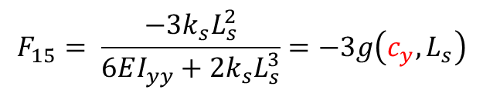
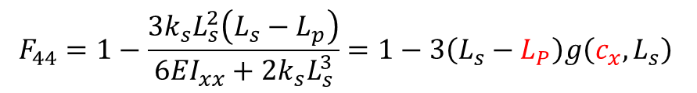
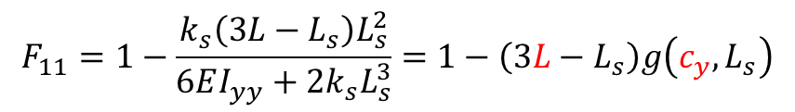

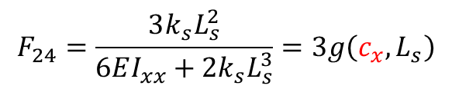
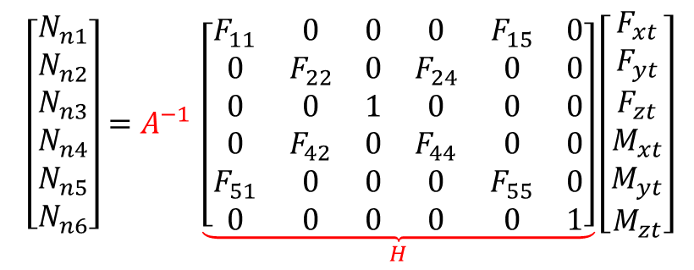
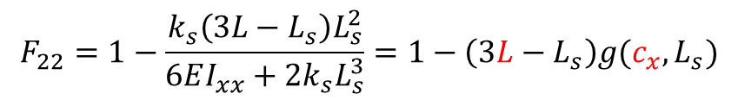
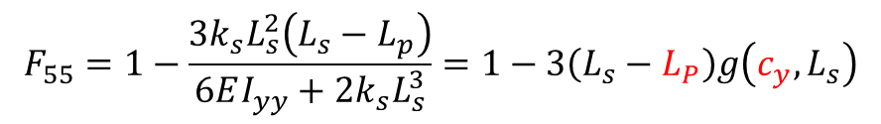
$$F_{11}=1−\frac{k_{s}\left(3L−L_{s}\right)L_{s}^{2}}{6EI_{yy}+2k_{s}L_{s}^{3}}=1−\left(3L−L_{s}\right)g\left(c_{y},L_{s}\right)$$
$$\left[\begin{aligned}N_{n1} \\ N_{n2} \\ N_{n3} \\ N_{n4} \\ N_{n5} \\ N_{n6}\end{aligned}\right]=A^{−1 }\underset{H}{\underbrace{\left[\begin{matrix}F_{11} & 0 & 0 & 0 & F_{15} & 0 \\ 0 & F_{22} & 0 & F_{24} & 0 & 0 \\ 0 & 0 & 1 & 0 & 0 & 0 \\ 0 & F_{42} & 0 & F_{44} & 0 & 0 \\ F_{51} & 0 & 0 & 0 & F_{55} & 0 \\ 0 & 0 & 0 & 0 & 0 & 1\end{matrix}\right]}}\left[\begin{aligned}\begin{aligned}F_{xt} \\ F_{yt} \\ F_{zt} \\ M_{xt} \\ M_{yt} \\ M_{zt}\end{aligned}\end{aligned}\right]$$
$$F_{15}= \frac{−3k_{s}L_{s}^{2}}{6EI_{yy}+2k_{s}L_{s}^{3}}=−3g\left(c_{y},L_{s}\right)$$
$$F_{22}=1−\frac{k_{s}\left(3L−L_{s}\right)L_{s}^{2}}{6EI_{xx}+2k_{s}L_{s}^{3}}=1−\left(3L−L_{s}\right)g(c_{x},L_{s})$$
$$F_{24}=\frac{3k_{s}L_{s}^{2}}{6EI_{xx}+2k_{s}L_{s}^{3}}=3g\left(c_{x},L_{s}\right)$$
$$L_{s}=L_{s,OS}+q_{5}$$
$$F_{42}=\frac{k_{s}\left(3L−L_{s}\right)L_{s}^{2}(L_{s}−L_{P})}{6EI_{xx}+2k_{s}L_{s}^{3}}−\left(L−L_{P}\right)=\left(3L−L_{s}\right)\left(L_{s}−L_{P}\right)g\left(c_{x},L_{s}\right)−\left(L−L_{P}\right)$$
$$F_{44}=1−\frac{3k_{s}L_{s}^{2}\left(L_{s}−L_{p}\right)}{6EI_{xx}+2k_{s}L_{s}^{3}}=1−3\left(L_{s}−L_{P}\right)g\left(c_{x},L_{s}\right)$$
$$F_{51}=\left(L−L_{P}\right)−\frac{k_{s}\left(3L−L_{s}\right)L_{s}^{2}\left(L_{s}−L_{P}\right)}{6EI_{yy}+2k_{s}L_{s}^{3}}=\left(L−L_{P}\right)−\left(3L−L_{s}\right)\left(L_{s}−L_{P}\right)g\left(c_{y},L_{s}\right)$$
$$F_{55}=1−\frac{3k_{s}L_{s}^{2}\left(L_{s}−L_{p}\right)}{6EI_{yy}+2k_{s}L_{s}^{3}}=1−3\left(L_{s}−L_{P}\right)g\left(c_{y},L_{s}\right)$$

Slide 11
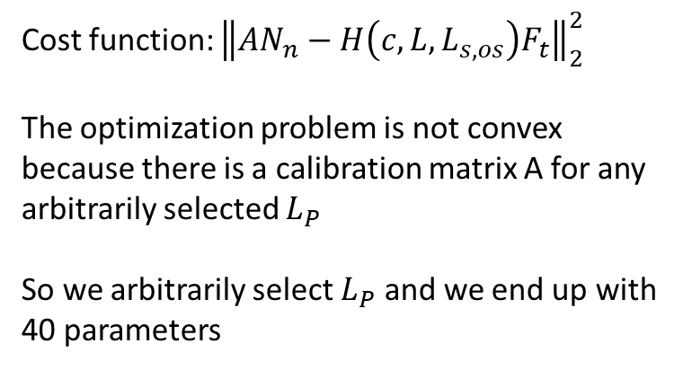
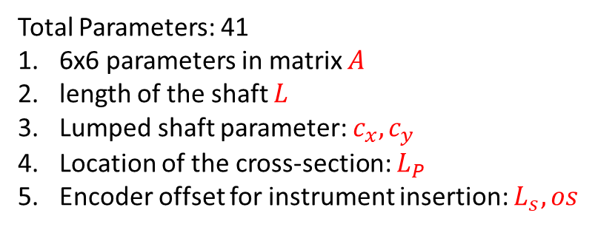
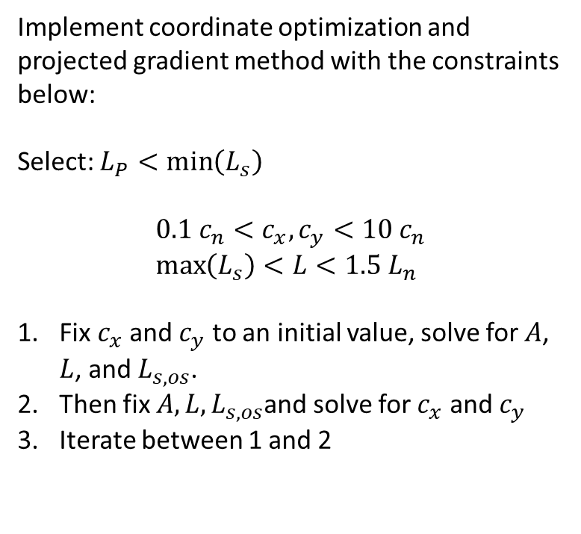
Total Parameters: 41
6x6 parameters in matrix $A$
length of the shaft $L$
Lumped shaft parameter: $c_{x},c_{y}$
Location of the cross-section: $L_{P}$
Encoder offset for instrument insertion: $L_{s},os$
Cost function: ${\left\|AN_{n}−H\left(c,L,L_{s,os}\right)F_{t}\right\|}_{2}^{2}$
The optimization problem is not convex because there is a calibration matrix A for any arbitrarily selected $L_{P}$
So we arbitrarily select $L_{P}$ and we end up with 40 parameters
Implement coordinate optimization and projected gradient method with the constraints below:
Select: $L_{P}<\min\left(L_{s}\right)$
$$0.1 c_{n}<c_{x}, c_{y}<10 c_{n} \\ \max\left(L_{s}\right)<L<1.5 L_{n}$$
Fix $c_{x}$ and $c_{y}$ to an initial value, solve for $A$, $L$, and $L_{s,os}$.
Then fix $A, L, L_{s,os}$and solve for $c_{x}$ and $c_{y}$
Iterate between 1 and 2

Slide 12
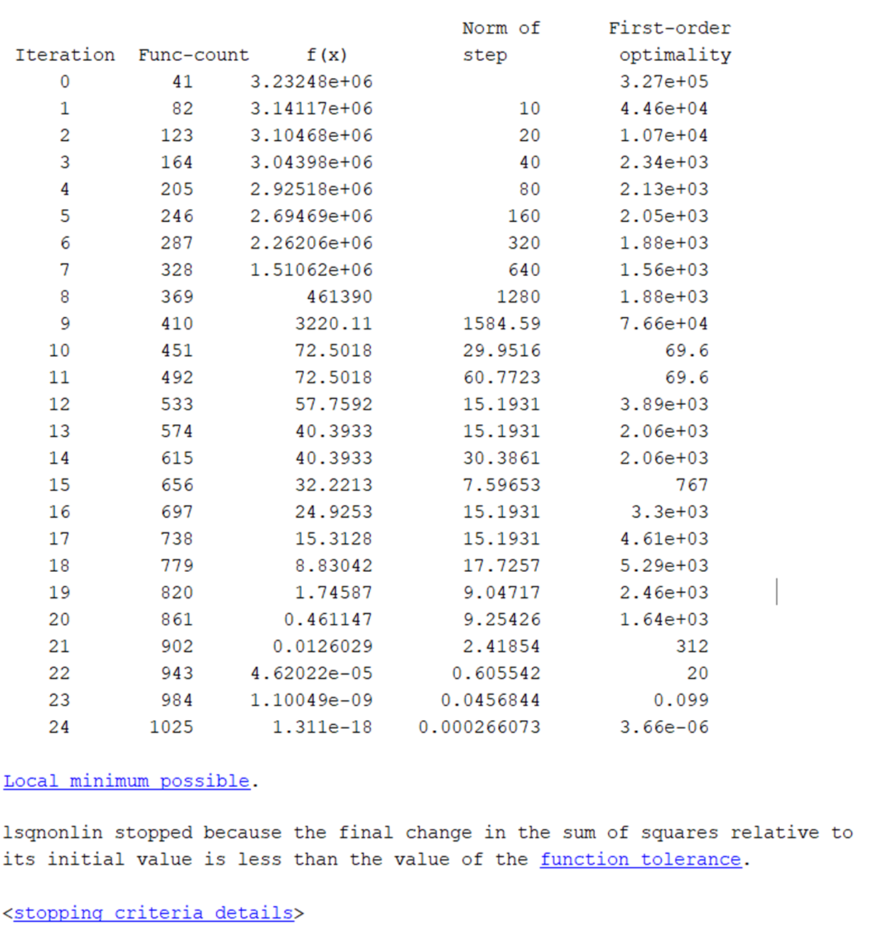

Slide 13
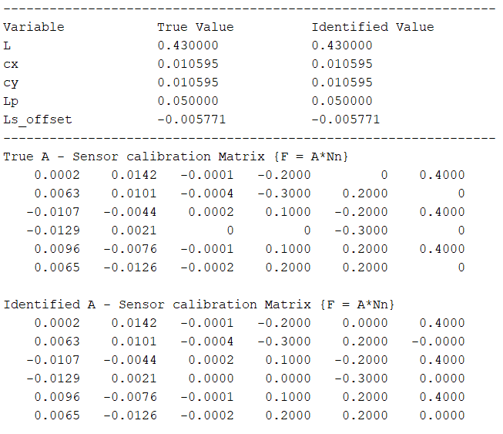

Slide 14
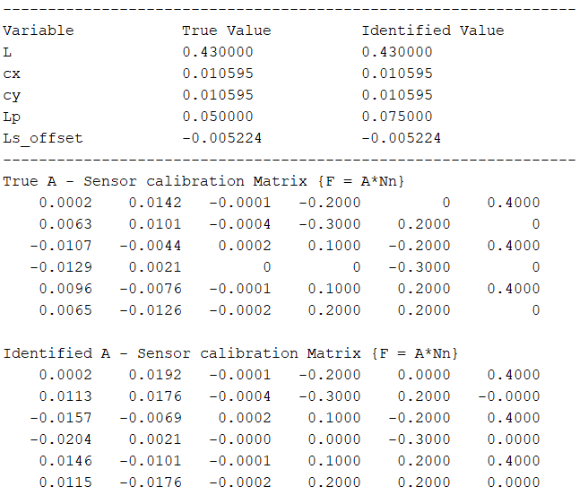

Slide 15
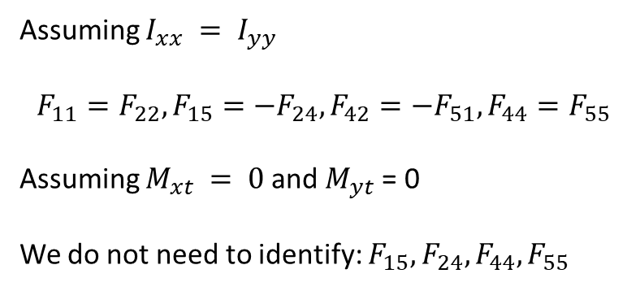
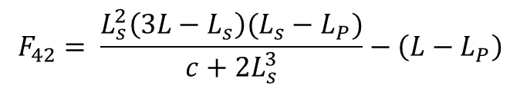
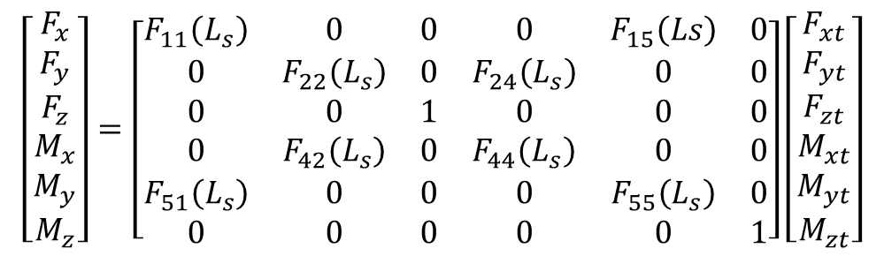
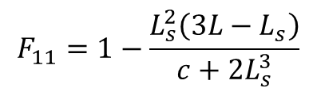
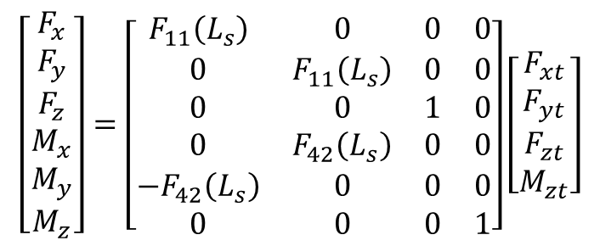
Fontanelli et al. 2017
For the case of the instrument used in the experiments, the dynamic effects (gravity and inertial forces) are small compared to the range of the measured forces (about 1% of the maximum force) and could be neglected. Of course, when instruments with higher weight and inertia are used, the dynamic effects should be compensated.
Schwalb et al. 2017
During MIS, inertia is low and is assumed to be negligible, and is further validated in the experimental results section.
$$\left[\begin{aligned}F_{x} \\ F_{y} \\ F_{z} \\ M_{x} \\ M_{y} \\ M_{z}\end{aligned}\right]=\left[\begin{matrix}F_{11}\left(L_{s}\right) & 0 & 0 & 0 & F_{15}\left(Ls\right) & 0 \\ 0 & F_{22}\left(L_{s}\right) & 0 & F_{24}\left(L_{s}\right) & 0 & 0 \\ 0 & 0 & 1 & 0 & 0 & 0 \\ 0 & F_{42}\left(L_{s}\right) & 0 & F_{44}\left(L_{s}\right) & 0 & 0 \\ F_{51}\left(L_{s}\right) & 0 & 0 & 0 & F_{55}\left(L_{s}\right) & 0 \\ 0 & 0 & 0 & 0 & 0 & 1\end{matrix}\right]\left[\begin{aligned}\begin{aligned}F_{xt} \\ F_{yt} \\ F_{zt} \\ M_{xt} \\ M_{yt} \\ M_{zt}\end{aligned}\end{aligned}\right]$$
Assuming $I_{xx} = I_{yy}$
$$F_{11}=F_{22}, F_{15}=−F_{24},F_{42}=−F_{51},F_{44}=F_{55}$$
Assuming $M_{xt} = 0$and $M_{yt}$= 0
We do not need to identify: $F_{15},F_{24},F_{44},F_{55}$
$$\left[\begin{aligned}F_{x} \\ F_{y} \\ F_{z} \\ M_{x} \\ M_{y} \\ M_{z}\end{aligned}\right]=\left[\begin{matrix}F_{11}\left(L_{s}\right) & 0 & 0 & 0 \\ 0 & F_{11}\left(L_{s}\right) & 0 & 0 \\ 0 & 0 & 1 & 0 \\ 0 & F_{42}\left(L_{s}\right) & 0 & 0 \\ {−F}_{42}\left(L_{s}\right) & 0 & 0 & 0 \\ 0 & 0 & 0 & 1\end{matrix}\right]\left[\begin{aligned}\begin{aligned}F_{xt} \\ F_{yt} \\ F_{zt} \\ M_{zt}\end{aligned}\end{aligned}\right]$$
We only need to identify two functions, $F_{11}$ and $F_{42}$
$$F_{11}=1−\frac{L_{s}^{2}\left(3L−L_{s}\right)}{c+2L_{s}^{3}}$$
$$F_{42}= \frac{L_{s}^{2}\left(3L−L_{s}\right)(L_{s}−L_{P})}{c+2L_{s}^{3}}−\left(L−L_{P}\right)$$

Slide 16
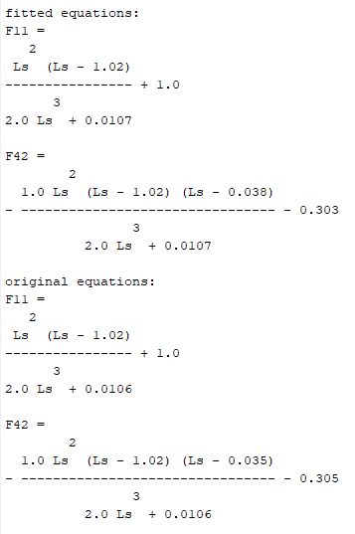


Slide 17













$$y$$
$$B$$
$$x$$
$$z$$
$$H$$
$$\vec{e_{1}}$$
$$\vec{l_{1}}$$
$$d_{z}$$
$$H′$$
$$C$$
$$r_{s}$$
$$P$$

Slide 19









$$\vec{e_{2}}$$
$$y$$
$$\vec{e_{3}}$$
$$\vec{e_{1}}$$
$$x$$
$$\vec{e_{4}}$$
$$r_{s}$$
$$\vec{e_{6}}$$
$$\vec{e_{5}}$$

Slide 20

Interconnect Flex
Bicell Board
Adjustment Gear
Infrared LED
Bicell Photodiode
Onboard ADC

Slide 21


