Slide 1
Natural Language Processing Project Analyzing Twitter users' feelings about the takeover of Twitter by Elon Musk using 75000 tweets Amir Hajiabadi Molin Zhang Jialing Li Master’s Degree in Artificial Intelligence University of Bologna 16th June 2022
Notes:
Natural Language Processing Project Analyzing Twitter users' feelings about the takeover of Twitter by Elon Musk using 75000 tweets

Slide 2
Sentiment Analysis
Sentiment analysis is the automated process of identifying and classifying subjective information in text data. This might be an opinion, a judgment, or a feeling about a particular topic or product feature. The most common type of sentiment analysis is 'polarity detection' and involves classifying statements as Positive, Negative, or Neutral.
Notes:
Sentiment analysis is the automated process of identifying and classifying subjective information in text data. This might be an opinion, a judgment, or a feeling about a particular topic or product feature.
The most common type of sentiment analysis is 'polarity detection' and involves classifying statements as Positive, Negative, or Neutral.
Sentiment analysis uses Natural Language Processing (or NLP) to make sense of human language and machine learning to deliver accurate results automatically

Slide 3
Our Goal!
Analyzing Twitter users' feelings about the takeover of Twitter by Elon Musk
Notes:
And what is our idea?
We saw that Elon Musk who is a famous business magnate and investor, CEO & founder of some famous companies like Tesla, SpaceX, Neuralink and OpenAI
recently expressed his desire to buy Twitter, met with many reactions.
It has been a hot topic since then, and we used a large dataset to analyze people's feelings about it.

Slide 4
Roadmap
Gather relevant Tweets
Visualizing the data
Analyzing using
our sentiment analysis model
1
3
5
2
4
Data cleaning and Preprocessing
Create a sentiment analysis machine learning model
Notes:
Performing sentiment analysis on Twitter data involves five steps:
1. Gather relevant Tweets
2. Clean the data using pre-processing techniques
3. Visualizing the data
4. Create a sentiment analysis machine learning model
5. Analyze the Twitter data using the sentiment analysis model

Slide 5
100,000 tweets
The dataset used is from Kaggle, which contains 100,000 tweets in different languages and 38 columns of details about them. Our final dataset contains 75,000 tweets in English.
Notes:
The dataset used is from Kaggle, which contains 100,000 tweets in different languages
and 38 columns of details about them.
We just wanted to work on the tweets in English and be more integrated, so we removed the rest of the rows and columns before. Our final dataset contains 75,000 tweets.

Slide 6
The unbalanced data
 | Positive | Neutral | Negative
Train | 7158 | 6289 | 27687
Test | 2224 | 1901 | 6367
Total | 20853 | 17531 | 37155
Notes:
Here you can see the unbalanced data, We consider 80 percent of them as the training set.
the table shows how our data is distributed
In total: We have about 21000 positive, 17000 neutral, 37000 negative sentences

Slide 7
Data Preprocessing
Tokenization
Alphanumeric characters
Expanding contractions
Removing additional characters
Lemmatization of the text
Notes:
The dataset is not so clean. Therefore, some further cleaning is needed. We do text normalization, transforming the text into a canonical (standard) form.
We do it in 5 steps:
First: Tokenization
In Natural language processing It becomes vital to understand the patterns in the text. Tokenization is when a significant quantity of text is divided into smaller parts called tokens. These tokens are handy for finding such patterns and are considered a base step for stemming and lemmatization. Sentence tokenization is the process of splitting text into individual sentences. It does this by looking for the types of textual constructs that confuse the tokenizer and replacing them with single words
Second. Alphanumeric characters Alphanumeric characters and decimals have been replaced with characters
Third. Expanding Contractions A contraction is a shortened form of a word that omits certain letters or sounds. Expanding Contractions is a process where words like isn’t, didn’t are expanded to is not, did not. Finally, we store the cleaned data in a dataframe and eliminate the duplicate or empty rows.
Fourth. Removing additional characters We can further see that there are still some special characters in the dataframe. They must be eradicated using the strip function.
As the last step. Lemmatization of the text Lemmatization usually refers to doing things properly using a vocabulary and morphological analysis of words, aiming to remove inflectional endings only and return to the base. Alternatively, the dictionary form of a word is the lemma.
Lemmatization will generate the root form of the inflected words.
here, we used Swifter which is a package that efficiently applies any function to a pandas dataframe or series in the fastest available manner than the normal apply function.
In the end, we will Remove stopwords from the dataframe.

Slide 8
Visualization
Visualizing the most frequent words in the dataframe will be done using the wordcloud technique.
We have listed the 100 most repeated words throughout the data.
The term 'Twitter' has been repeated 166959 times.
Notes:
Visualizing the most frequent words in the dataframe will be done using the wordcloud technique (showed in next page)
We have listed the 100 most repeated words throughout the data.
The term 'Twitter' has been repeated about 167000 times.

Slide 9
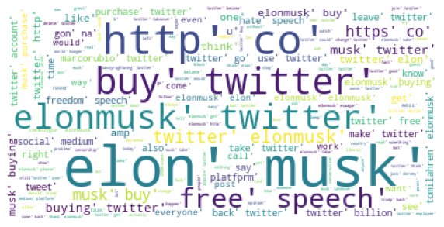
Notes:
This is our wordcloud.
For the most frequent words in the data frame.
As we can see, The term 'Twitter’ and ‘elon musk’ have been repeated the most.

Slide 10
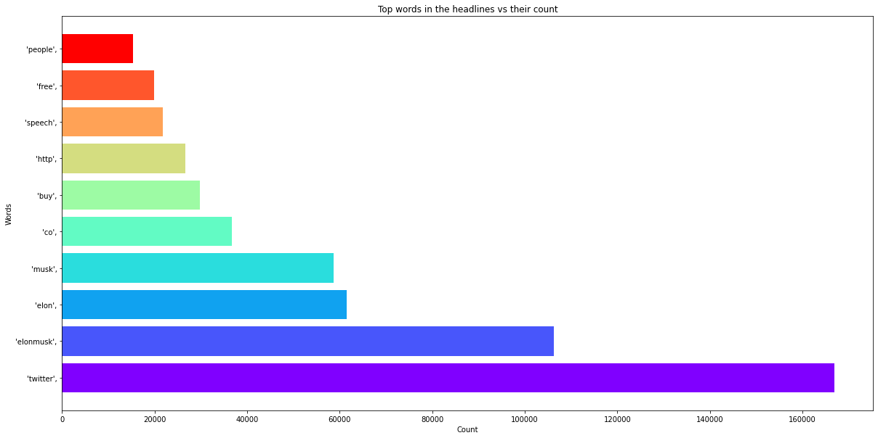
Notes:
This is our bar graph for the most frequent words in the data frame.
And indicates how many times they’ve been repeated.

Slide 11

Sentiment Analysis
Notes:
Now we start Sentiment Analysis

Slide 12

Vader Sentiment Analysis
for a given Sentence if it is positive, negative or neutral in nature
Notes:
We used Vader in this part.
VADER belongs to a sentiment analysis type based on lexicons of sentiment-related words.

Slide 13
Notes:
In this approach, each of the words in the lexicon is rated as to, whether it is positive or negative or neutral in nature.
and how positive or negative in many cases.
We can see part of the result from VADER’s lexicon, where more positive words have higher positive ratings and more negative words have lower negative ratings.
In addition, a compound score shows the importance of a sentence. In the end, we converted all polarity scores and sentences into a dataframe.
We arranged the dataset in descending order based on (Compound score) to find the most crucial sentence from the given data.

Slide 14
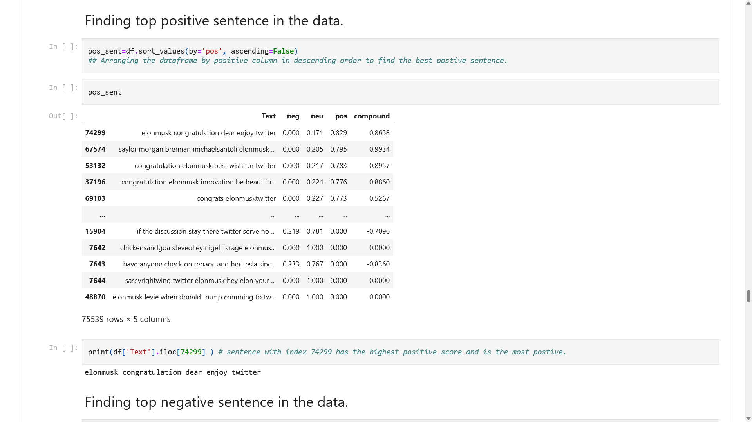
Notes:
We did the same to fine the most positive and negative sentences.

Slide 15
Final Dataframe
Giving threshold values for classification The threshold value will categorize if a given sentence is positive, negative, or neutral, and the predictions will be saved into a Target or sentiment column in our dataframe.
Notes:
Now we’re Giving threshold values for classification The threshold value will categorize if a given sentence is positive, negative, or neutral, and the predictions will be saved into a Target or sentiment column in our dataframe.

Slide 16
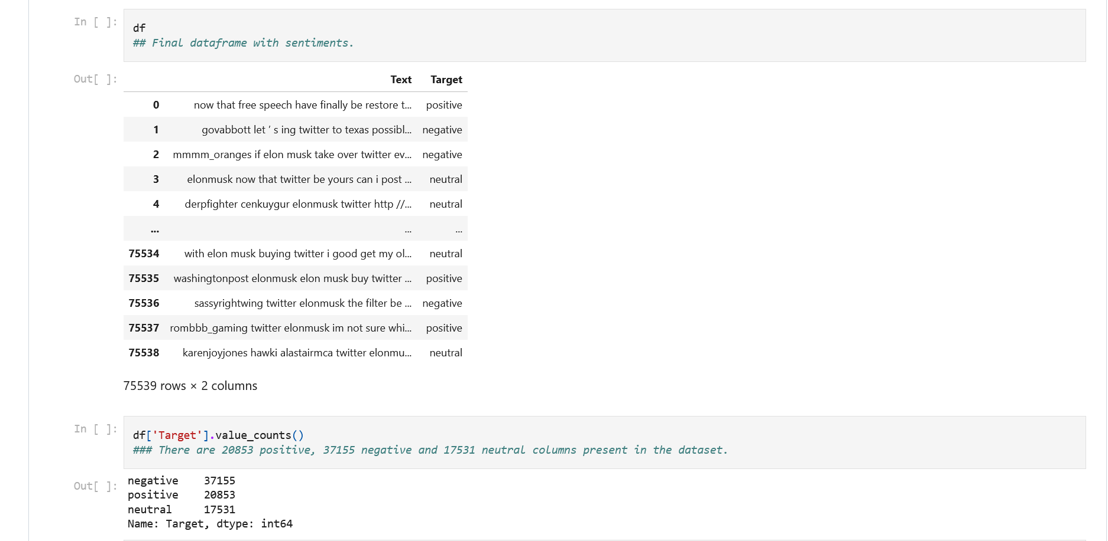
Notes:
As We don’t need other columns such as the score of being negative, neutral, positive, and compound we removed them
to reach the Final dataframe with Target column which assigns a label negative, neutral, positive to our sentence.
There are about 21000 positive, 37000 negative, and 17000 neutral sentences present in the dataset.

Slide 17
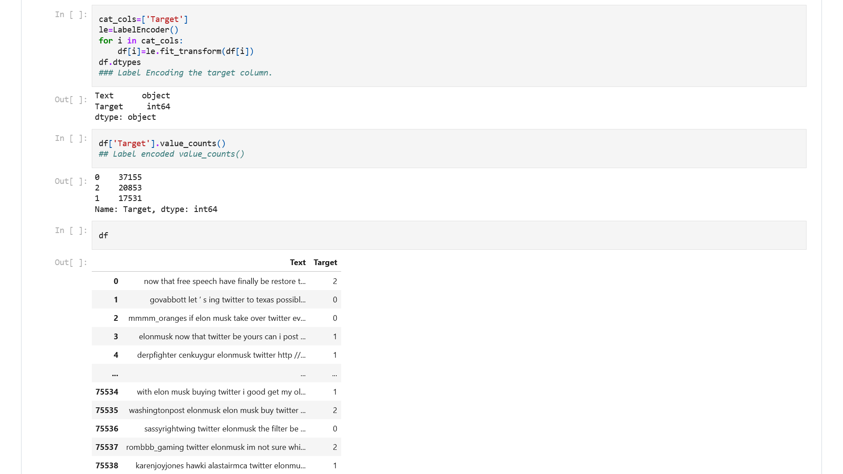
Notes:
As the last step, before applying machine learning models, we need to Label Encoding the target column.
We do that by Label encoder, which converts categorical values into numeric ones

Slide 18
Machine Learning models in comparison
● Logistic Regression
● Decision Tree Classifier
● Random Forest Classifier
● K neighbors Classifier
● Support Vector Machine
Notes:
now it’s time to work on Machine Learning models & compare the accuracy
first we need to Vectorizing the training data
Applying Tf-Idf vectorizer on a Text column converts a text to a feature vector that can be used as an input for our estimator.
Then we split the data and consider 80 percent of it as the training set.
And These are our machine learning models we examine one by one

Slide 19
Logistic Regression
Model accuracy on train is: 0.832933428207377
Model accuracy on test is: 0.757280910775748
Notes:
Logistic Regression
We fit the model to our data and, after some predictions, calculate the accuracy.
Our Model accuracy on train set is: 0.83
Our Model accuracy on test set is: 0.75

Slide 20
Decision Tree Classifier
Model accuracy on train is: 0.9995532094454833
Model accuracy on test is: 0.6633571617685994
Wrong predictions out of total:
5086 / 15108
Kappa Score is: 0.46165977029207494
Notes:
Decision Tree Classifier
Moreover, from now on, the Confusion matrix, the number of wrong Predictions made, and Kappa Score have been calculated.
The Model accuracy on train is: 0.9995532094454833
The Model accuracy on test is: 0.6633571617685994
Wrong predictions out of total: 5086 / 15108
KappaScore is: 0.46165977029207494

Slide 21
Random Forest Classifier
Model accuracy on train is: 0.999619400638745
Model accuracy on test is: 0.6894360603653693
Wrong predictions out of total:
4692 / 15108
Notes:
RandomForestClassifier
Model accuracy on train is: 0.999619400638745
Model accuracy on test is: 0.6894360603653693
4692 / 15108

Slide 22
K neighbors Classifier
Model accuracy on train is: 0.6922605947278715
Model accuracy on test is: 0.5873709293089754
Wrong predictions out of total:
6234 / 15108
Notes:
K Neighbors Classifier
Model accuracy on train is: 0.6922605947278715
Model accuracy on test is: 0.5873709293089754
Wrong predictions out of total:
6234 / 15108

Slide 23
Support Vector Machine
Model accuracy on train is: 0.8686270291737684
Model accuracy on test is: 0.7839555202541699
Wrong predictions out of total:
3264 / 15108
Notes:
And as the last model: Support Vector Machine
Model accuracy on train is: 0.8686270291737684
Model accuracy on test is: 0.7839555202541699
Wrong predictions out of total: 3264 / 15108

Slide 24
Conclusion
The best performance belongs to:
Support Vector Machine with 3264 wrong predictions out of 15108 predictions (0.78% accuracy)
Notes:
Conclusion
So we Saw the best performance belongs to:
Support Vector Machine with 3264 wrong predictions out of 15108 predictions (0.78% accuracy)

Slide 25
Bigger Project
Our project has 80 jupyter notebook cells & more than 4500 lines of codes but we could use more models
or XGBoost to improve the performance.
Notes:
And as limitations and possible improvements:
Our project has 80 jupyter notebook cells & more than 4500 lines of codes but we could use more models
or XGBoost to improve the performance.
Also, create a bot for daily gathering data, a web application to monitor its performance and do this analysis every day based on the bigger available dataset

Slide 26
Thanks!

