Slide 1
Blockchain and Cryptocurrencies Project Children's wallet with limited withdrawals Amir Hajiabadi Master’s Degree in Artificial Intelligence University of Bologna February 2023

Slide 2
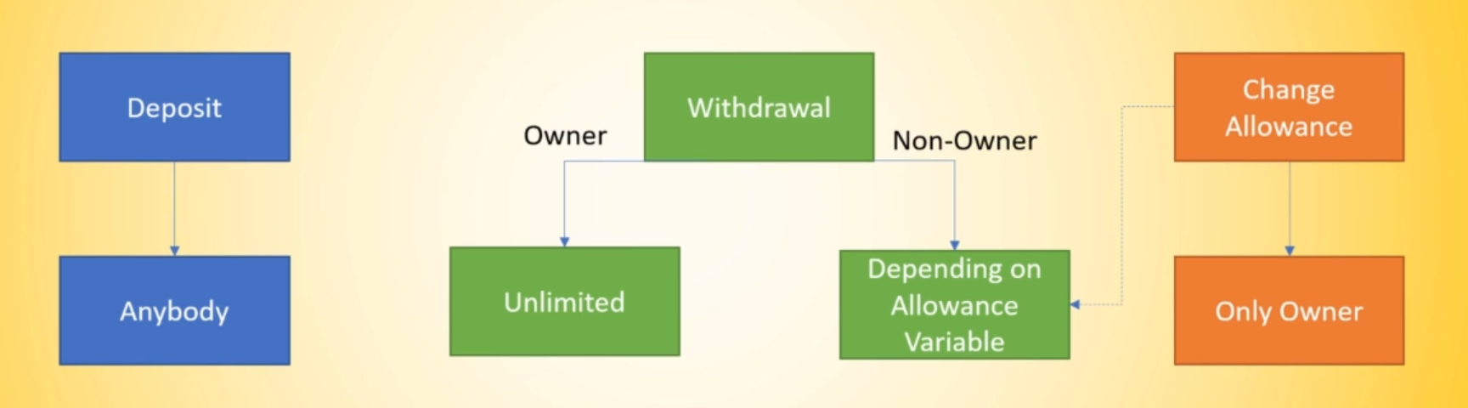
Simple Wallet Functionality

Slide 3
Roadmap
Deposit funds with fallback function
Security, Permission
Events
1
3
5
2
4
Withdraw money
Allowance

Slide 4
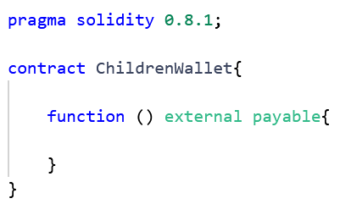
Deposit funds with fallback function
the first basic function that we are going to use

Slide 5
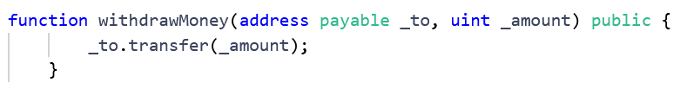
Withdraw money

Slide 6
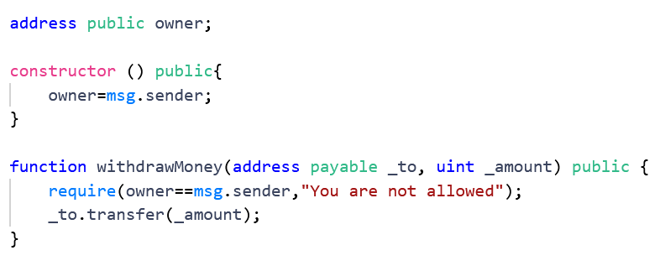
Adding Security
We want just the owner to be able to withdraw money

Slide 7
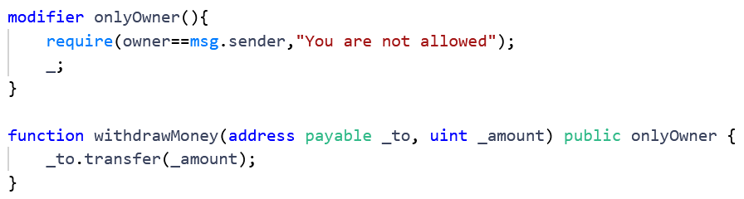
Modifier
● We can do the same with modifier and later we are able to extend its capabilities for the owner

Slide 8
OpenZeppelin [link]
Instead of Reinventing the wheel, we can use already existing smart contracts. OpenZeppelin has developed a set of different smart contracts under MIT license that we can use pretty much everywhere.
In remix we just need to import them.

Slide 9
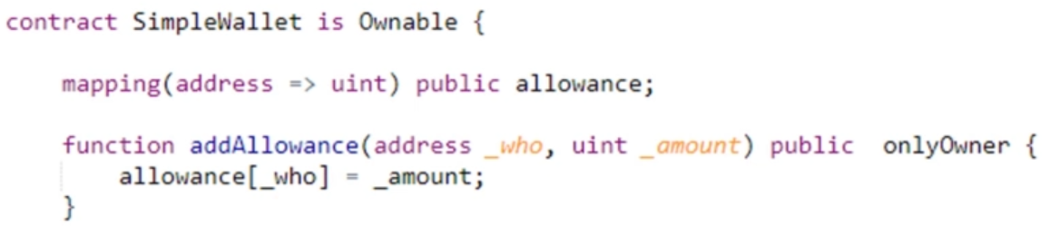
Adding Allowance Functionality

Slide 10
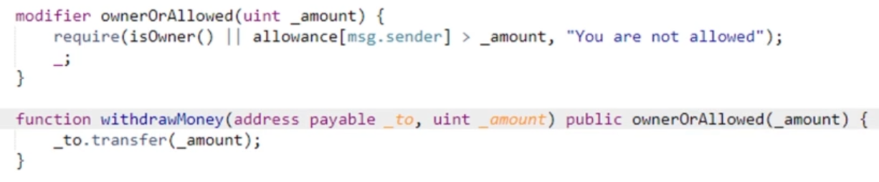
Adding Allowance Functionality

Slide 11
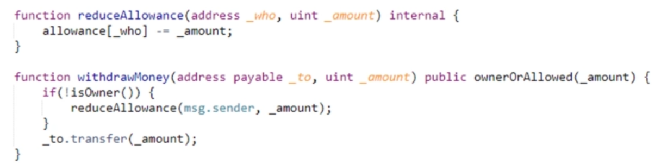
Double Spending
We need to reduce Allowance to prevent spending more than the allowed amount

Slide 12
Improving the structure

Slide 13

Informing
the users
Events are used for distributed applications which users can listen to things going on the blockchain without all the time pulling the blockchain node. Events are stored in a sort of sidechain. You can not retrieve them within solidity, but you can retrieve and listen to them from outside of solidity. Moreover, Using indexed we can search for them.

Slide 14
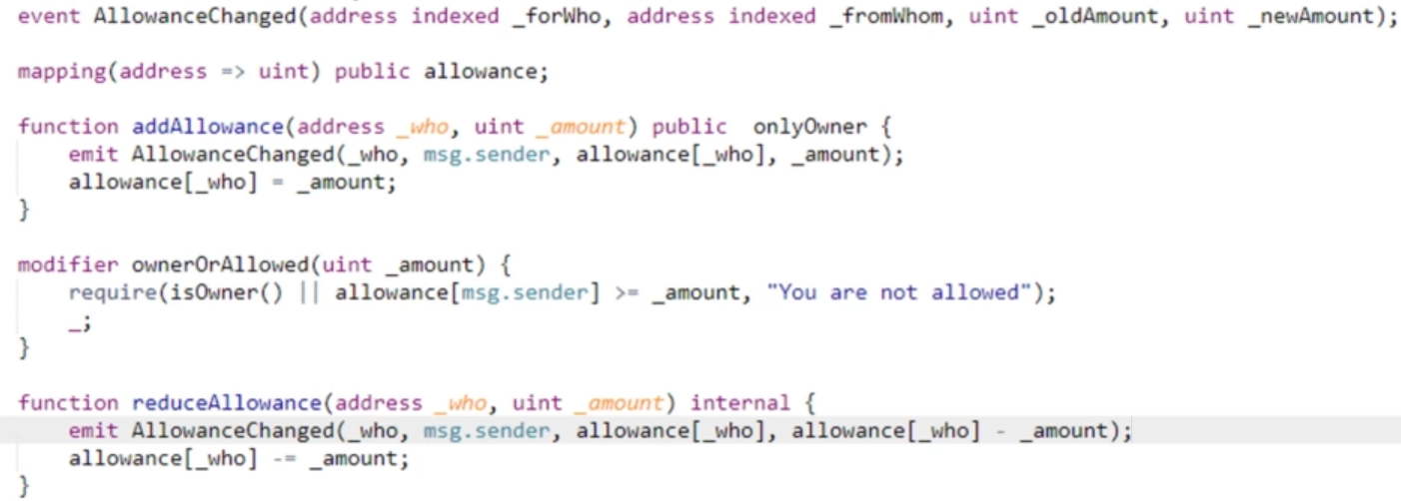

Slide 15
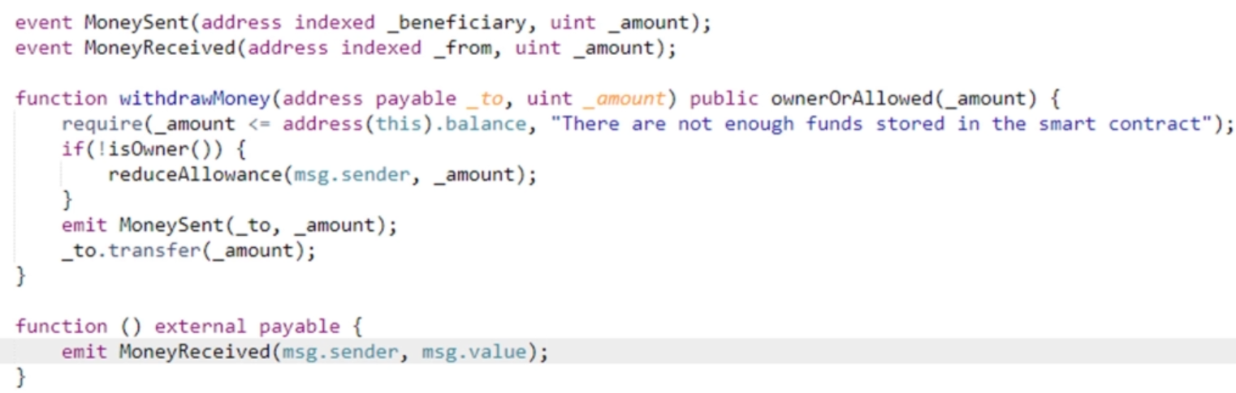

Slide 16
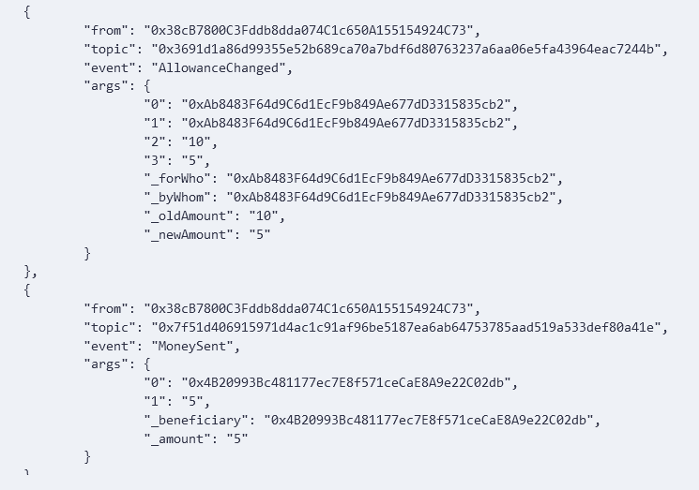

Slide 17
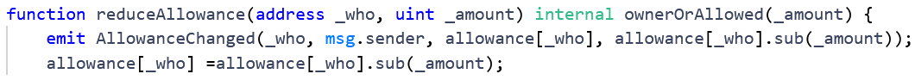
SafeMath

Slide 18
Renounce Ownership
In this case it doesn’t mean to have this function
So, we need to rewrite it

Slide 19
Bigger Project

Slide 20
Multi-sig functionality: Add multiple signature support to the smart contract, so that a certain number of family members need to sign off on a transaction before it can be executed.
Time-locked functionality: Add time-locked functionality to the smart contract, where a transaction can only be executed after a certain amount of time has passed.
Permission-based functionality: Add different levels of permissions for different family members, such as read-only access, partial spending access, and full spending access.
Automated payment scheduling: Add the ability to automatically schedule payments or transfers at specific times or intervals.
Integration with other smart contracts: Integrate the shared wallet smart contract with other smart contracts, such as decentralized exchanges or lending protocols, to allow for more advanced financial operations.
Audit trail and reporting: Add features to the smart contract that allow for tracking and reporting of all transactions made from the wallet, for transparency and accountability.
User interface: Develop a user-friendly interface to interact with the smart contract, such as a mobile app or web interface, that makes it easy for family members to manage the wallet.

Slide 21
Thanks!

