Slide 1
Coursework 2 - Robot Vision and Navigation
Manuel de Castro Ribeiro Jardim, Hassim Al-Obaidi, Cristhian Poveda, Amir Gerges - Group 4
27th March 2026
Notes:
Cover title slide using a full UCL Dark Purple colour as the background. The slide layout includes a main heading in the top left corner. The presenters’ names and the date are shown in the bottom left corner. The UCL logo is positioned in the bottom right corner of the slide.

Slide 2
Question 2 - Visual SLAM
Data collection & strategy
3D Reconstruction & camera calibration
ORB-SLAM2 configuration
Results and analysis
Notes:
Divider slide with a one-column layout. A headline is positioned at the top right and body text arranged beneath it. Sits on dark purple background.

Slide 3
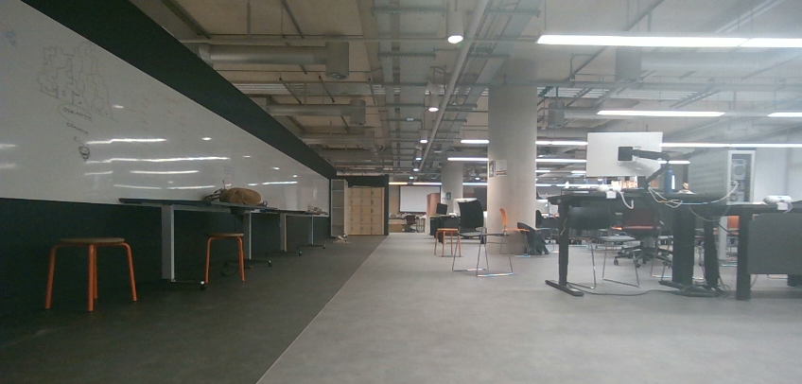
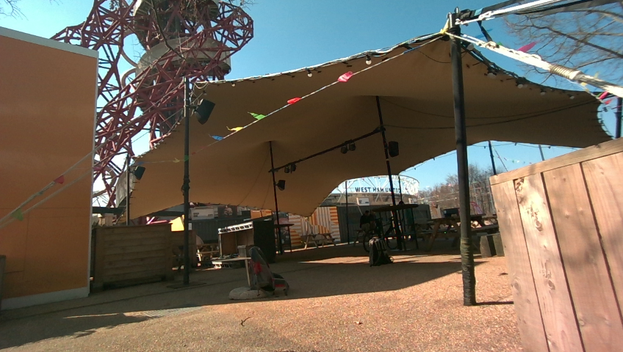
Data collection
The Bartlett Studio at UCL Marshgate chosen as the indoors environment.
  Contains a lot of easily identifiable static objects
  Stable lighting conditions
Riverside patio chosen as outdoor environment
  Feature rich
  Enough foreground objects for parallax effect.
Indoor environment (Bartlett Studio at UCL Marshgate)
Outdoor environment (Riverside patio)
Notes:
This content slide features a headline at the top left, followed by two columns, each providing space for an image with accompanying copy beneath.

Slide 4
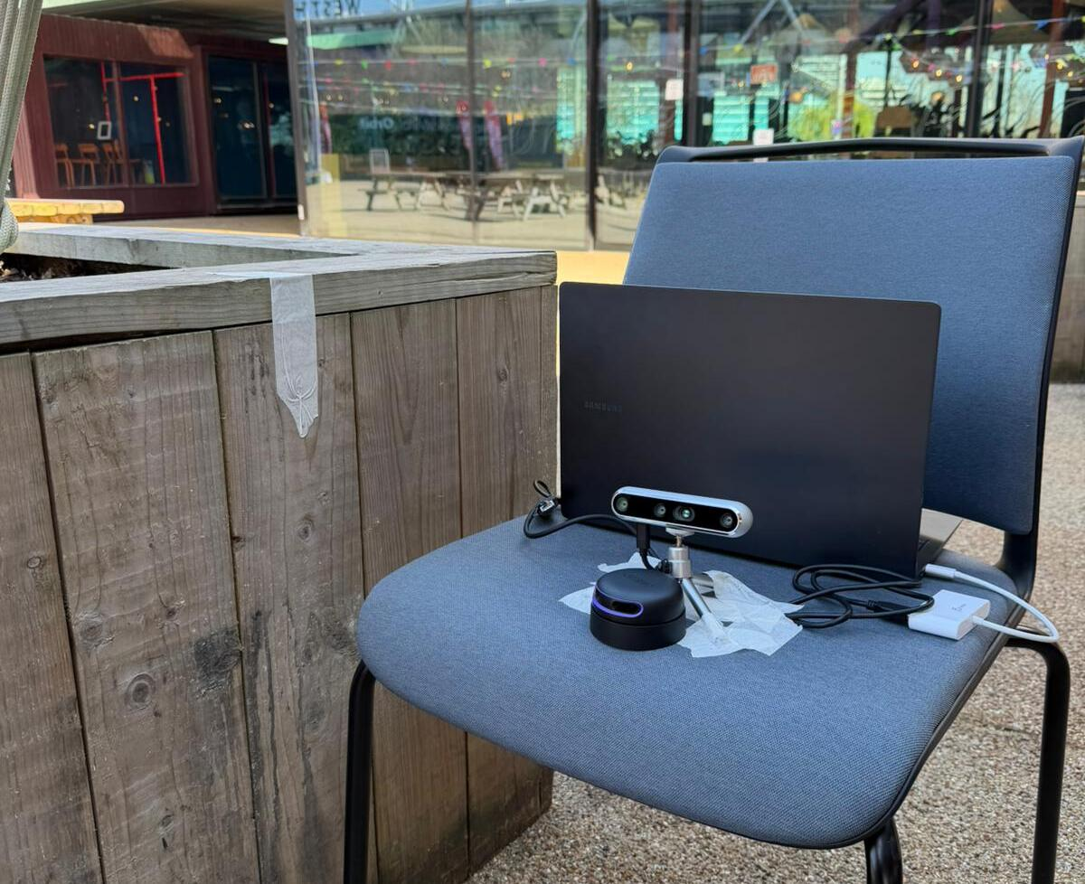
Data collection
Mobile camera setup used for data collection
Images were captured at 10 fps with a resolution of 848 x 480.
Images processed offline and downsampled to 550 images uniformly distributed over the loop duration.
Mobile camera setup
Notes:
This content slide features a headline at the top left, followed by two columns, each providing space for an image with accompanying copy beneath.

Slide 5

3D reconstruction & camera calibration
Feature extraction:
  Through the COLMAP database, the optimiser uses the entire dataset to compute a single unified set of calibrated parameters.
  OpenCV camera model used, defining 8 intrinsic parameters, including distortion for a precise estimation of the camera projection matrix.
Feature matching:
  Vocab tree to filter out what images share the same scenery as the current frame.
  Name of the tree filter?
Mapping:
  3D reconstruction left to default values, bundle adjustment at every 10% increase in number of images or points.
  Mapping step used to refine camera calibration.
Notes:
This content slide features a headline at the top left, followed by two columns, each providing space for an image with accompanying copy beneath.

Slide 6
ORB-SLAM Configuration
Image pyramid at scale factor 1.2 with 8 levels
RealSense camera resolution of 840x480
Fast threshold set to 20
Indoor Sequence:
  Environment rich in distinct features, therefore number of features set to 1000 per frame
Outdoor Sequence:
  Number of features set to 2000
  Ensures enough foreground features are detected and used for localization
Notes:
This content slide features a headline at the top left, followed by two columns, each providing space for an image with accompanying copy beneath.

Slide 7
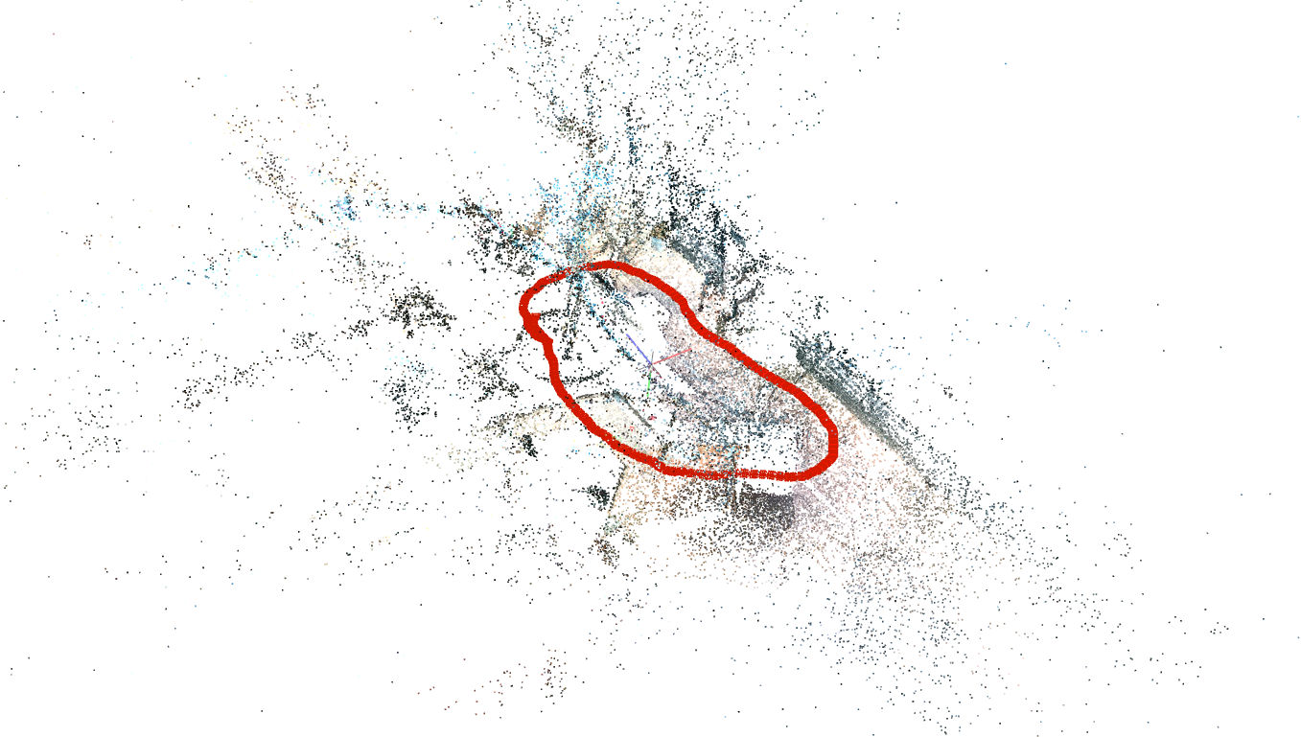
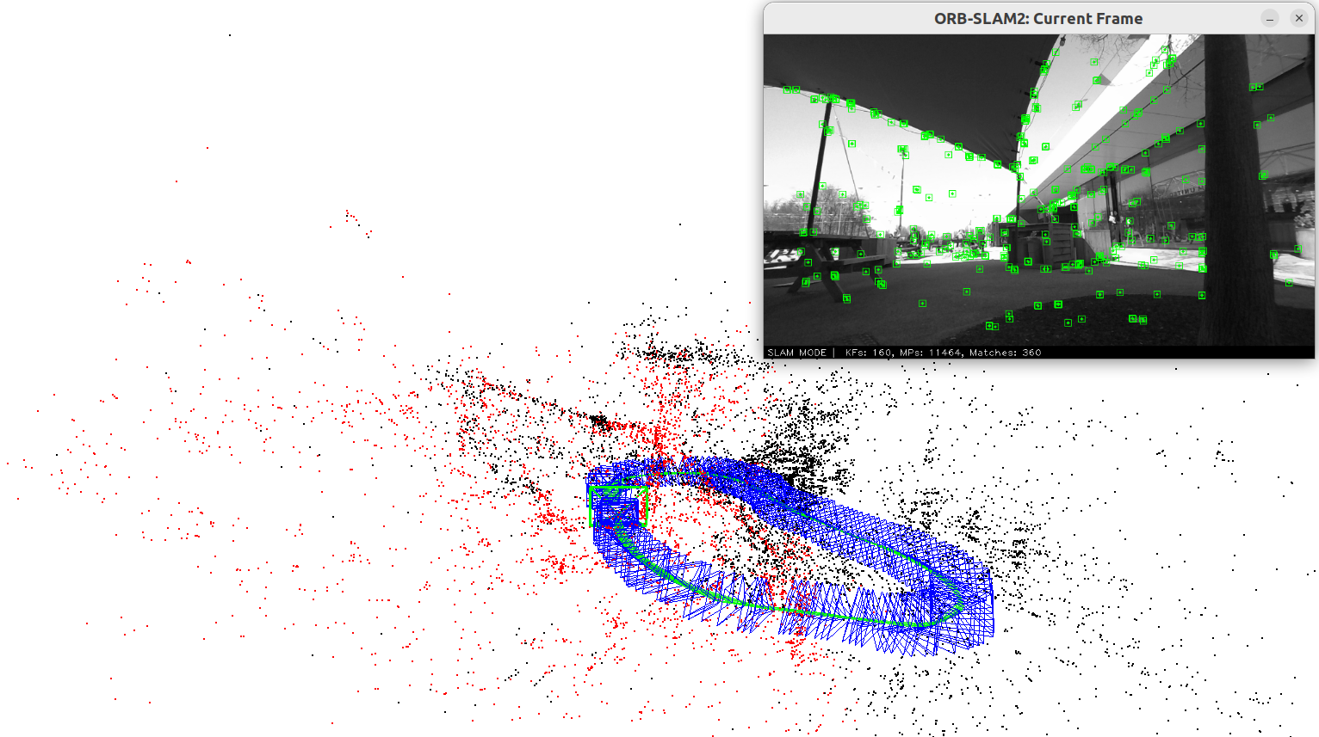
Results
3D Reconstructions:
  COLMAP outputs a significantly denser reconstruction than ORB-SLAM2
  In contrast, ORB efficiently triangulates high-gradient features, enough to perform live tracking.
  Both methods successfully perform loop closure
ORB-SLAM2 reconstruction of outdoor environment
COLMAP reconstruction of outdoor environment
Notes:
This content slide features a headline at the top left, followed by two columns, each providing space for an image with accompanying copy beneath.

Slide 8
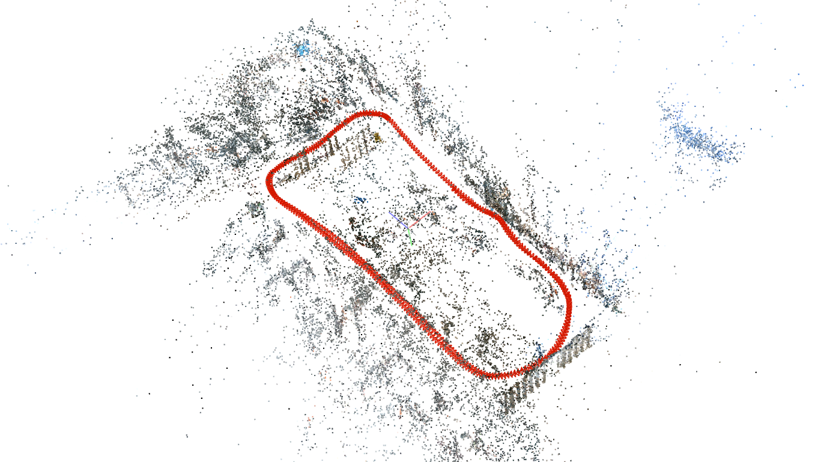
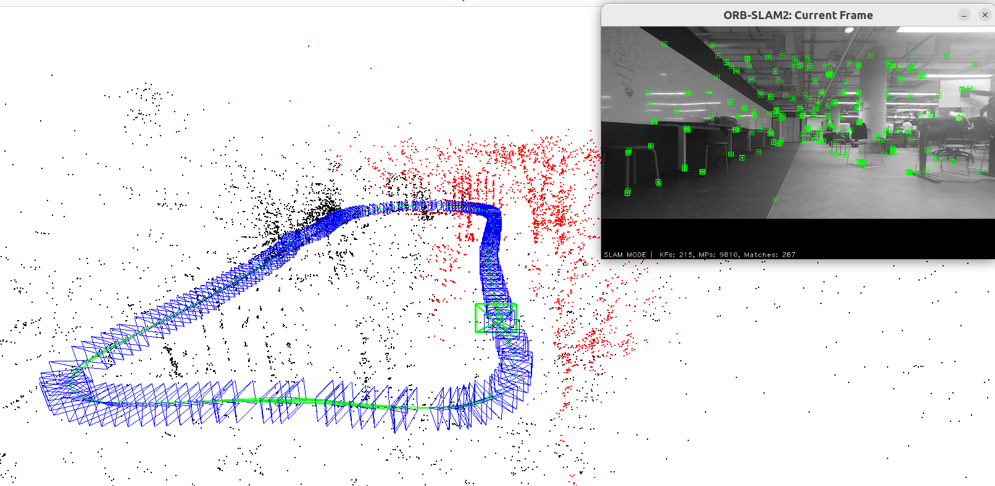
Results
ORB-SLAM2 reconstruction of indoor environment
COLMAP reconstruction of indoor environment
Notes:
This content slide features a headline at the top left, followed by two columns, each providing space for an image with accompanying copy beneath.

Slide 9
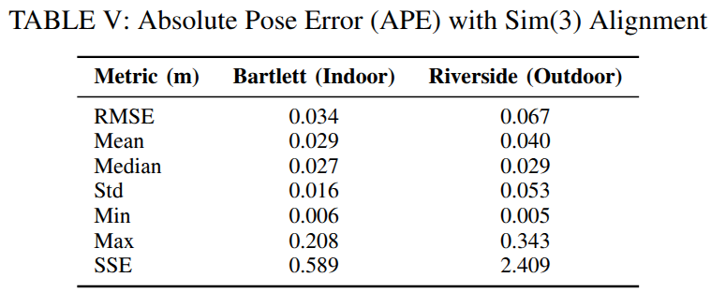
Results
Trajectory alignment and reconstruction:
  COLMAP was used as the ground-truth for Absolute Pose Error (APE)
  While the Riverside environment had a higher mean error, both scenarios were successfully reconstructed by ORB-SLAM2, with centimeter level precision.
Notes:
This content slide features a headline at the top left, followed by two columns, each providing space for an image with accompanying copy beneath.

Slide 10
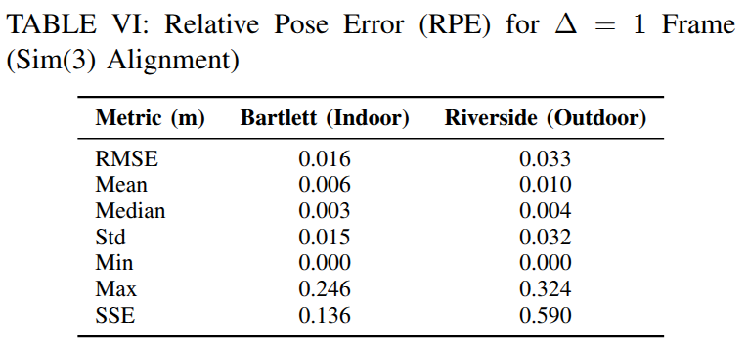
Results
Trajectory alignment and reconstruction:
  Displays the Relative Pose Error (RPE) between the COLMAP and ORB-SLAM2 computed trajectories
  Demonstrates that ORB-SLAM2 is highly stable at computing frame-to-frame tracking.
Notes:
This content slide features a headline at the top left, followed by two columns, each providing space for an image with accompanying copy beneath.

Slide 11
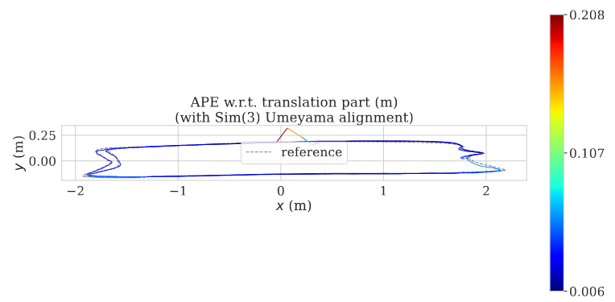
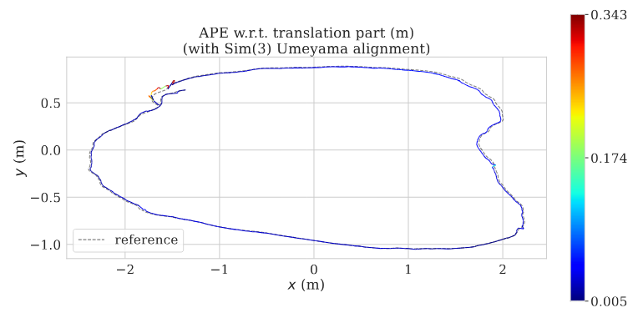
Results
Trajectory alignment and reconstruction:
  Error heatmap for the APE of ORB-SLAM2 compared with COLMAP for both scenarios.
  Overall, the estimated path is accurate to the ground truth
  The highest errors occur under pure rotation of the camera
Indoor Sequence (Bartlett)
Outdoor Sequence (Riverside)
Notes:
This content slide features a headline at the top left, followed by two columns, each providing space for an image with accompanying copy beneath.

Slide 12
Question 3 - LiDAR SLAM
Parameter Sweeps on LiDAR Scans
Automatic Loop Detection
Factor Graph Optimisation
Map Points, Occupancy Grids and Live SLAM Videos
Notes:
Divider slide with a one-column layout. A headline is positioned at the top right and body text arranged beneath it. Sits on dark purple background.

Slide 13
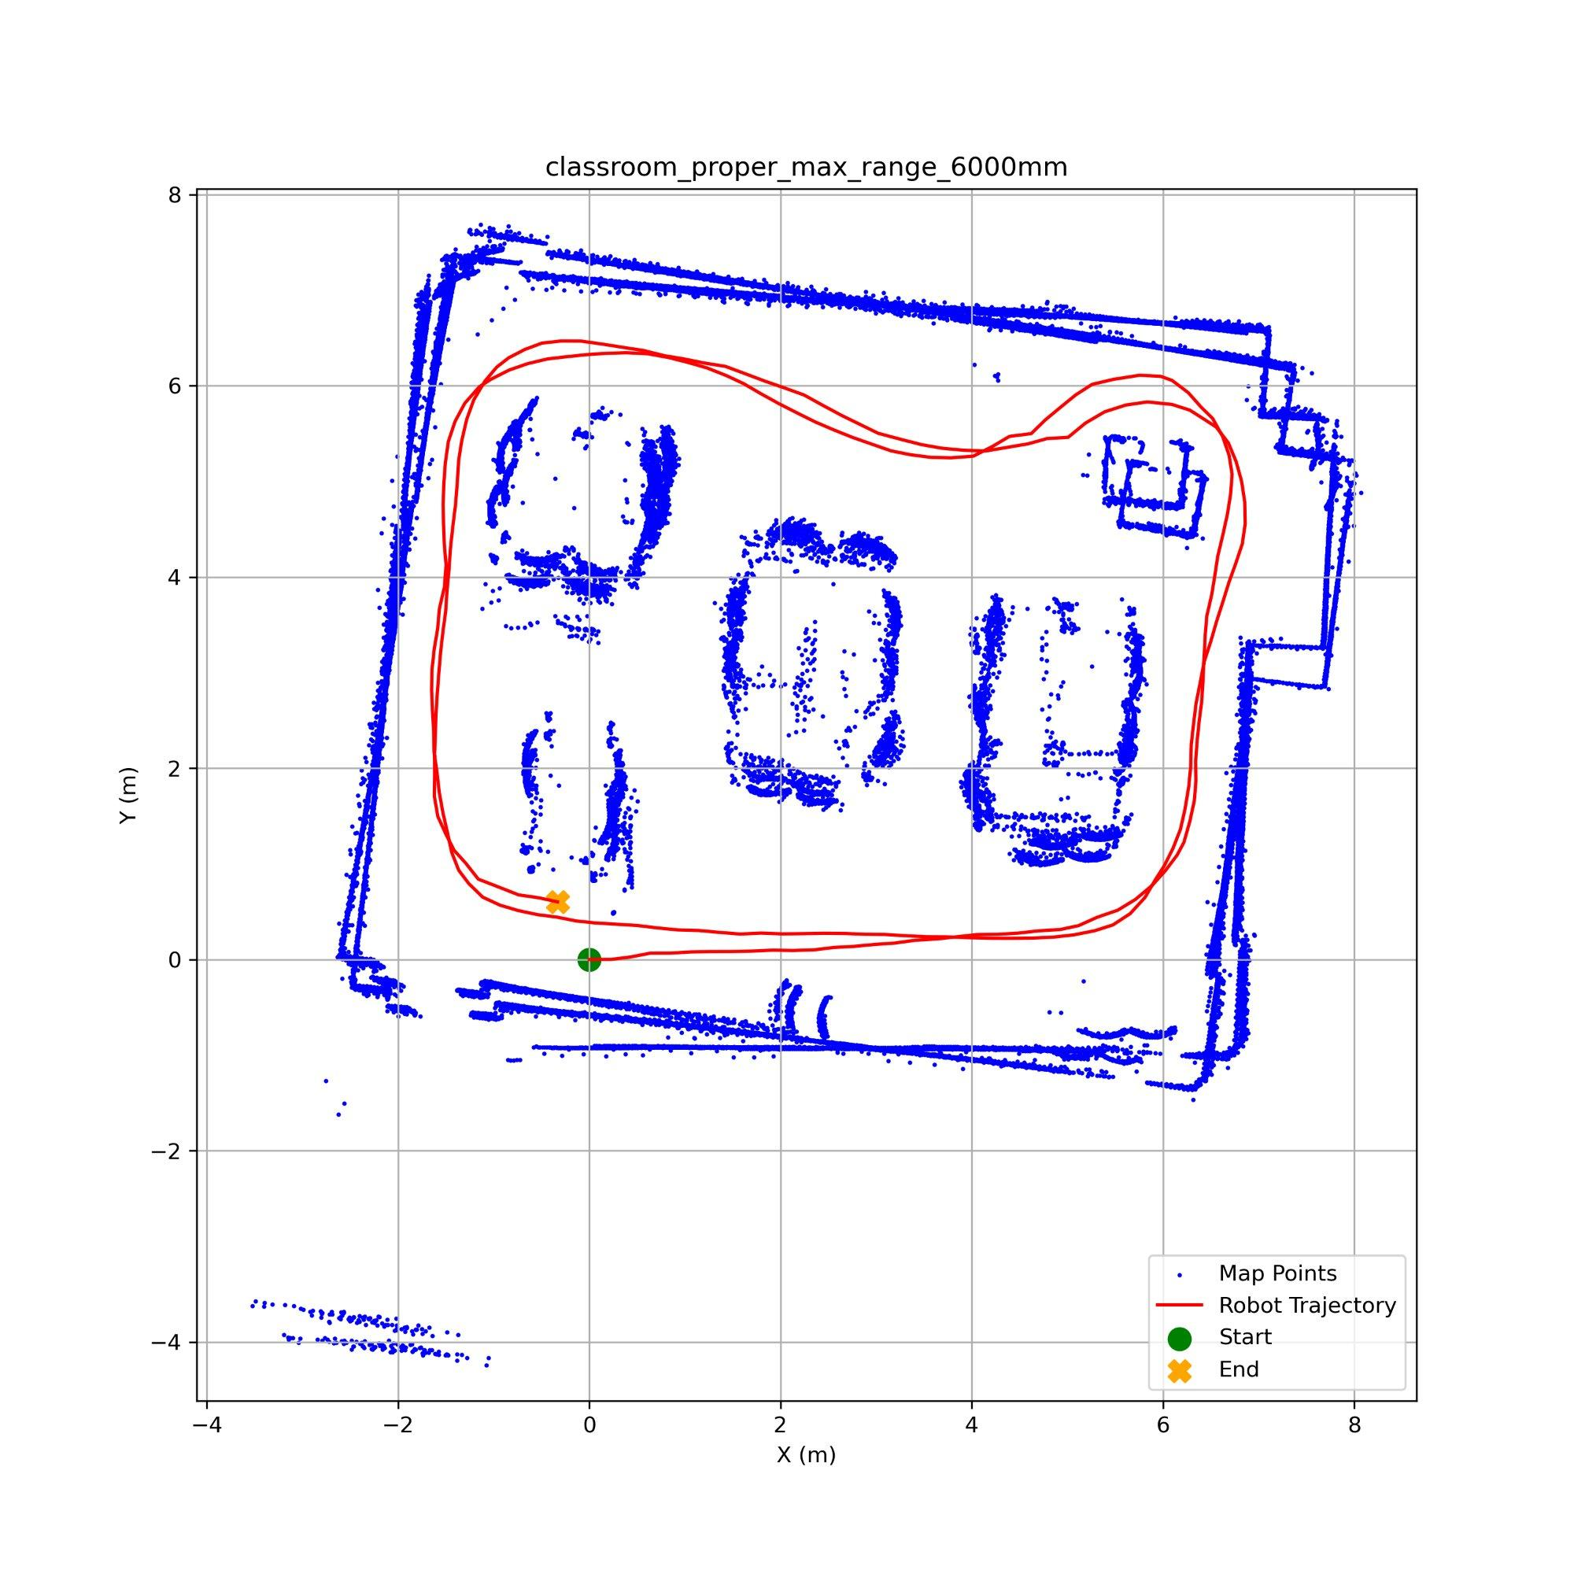
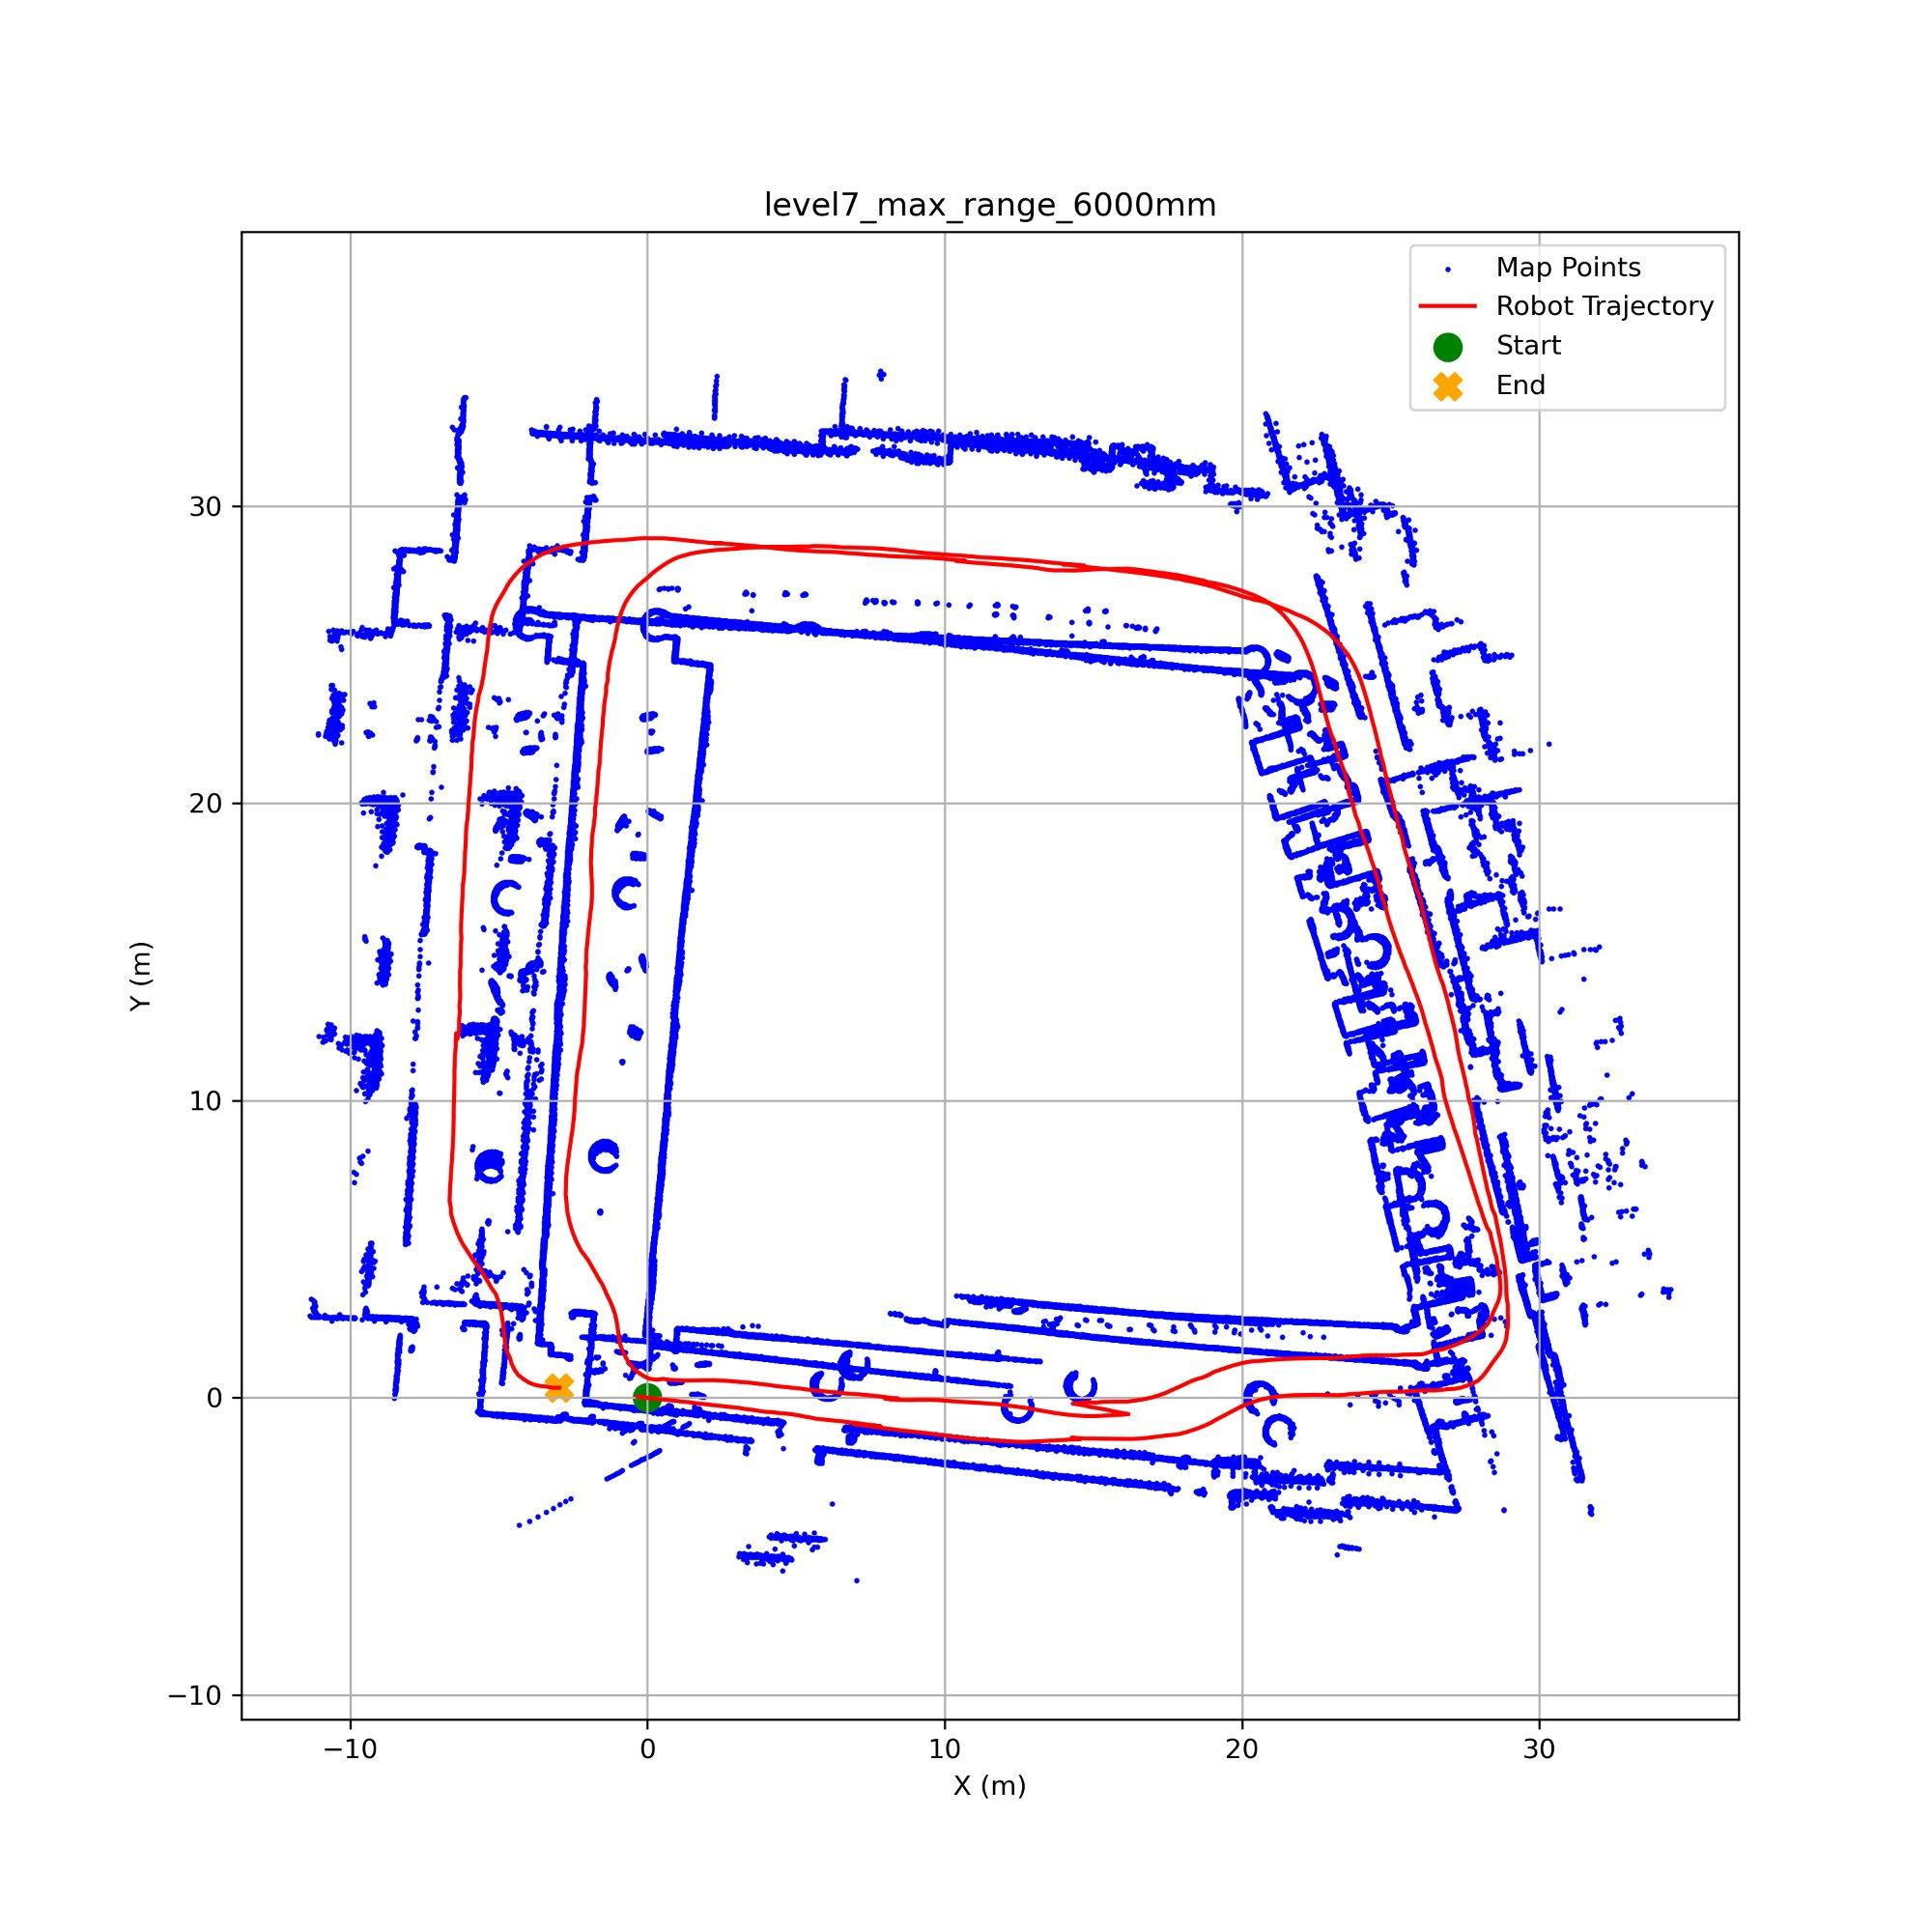
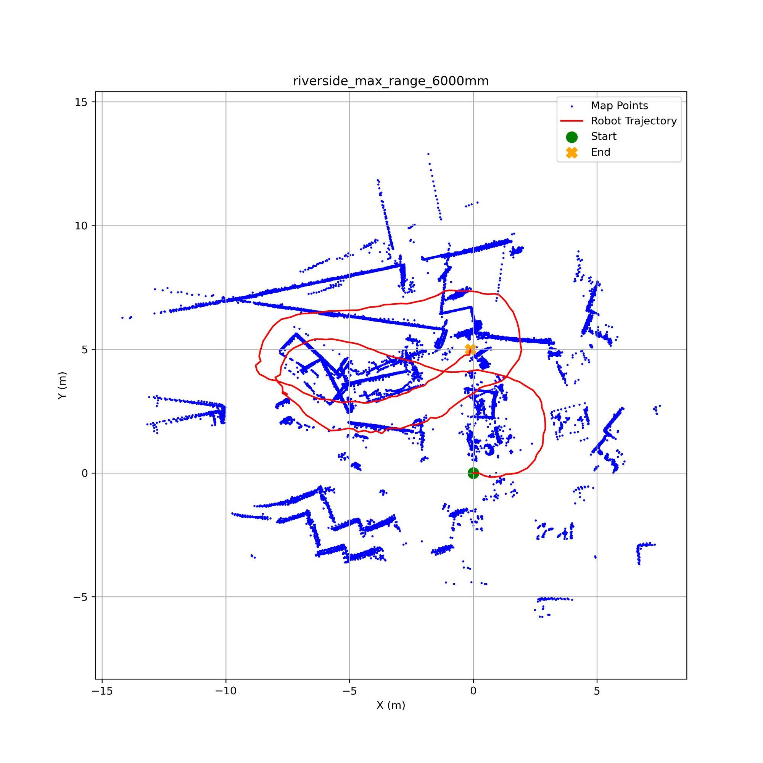
Maximum Range
Classroom
Level 7
Riverside
Classroom was unaffected (avg sep 0.14m) since everything in the room is already within 6m
Level 7 looks like it improved (closure 4.68 to 2.99m) but the loops actually drifted more mid-path (avg sep 0.72 to 1.70m)
Riverside got significantly worse (avg sep 0.31 to 1.34m) because most features are beyond 6m in this outdoor space
Only useful in small spaces. Also shows why closure error alone can be misleading
Notes:
This content slide features a headline at the top left, followed by two columns, each providing space for an image with accompanying copy beneath.

Slide 14
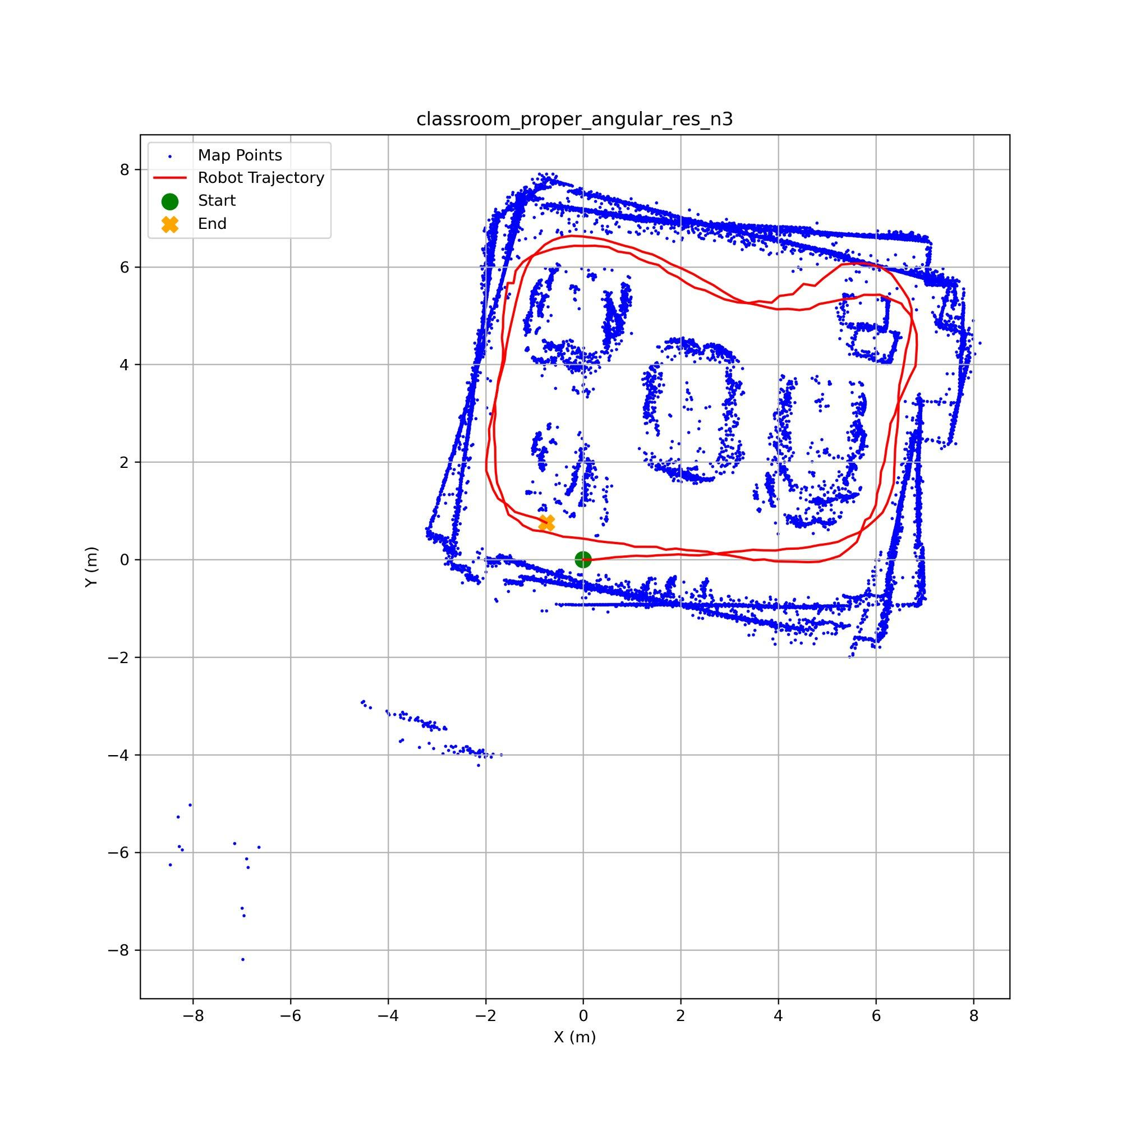
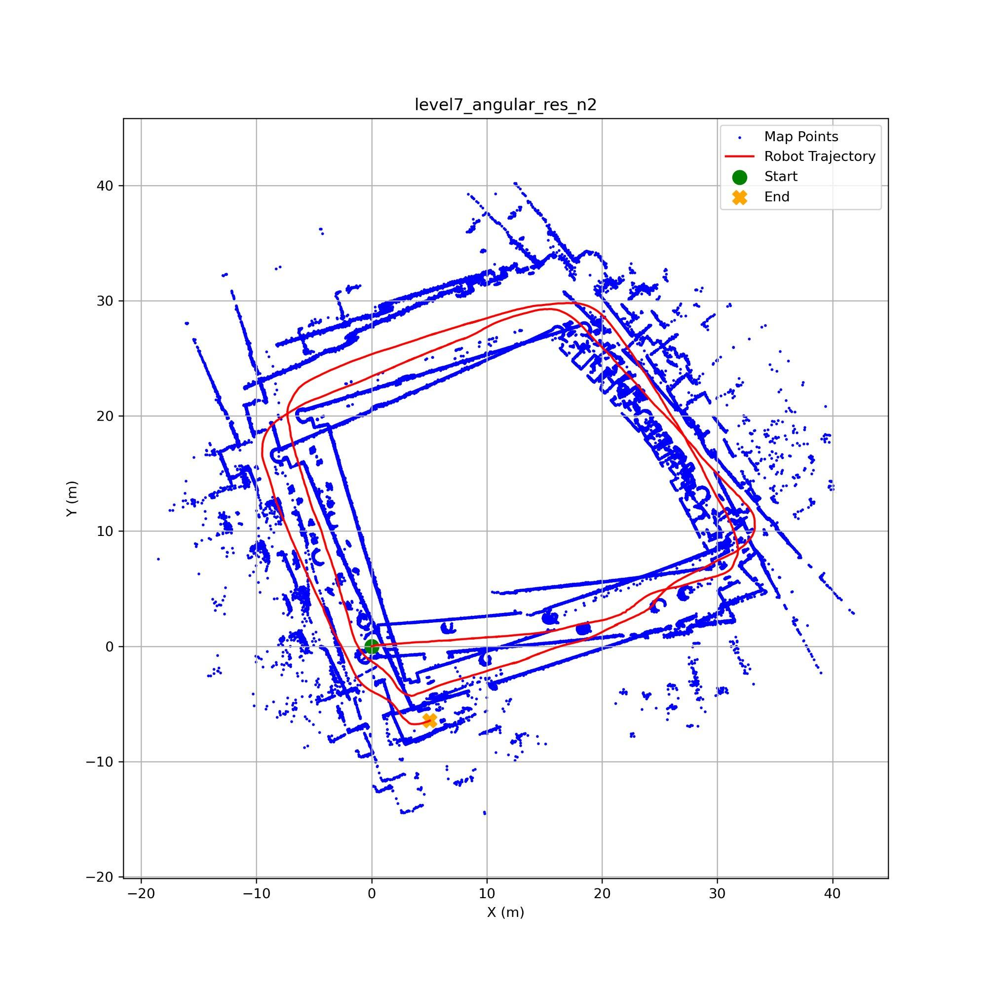
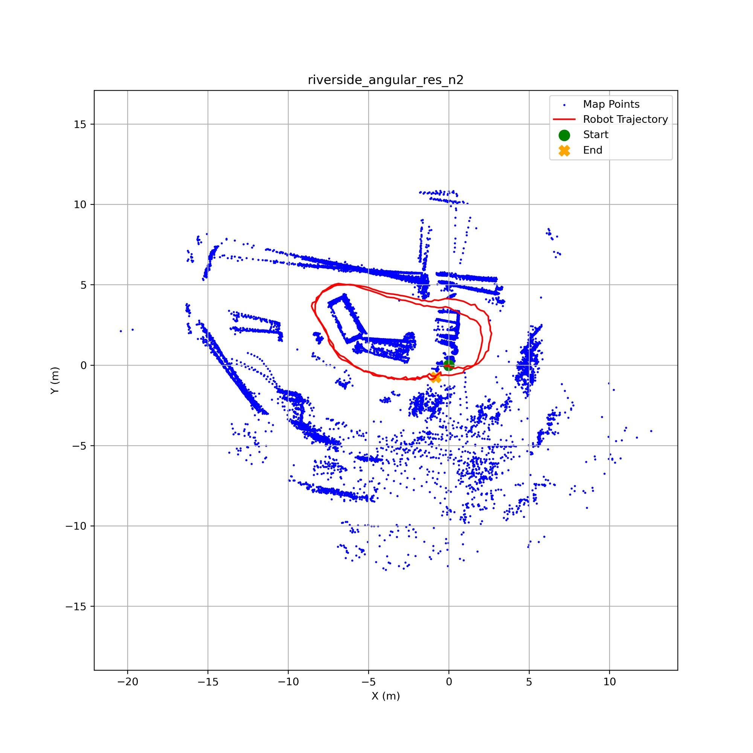
Angular Resolution
Classroom (n=3)
Level 7 (n=2)
Riverside (n=2)
Classroom handled it reasonably at n=3 (avg sep 0.15 to 0.20m) but degraded more at n=2 (0.30m)
Level 7 struggled the most as halving beams caused the avg sep to jump from 0.72 to 1.55m
Riverside was barely affected even at n=2 (avg sep 0.31 to 0.26m) due to nearby geometry
This depends on the environment if there is strong geometry close by, ICP can still align with fewer beams

Slide 15
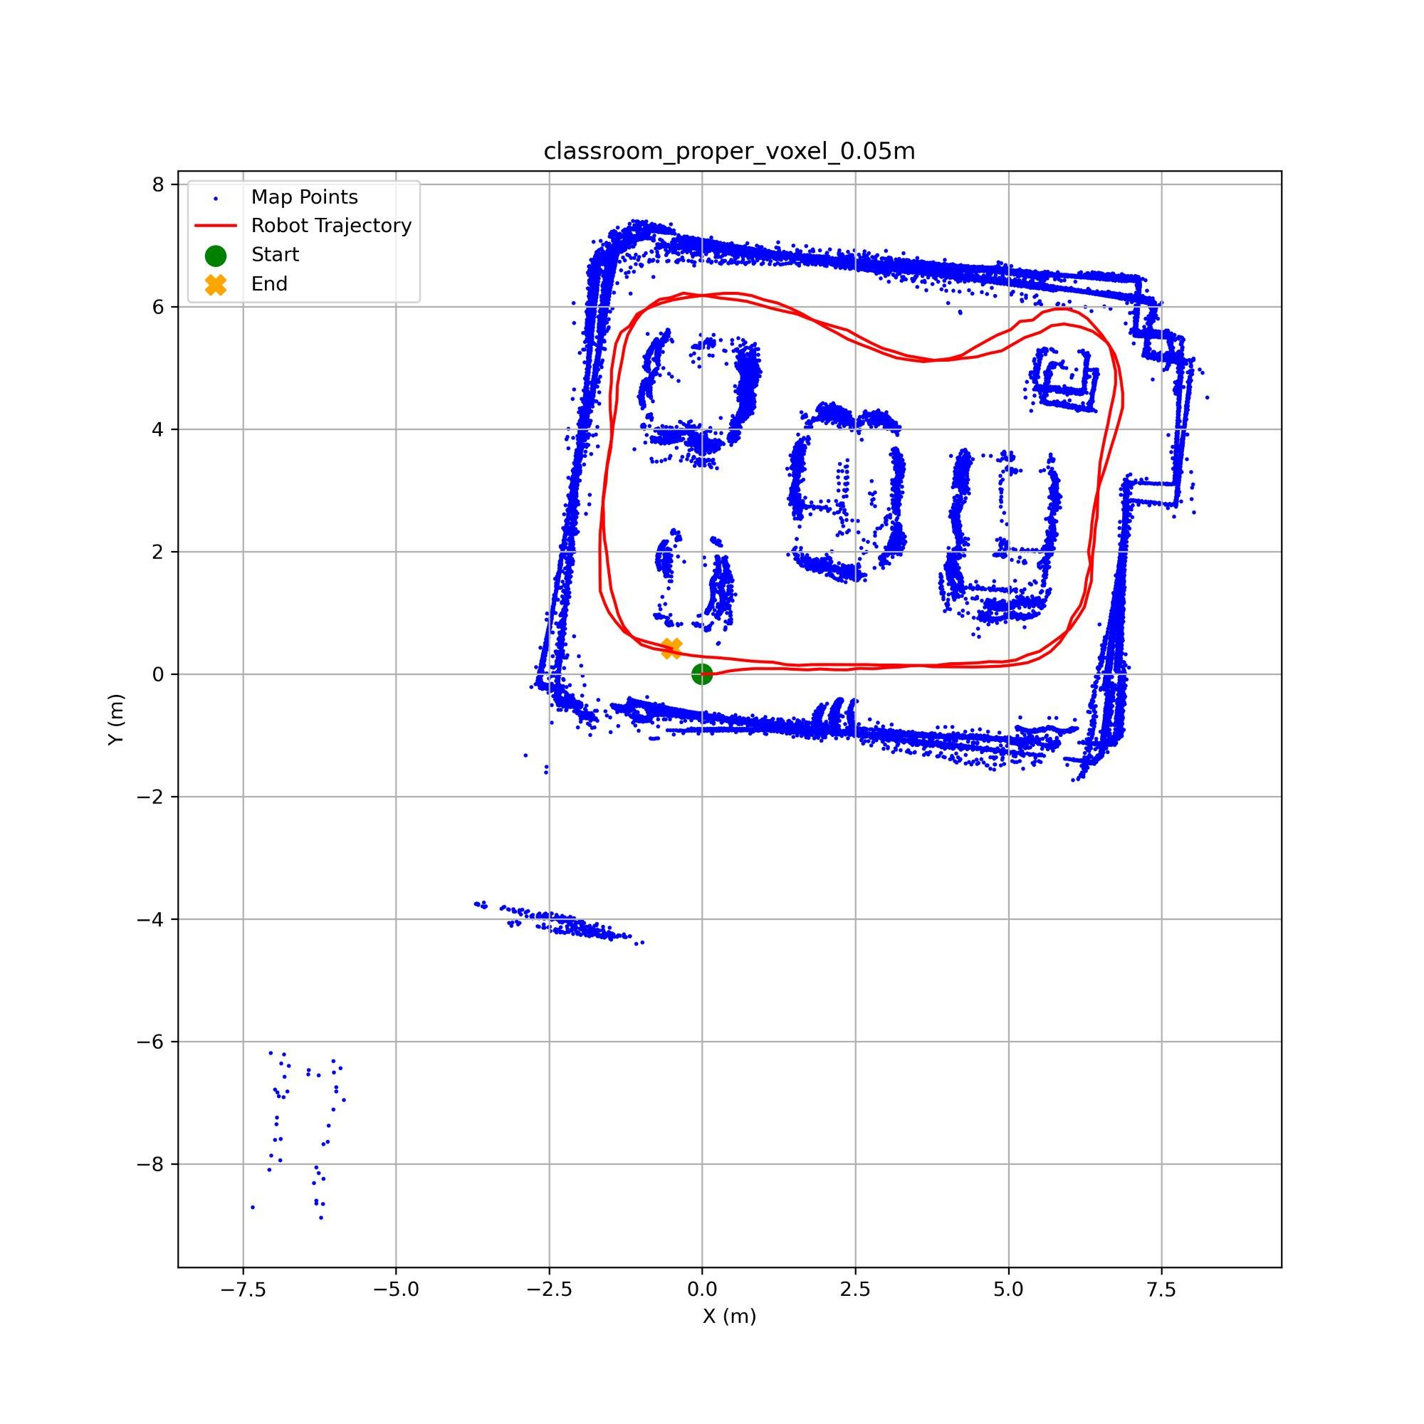
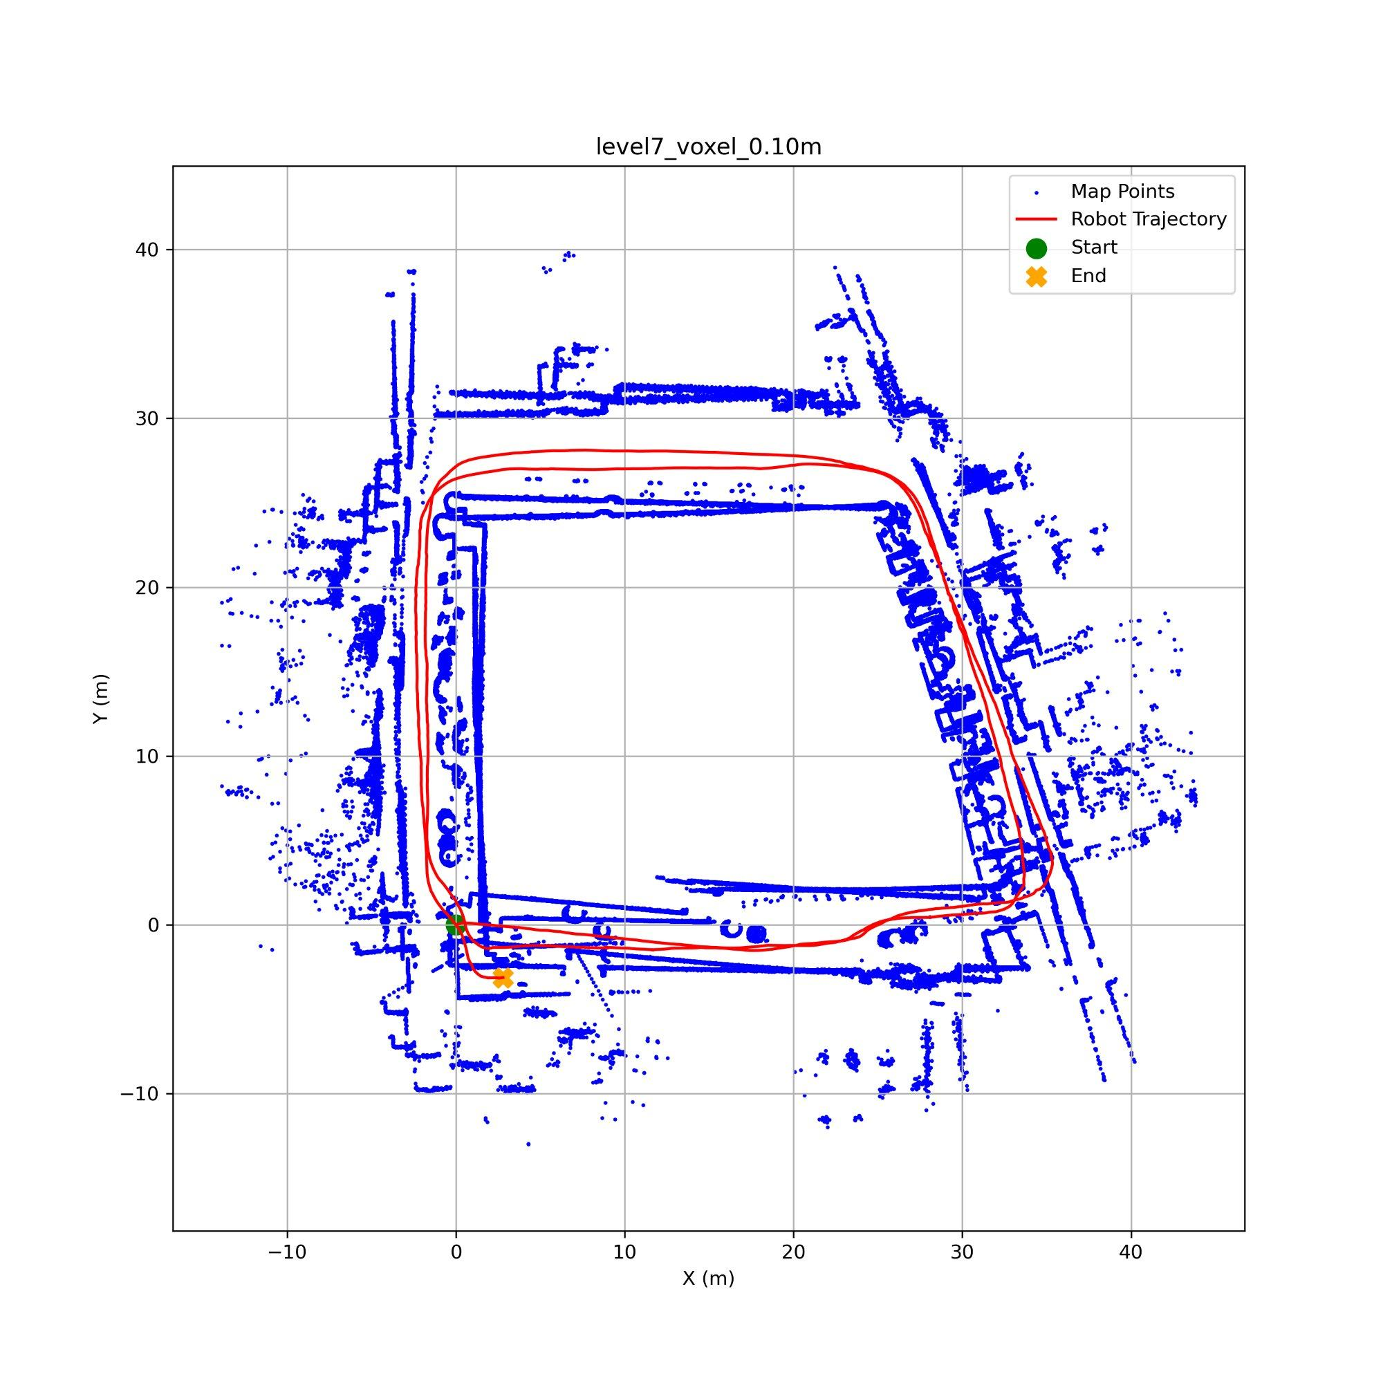
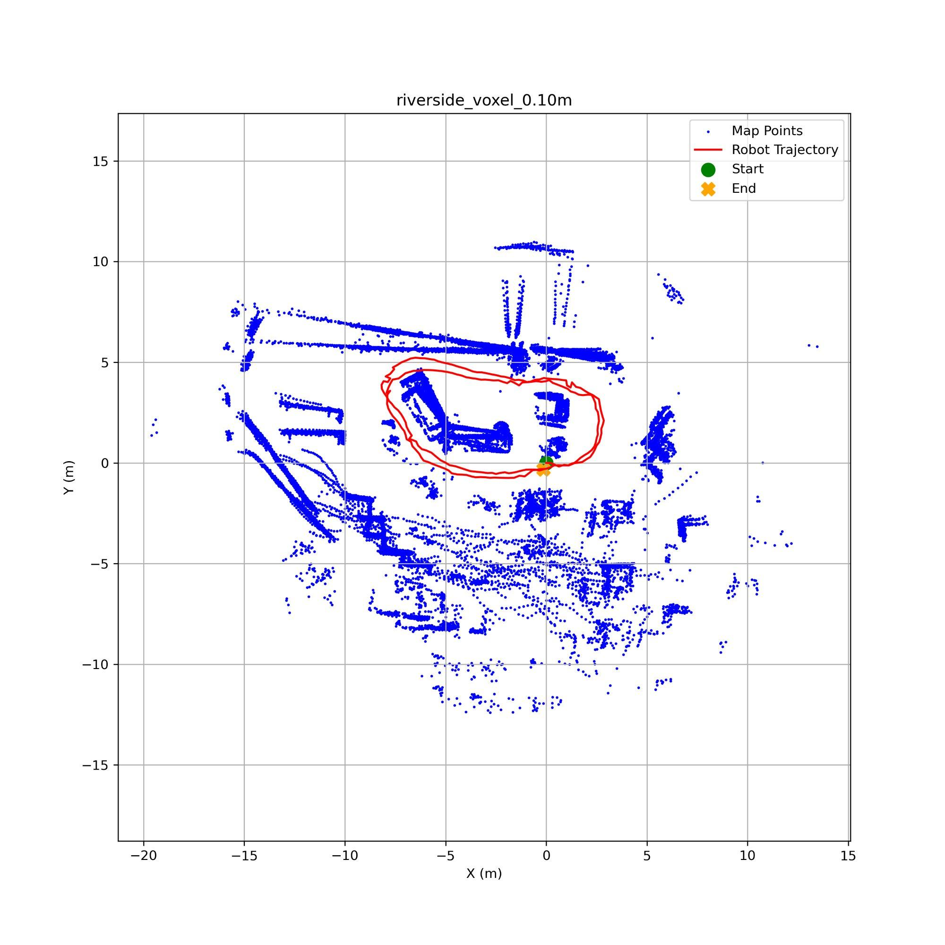
Voxel Grid Downsampling
Classroom (0.05m)
Level 7 (0.10m)
Riverside (0.10m)
Classroom at 0.05m gave our best result for this dataset (avg sep 0.12m, closure 0.65m)
Level 7 at 0.10m also improved over baseline (avg sep 0.72 to 0.58m, max sep 2.60 to 1.81m)
Riverside at 0.10m was the best of any riverside experiment (avg sep 0.27m, closure just 0.35m)
Best parameter overall as it cleans up dense clusters without throwing away features in sparse areas, so ICP gets better correspondences

Slide 16
Scan Rate
Classroom (0.05m)
Level 7 (0.10m)
Riverside (0.10m)
Classroom stayed stable even with only 33% of scans (avg sep 0.14m, closure 0.38m)
Level 7 actually improved as avg sep dropped from 0.72 to 0.44m because fewer ICP steps means less accumulated drift
Riverside also held up good (avg sep 0.35m, slight closure increase to 1.55m but loops stayed aligned)
Safest parameter to change as each scan still has all its beams so individual ICP quality is not affected, only the total number of steps changes

Slide 17
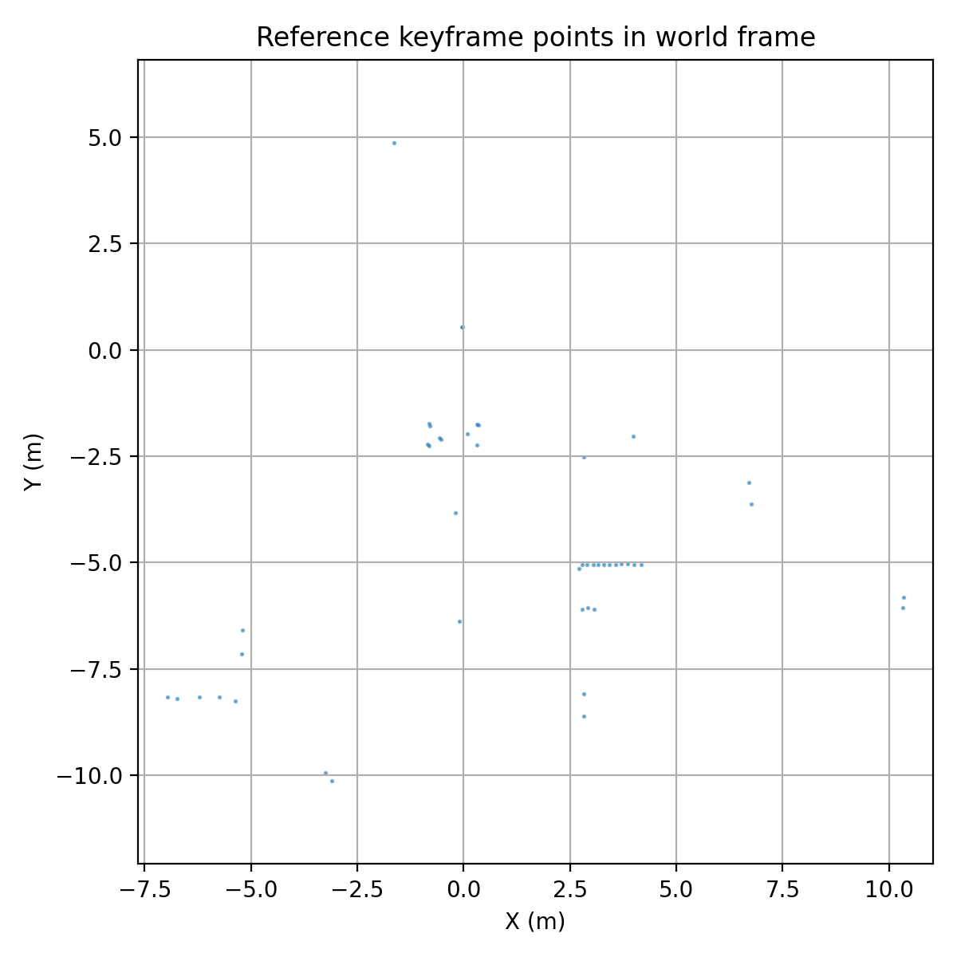
Loop Closure Detection
Core challenge: Single-scan matching is unreliable — individual LiDAR scans are too sparse/noisy for direct comparison
Solution: Aggregate each keyframe with ±10 neighbouring keyframes, then compute a 2D bearing-range histogram descriptor (36 angular × 24 range bins = 864-dim vector)
Similarity metric: Cosine similarity after L₂ normalisation
Notes:
This content slide features a headline at the top left, followed by two columns, each providing space for an image with accompanying copy beneath.

Slide 18
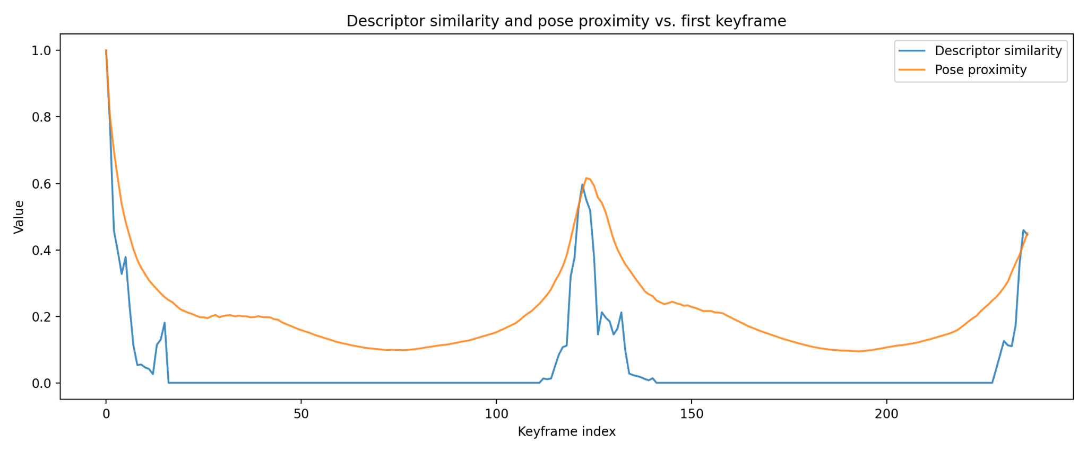
Dual Signal Criterion

Slide 19
Loop Closure Detection - Avoiding False Positives
Peak confirmation: 5-keyframe sliding window - candidate only confirmed once the signal has peaked and begun to decline (avoids premature triggering on an ascending signal)
Minimum temporal gap: 30 keyframes enforced to prevent self-matches
Proximity gate: 3 m Cartesian threshold before descriptor computation is even attempted
Cap of 10 loop closures per run to limit risk of false positives in bad environments e.g long corridors
Notes:
This content slide features a headline at the top left, followed by two columns, each providing space for an image with accompanying copy beneath.

Slide 20
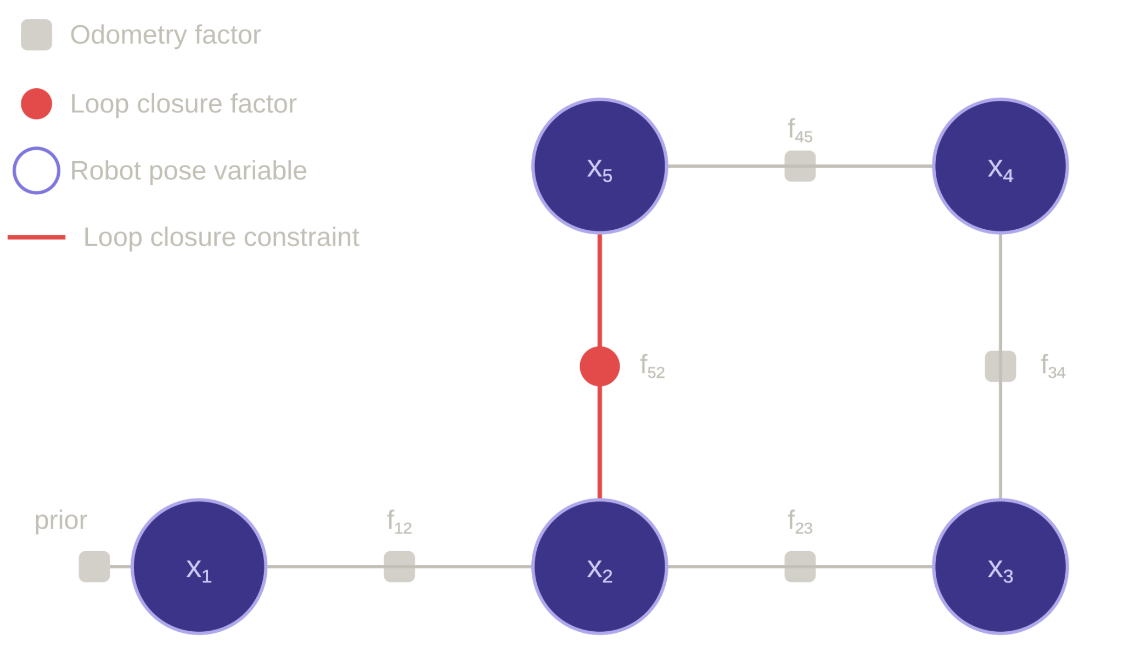
Graph Optimisation
Node: robot pose (x, y, theta)
Odometry Factor: encodes the rotation and translation between current and next robot pose (from ICP)
Loop Closure Factor: hard constraint that both robot poses are the same
Levenberg-Marquardt: optimisation called for every loop closure
Notes:
This content slide features a headline at the top left, followed by two columns, each providing space for an image with accompanying copy beneath.

Slide 21
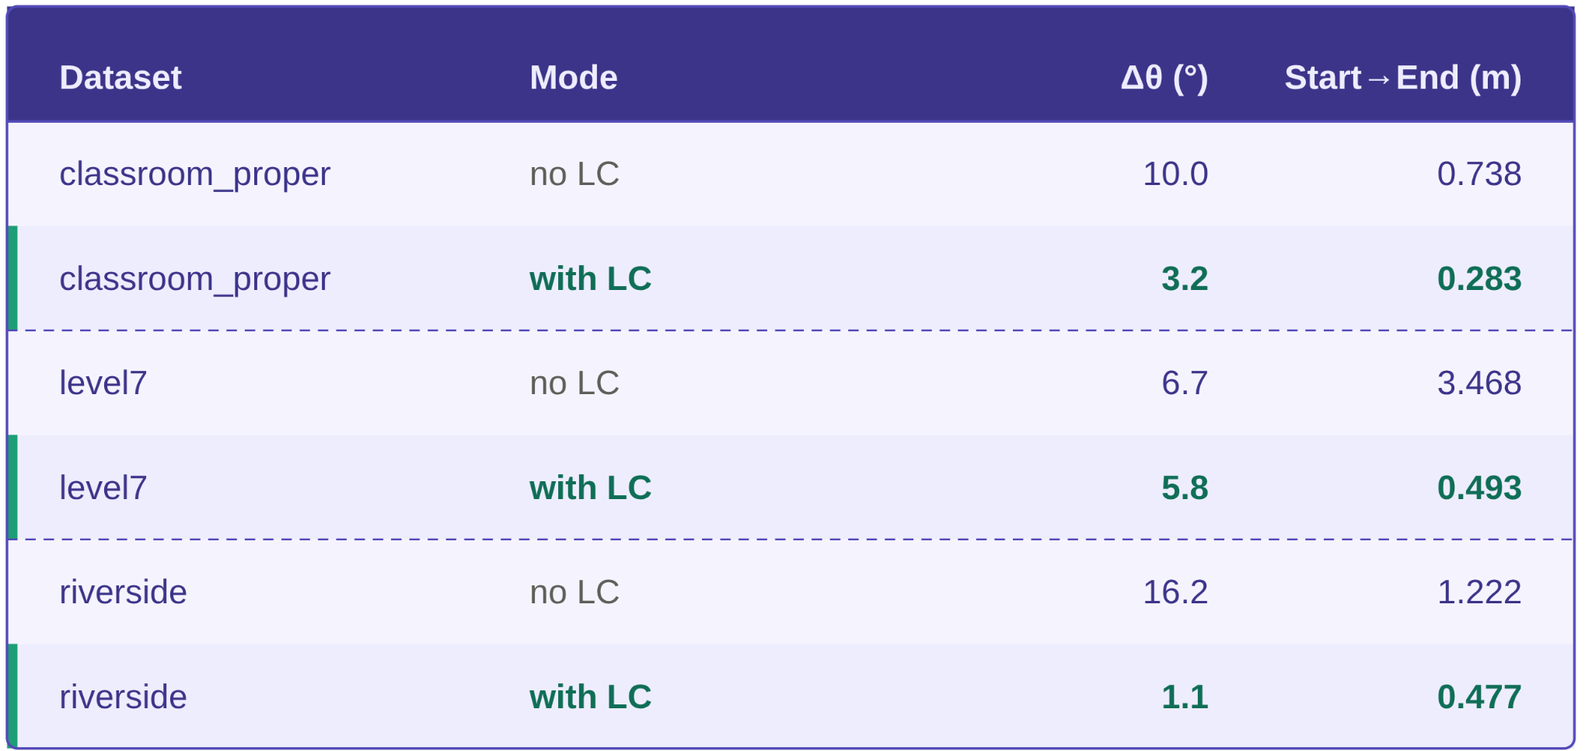
LiDAR Results - Quantitative

Slide 22
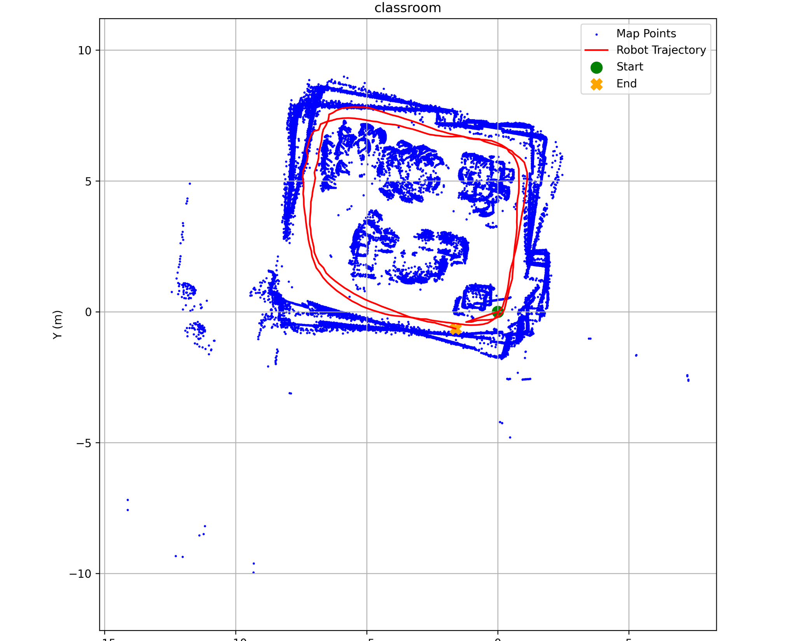
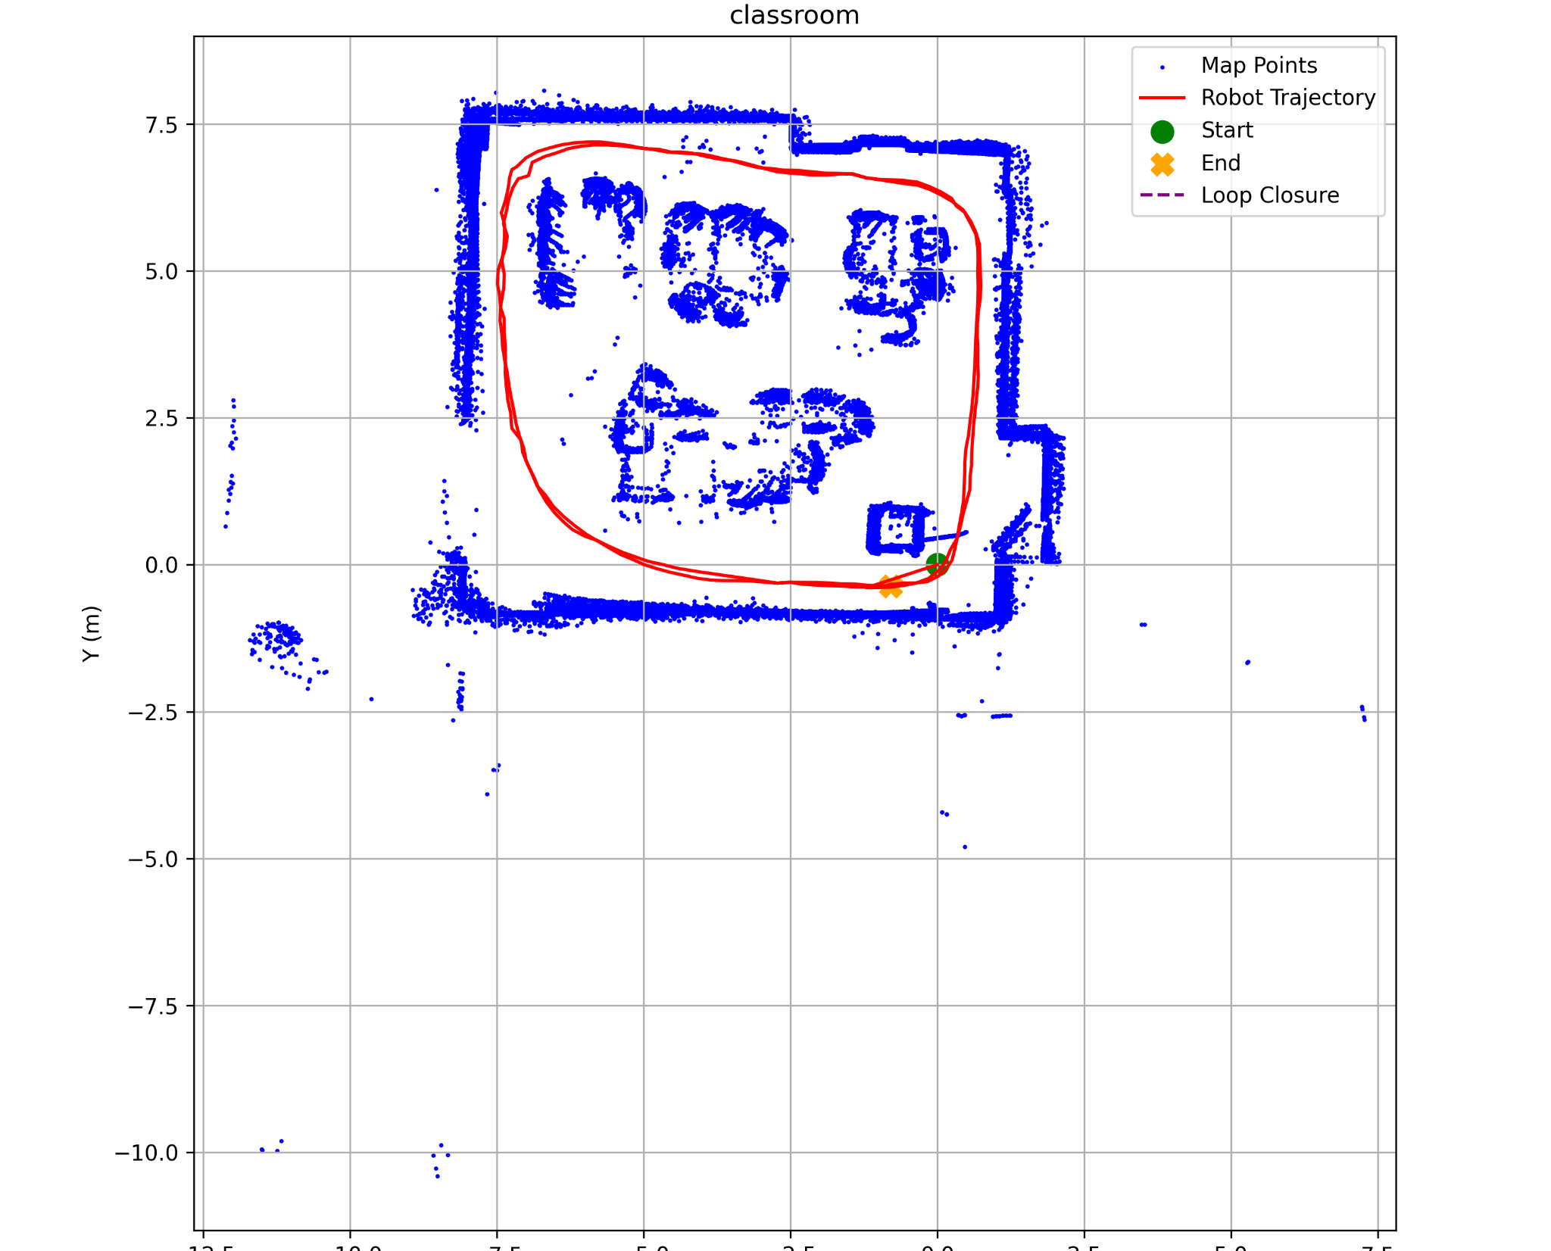
Results - Classroom

Slide 23
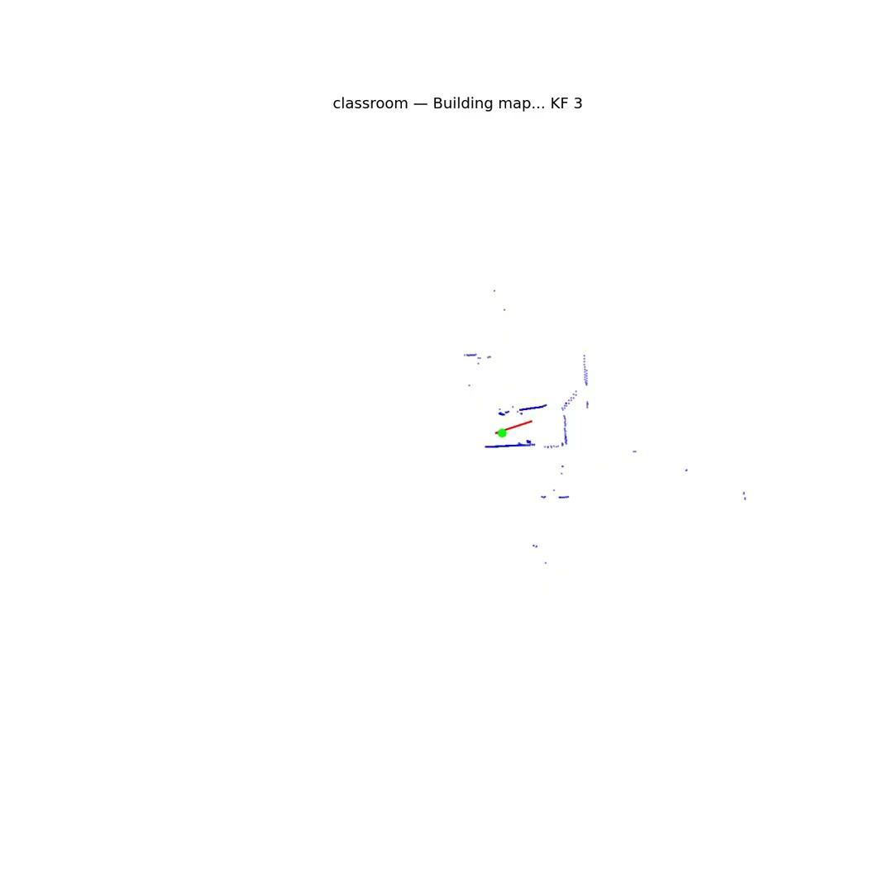
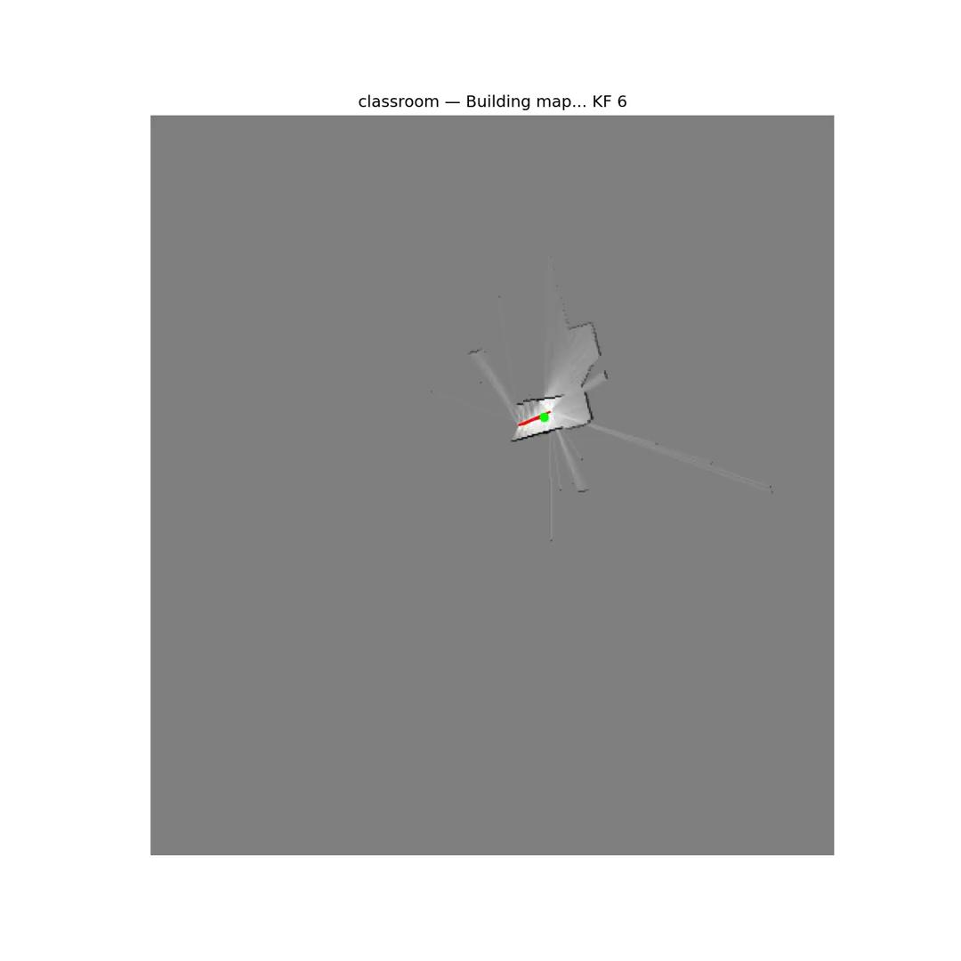

Slide 24
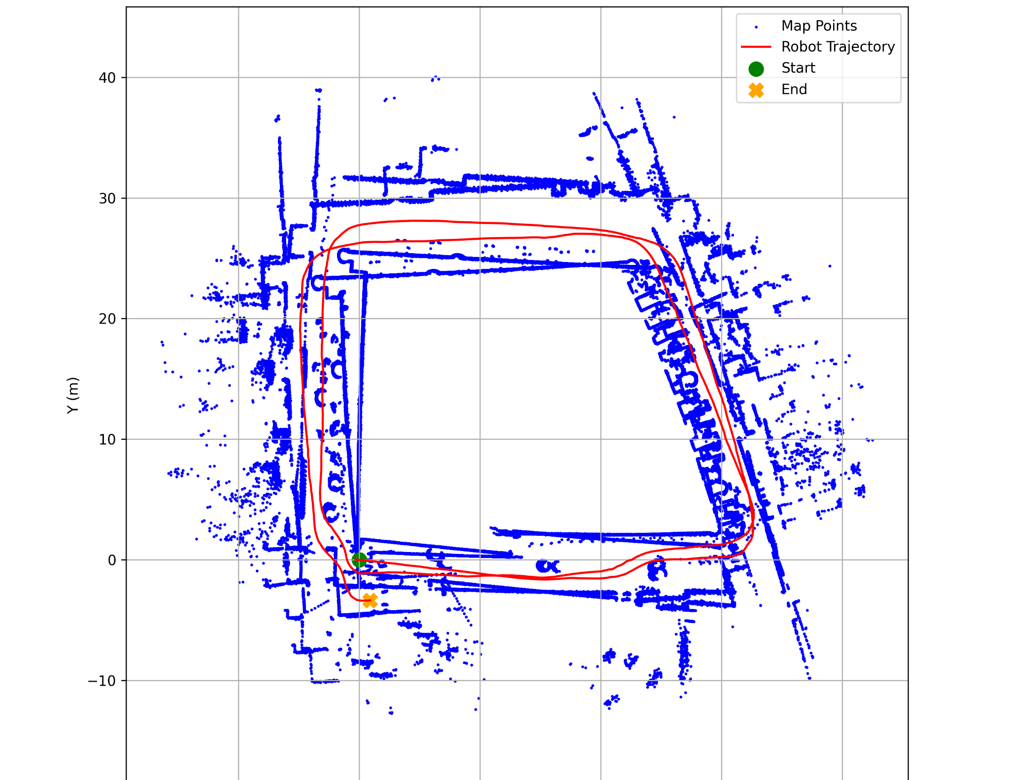
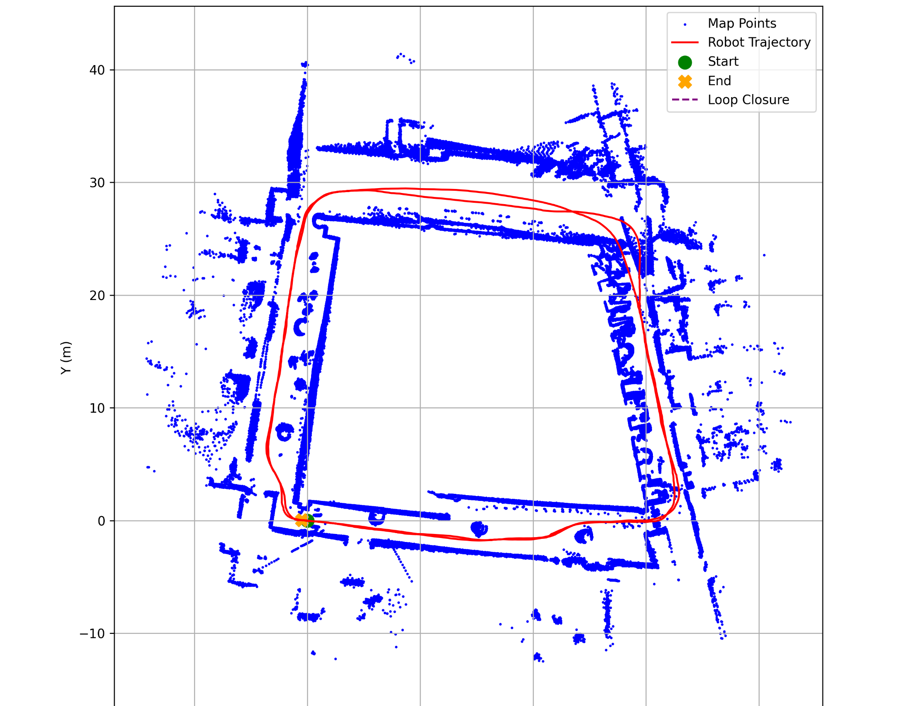
Results - Marshgate Level 7

Slide 25
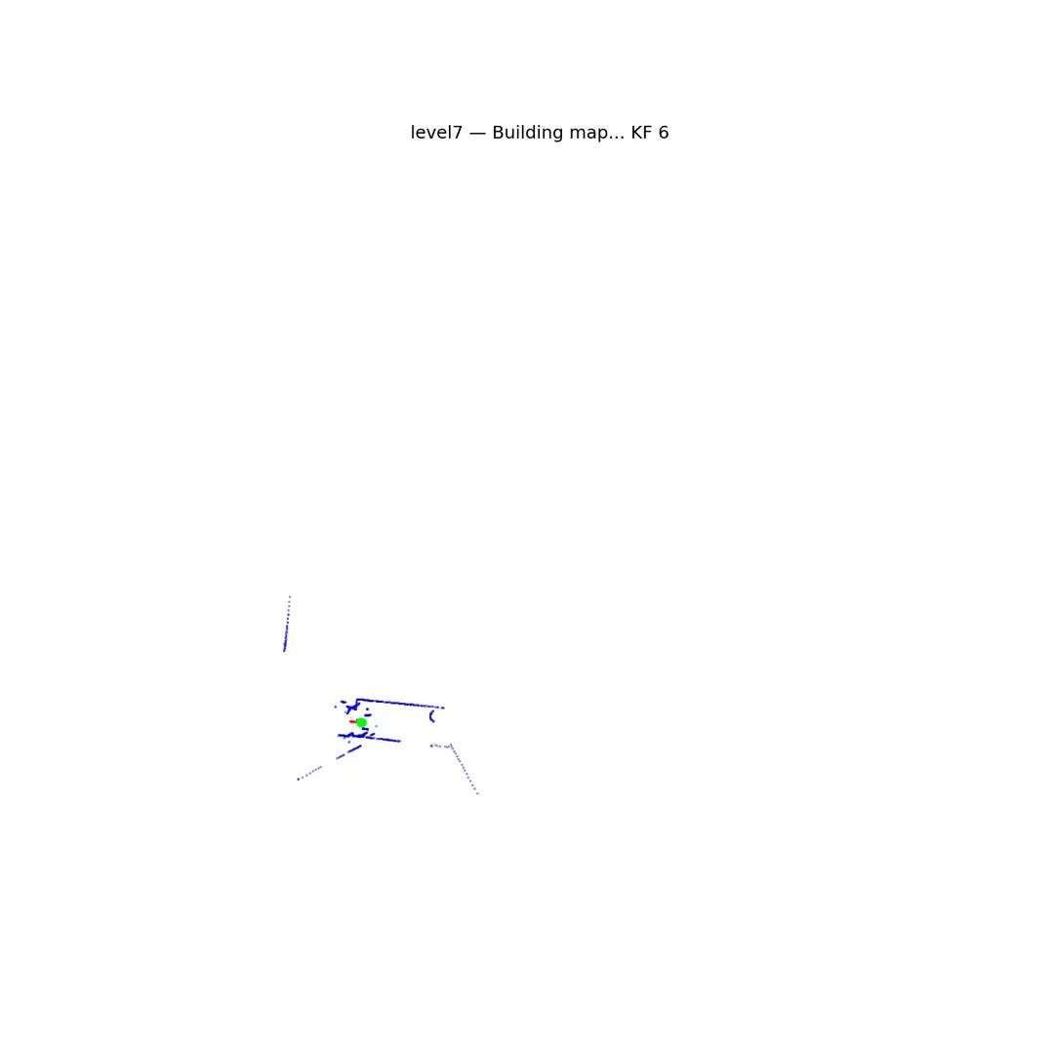
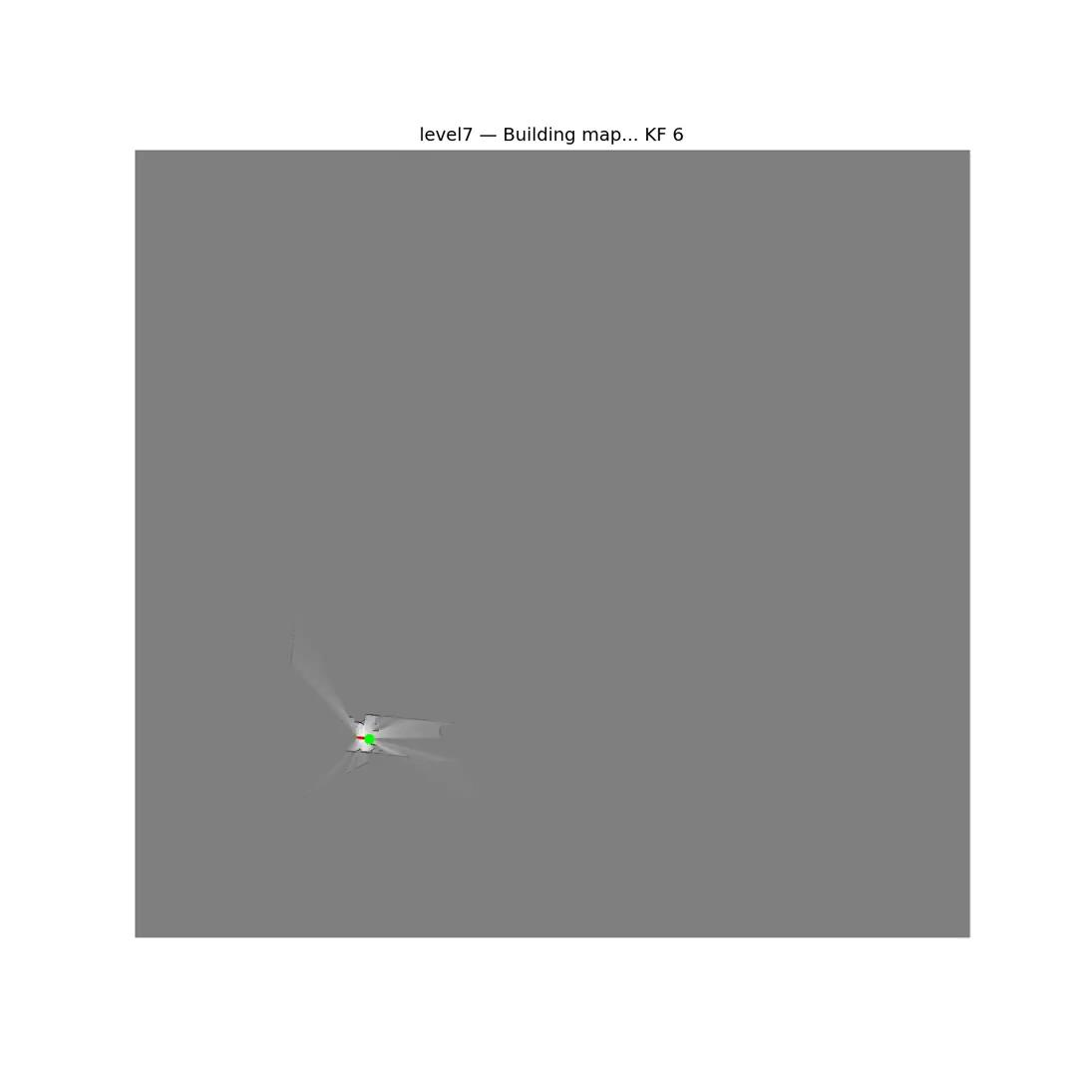

Slide 26
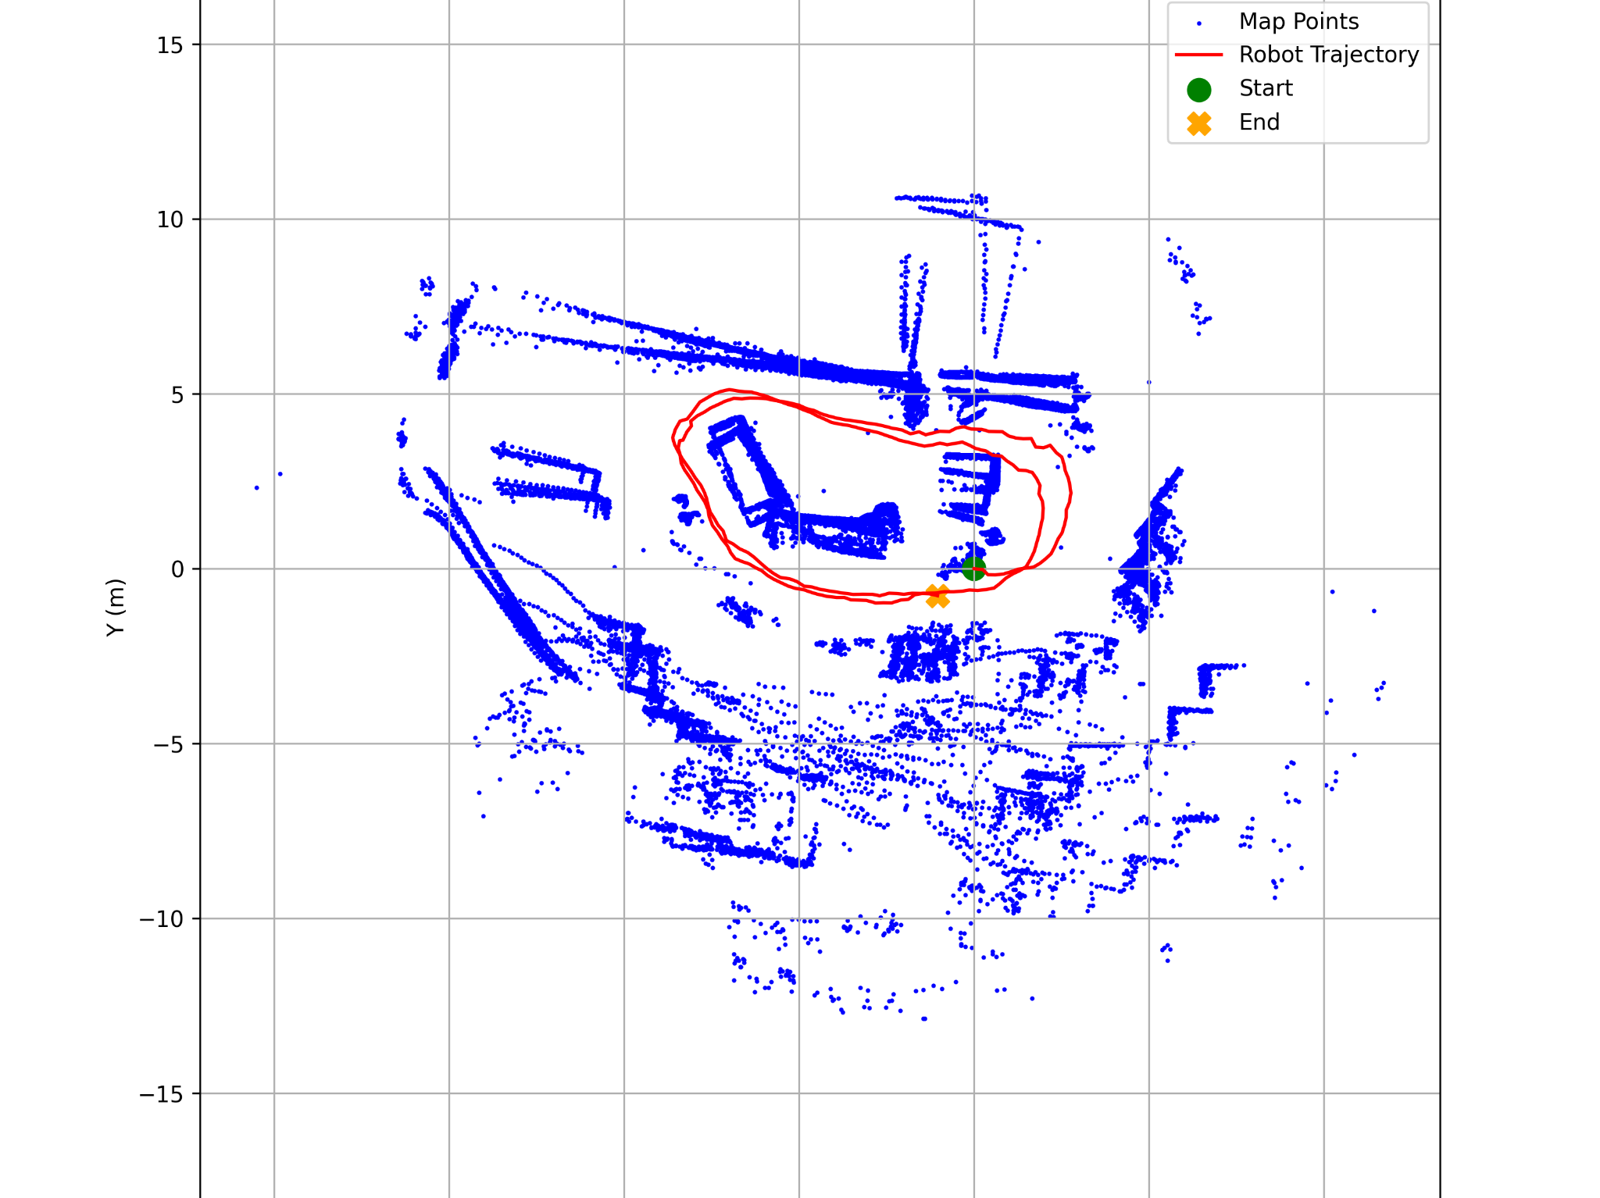
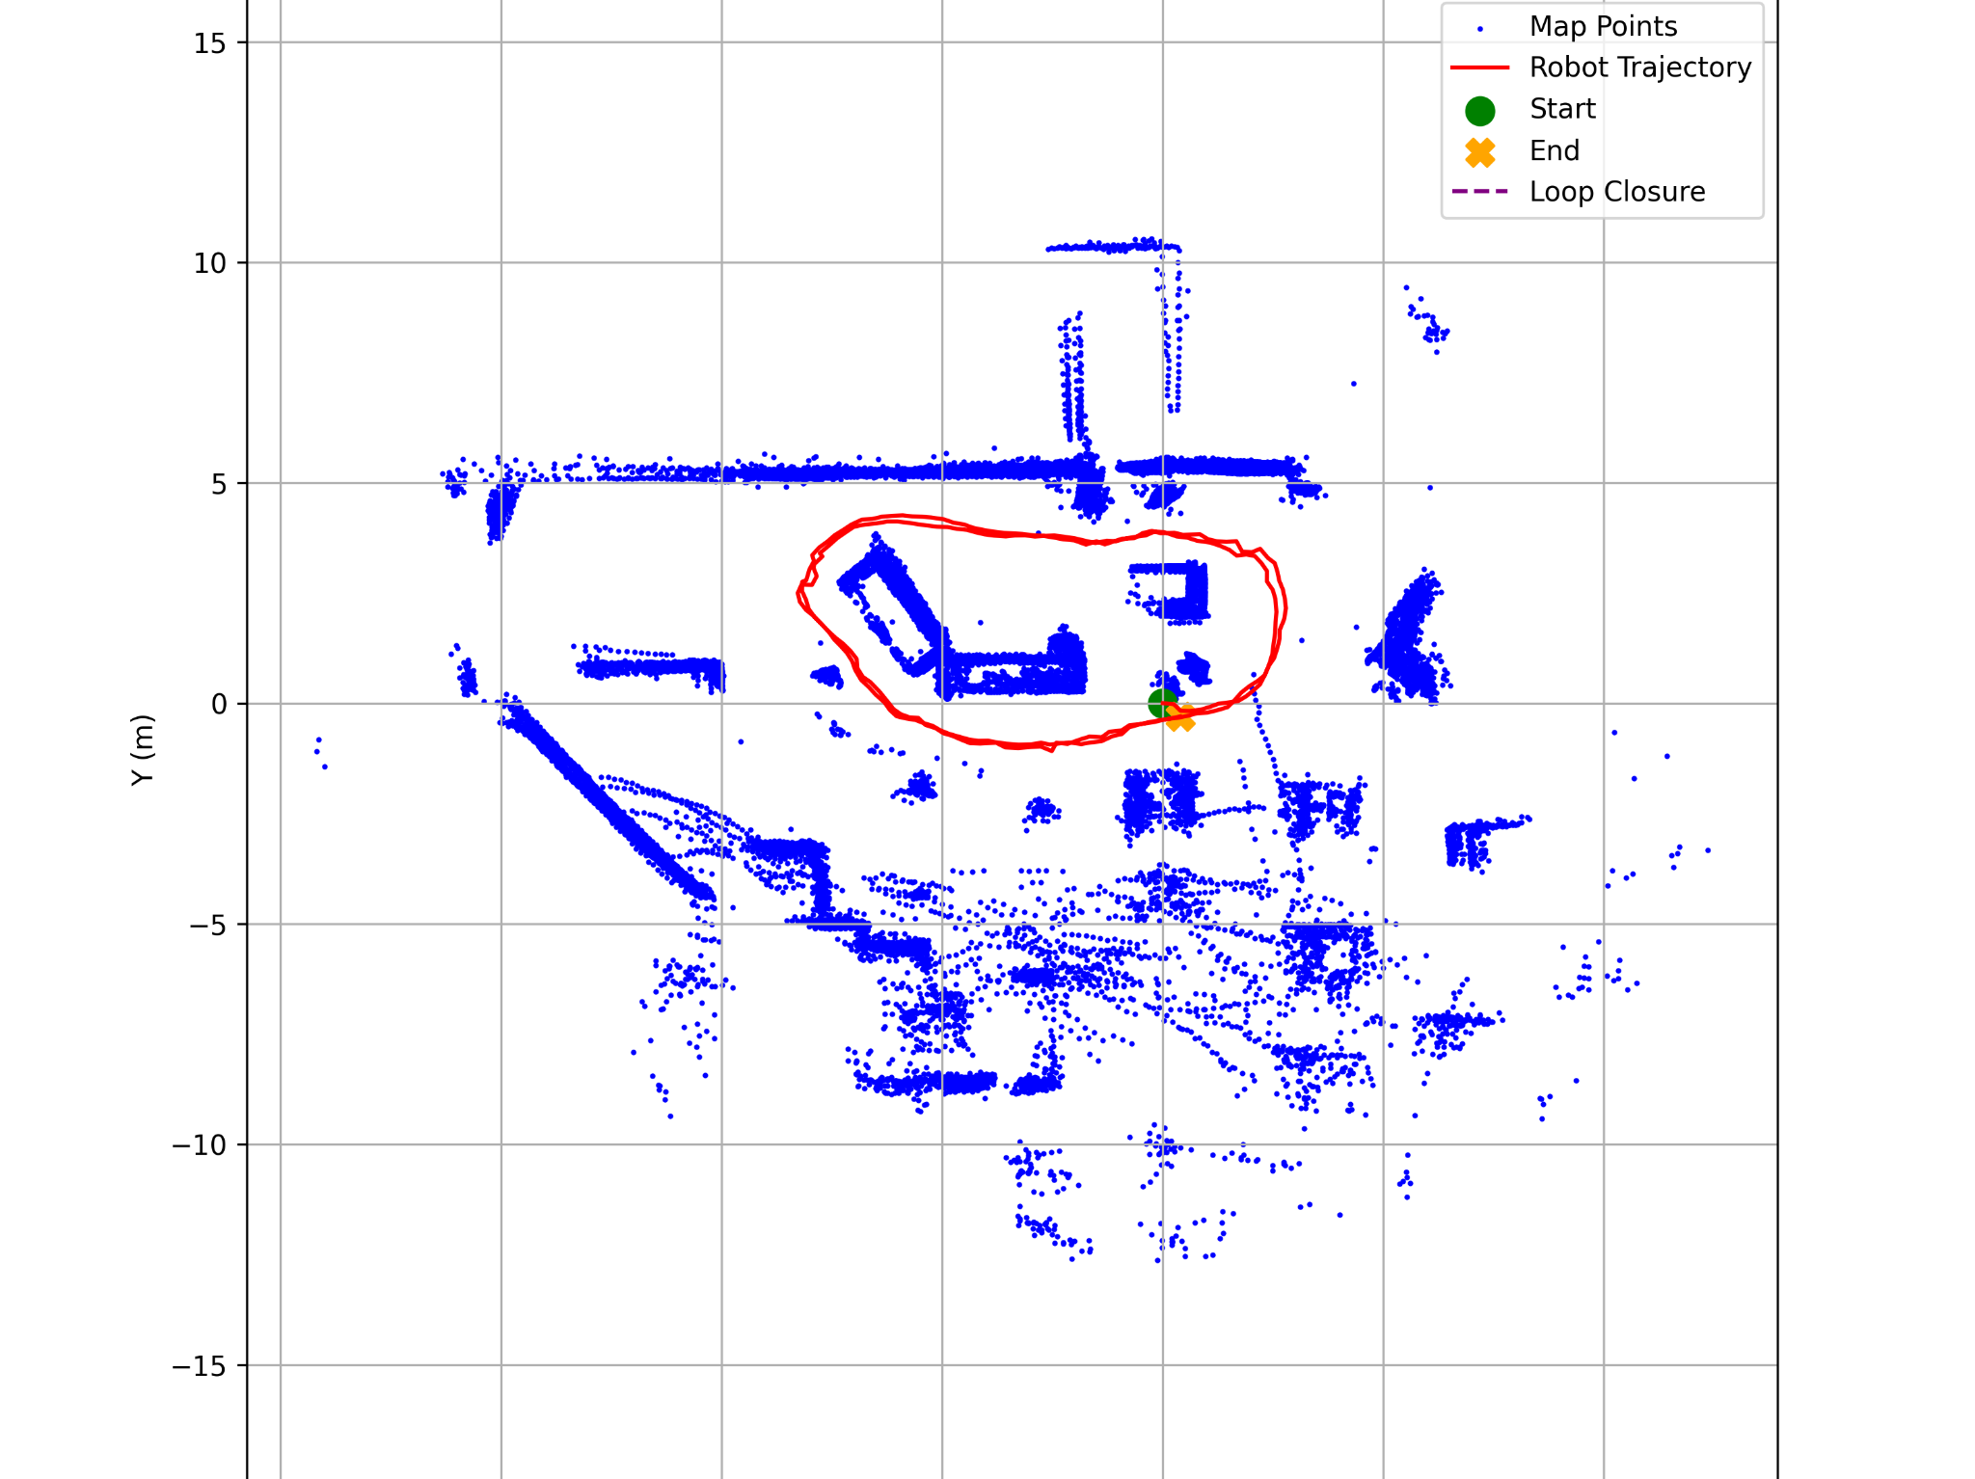
Results - Riverside Cafe

Slide 27
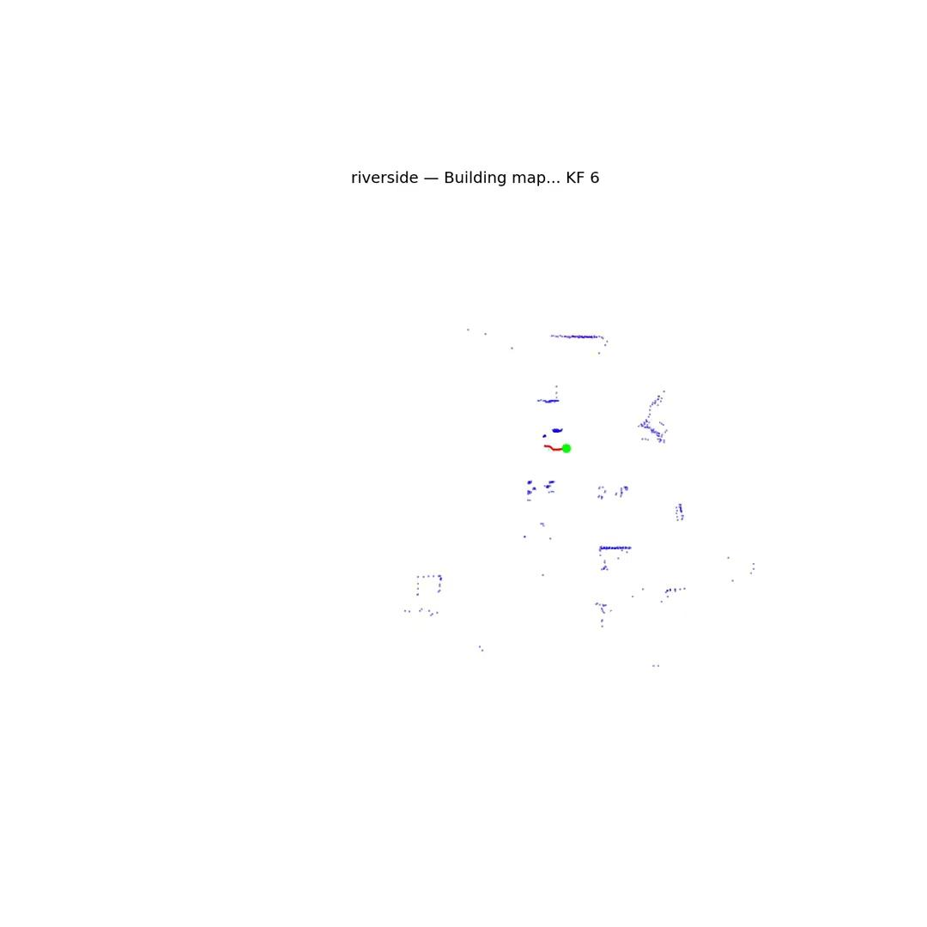
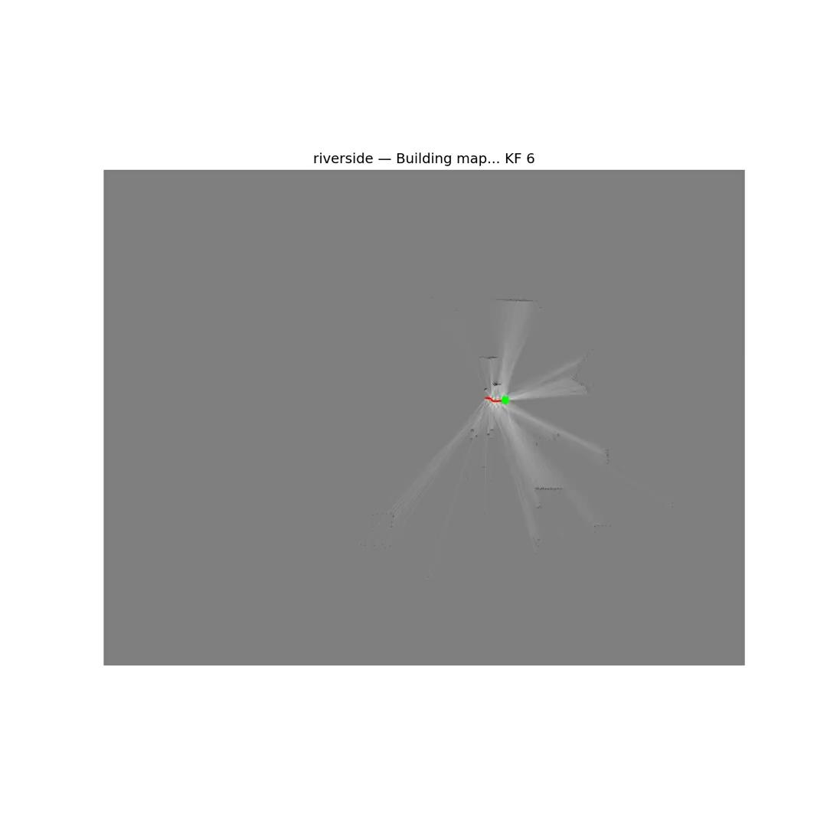

Slide 28
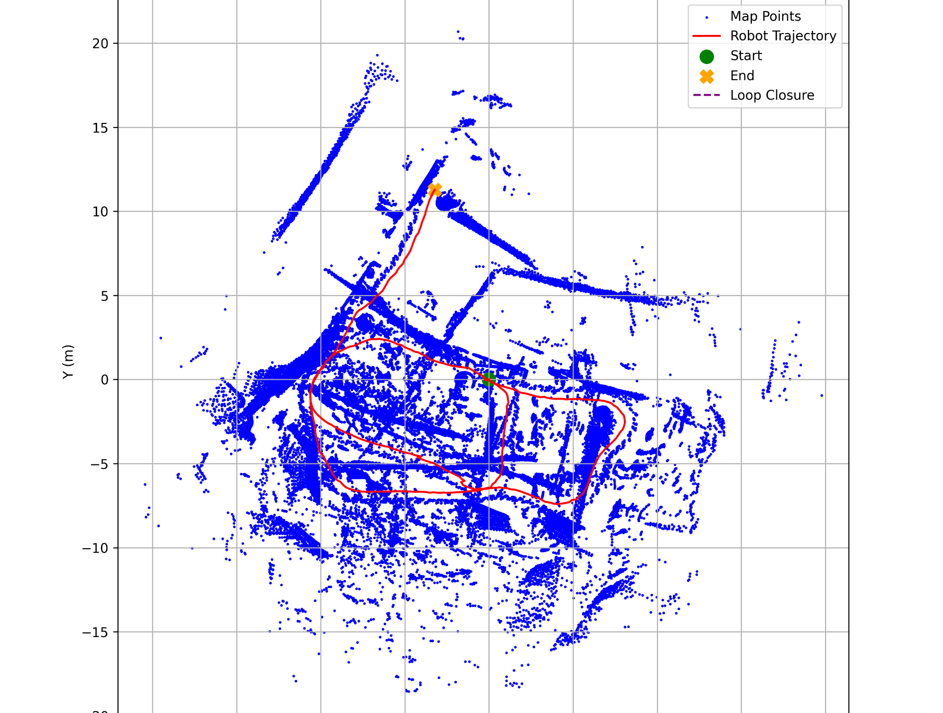
Limitations - Bartlett Art Center
Not enough useful objects to bounce the LiDAR back on within short range - only slender chair legs, repetitive walls
Presence of reflective floor to ceiling windows on one side of the trajectory

