Slide 1
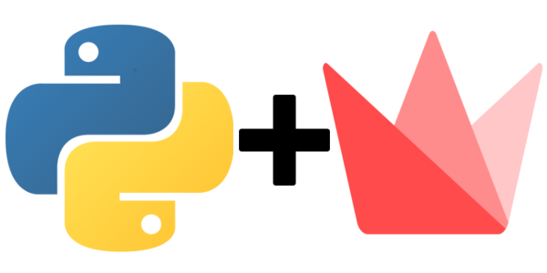
Web-Apps in Python using Streamlit
Amirhessam Tahmassebi

Slide 2
Overview
General Workflow of a Model
Streamlit API
Deployment
Live Demo of the Essentials
Live Demo of a few Deployed Apps

Slide 3
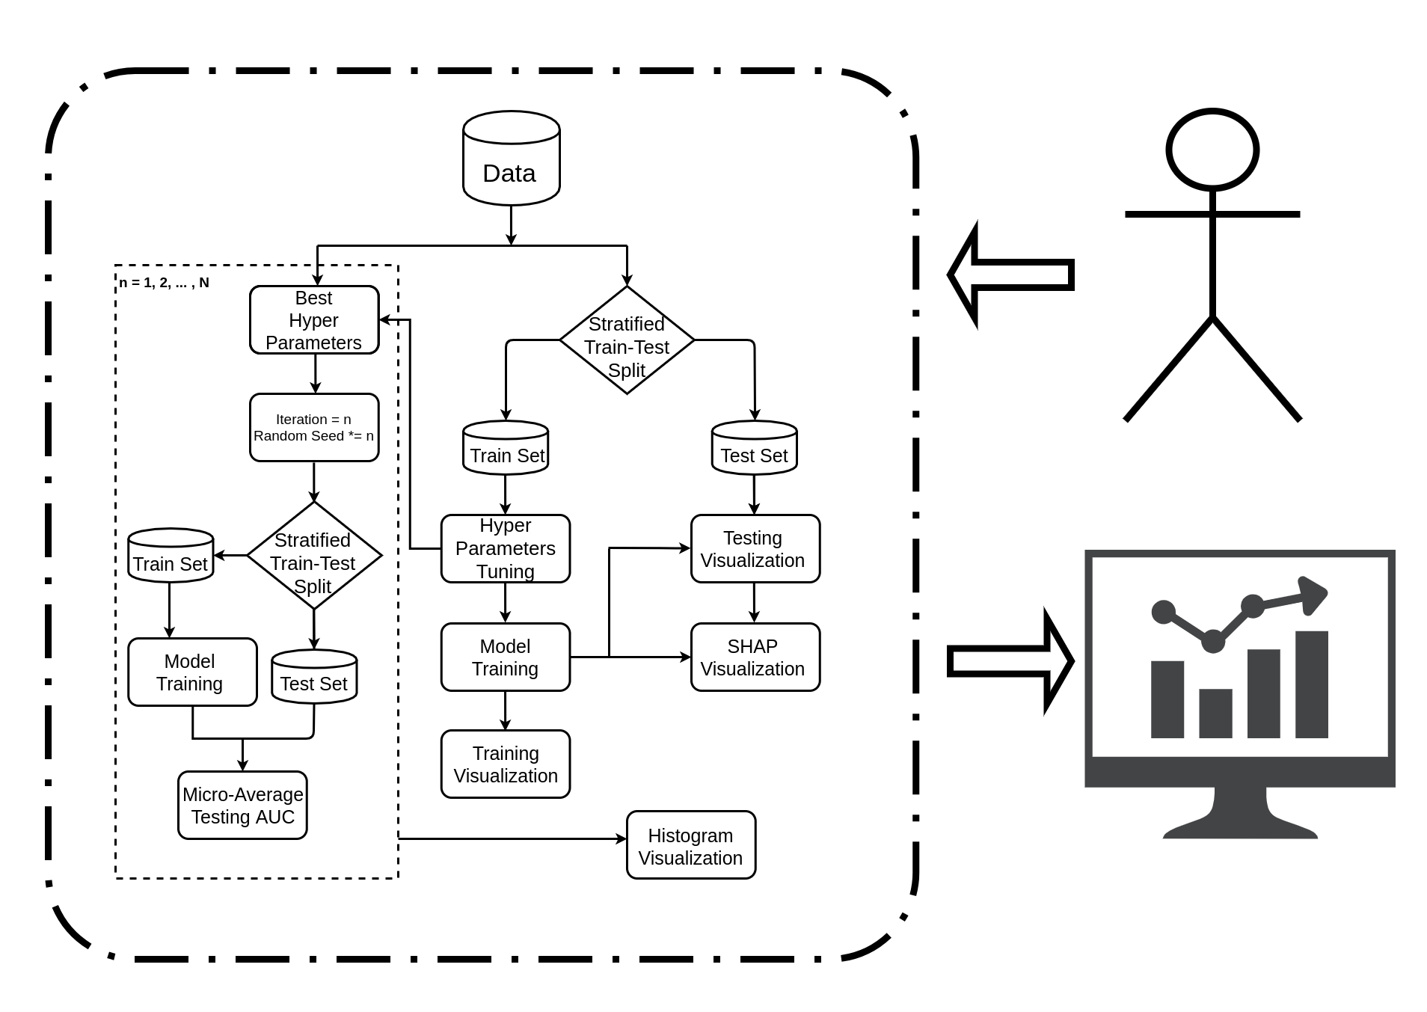
General Workflow of a Model

Slide 4
API Cheat Sheet
Installation
Display Text
Display Data
Display Charts
Display Interactive Widgets
Display Media/Code
Display Animation/Misc.
Optimize Performance

Slide 5
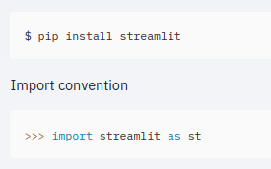
Installation

Slide 6
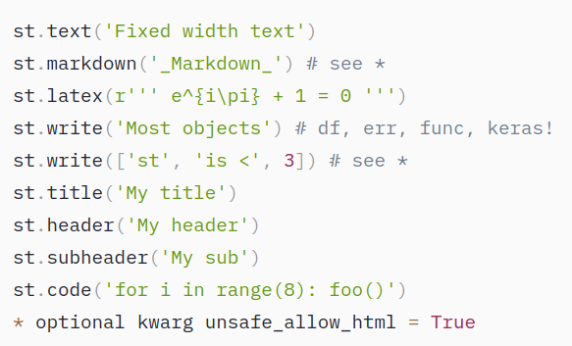
Display Text

Slide 7
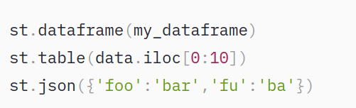
Display Data

Slide 8
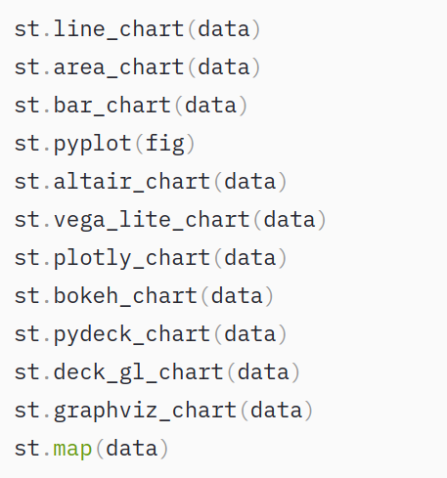
Display Charts

Slide 9
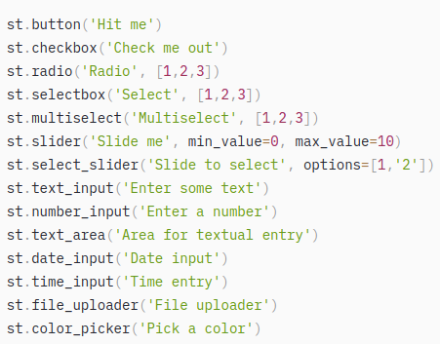
Display Interactive Widgets

Slide 10
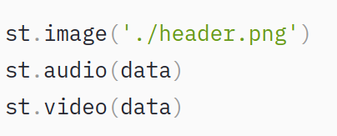
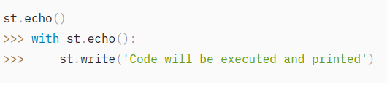
Display Media/Code

Slide 11
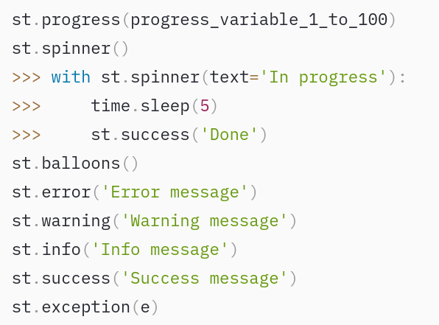
Display Animation/Misc.

Slide 12
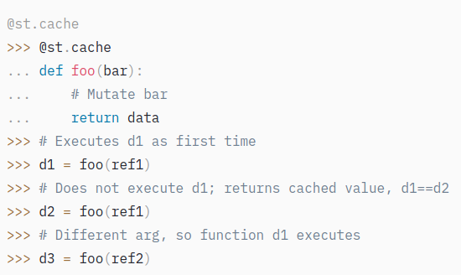
Optimize Performance

Slide 13
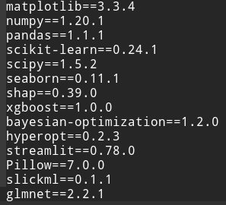
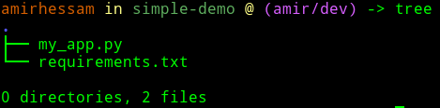
Deployment via Streamlit & GitHub
Your app needs to live under one repository of your GitHub account.
Your app should be called via on *.py fille i.e. `my_app.py`
All Python requirements should be passed via `requirements.txt`
You need to sign-up at https://share.streamlit.io/

Slide 14
Let’s look at some examples

