Slide 1
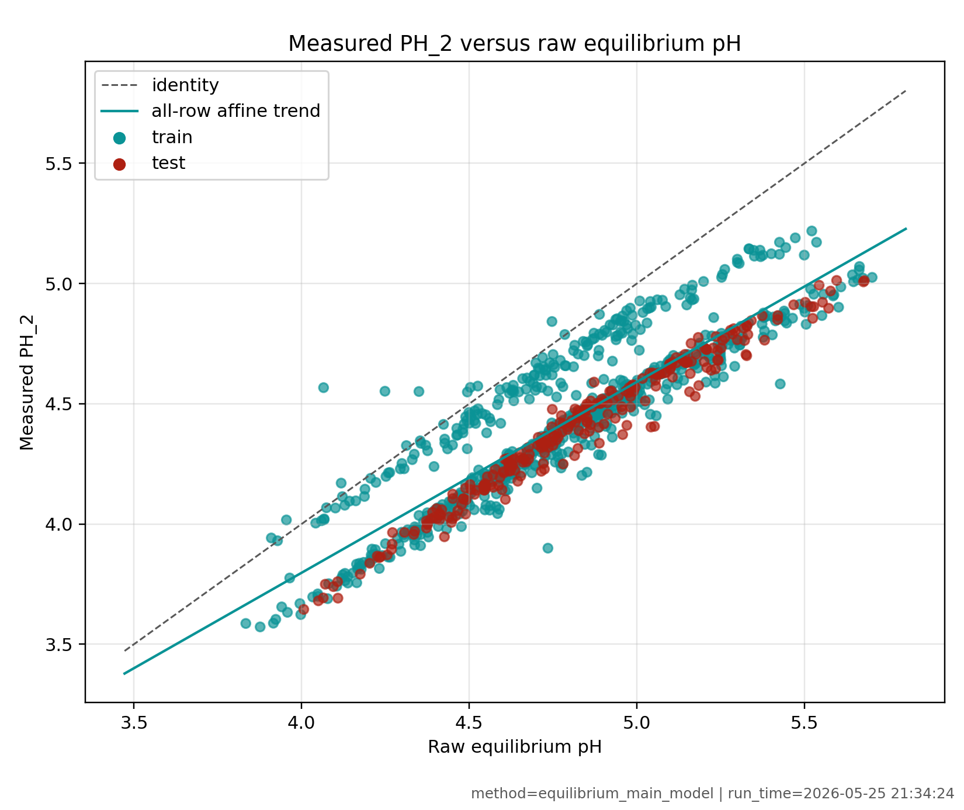
EQUILIBRIUM WORK
Equilibrium model is a calibrated chemistry core
Model role
Charge balance uses acid, acetate, and water flows.
Raw pH_eq is a physical coordinate, not a standalone simulator.
Current PH_2 map: 0.6567 + 0.7909 pH_eq.
Raw test RMSE
0.441
pH units
Affine test RMSE
0.0975
pH units
Affine max abs
0.247
test split
Interpretation
Measured PH_2 is lower and compressed relative to ideal equilibrium.
The calibration is useful evidence, but dynamics are still missing.
Next model should identify delay, mixing, and sensor response.
Evidence: measured PH_2 versus raw equilibrium pH, train/test split.
pH modeling update | equilibrium chemistry, BioSMB library, and open-loop experiments
1/5

Slide 2
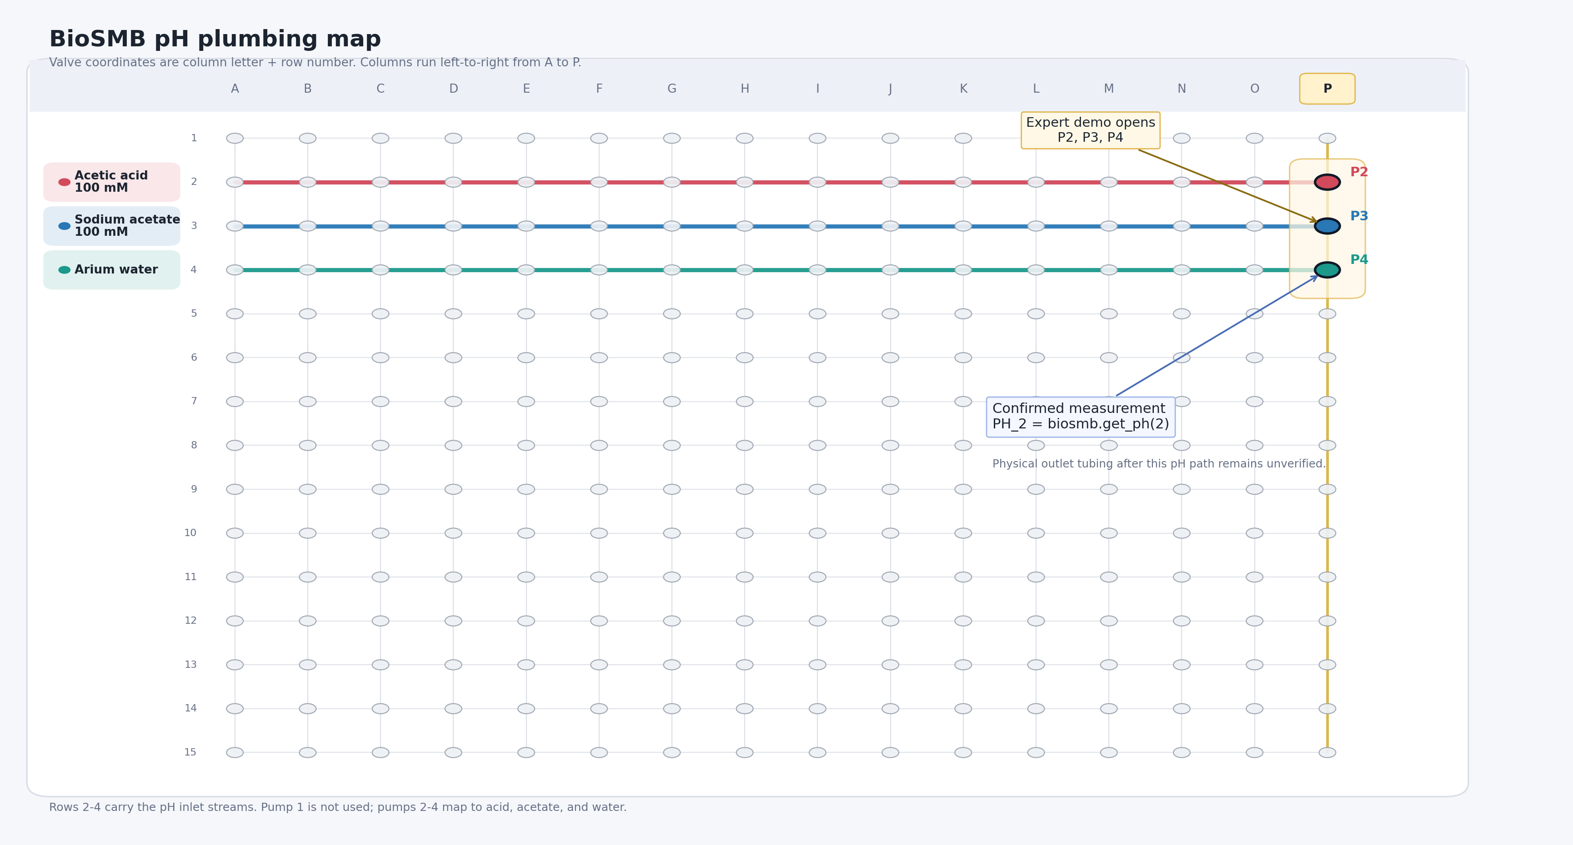
BIOSMB LIBRARY
BioSMB gives the hardware interface, not the plant model
Confirmed pH mapping
Pump 2: acetic acid.
Pump 3: sodium acetate.
Pump 4: Arium water.
Reliable output: PH_2 with get_ph(2).
Library API
One-indexed pumps and sensors.
Valve labels are column plus row, e.g. P2/P3/P4.
OPC-UA wrapper reads and writes hardware nodes.
Safety gap
The library does not enforce flow bounds, finite schedules, or cleanup.
Experiment runners must add those controls.
P2/P3/P4 are valve coordinates on the pH inlet rows, not pump numbers.
pH modeling update | equilibrium chemistry, BioSMB library, and open-loop experiments
2/5

Slide 3
BIOSMB LIBRARY
Read-only smoke test proved the library path before writes
Local OPC emulator
Temporary settings.json
BioSMBManager
Read flows, valves, PH_2, sensors
What the read-only script checks
Imports the real biosmb_interface and emulator packages.
Connects to opc.tcp://127.0.0.1:4865/BioSMB/.
Resolves P2, P3, P4 and pump readbacks for pumps 2-4.
Reads current pH with biosmb.get_ph(2).
What it deliberately avoids
No enable_pump calls.
No set_flow calls.
No open_valve calls.
No claim that the physical outlet path is fully verified.
Next safe use
Move from emulator read-only validation to a supervised valve-only or very low-flow hardware check with try/finally cleanup.
pH modeling update | equilibrium chemistry, BioSMB library, and open-loop experiments
3/5

Slide 4
EXPERIMENTS TO RUN
Experiment 1 should step pH chemistry at fixed total flow
Purpose
Excite pH_eq through the acid/acetate ratio.
Hold total flow near 15 mL/min to reduce residence-time confounding.
Use both upward and downward pH-coordinate changes.
design pH_eq
F_H
F_A
F_W
3.85
8.90
1.10
5.00
4.15
8.03
1.97
5.00
4.76
5.00
5.00
5.00
Design equations
F_H + F_A = 10 mL/min, F_W = 5 mL/min.
r = 10^(design_pH_eq - pKa).
F_H = 10/(1+r), F_A = 10r/(1+r).
5.37
1.97
8.03
5.00
5.67
1.10
8.90
5.00
Run order example
4.76 -> 4.15 -> 5.07 -> 3.85 -> 5.67 -> 4.45 -> 5.37 -> 4.76.
Hold 10-20 min per step and sample PH_2 every 2-5 s if possible.
Validation output
Compare PH_2 against raw and affine equilibrium predictions for each held-out step.
pH modeling update | equilibrium chemistry, BioSMB library, and open-loop experiments
4/5

Slide 5
EXPERIMENTS TO RUN
Experiment 2 should separate flow dynamics from chemistry
Block B: throughput
Keep composition fixed with equal streams.
Run [3,3,3], [5,5,5], and [8,8,8] mL/min.
Test whether response speed scales with total flow.
Block C: water fraction
Keep acid/acetate ratio fixed.
Run [5,5,1], [5,5,5], and [5,5,10] mL/min.
Separate dilution, conductivity, and flushing effects.
Block 0: local check
Start at [3,3,3].
Step one pump to 6, return to baseline, then repeat.
Use repeated center steps to expose drift.
Dynamic wrapper to fit after the data
tau_eff d y_hat/dt = y_static(t - theta) - y_hat.
theta(t) = 60 V_delay / F_T(t), with F_T in mL/min.
If data support it, split mixing lag from PH_2 sensor response.
Decision criteria
Improve test RMSE by at least 0.02 pH or 20 percent over static calibration.
Hold final offsets mostly within 0.05-0.10 pH.
Show physically sensible response speed versus total flow.
Boundary
No feedback control, MPC, RL, reward functions, or policies until this open-loop model predicts held-out PH_2 reliably.
pH modeling update | equilibrium chemistry, BioSMB library, and open-loop experiments
5/5

