Slide 1

Manipulating Files and Directories
All the best people in life seem to like LINUX. Steve Wozniak
Making Linux GPL'd was definitely the best thing I ever did.
Linus Torvalds
Amirkabir Linux Festival 2021

Slide 2
Contents
Introduction
Listing files and directories
Finding and searching for files
Deleting, copying and moving files
Intro to Wildcards
More examples
Books

Slide 3
Introduction
Every command in Linux has some arguments, which will control the type of the command.
Every command has some options, these options are the controllers of command output type. ( also known as flags )
To see those options, you can use the “--help” argument with the command you want to check.
Ex : $ ls --help
$ mv --help
$ find -- help

Slide 4

List files and directories
The “ls” command:
The ls command is used to list files or directories in Linux and other Unix-based operating systems.

Slide 5
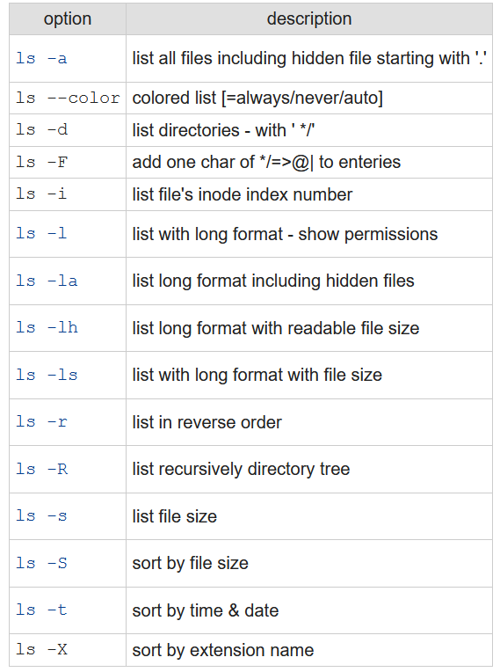
Ls command options:

Slide 6
Sources:
https://www.freecodecamp.org/news/the-linux-ls-command-how-to-list-files-in-a-directory-with-options/
https://www.rapidtables.com/code/linux/ls.html
https://www.mkssoftware.com/docs/man1/ls.1.asp

Slide 7
Finding and searching for files
The “find” command:
The find command is one of the most powerful tools in the Linux system administrators arsenal. It searches for files and directories in a directory hierarchy based on a user given expression and can perform user-specified action on each matched file.

Slide 8
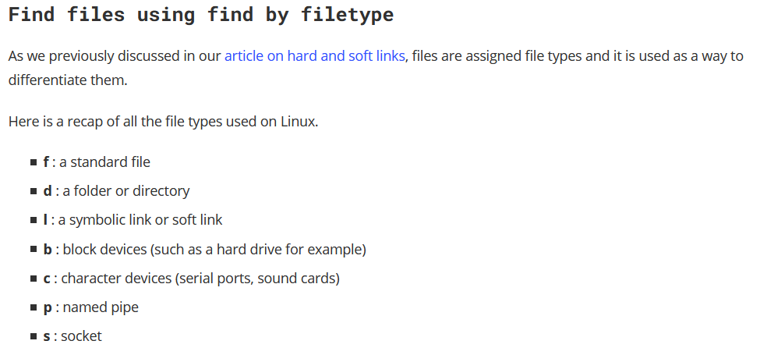

Slide 9
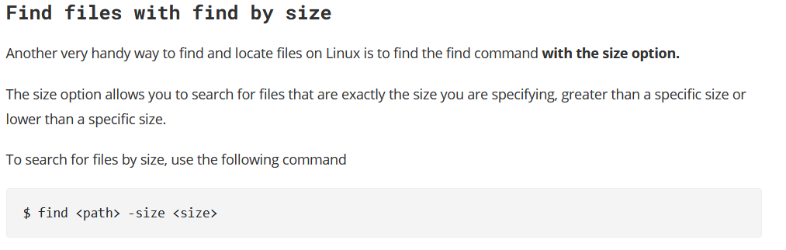

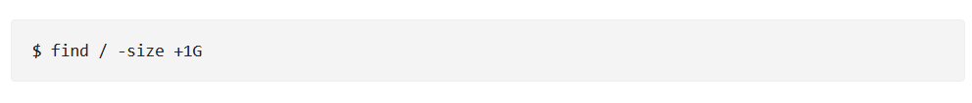

Slide 10
The “grep” command:
The grep command is used to search text. It searches the given file for lines containing a match to the given strings or words. It is one of the most useful commands on Linux and Unix-like system.

Slide 11
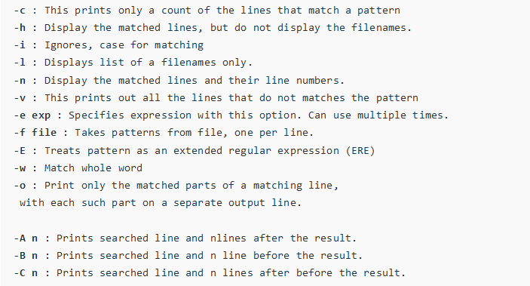
Grep command options:

Slide 12

Pips:
The Pipe is a command in Linux that lets you use two or more commands such that output of one command serves as input to the next. In short, the output of each process directly as input to the next one like a pipeline. The symbol '|' denotes a pipe.
Pipes help you mash-up two or more commands at the same time and run them consecutively. You can use powerful commands which can perform complex tasks in a jiffy.

Slide 13
Sources:
https://linuxize.com/post/how-to-find-files-in-linux-using-the-command-line/
https://www.linux.com/topic/desktop/how-search-files-linux-command-line/
https://www.plesk.com/blog/various/find-files-in-linux-via-command-line/
https://www.binarytides.com/linux-find-command-examples/
https://phoenixnap.com/kb/grep-command-linux-unix-examples/
https://www.cyberciti.biz/faq/howto-use-grep-command-in-linux-unix/
https://www.guru99.com/linux-pipe-grep.html/
https://www.geeksforgeeks.org/piping-in-unix-or-linux/

Slide 14

Deleting, copying and moving files
The “rm” command:
To remove (or delete) a file in Linux from the command line, use either the rm ( remove ) or unlink command.
The unlink command allows you to remove only a single file, while with rm command you can remove multiple files at once.
Be extra careful when removing files or directories, because once the file is deleted, it cannot be easily recovered.

Slide 15
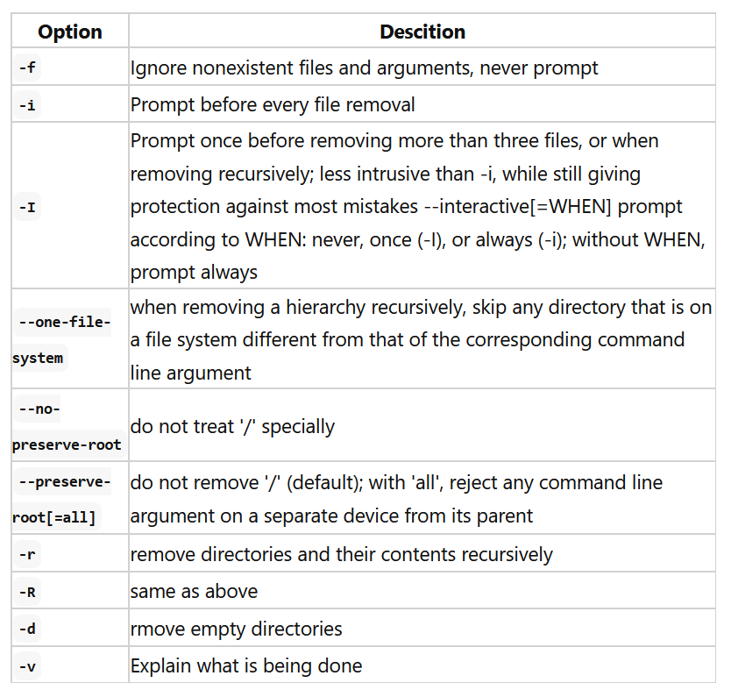
Rm command options:

Slide 16

Never “run rm -rf /” as an administrator or normal UNIX / Linux user:
The rm -rf / variant of the command, if run by an administrator, would cause the contents of every writable mounted filesystem on the computer to be deleted.

Slide 17
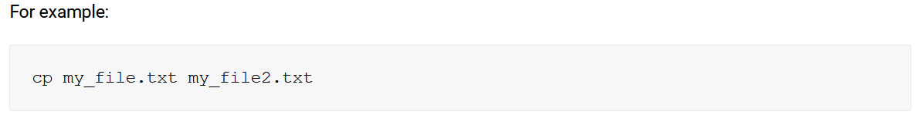
The “cp” command:
The cp command is the primary method for copying files and directories in Linux.

Slide 18
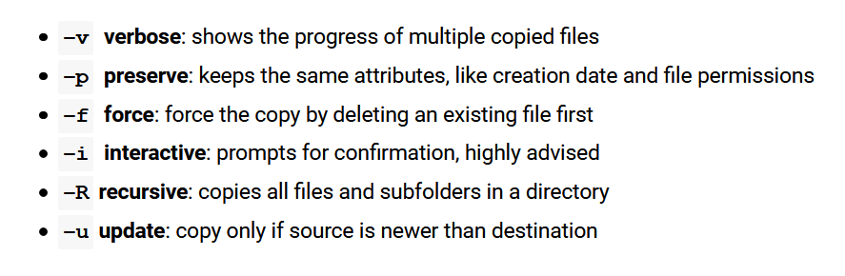
Cp command options:

Slide 19
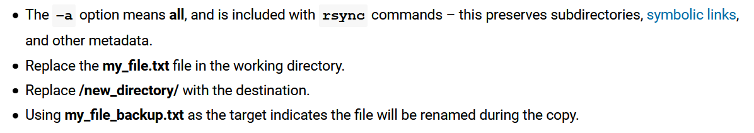
Copy Using “rsync” Command:
The rysnc command in linux is used to synchronize or transfer data between two locations.
Usage is similar to cp, but there are a few key differences to note.

Slide 20
The “mv” command:
The mv command (short from move) is used to rename and move and files and directories from one location to another.

Slide 21
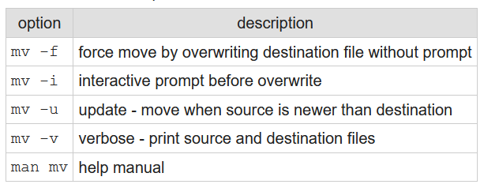
Mv command options:

Slide 22
Sources:
https://linuxize.com/post/how-to-remove-files-and-directories-using-linux-command-line/
https://www.cyberciti.biz/faq/howto-linux-unix-delete-remove-file/
https://www.cyberciti.biz/faq/copy-command/
https://phoenixnap.com/kb/how-to-copy-files-directories-linux/
https://www.rapidtables.com/code/linux/mv.html
https://linuxize.com/post/how-to-move-files-in-linux-with-mv-command/

Slide 23
Wildcards
A wildcard in Linux is a symbol or a set of symbols that stands in for other characters. It can be used to substitute for any other character or characters in a string. ( Something like regex )
For example, you can use a wildcard to get a list of all files in a directory that begin with the letter O.
You can use them with any command such as ls or rm command to list or remove files matching a given criteria ( pattern ), receptively.

Slide 24
These wildcards are interpreted by the shell and the results are returned to the command you run. There are three main wildcards in Linux:
An asterisk (*) – matches one or more occurrences of any character, including no character.
Question mark (?) – represents or matches a single occurrence of any character.
Bracketed characters ([ ]) – matches any occurrence of character enclosed in the square brackets.
It is possible to use different types of characters (alphanumeric characters): numbers, letters, other special characters etc.

Slide 25
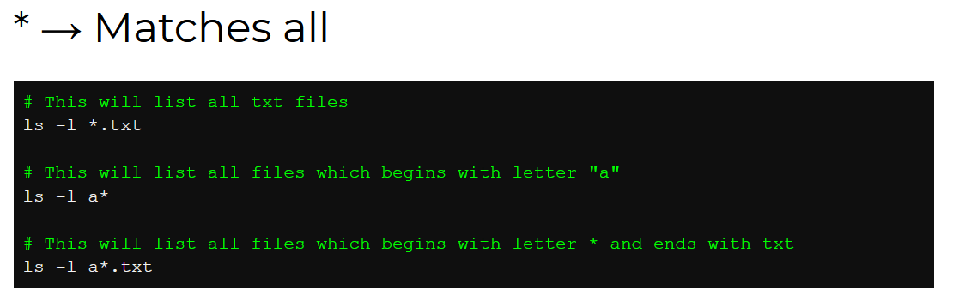

Slide 26
Example:
This command matches all files with names starting with “l” (which is the prefix) and ending with one or more occurrences of any character.

Slide 27
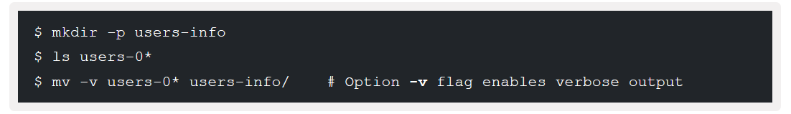
Example:
This example shows another use of * to copy all filenames prefixed with “users-0” and ending with one or more occurrences of any character.

Slide 28
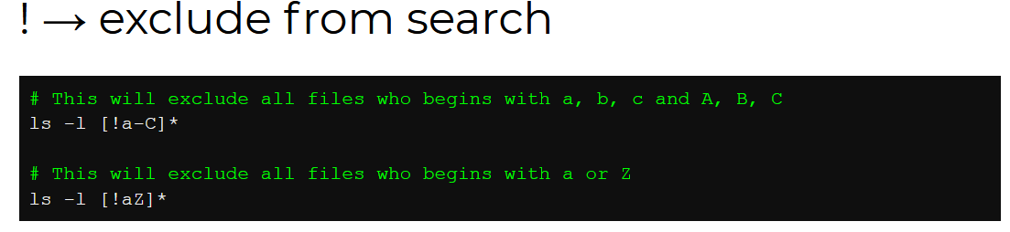

Slide 29
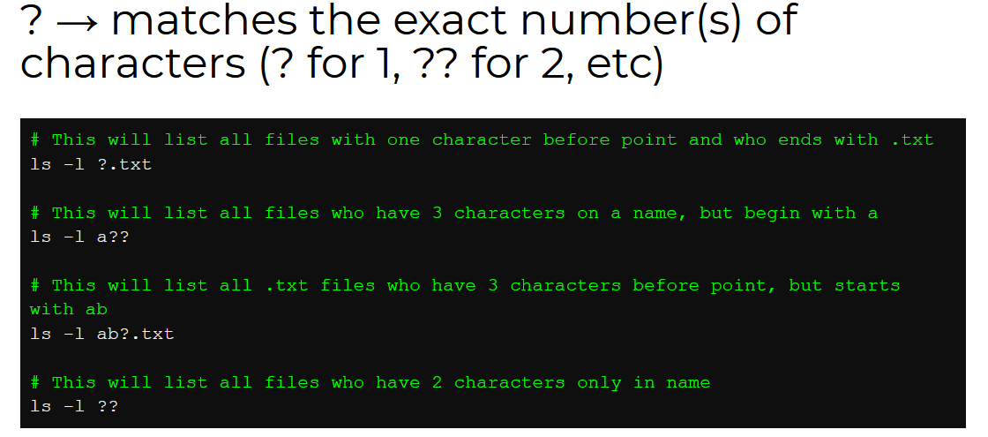

Slide 30
Example:
The following command matches all files with names beginning with “l” ollowed by any single character and ending with “st.sh”.

Slide 31
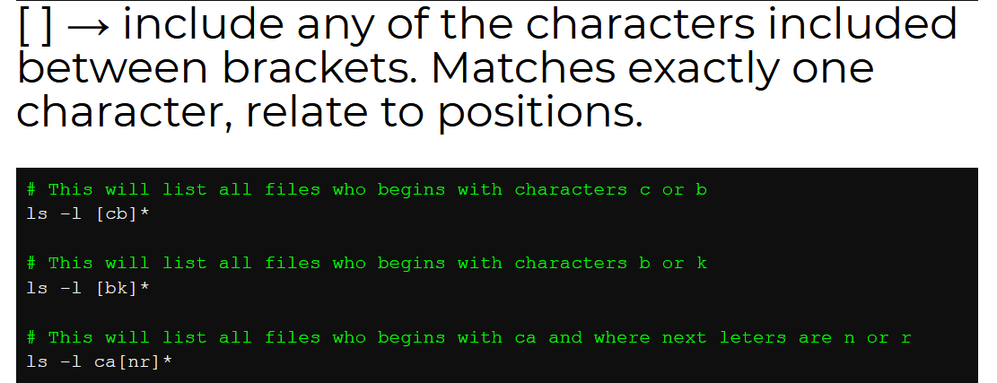

Slide 32
Example:
The command below matches all files with names starting with “l” followed by any of the characters in the square bracket but ending with “st.sh”.

Slide 33
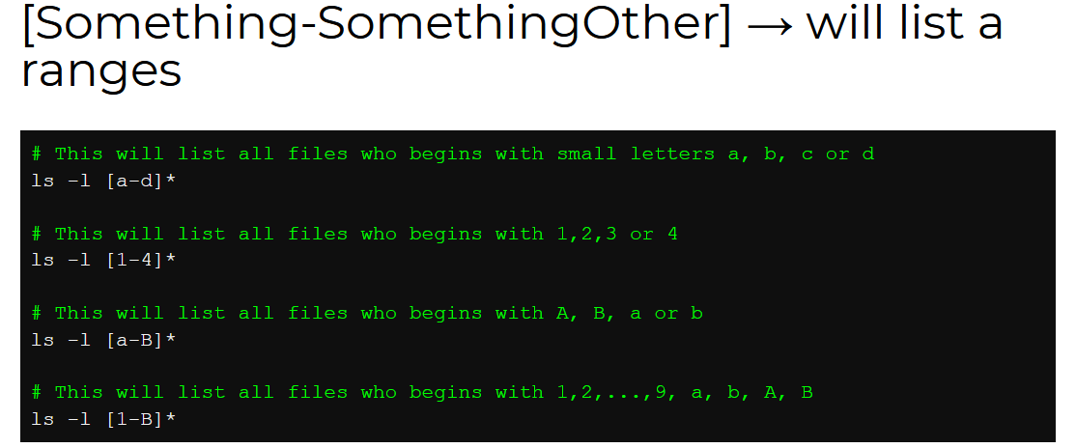

Slide 34
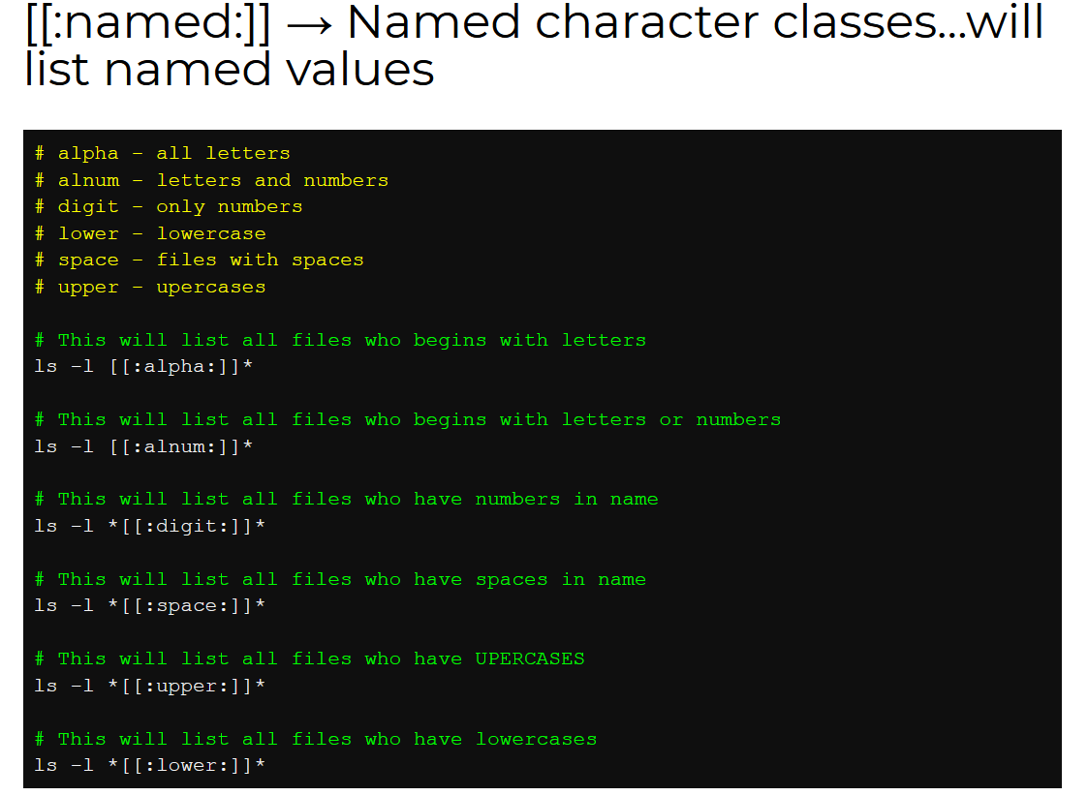

Slide 35
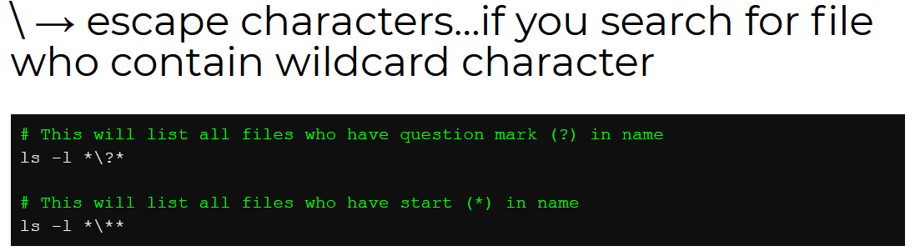

Slide 36
Sources:
https://geek-university.com/linux/wildcard/
https://www.tecmint.com/use-wildcards-to-match-filenames-in-linux/
https://ryanstutorials.net/linuxtutorial/wildcards.php/
https://linuxhint.com/bash_wildcard_tutorial/
https://tldp.org/LDP/GNU-Linux-Tools-Summary/html/x11655.htm/
https://kompjuteras.com/en/wildcards-in-linux-commands-with-practical-examples/

Slide 37
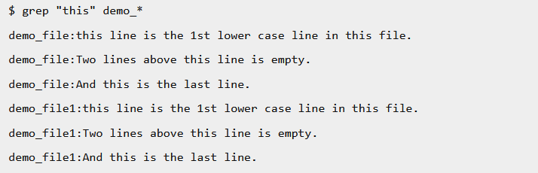
More Examples
1. Checking for the given string in multiple files

Slide 38
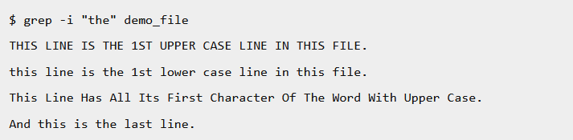
2. Case insensitive search using grep -i

Slide 39

3. Match regular expression in files

Slide 40

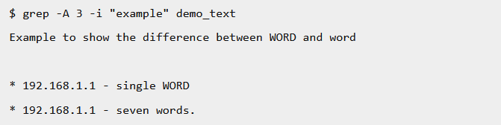
4. Displaying lines before/after/around the match using grep -A, -B and -C
The following example prints the matched line, along with the 3 lines after it.

Slide 41
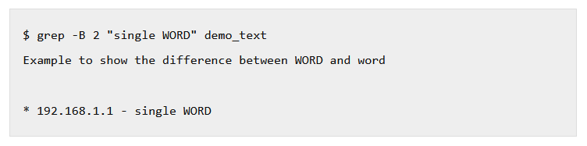
-B is the option which prints the specified N lines before the match.

Slide 42
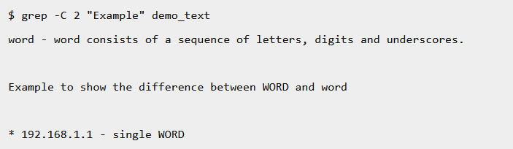
-C is the option which prints the specified N lines before the match.

Slide 43
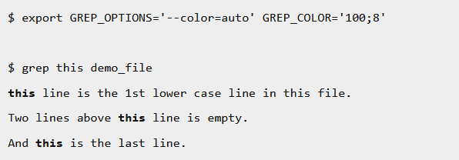
5. Highlighting the search using GREP_OPTIONS with export

Slide 44
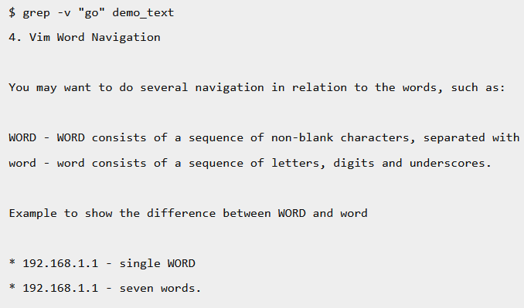
6. Invert match using grep –v
When you want to display the lines which does not matches the given string/pattern, use the option -v as shown below.

Slide 45
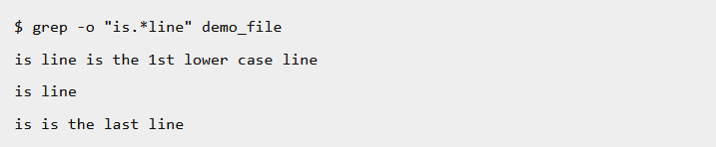
7. Show only the matched string, with grep -o

Slide 46

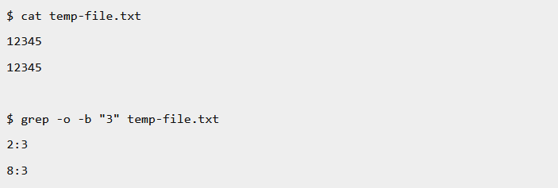
8. Show the position of match in the line

Slide 47
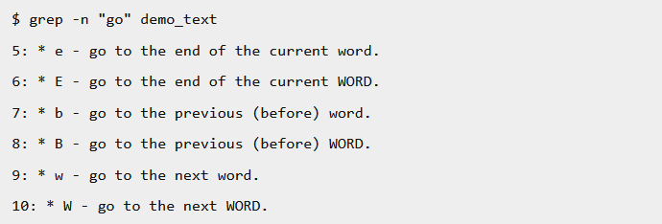
9. Show line number while displaying the output using grep -n

Slide 48
10. Find all empty files in home directory

Slide 49
11. Order Files Based on Last Modified Time (In Reverse Order)

Slide 50
12. Create nested directories using one mkdir command

Slide 51
13. Print N number of lines from the file named filename.txt

Slide 52

14. Open Last Edited File

Slide 53
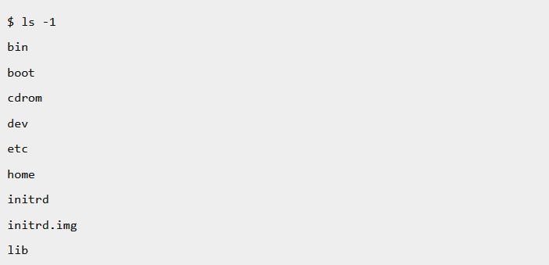
15. Display One File Per Line

Slide 54

16. Escaping the special character (\)
If you want to search for special characters (for example: * , dot) in the content you have to escape the special character in the regular expression.

Slide 55
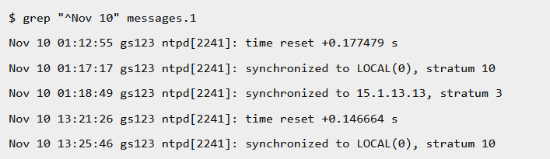
17. Beginning of line ( ^ )
In grep command, caret Symbol ^ matches the expression at the start of a line. In the following example, it displays all the line which starts with the Nov 10.

Slide 56
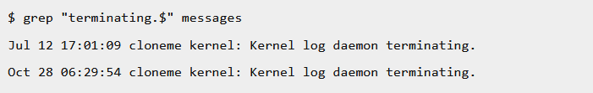
18. End of the line ($)
Character $ matches the expression at the end of a line. The following command will help you to get all the lines which ends with the word “terminating”.

Slide 57
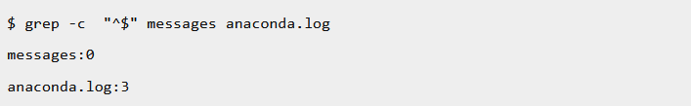
19. Count of empty lines ( ^$ )
Using ^ and $ character you can find out the empty lines available in a file. “^$” specifies empty line. The bellow commands displays the count of the empty lines available in the messages and anaconda.log files.

Slide 58
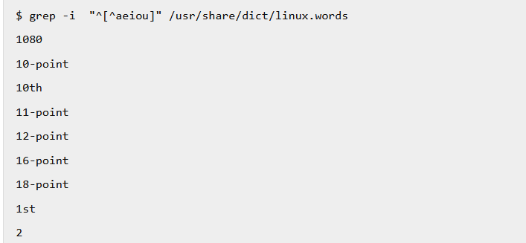
20. Exception in the character class
If you want to search for all the characters except those in the square bracket, then use ^ (Caret) symbol as the first character after open square bracket. The following example searches for a line which does not start with the vowel letter from dictionary word file in linux.

Slide 59
Source Books
Linux bible, by Christopher Negus
Linux Command Line and Shell Scripting Bible, by Christine Bresnahan and Richard Blum
Linux 101 Hacks 2nd edition, by Ramesh Natarajan

