Slide 1

All the best people in life seem to like LINUX. Steve Wozniak
Making Linux GPL'd was definitely the best thing I ever did.
Linus Torvalds
Amirkabir Linux Festival 2021

Slide 2
Users and groups:Overall view
All the information about a system’s users are stored inside a database file located at /etc/passwd
passwd and chpasswd commands are used to change or set a user’s password.
useradd and usermod commands are used to create and modify a user in linux
userdel is used to delete users
groups command is used to see the groups that the user is a part of.

Slide 3
/etc/passwd
System use this file to store user’s information. Users are stored with the following format:
[username]:[pass]:[UID]:[GID]:[Comment]:[Home Dir]:[Default shell]
smf8: x :1000 : 1000 :Mohammad: /home/smf8 : /bin/bash
if there is a x in place of password field, User password is located in /etc/shadow file
UID and GID for root user is set to 0

Slide 4
useradd
create a new user or update default new user information.
In debian systems, it is recommended to use adduser instead.
commonly used options:
-c uesd to provide comments for user
-d path to the home directory
-g,-G provide a single group or a list of groups for user
adduser [options] username adduser will prompt you for a password but useradd will not.

Slide 5
passwd
passwd [Options] user
User will be prompt to enter old password. For root user this step is bypassed.
After entering password, it’ll be checked for complexity, complexity limitations vary in distribution. as a general guideline, passwords should consist of 6 to 8 characters of :
lowercase alphabets
digits from 0 to 9
punctuation marks
Options:
-e set account’s password expiry
-d delete password

Slide 6
usermod
usermod is used to modify a user’s information.
usermod [options] username
commonly used options:
-aG used to append groups to user
-d used to set user’s home directory
-s change user’s default shell
How to give an existing user sudo privilege ? ans: usermod -aG sudo username

Slide 7
userdel or deluser ?
userdel or deluser both are used to delete users from a system but deluser provides friendlier front end to userdel.
check deluser’s man page for it’s usage syntax and options.
How to remove sudo privilege from a user ? ans: deluser username sudo

Slide 8
ownership
In linux, permissions are divided into 3 groups.
Owner Group Others
User (Owner) : By default, the user who created the file is it’s owner Group: These types of permissions are applied to the group that is assigned to the file.
It is possible for a group to have multiple users.
Others: Pretty self-explanatory.

Slide 9
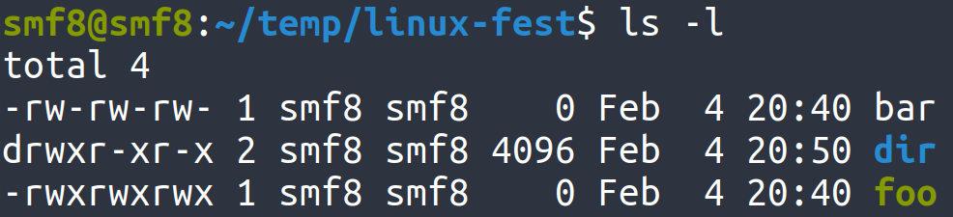
permissions
Group
Symbol
Permission
User Owner
Others
r
Read
w
Write
x
Execute

Slide 10
File vs Directory permission:
^{Permission}
^{Directory}
^{File}
^{r}
^{Allows reading of dir’s files}
^{Allows file to be read}
^{w}
Allows modification of folder’s content
^{Allows file modification}
^{x}
Allows user’s entrance into dir
^{Allows file to be executed}
⁻
^{No permission}
^{No permission}
What permission(s) do we need to delete a file ?
https://unix.stackexchange.com/questions/21251/execute-vs-read-bit-how-do-directory-permissions-in-linux-work

Slide 11
Modifying permissions
for each owner type there are 3 permissions represented with: --- (read)(write)(execute).
each permission have either 0 or 1 value.
the total value of 3 bit number --- represented in octal base is that owner type’s permission.
Example : 755 : 111 101 101 , rwx r-x r-x
use permissions and ownership symbols to modify permissions
ownerships: u(user), g(group), o(other), a(all)
permissions: r(read), w(write), x(execute)
operations: +(add), -(subtract), =(set)
Examples:
o+w (will add write permission for others)
g-w (will revoke write permission for groups)
u=rw (will set user’s permission to rw-)

Slide 12
chmod
Permission modification is with ‘chmod’ command in linux.
usage syntax: chmod permission file example commands:
chmod 644 bar.txt chmod g+x,o+x bar.txt
chmod a=rw bar.txt
// 644 in binary format is 110 100 100 so file’s permissions will become -rw-r--r--
// -rw-r-xr-x
// -rw-rw-rw-

Slide 13
Changing ownership

Slide 14
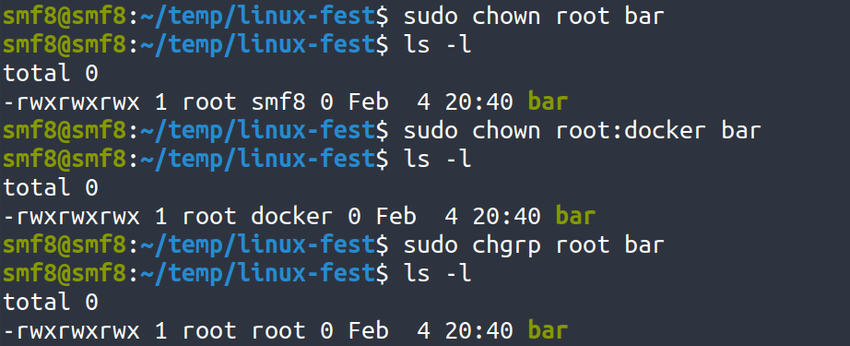
Changing ownership
‘chown’ is used for changing ownership (user, group) of a file. chown requires root privileges
syntax: chown user:group filename
‘chgrp’ is used to only change group owner of a file

