Slide 1
Iris Classification

Slide 2
Iris Classification
Predict species from 4 measurements
150 samples, 3 balanced classes

Slide 3
Results
Metric | Value
Test accuracy | 0.911
5-fold CV | 0.960 (+/- 0.039)
Baseline | 0.333

Slide 4
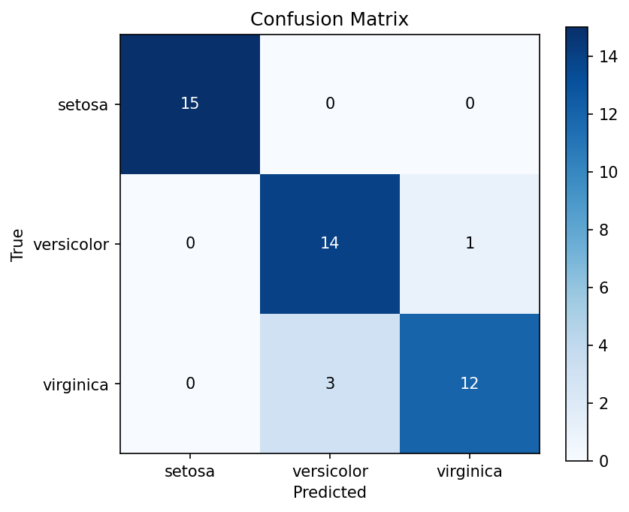
Results

Slide 5
Conclusion
Simple validated model separates species reliably

