Slide 1
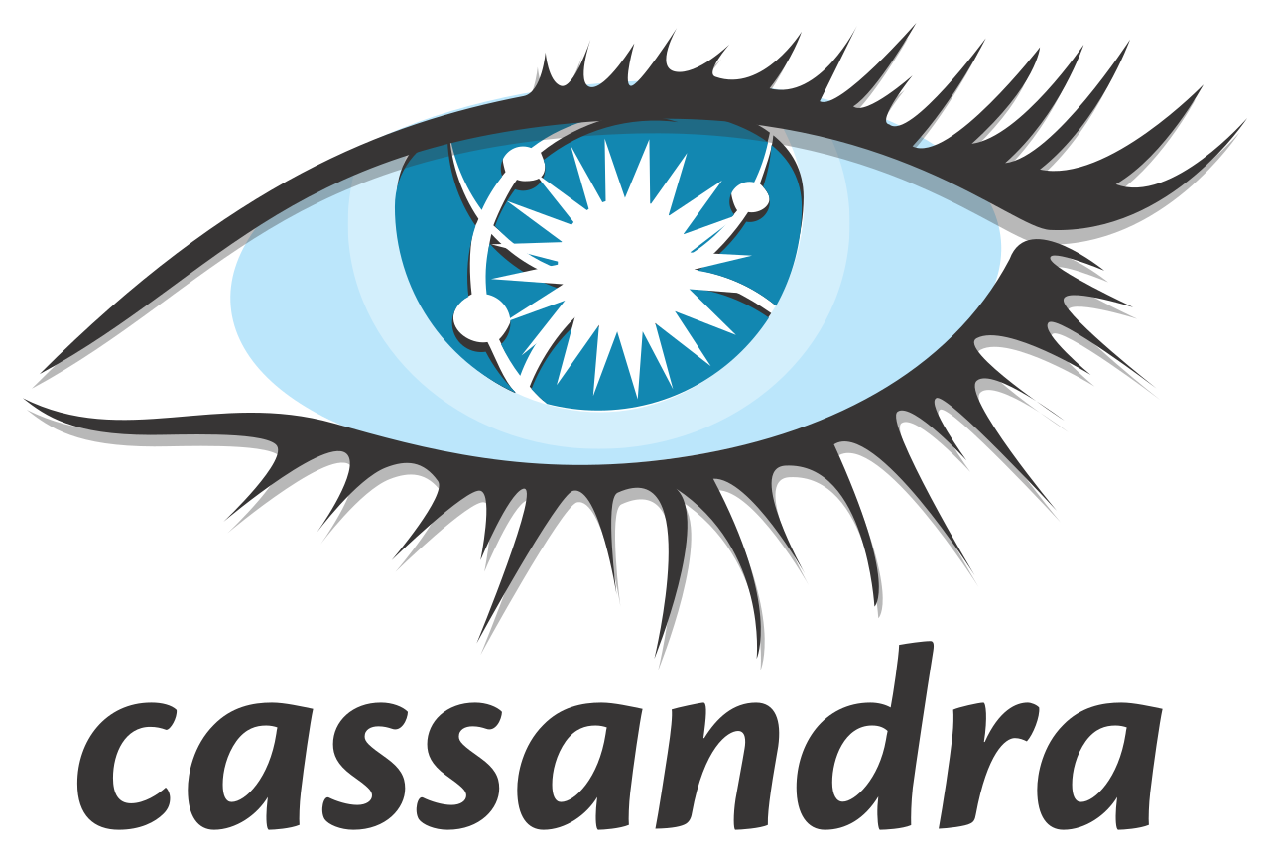
Distributed Systems

Slide 2
Introduction
The rise of Big Data and the need for new types of databases
Difference between SQL and NoSQL databases
NoSQL: schema-less, highly scalable, fast for large data
Cassandra: a leading distributed NoSQL database

Slide 3
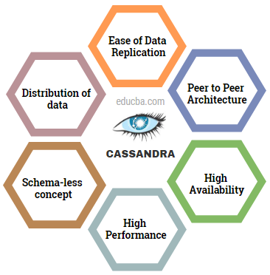
What is Cassandra?
Open-source, distributed, wide-column NoSQL database
Initially developed at Facebook; now an Apache project
Designed for handling massive amounts of data across servers
Used by Netflix, Instagram, Apple, and others

Slide 4
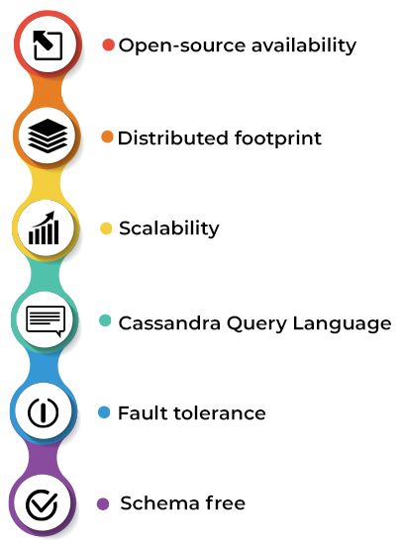
Key Features
No Single Point of Failure: every node is equal
Horizontal Scalability: easy to add more nodes
High Availability: thanks to replication
Optimized for writes: fast write-heavy workloads

Slide 5
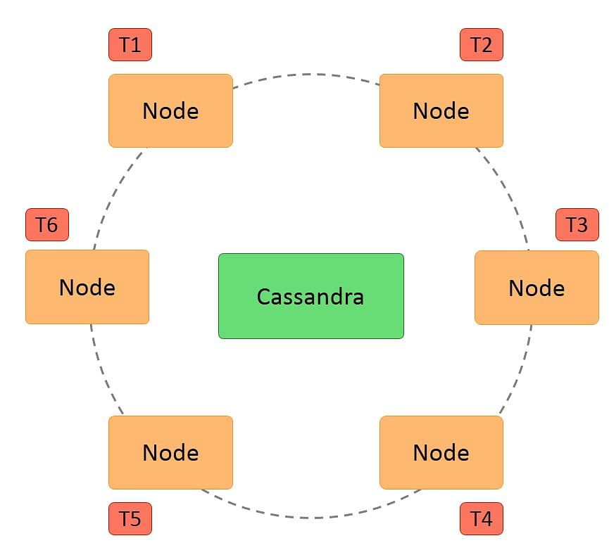
Architecture Overview
Ring topology: no master node, peer-to-peer communication
Gossip Protocol: nodes share state information
Partitioning: data is distributed using partition keys
Replication: copies of data stored across nodes
Replication Strategies: SimpleStrategy & NetworkTopologyStrategy

Slide 6
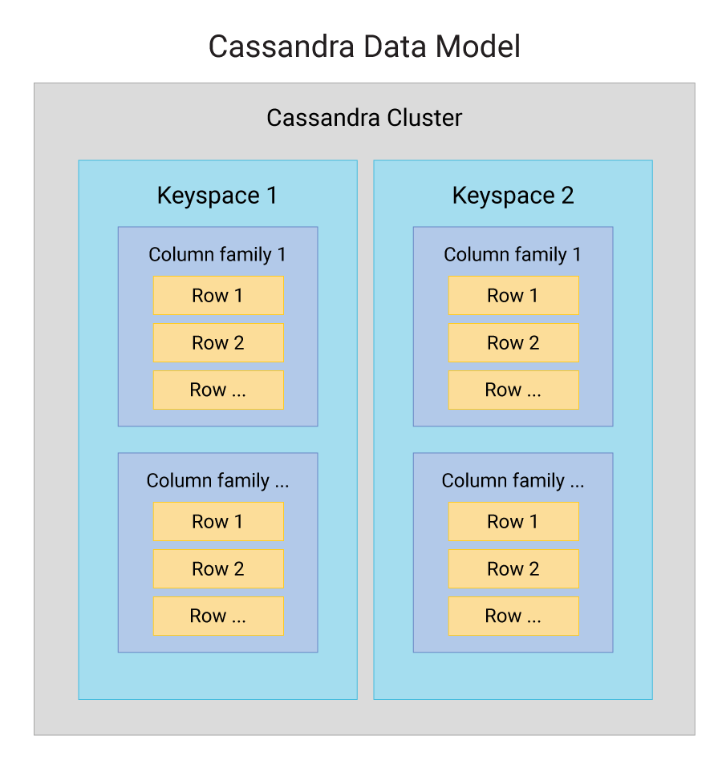
Data Model in Cassandra
Keyspace: similar to a database in RDBMS
Table → Rows → Columns
Primary Key = Partition Key + Clustering Column
Partition Key decides data location; Clustering Column defines sorting

Slide 7
Cassandra vs. Traditional RDBMS
RDBMS: rigid schema, support joins, strong consistency
Cassandra: flexible schema, no joins, tunable consistency
RDBMS for analytical queries; Cassandra for operational workloads

Slide 8

Real-World Use Cases
Netflix: user preferences and stream metadata
Instagram: comment storage and activity logs
Apple: iCloud services backend
Selected for scalability and fault tolerance

Slide 9
Why Cassandra for Distributed Systems?
Resilient to node failures
01
Built-in data replication
02
Load balancing among nodes
03
Designed for decentralized, large-scale systems
04

Slide 10
Summary of Theory
Cassandra is a powerful NoSQL database for distributed systems
Key benefits: scalability, availability, fault-tolerance
Suitable for high-write, always-on, globally distributed applications
Now, let’s move on to the hands-on part of the presentation…

