Slide 1
Multinomial NAÏVE BAYES text CLASSIFIER FOR FAKE NEWS RECOGNITION
Members:
Jelin Raphael Akkara - 2072064
Amirhossein Rostami - 2084299

Slide 2
OUTLINE
INTRODUCTION TO NAÏVE BAYES
CHALLENGES AND METHODS USED
COMPARISON OF PARAMETERS
CONCLUSION

Slide 3
i. INTRODUCTION TO NAÏVE BAYES
Introduction to Problem
Multinomial Naïve Bayes Classifier
General Approach

Slide 4
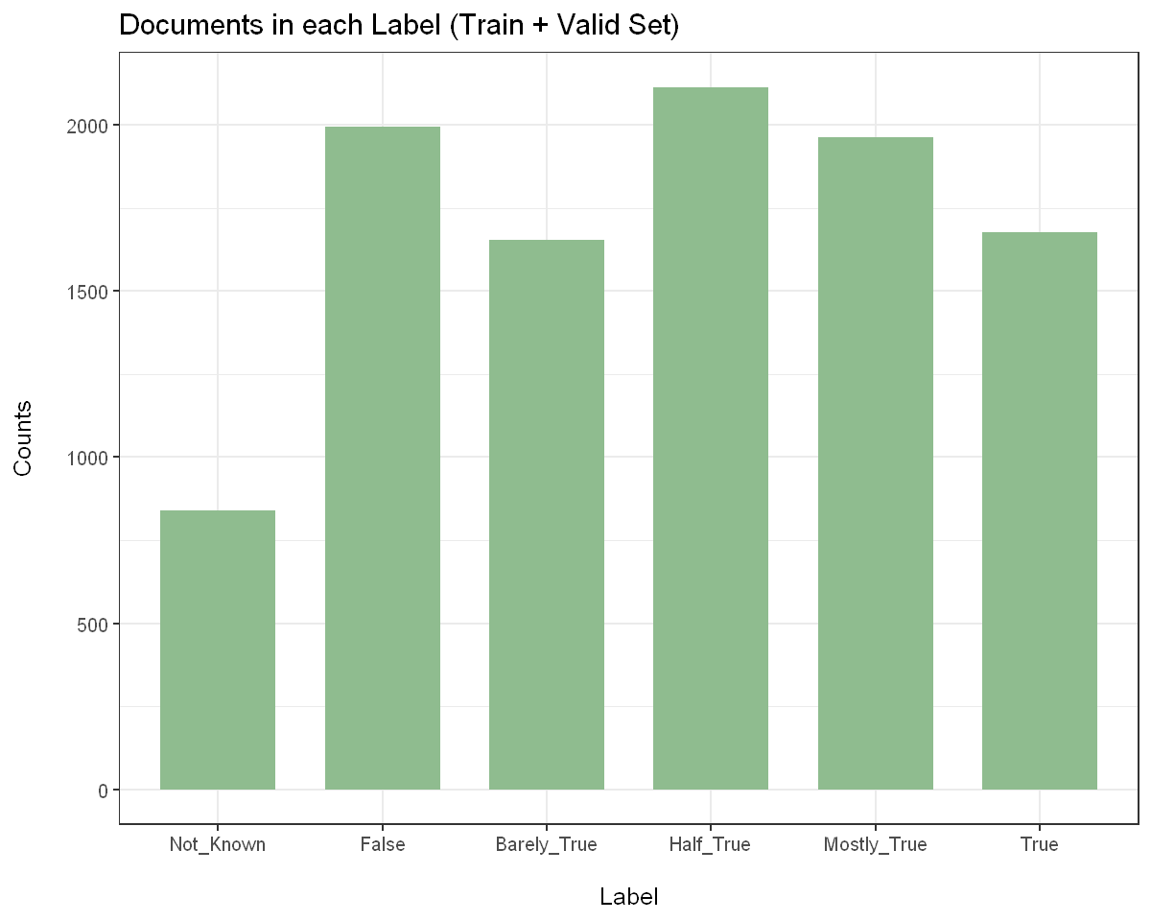
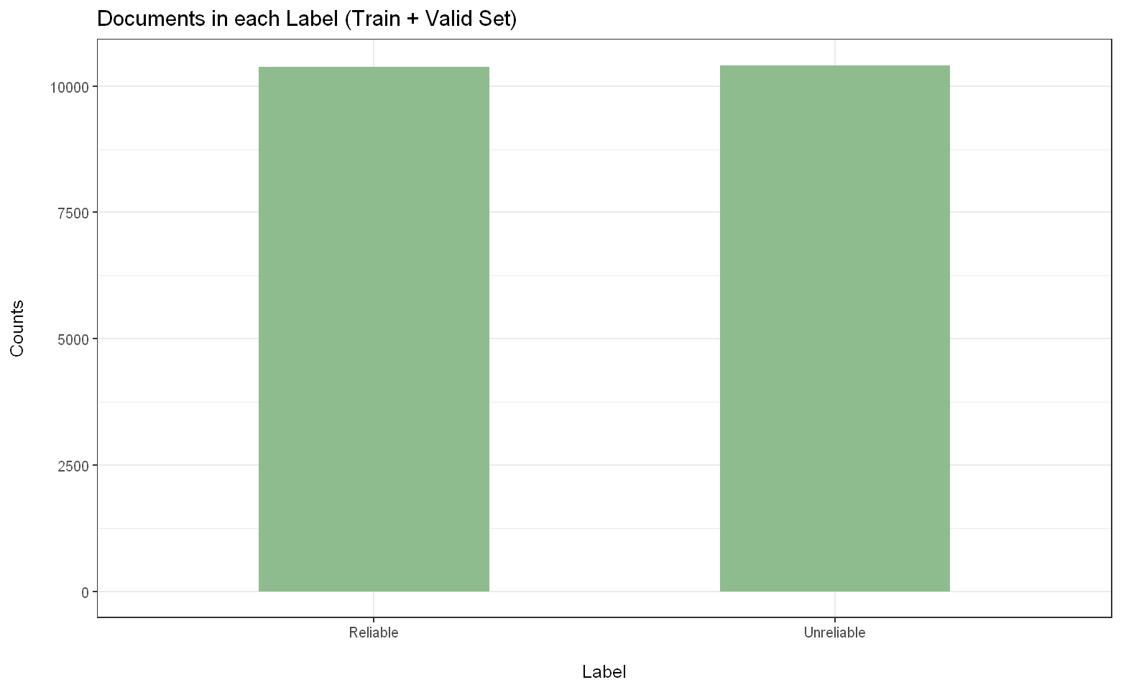
1. Introduction to the problem
We have two datasets consisting of labelled documents.
We need to build classifiers that are able to correctly predict the label of a given document.
Naïve Bayes algorithm is a basic, yet effective model for a text classification model.

Slide 5
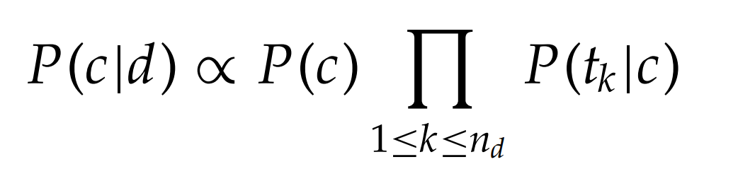
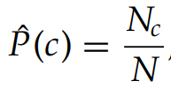
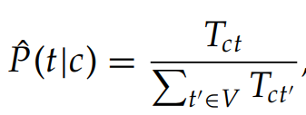
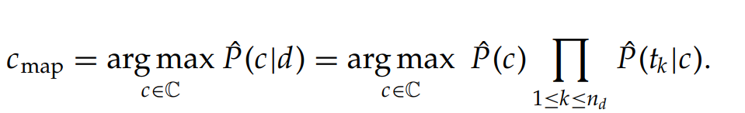
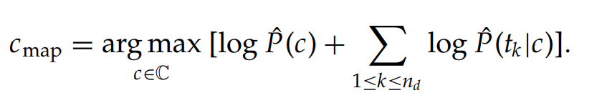
2. Multinomial naïve bayes classifier
In a basic sense, if we have a text document, we can utilize the Bayes’ Theorem to make a prediction on it.
The prior is the probability assigned to a label or a class. This can either be taken as a uniform probability throughout all classes, or can be assigned with respect to each class occurrence in the training set.
The likelihood is the probability of having the document given the class. Since a document is made of words, it can be broken down into individual words (terms/features/tokens).
To make a classification, we select the class with the highest probability.

Slide 6
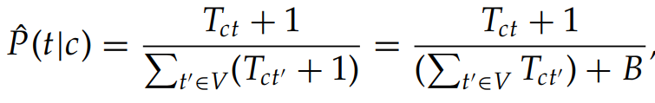
2. Multinomial naïve bayes classifier
Laplace Smoothing: To prevent the product of conditional probability from going to zero due to absence of a word, we add 1 to all term counts.

Slide 7
2. Multinomial naïve bayes classifier
ASSUMPTIONS: BAG OF WORDS MODEL
Conditional Independence: Words are independent of each other given the class, and do not influence each other
Positional Independence: Words occurring in different positions of a document have the same conditional probability.

Slide 8
3. General Approach used
Utilizing a SQL approach with dplyr library: Since text classification can deal with large datasets, we decided using a SQL approach would be optimal where using methods like select, filter, join, etc. would be efficient.
This has the added advantage that it has easy translatability into other frameworks like SQL, Spark (SparkR), etc.
BUILDING AND TRAINING
MODEL
PRE-PROCESSING DATA
WORKING MODEL
FEATURE SELECTION
VALIDATING MODEL

Slide 9
ii. CHALLENGES AND METHODS USED
Pre-processing Data
Feature Selection
Building and Training Model
Validating Model

Slide 10
1. PRE-PROCESSING DATA
CHALLENGE: Remove inconsequential words and simplify the data
METHODS USED:
Remove Stop-Words, Punctuations, Numbers, Whitespaces
Lowering Text
Normalization using Stemming, Lemmatization
Stemming: (‘running’, ‘runner’, ‘runs’) -> (‘run’, ‘run’, ‘run’)
Lemmatization: (‘ate’, ‘ran’, ‘running’) -> (‘eat’, ‘run’, ‘run’)
Tokenization (with each word as token)

Slide 11
2. FEATURE SELECTION
CHALLENGE: Large vocabulary containing irrelevant words
FEATURE SELECTION: Selects a subset of vocabulary such that only relevant terms of each class are used. It decreases the size of vocabulary and removes noise features, reducing the overfitting that may occur.
Assigns utility measure to each combination of (term, class) and selects the top n terms per class
We use Mutual Information measure, which gives a sense of how relevant and related a word is to a class

Slide 12
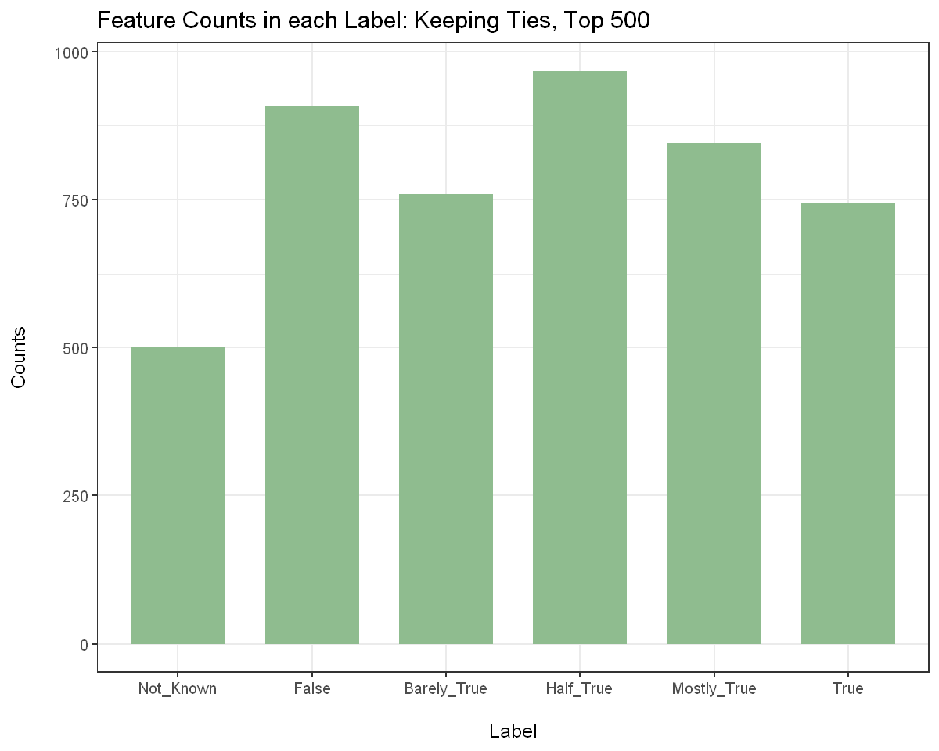
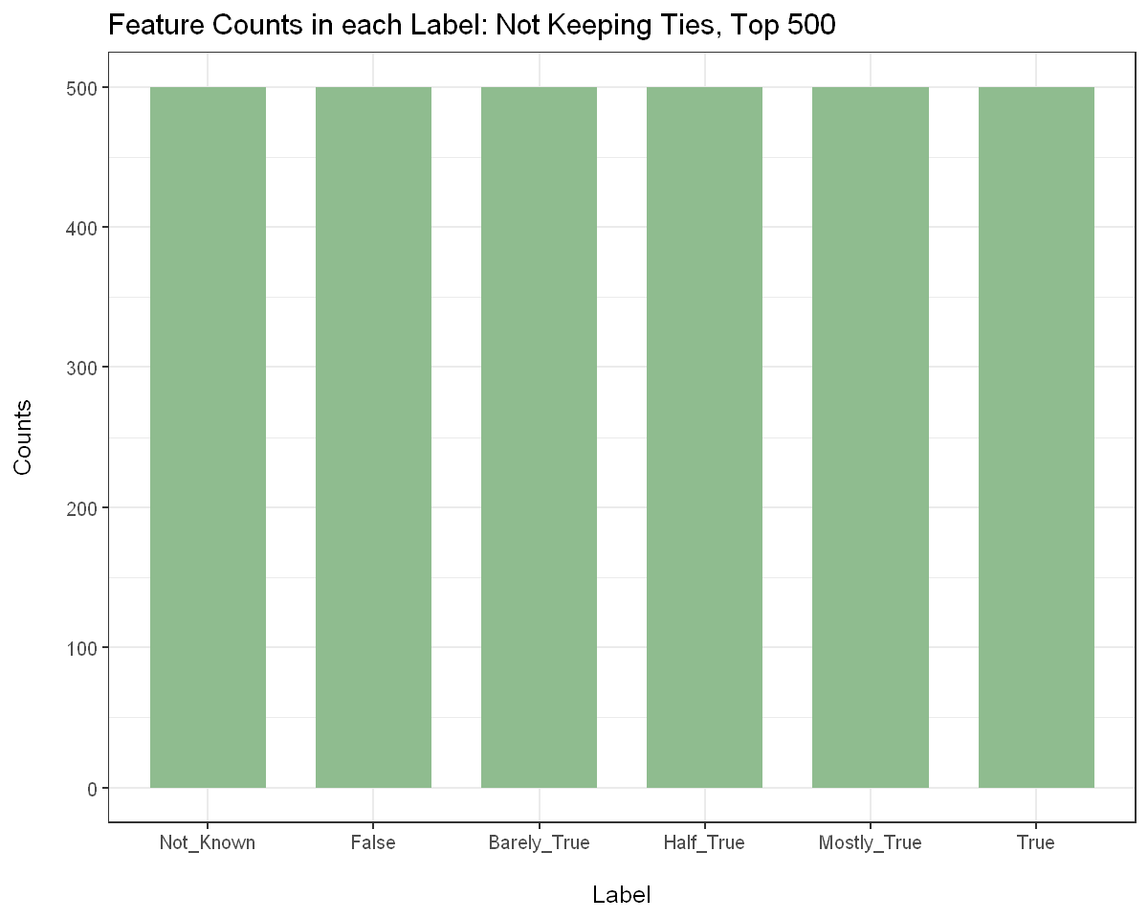
2. FEATURE SELECTION
Dealing with Tie Cases: For terms with same score, we have the option of keeping the ties vs removing the ties.
KEEPING TIES
REMOVING TIES

Slide 13
3. BUILDING AND TRAINING MODEL
We use the cleaned, tokenized dataset that has been reduced after feature selection
Assign Priors and Conditional Probabilities to each term in each class
Use Laplace Smoothing on conditional probabilities

Slide 14
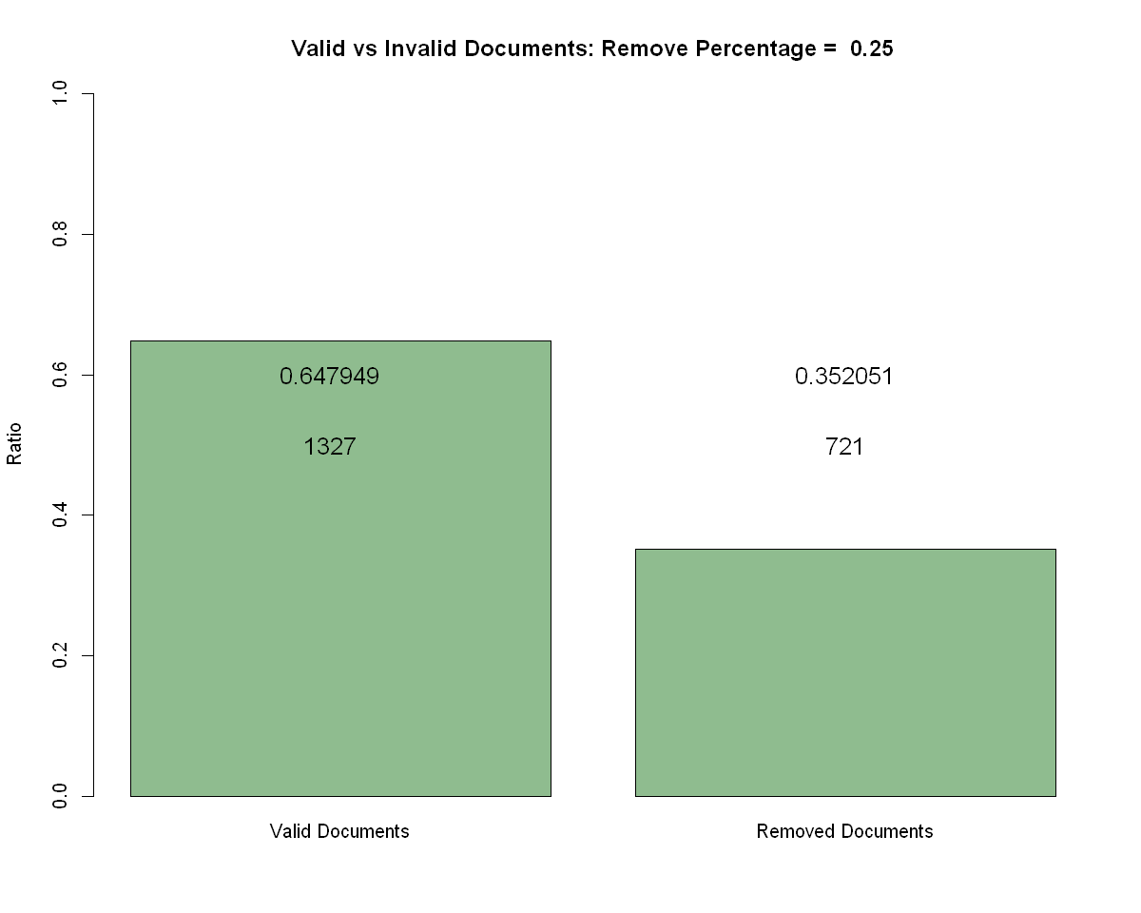
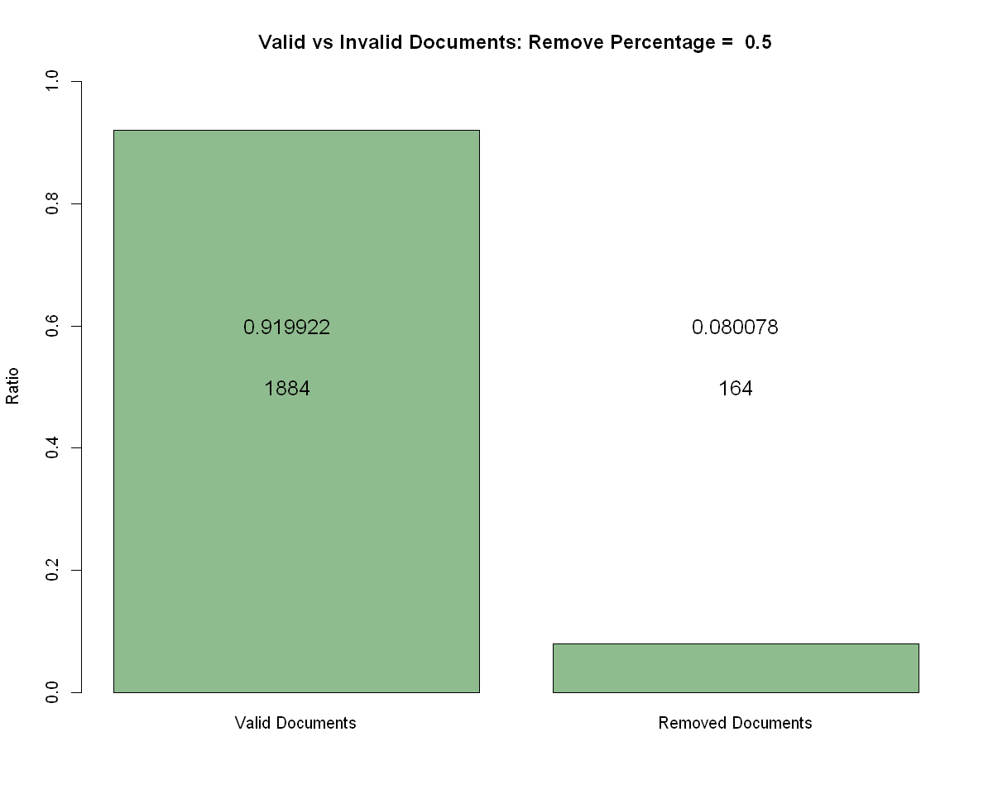
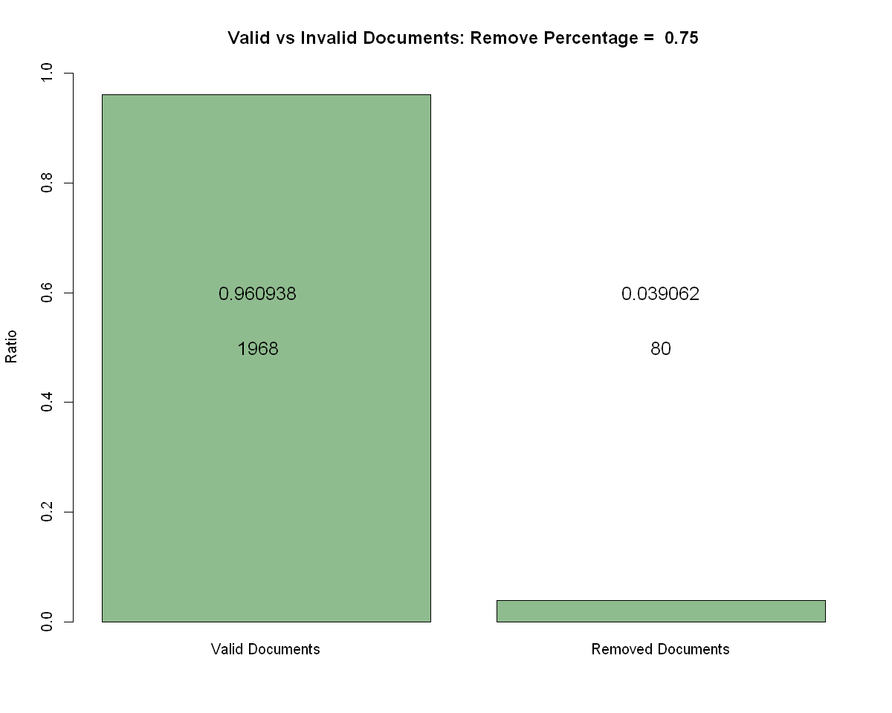
4. PREDICTIONS AND VALIDATING MODEL
We use the tibbles with conditional probabilities and priors to get the corresponding probability in each word in our validation dataset. Get the log probability for each label in each document, choosing the one with the largest value
Removing Documents with high number of new words: If a document contains a high percentage (say 75%) of words outside of our vocabulary, they are ignored since the predictions made on them would not be reliable.

Slide 15
iII. Comparison OF PARAMETERS
Obtaining Metrics
Stemming vs Lemmatization
Feature Selection: With vs Without
Keeping Ties: With vs Without
Features vs Accuracy

Slide 16
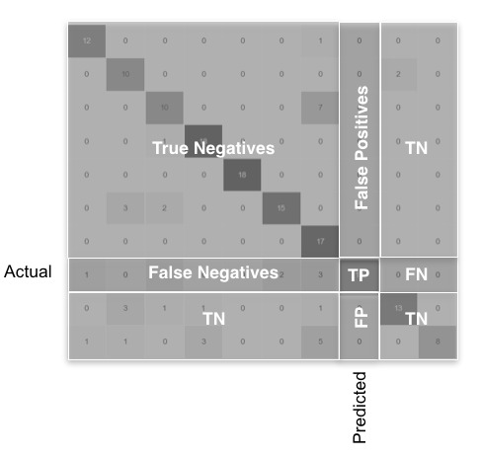
1. OBTAINING METRICS
Micro-Accuracy: The proportion of correctly labelled predictions against the total number of predictions.
Macro-(Accuracy, Precision, Recall, F_1 Score): The metric values for each class or label individually.
TRUE POSITIVE | FALSE NEGATIVE
FALSE POSITIVE | TRUE NEGATIVE
1
ACTUAL LABEL
0
1
0
PREDICTED LABEL

Slide 17
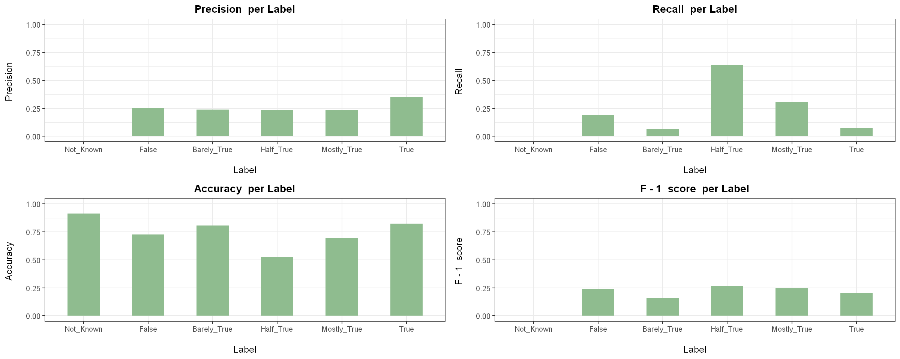
2. Normalization: Stemming vs lemmatization
STEM: 1, LEM: 0, FEAT: 0
TIMING
1.2 seconds

Slide 18
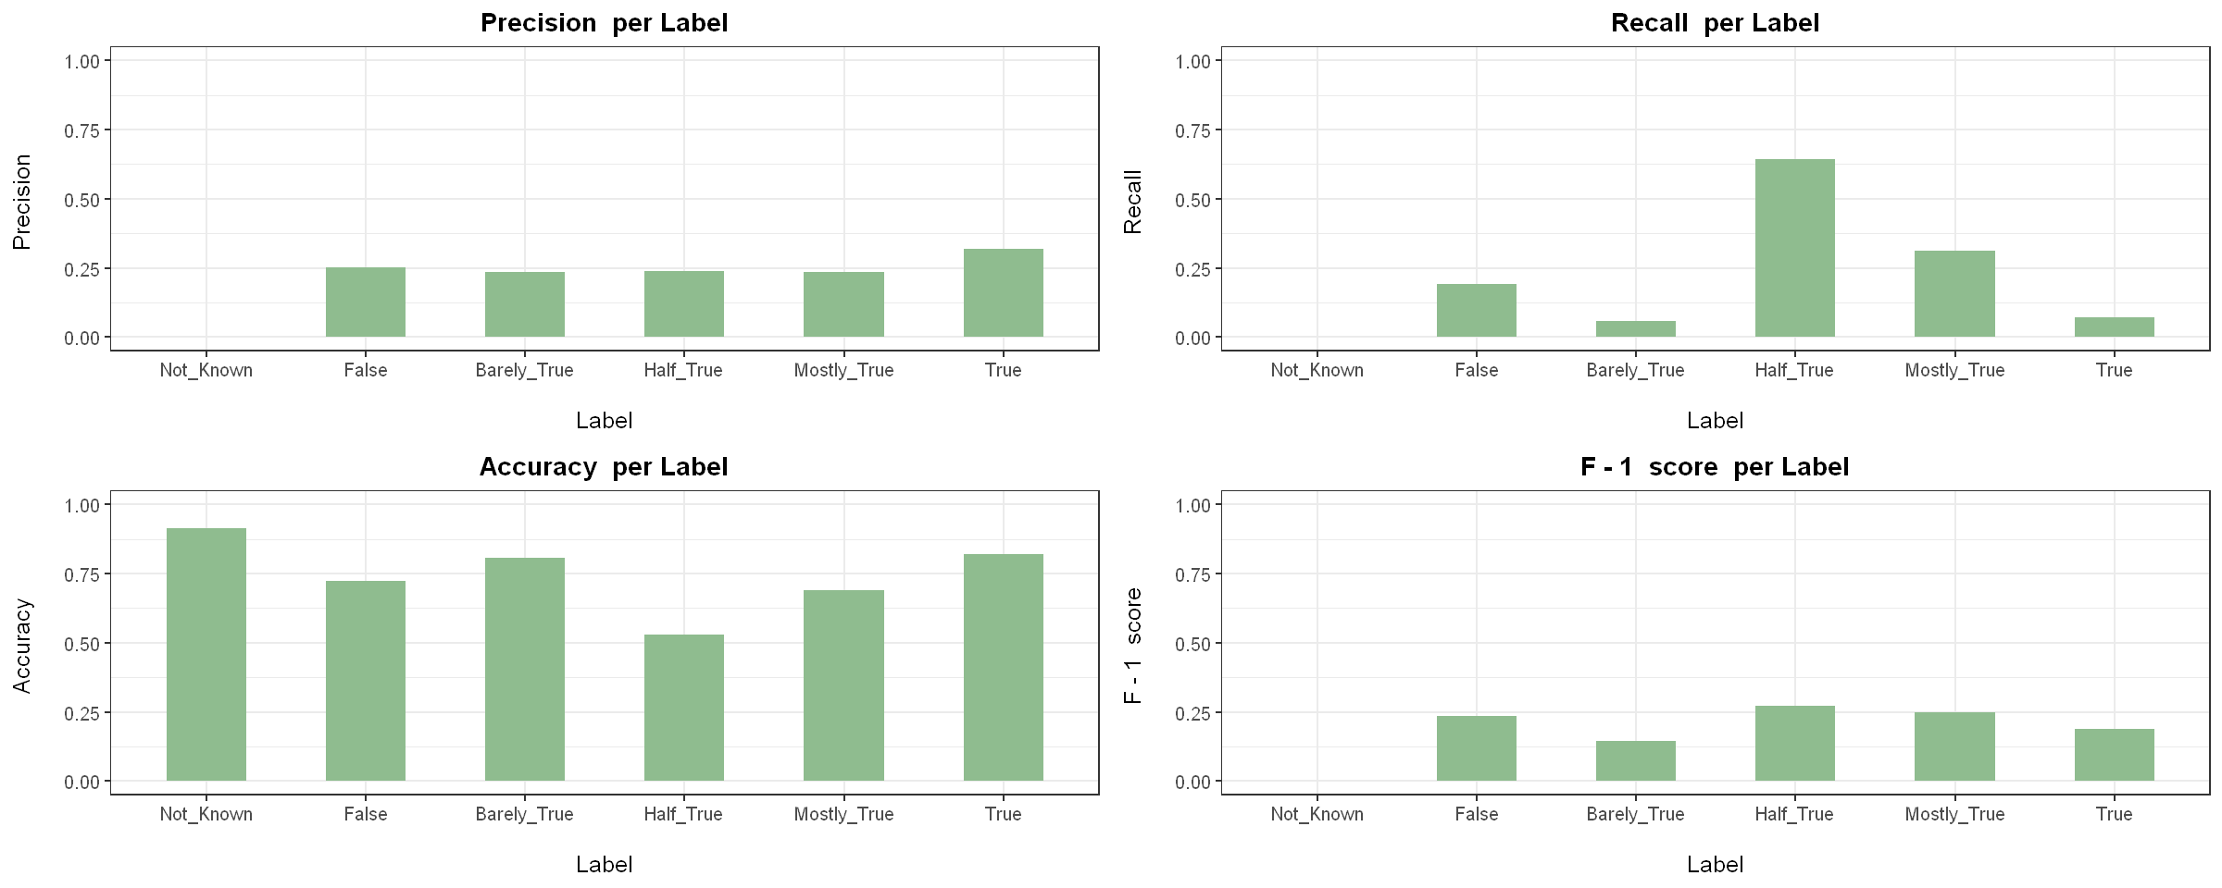
2. Normalization: Stemming vs lemmatization
STEM: 1, LEM: 1, FEAT: 0
TIMING
5 minutes

Slide 19
3. FEATURE SELECTION: WITH VS WITHOUT
STEM: 1, LEM: 0, FEAT: 0
TIMING
1.2 seconds

Slide 20
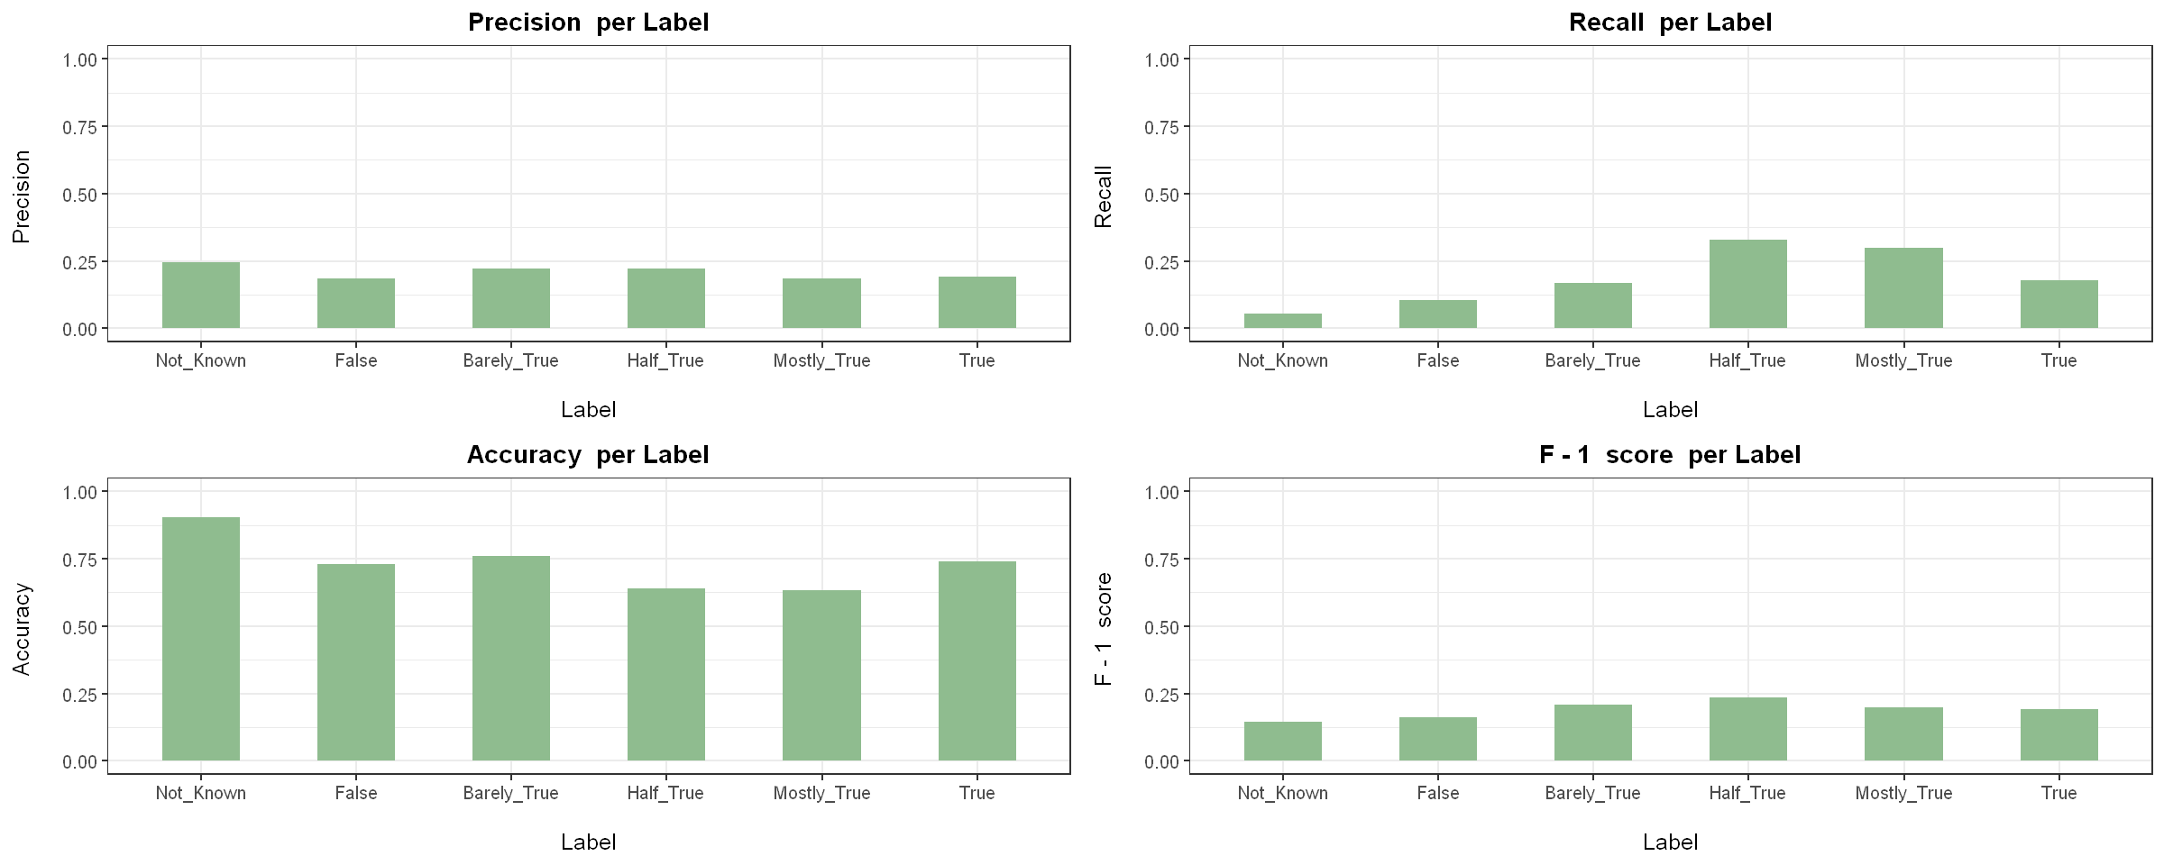
3. FEATURE SELECTION: WITH VS WITHOUT
STEM: 1, LEM: 0, FEAT: 1
TIMING
2.4 seconds

Slide 21
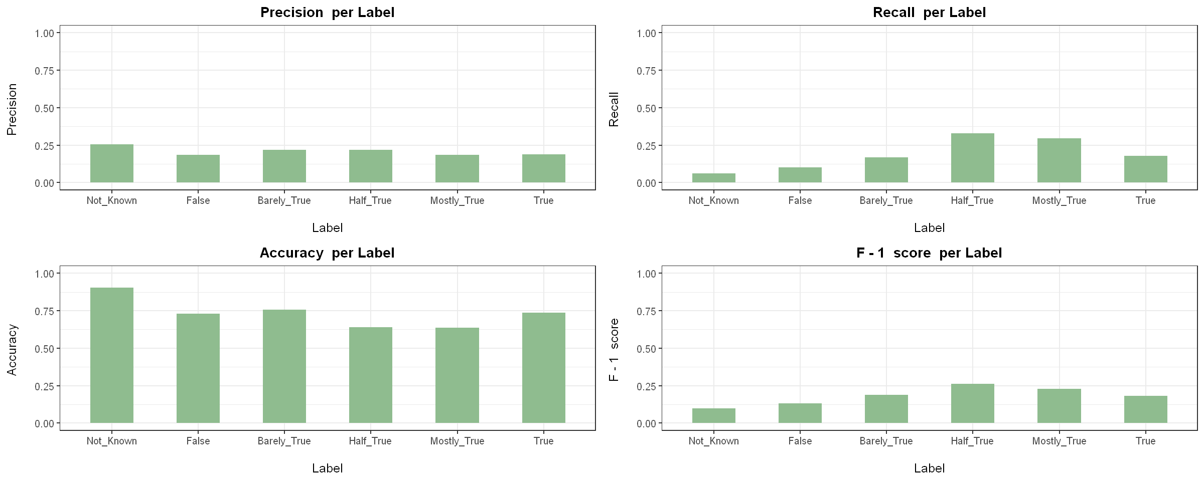
4. Keeping ties: WITH VS WITHOUT
TIMING
STEM: 1, LEM: 0, FEAT: 1, TIES: 0, TOP_K: 500
1.8 seconds

Slide 22

4. Keeping ties: WITH VS WITHOUT
TIMING
STEM: 1, LEM: 0, FEAT: 1, TIES: 1, TOP_K: 500
1.9 seconds

Slide 23
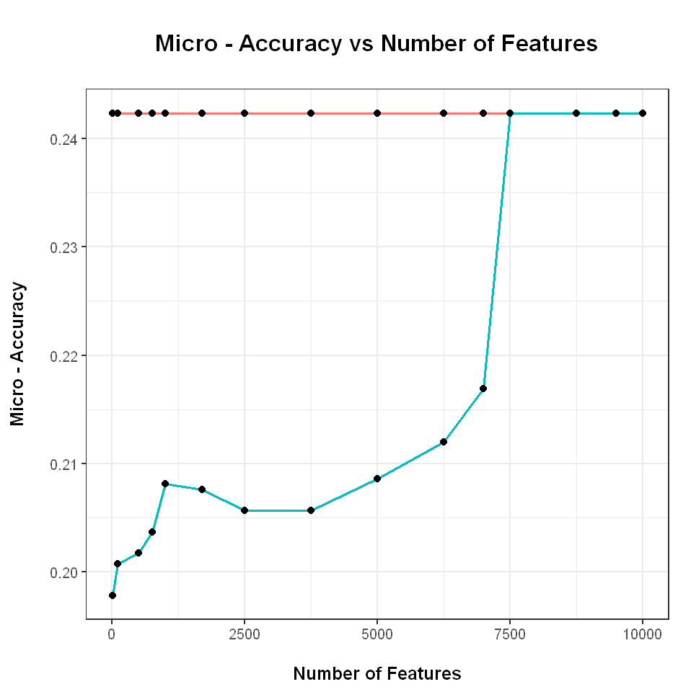

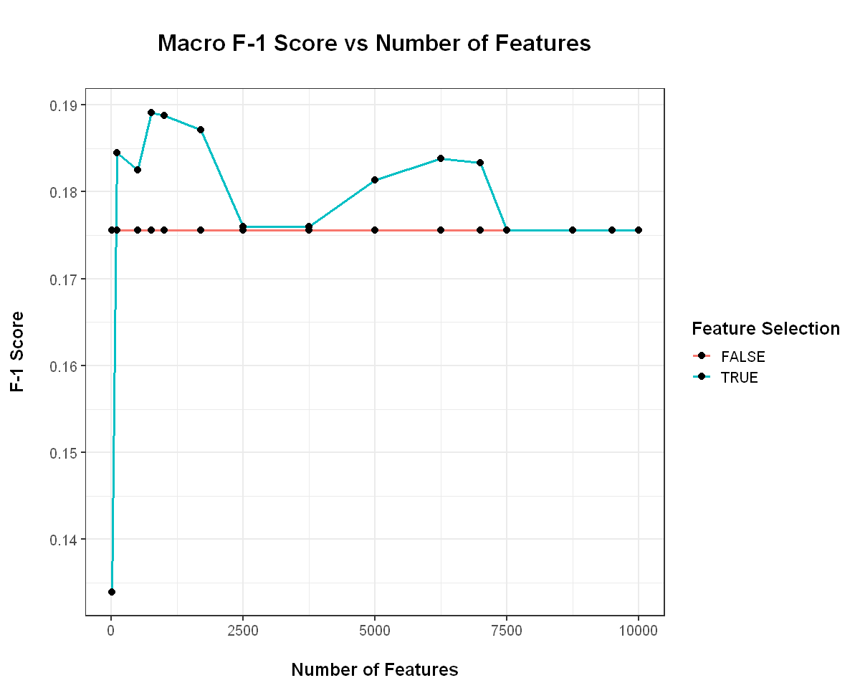
5. NUMBER OF FEATURES: ACCURACY, F-1 SCORE ACROSS VALUES
STEM: 1, LEM: 0, FEAT: 1, TIES: 0
TOP_K OPTIMAL: 100 (8%), 500 (41%), 750 (60%)
( Out of 7417 features in vocabulary )

Slide 24
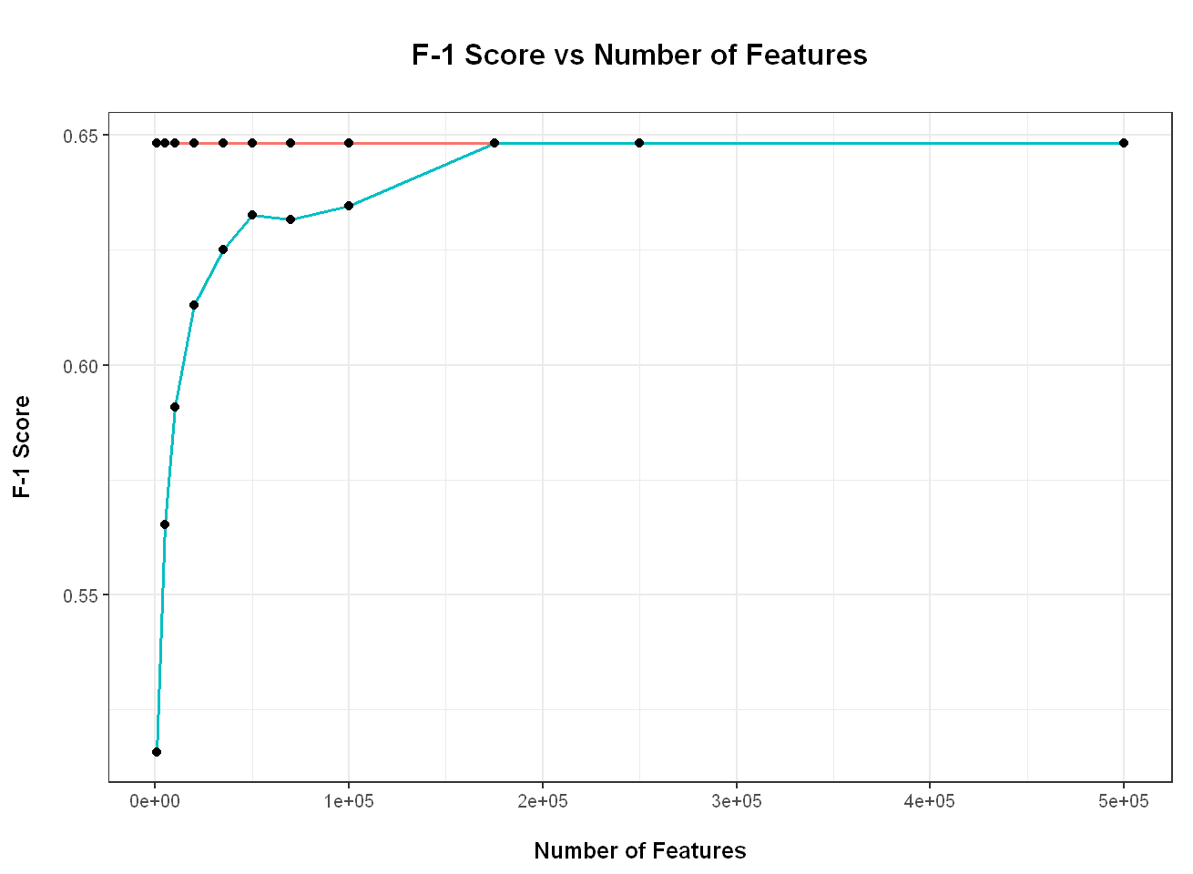
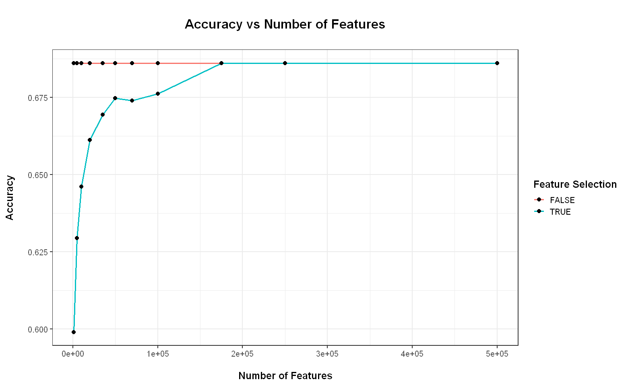
5. NUMBER OF FEATURES: ACCURACY, F-1 SCORE ACROSS VALUES
STEM: 1, LEM: 0, FEAT: 1, TIES: 0
TOP_K OPTIMAL: 20000 (28%), 35000 (49%), 50000 (70%)
( Out of 142525 features in vocabulary )

Slide 25
v. conclusion

Slide 26
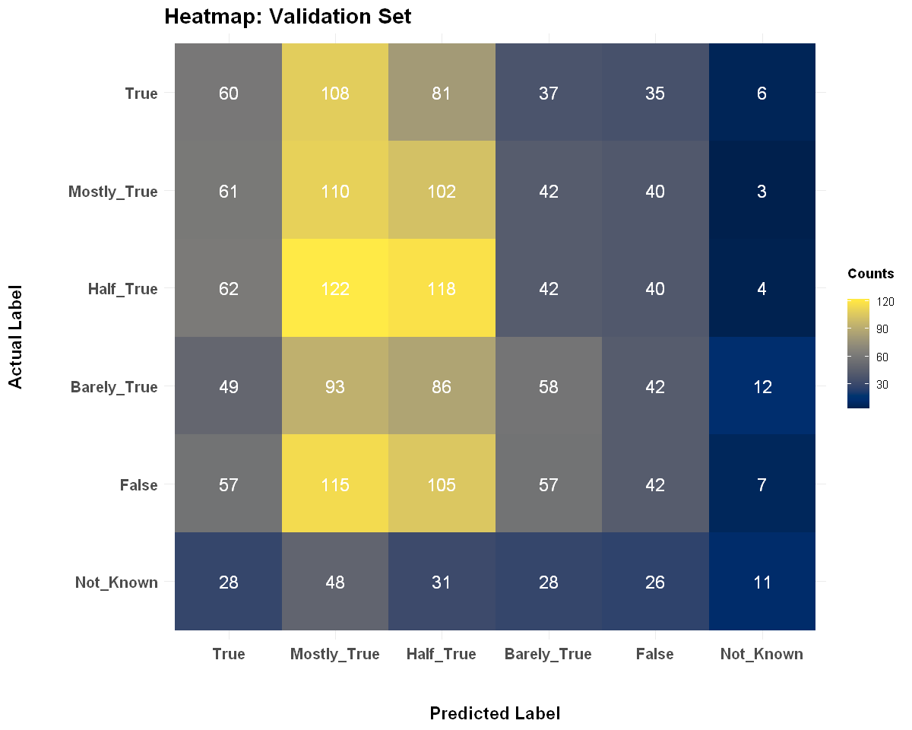
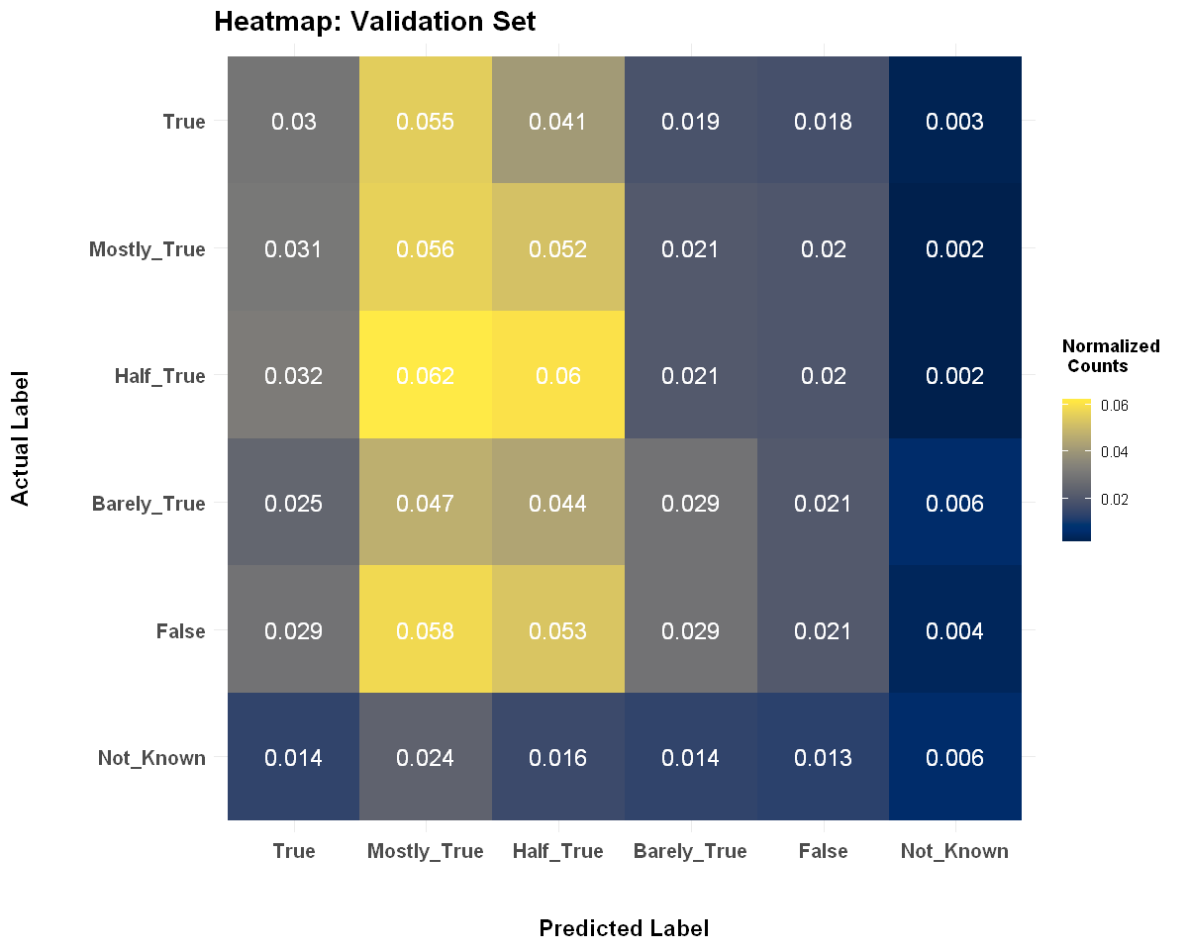
BEST MODEL: FIRST DATASET (six classes)
We have optimal set of parameters: ( Stem: 1, Lem: 0, Feat: 1, Ties: 0, Top_k: 500)

Slide 27
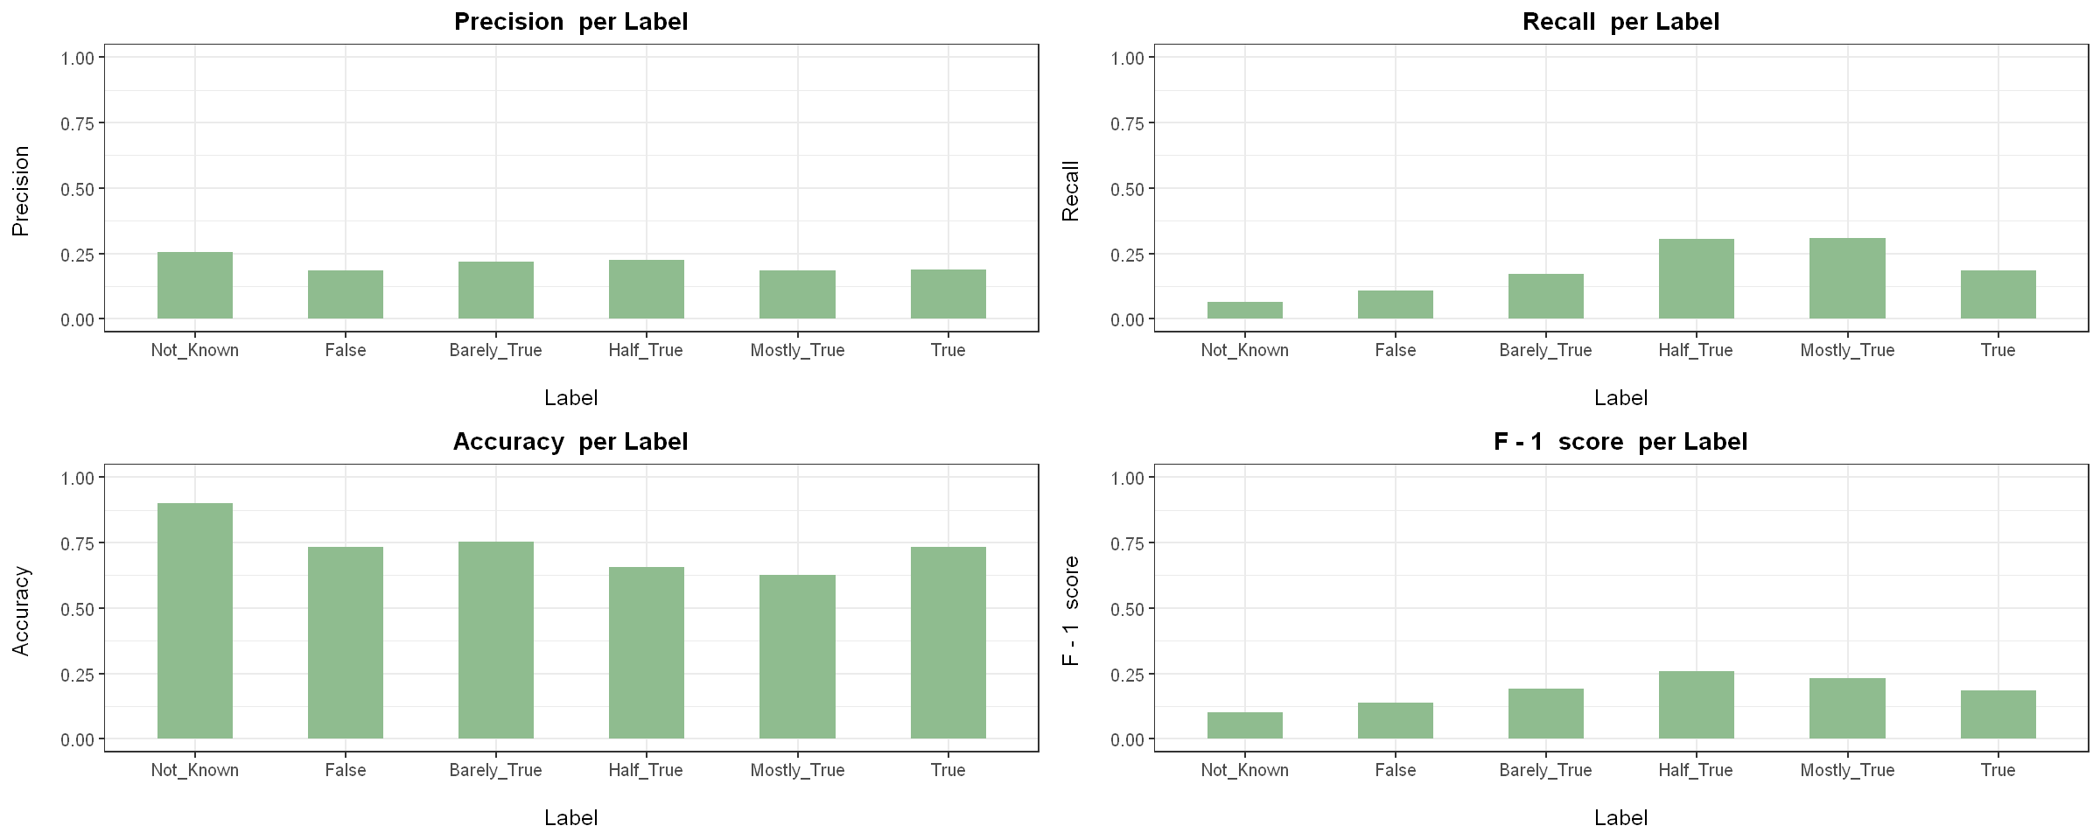
BEST MODEL: FIRST DATASET (six classes)
We have optimal set of parameters: ( Stem: 1, Lem: 0, Feat: 1, Ties: 0, Top_k: 500)

Slide 28
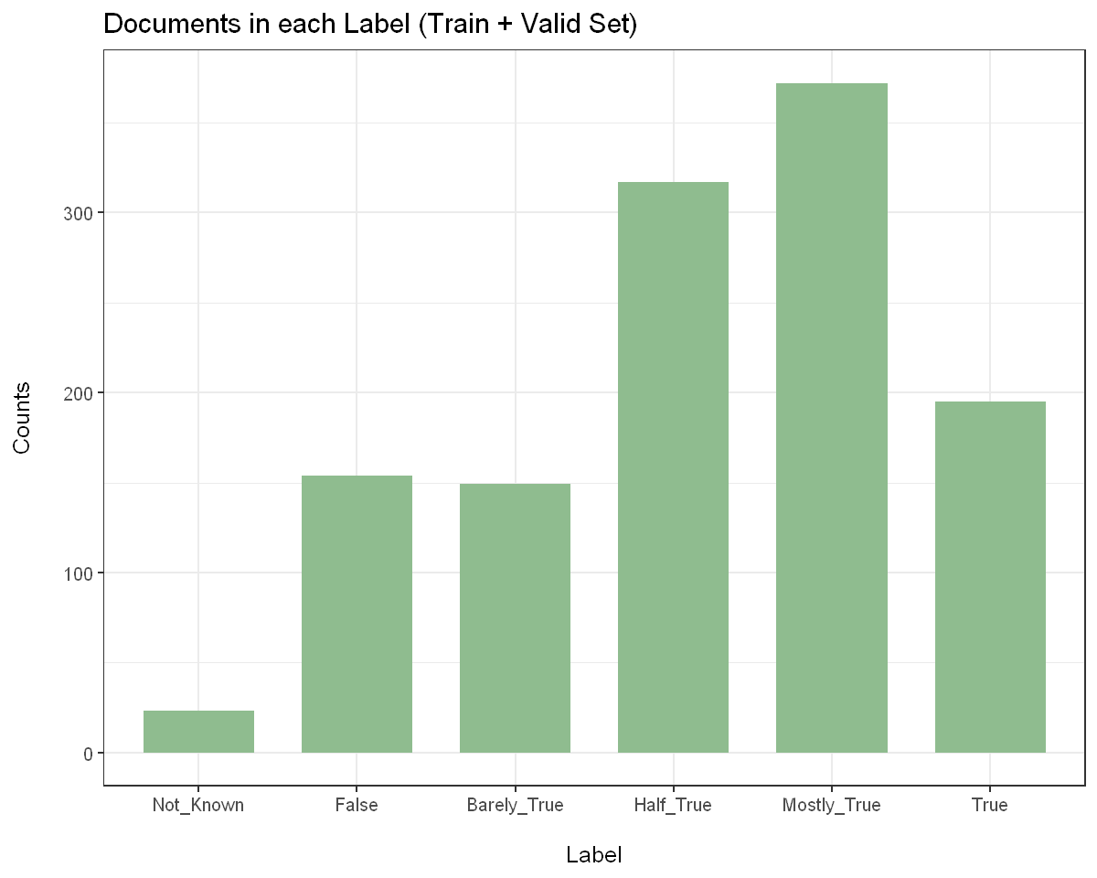
BEST MODEL: FIRST DATASET
Running on the Test Set:

Slide 29
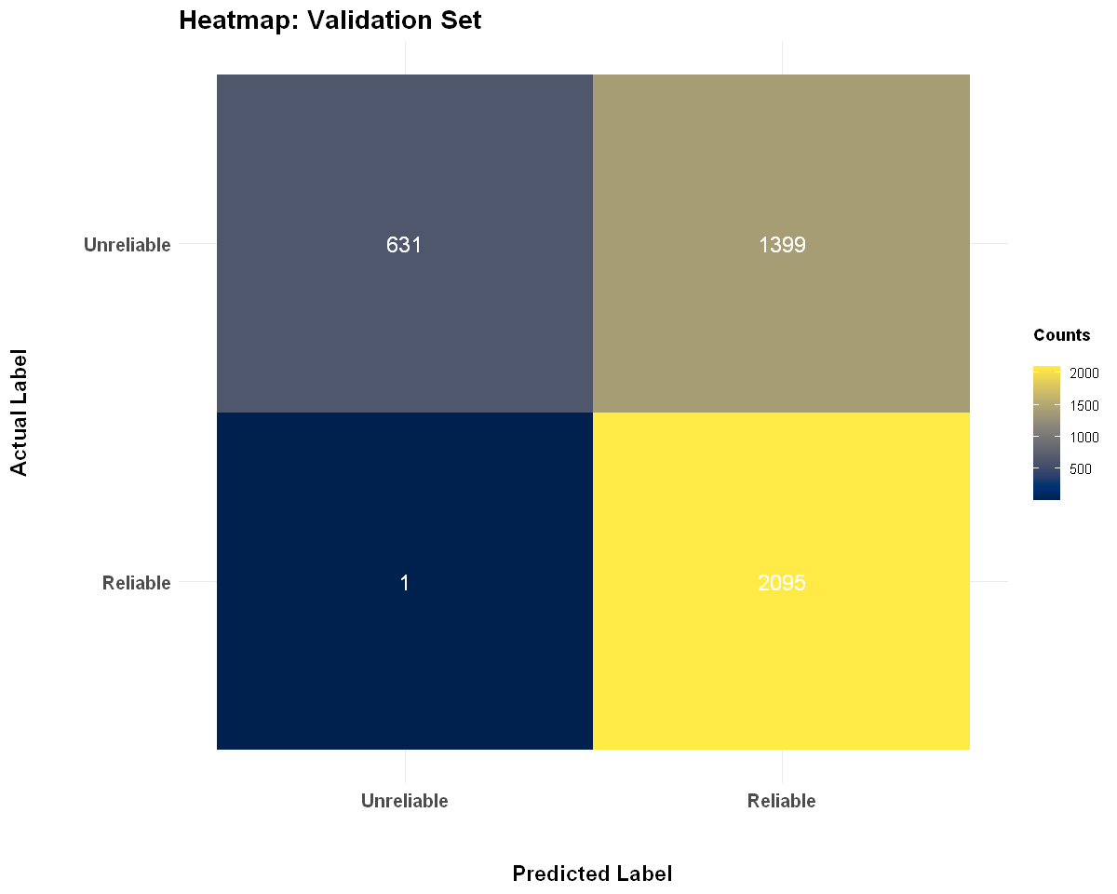
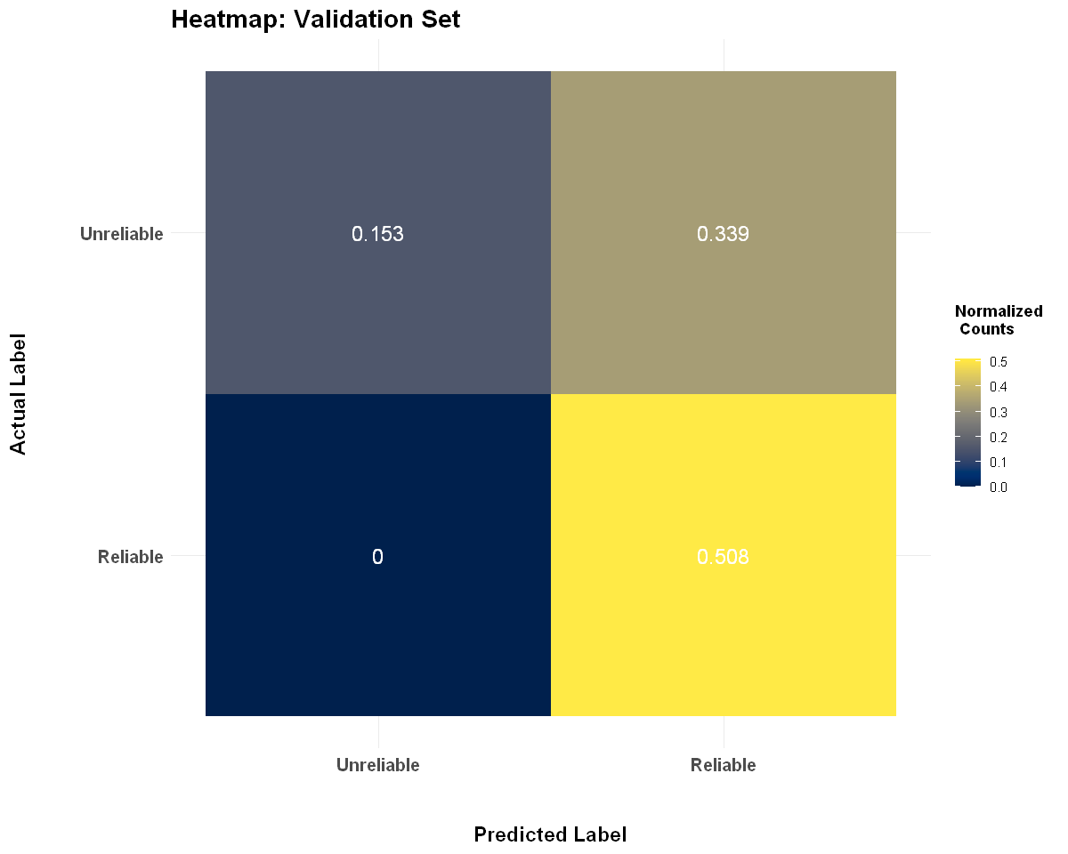
BEST MODEL: second DATASET (two Classes)
We have optimal set of parameters: ( Stem: 1, Lem: 0, Feat: 1, Ties: 0, Top_k: 20000)

Slide 30
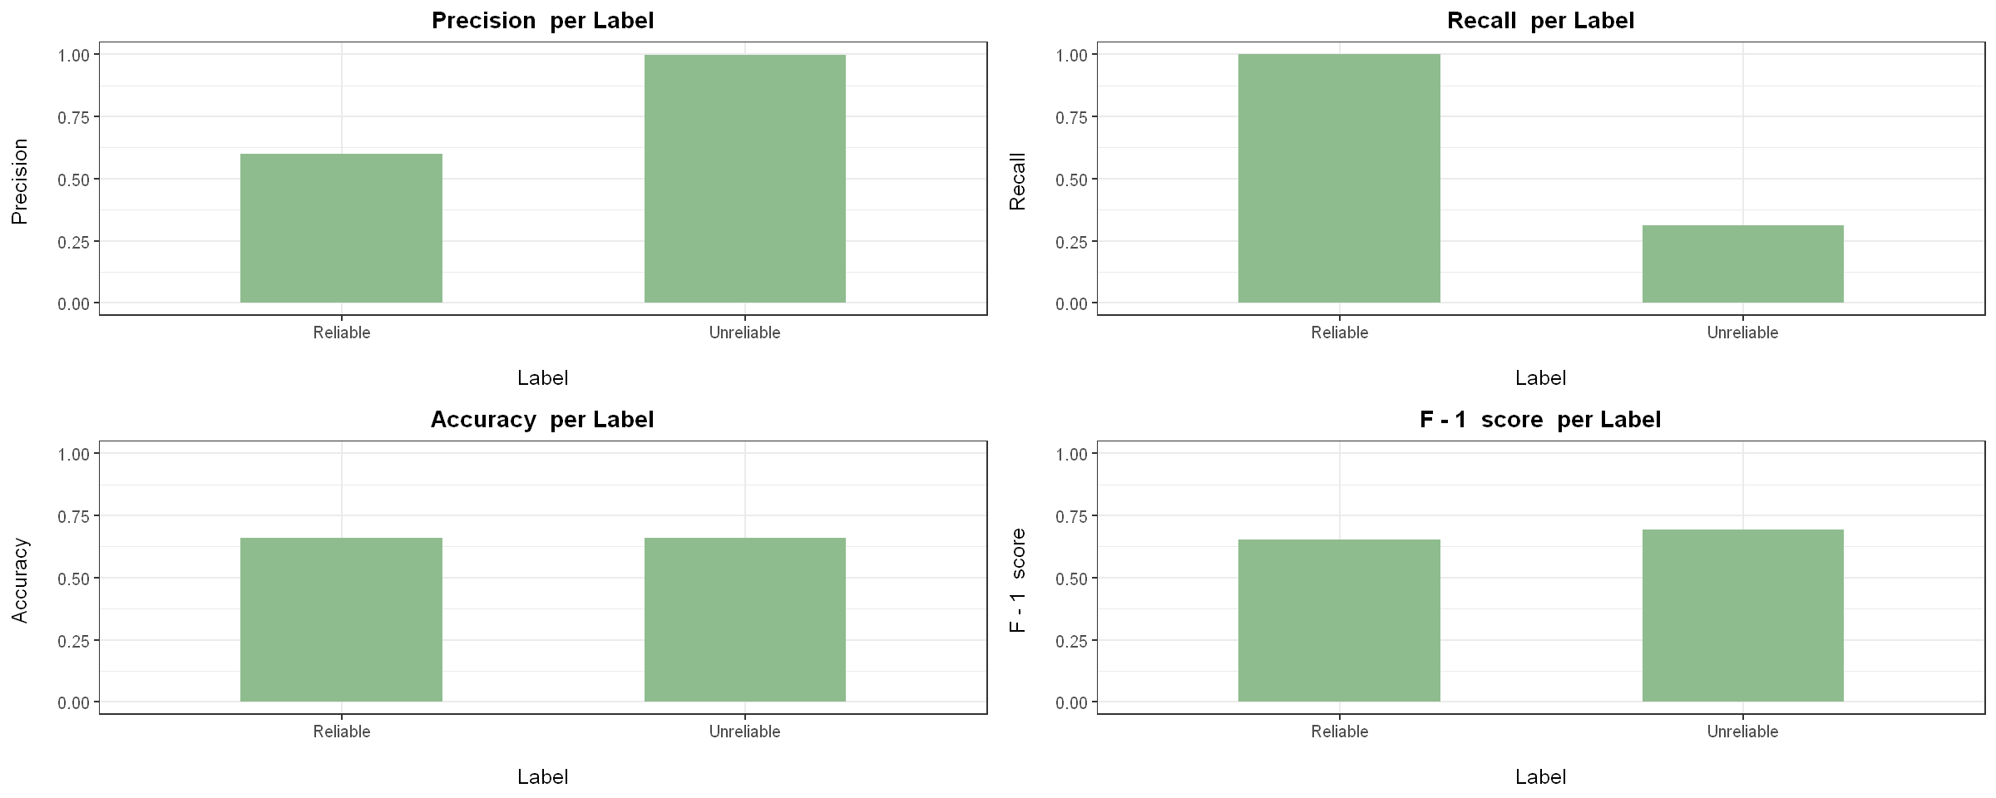
BEST MODEL: second DATASET (two Classes)
We have optimal set of parameters: ( Stem: 1, Lem: 0, Feat: 1, Ties: 0, Top_k: 20000)

Slide 31
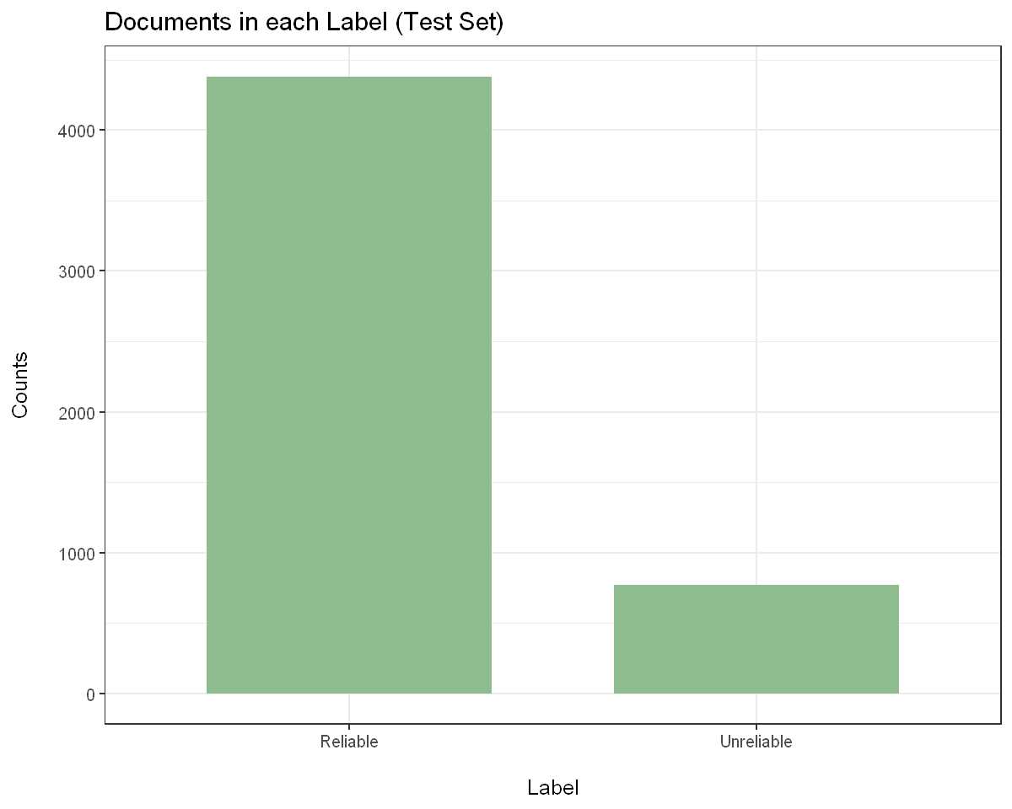
BEST MODEL: SECOND DATASET
Running on the Test Set

Slide 32
THANK YOU

