Slide 1
Alert Circle

Slide 2
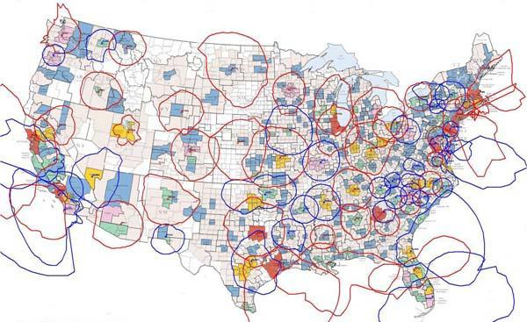
What is FEMA Alert System?
Integrated Public Alert and Warning System (IPAWS)

Slide 3
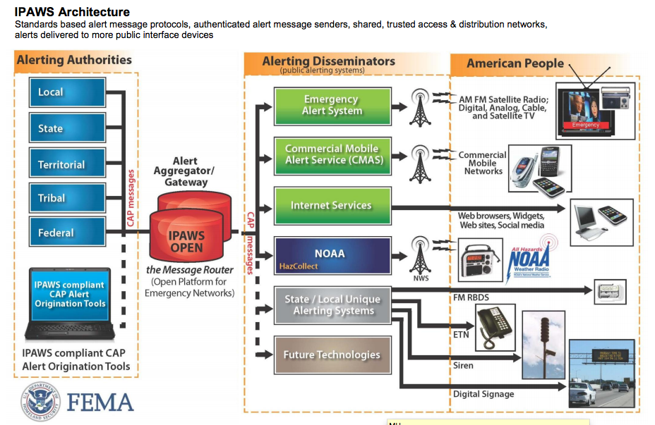

Slide 4
Value Proposition (1)
AlertCircle provides actionable information and guide on what to do. A simple 90 character alert from FEMA provides only awareness.

Slide 5
Value Proposition (2)
Unique opportunity of alerting based on *current* location of person without application being run on device through AT&T Location API.
Not available through GPS + Background App.

Slide 6
Value Proposition (3)
You can subscribe to friends & family locations.
Social Network Alerts and Integration (FB)
Aggregation of multiple information sources

Slide 7
Hackathong Technologies
AT&T API (SMS, placeholder for S2T)
AT&T Cloud Server
apigee (?)
Facebook API, Facebook Graph API
Tiggzi (HTML5)
AWS (for redundancy and failover)

Slide 8
Demo
Your home city is SF but you are driving down route 1 near L.A.
Since you are away from home, no other system (except Carrier) provides location.
FEMA Tsunami Alert comes

