Slide 1
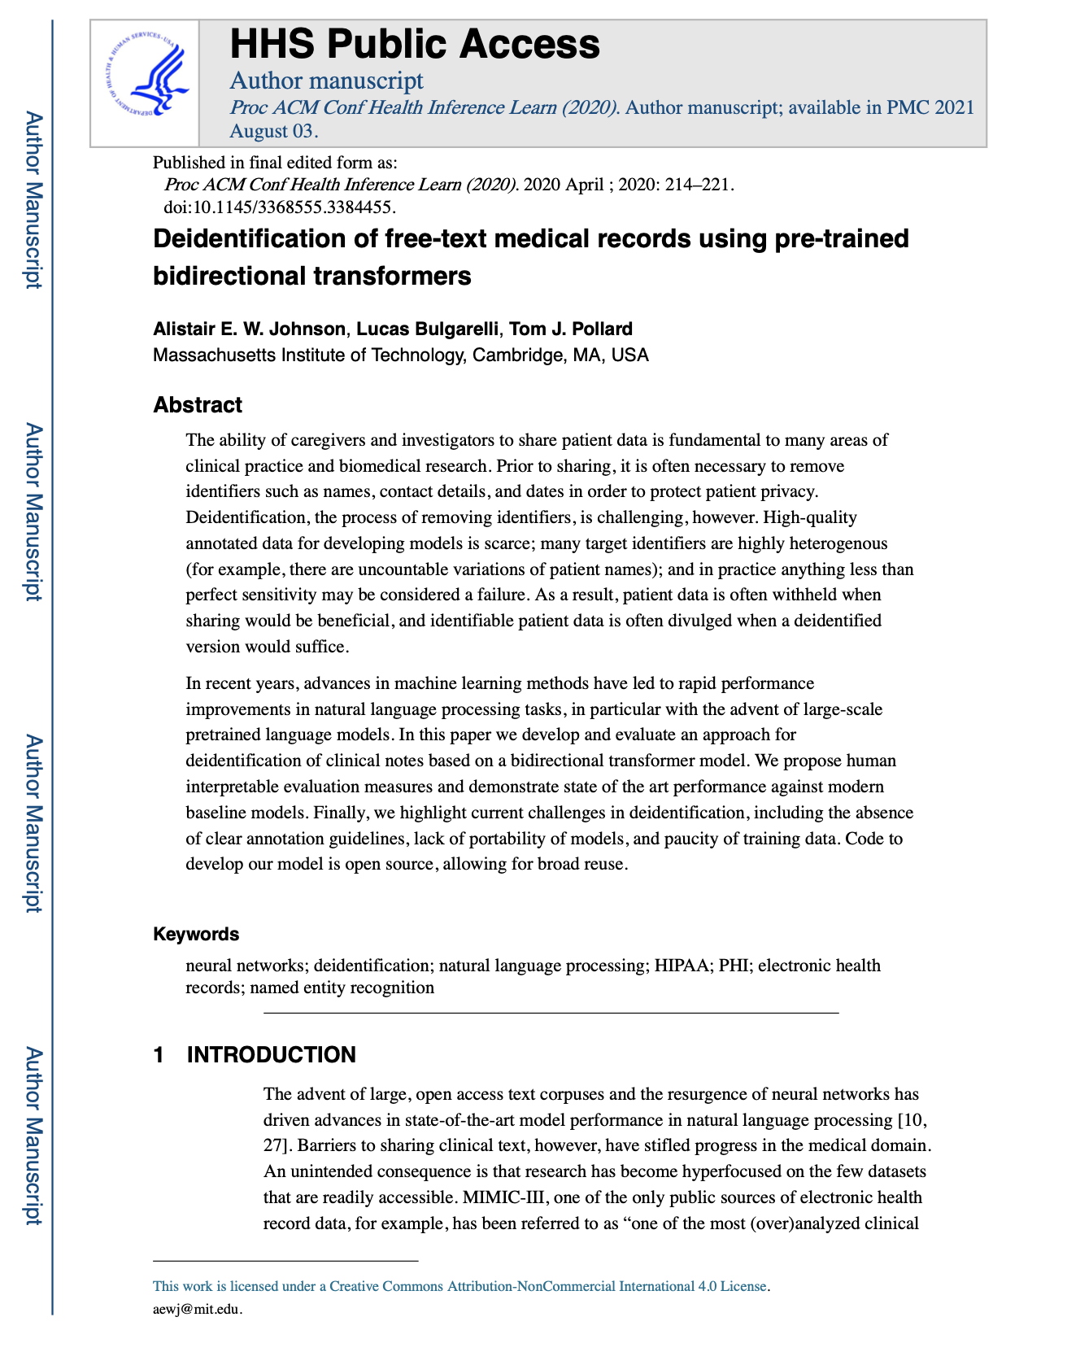

Reproducing “Deidentification of free-text medical records using pre-trained bidirectional transformers” Mohamadhossein Amirifardchime ma144
Johnson AEW, Bulgarelli L, Pollard TJ. Deidentification of free-text medical records using pre-trained bidirectional transformers. Proc ACM Conf Health Inference Learn (2020). 2020 Apr;2020:214-221. doi: 10.1145/3368555.3384455. Epub 2020 Apr 2. PMID: 34350426; PMCID: PMC8330601.
Notes:
Hi everyone, I’ll walk you through my reproduction and extension of the 2020 BERT‑deid system for stripping PHI from clinical notes.

Slide 2
1 | Problem & Goal
Why de‑identify?
• HIPAA mandates PHI removal from clinical text.
• Rules: high recall, brittle precision.
Goal: reproduce Johnson 2020 BERT‑deid on public data and test robustness.
Notes:
Clinical text is a goldmine for research, but HIPAA forces us to remove personal identifiers first. Rule‑based systems catch almost everything but mis‑fire often, hurting precision. Johnson et al. showed transformers can keep both recall and precision high. My goal is to reproduce their results on the only public corpus still online—PhysioNet 2010—then test how robust the model is and package it for others.

Slide 3
2 | Original Method
Johnson et al. 2020:
• Fine‑tunes BERT token classifier on 4 corpora.
• 8 HIPAA label set, WordPiece tokens.
Achieved 98 F1.
Notes:
The original paper fine‑tuned BERT as a token‑classifier over four corpora, mapping 18 granular tags into the eight HIPAA categories you see. Context from 12 transformer layers lets the model disambiguate names versus common words like ‘White’. They reported an impressive 98 F1.

Slide 4
3 | Reproduction Setup
Dataset & pipeline
• PhysioNet 2010 corpus (i2b2 offline).
• Align id.text & id.res → JSONL → HF Dataset.
• BERT‑base‑uncased, lr 5e‑5, epochs 3, batch 4.
Notes:
Because n2c2 datasets were temporarily unavailable, I focused on PhysioNet. I aligned the raw id.text with its de‑identified companion id.res, labelled every [** … **] span as PHI, converted to JSONL, then HuggingFace DatasetDict. BERT‑base‑uncased was trained for three epochs with a 5‑e‑5 learning rate on a single A100—fifteen minutes start to finish.

Slide 5
4 | Key Results
Token‑level F1 on PhysioNet
• Paper (multi‑corpus) 98.3
• Ours (base‑uncased) 98.0
• Base‑cased / Large ±0.1
+ Regex overlay → Recall 99.3 %, F1 98.0
Notes:
Baseline F1 is 98.0—just 0.3 below the original multi‑corpus figure, so the reproduction succeeds. Switching to a cased vocabulary or the 340‑million‑parameter large model buys only a tenth of a point. Overlaying four simple regexes for emails, SSNs, phones, and MRNs bumps recall from 98.1 to 99.3 per‑cent while losing one point of precision, which is a trade‑off we like in privacy‑critical settings.

Slide 6
5 | PyHealth Contribution
DeidTransformer task
```python
from pyhealth.task import DeidTransformer
task = DeidTransformer()
```
• One‑line fine‑tune; unit test passes CI.
PR: sunlabuiuc/PyHealth#412
Notes:
To make this useful for the wider community I wrapped the entire model in a new DeidTransformer task inside PyHealth. With one line you can fine‑tune on any labelled dataset and slot it into PyHealth’s trainer. The pull request is open and already passes CI, so future students or clinicians can build on top without reinventing the wheel.

Slide 7
6 | Takeaways & Future
Takeaways
• Reproduced within 0.3 F1 of paper.
• Hybrid rules halve false negatives.
Future
• Numeracy‑aware encoders, multi‑corpus re‑run, regex‑GUI for clinicians.
Notes:
Three takeaways: first, transformer baselines are indeed strong—you don’t need anything larger than base size. Second, a pinch of regex still matters; it halves false negatives at very high recall. Third, dataset availability remains a pain point; once i2b2 comes back online I’ll re‑run to confirm cross‑domain generalization. Looking ahead I want to test NUMBERT for numeric identifiers and build a quick UI so clinicians can curate regex patterns themselves.

