Slide 1
CS 170 Lab 01
My Name: Hossein Amiri
Ph.D. Student

Slide 2
Today
Introductions/ Lab Logistics
Review:
Java Programs
Turtle Graphics Library
For Loops
Questions?
Lab Assignment

Slide 3
General CS 170 Advice
Start homework assignments early!
They are longer, more challenging problems and will take some thinking
Do the practice quizzes!
They show you exactly what types of questions to expect on the quiz
Ask Questions!
Bring content-related questions from lecture to Lab
Go to office hours

Slide 4
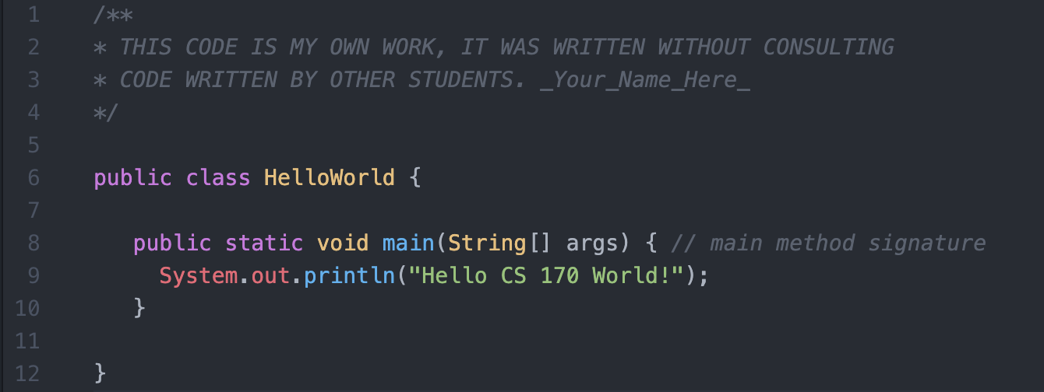
A Java Program
parameters/arguments
comments
class name
statement separator
function/method
statement(s)

Slide 5
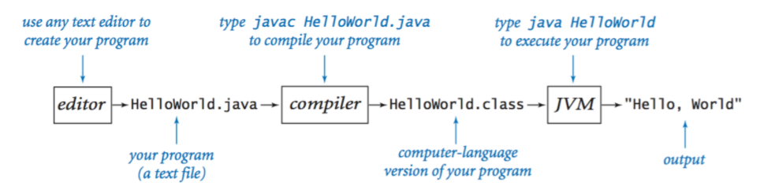
Java Programming Pipeline
Source: Princeton, Intro to CS

Slide 6
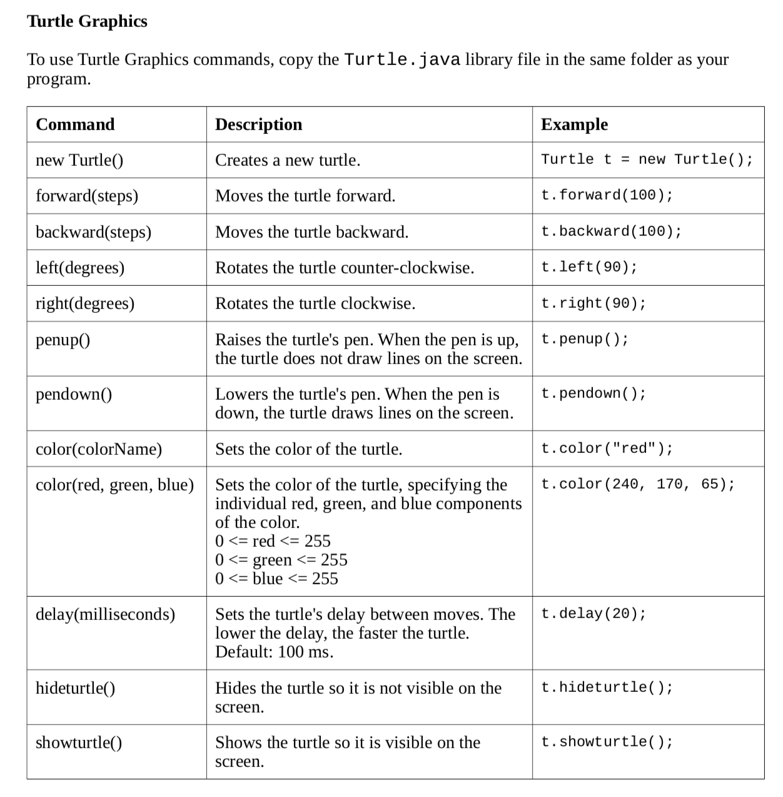

Slide 7
Draw a Square
public class Square{
public static void main(String[] args){
Turtle t = new Turtle();
t.forward(100);
t.left(90);
t.forward(100);
t.left(90);
t.forward(100);
t.left(90);
t.forward(100);
t.left(90);
}
}

Slide 8
For Loops – Why?
public class Square{
public static void main(String[] args){
Turtle t = new Turtle();
t.forward(100);
t.left(90);
t.forward(100);
t.left(90);
t.forward(100);
t.left(90);
t.forward(100);
t.left(90);
}
}
for(int i=0; i<4; i++){
t.forward(100);
t.left(90);
}
avoids repeated code
easier to read

Slide 9
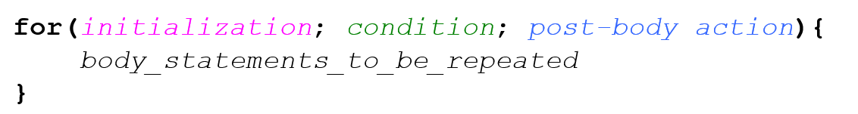
For Loops – Structure
1
only one time
2
4
3

Slide 10
For Loops – Examples
public class Square{
public static void main(String[] args){
Turtle t = new Turtle();
for(int i=0; i<4; i++){
t.forward(100);
t.left(90);
}
}
}
Iteration # | Value of i | Condition met?
1
0
Yes
2
1
Yes
3
2
Yes
4
3
Yes
5
4
No

Slide 11
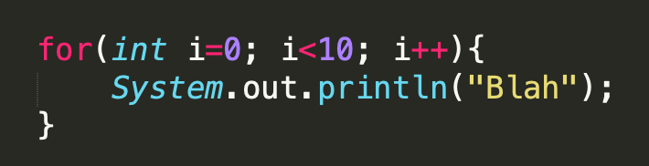
How many times will “Blah” print?
Notes:
Answer: 10

Slide 12
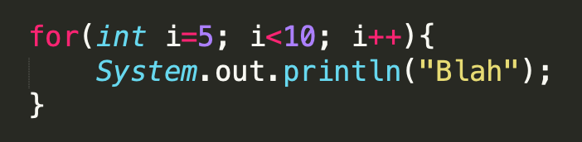
How many times will “Blah” print?
Notes:
Answer: 5

Slide 13
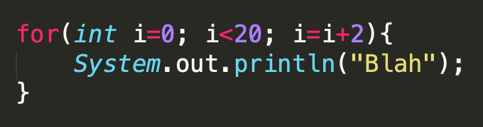
How many times will “Blah” print?
Notes:
Answer: 10

Slide 14
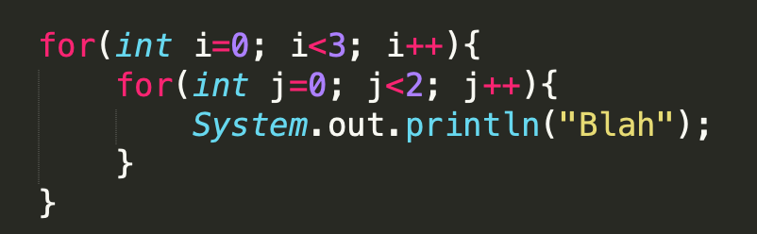
How many times will “Blah” print?
Notes:
Answer: 6

Slide 15
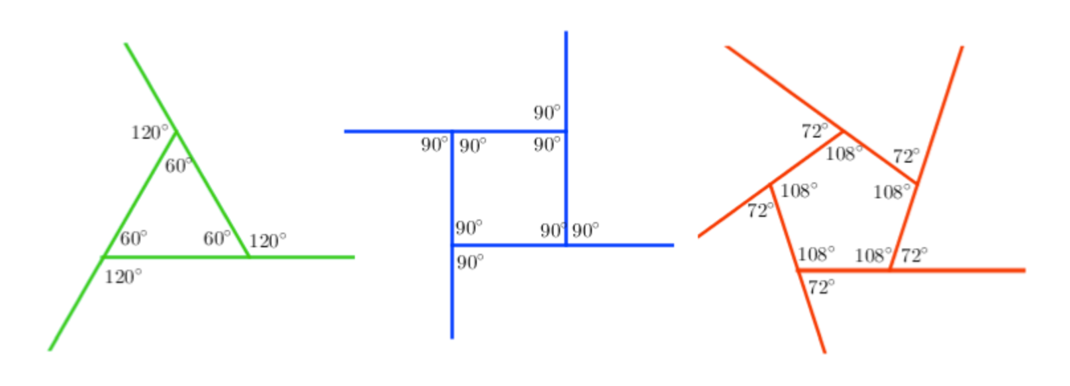

Hint: Turtle Shape Angles
(360/3)°
(360/4)°
90°
(360/5)°
numSides = 3
numSides = 4
numSides = 5
To draw a polygon, our Turtle’s rotating degree = 360/numSides

Slide 16
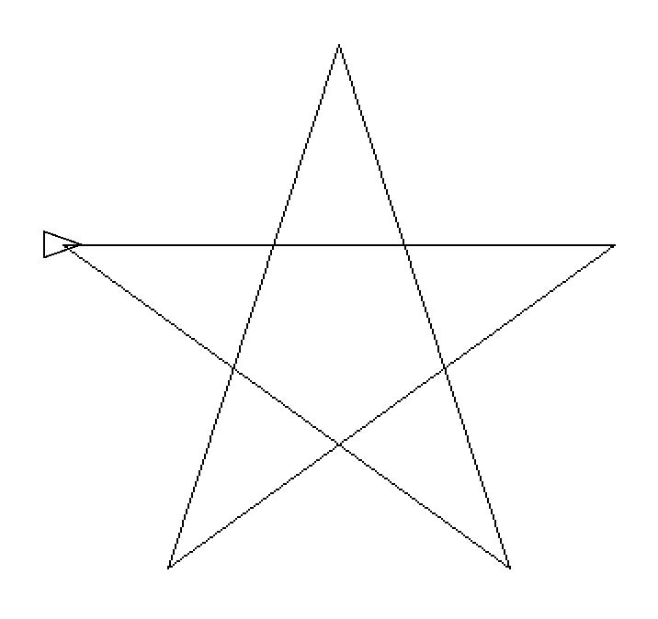
Hint: Turtle Shape Angles
36°
What’s the Turtle’s rotation angle?
36°
36°
144°
36°
36°

Slide 17


Lab Activity
1
void TGIF(Turtle t)
Draw the “TGIF” letters like image 1
void stars(Turtle t)
Draw 3 stars as in image 2
Your method should use a nested for loop (where makes most sense?)
Reminders/ Hints:
keep track of your discussions/ thinking/ challenges to include as comments in your submission
starter code available on Canvas under Modules -> Lab Notes -> Lab 01
you will need to reposition the turtle between calling each method (in main)
let me know if you have any questions or problems!
2
Notes:
Starter code: lab01.java
Answer key/ rubric: lab01_key.java

