Slide 1
CS 170 Lab 02

Slide 2
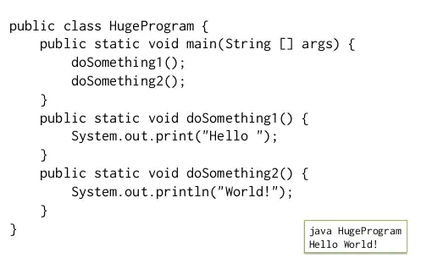
Today
Questions?
Review
Java Methods
Practice Quiz
Practice!

Slide 3
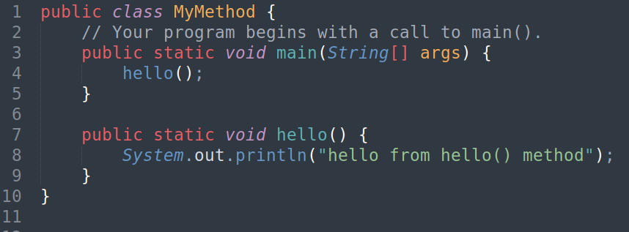
Java Methods
Methods in Java is a block of statements that must be in a class and can be executed by calling it from other places.
hello() is a method defined in our MyMethod class and called it from main() method.

Slide 4
Java Methods
Methods in Java is a block of statements that must be in a class and can be executed by calling it from other places.
static methods are the methods in Java that can be called without creating an object of class.
Remember?
Turtle t = new Turtle()
t.penup()
vs.
Math.random()

Slide 5
Java Methods
Methods in Java is a block of statements that must be in a class and can be executed by calling it from other places.
void means this method doesn't return any value.

Slide 6
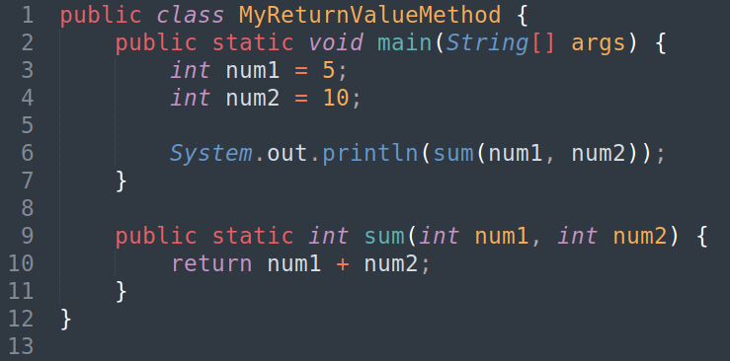
Java Methods
Methods in Java is a block of statements that must be in a class and can be executed by calling it from other places.
This method return the sum of the methods two parameters.
Note that the return type of the method is int

Slide 7




A Java class can have multiple methods
public class MyClass{
public static void main(String[] args){
}
}

Slide 8

Method definition location inside the class doesn’t matter
public class MyClass{
public static void main(String[] args){
}
}

Slide 9
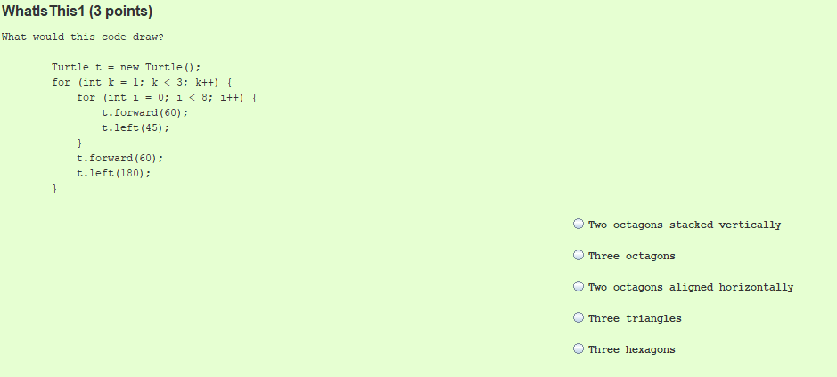
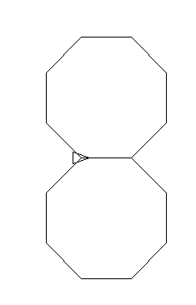
Practice Quiz

Slide 10
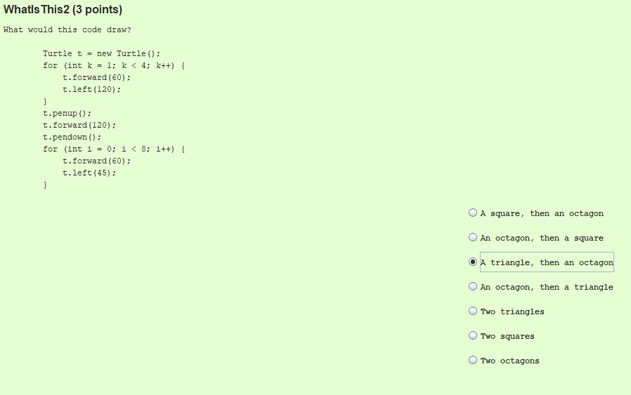
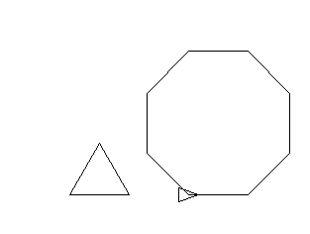
Practice Quiz

Slide 11
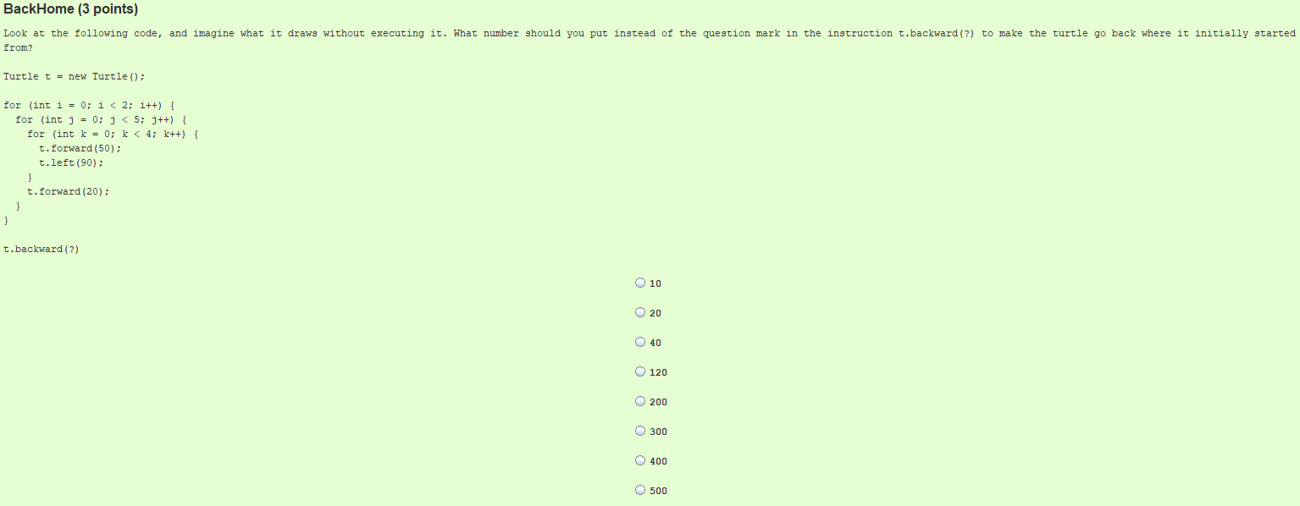
Practice Quiz

Slide 12
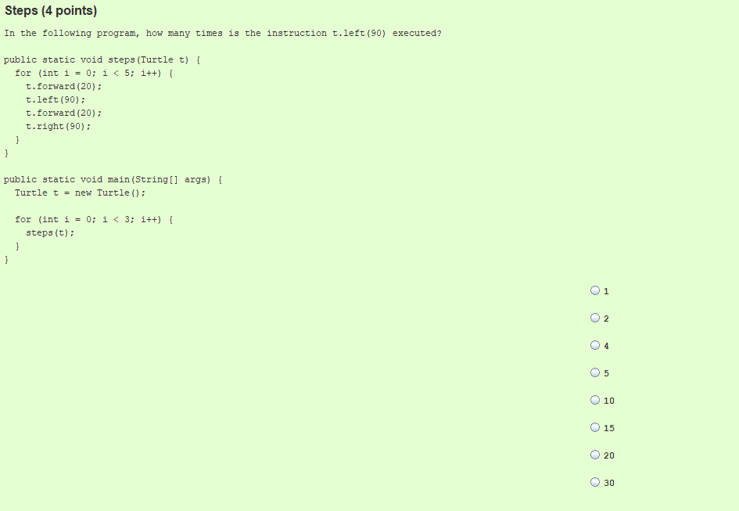
Practice Quiz

Slide 13
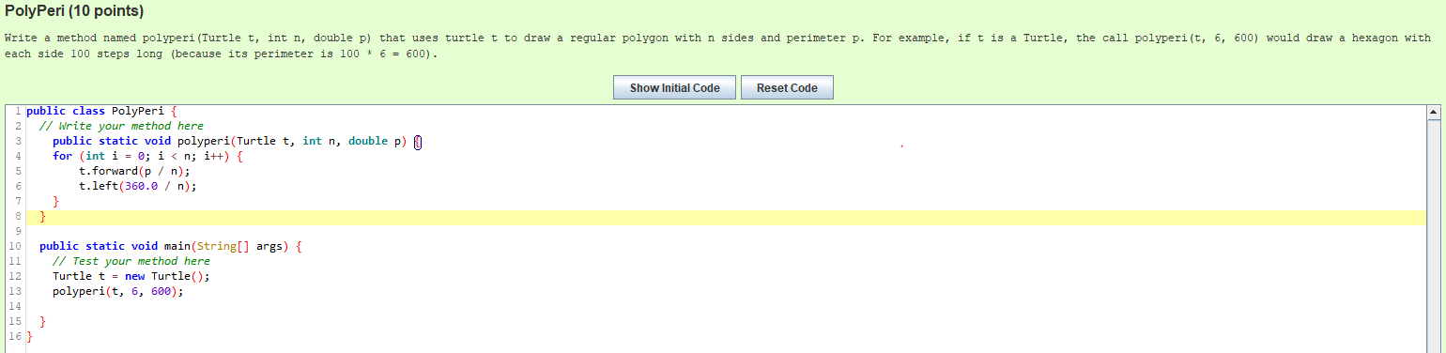
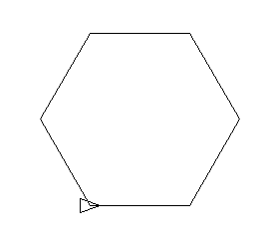
Practice Quiz

Slide 14
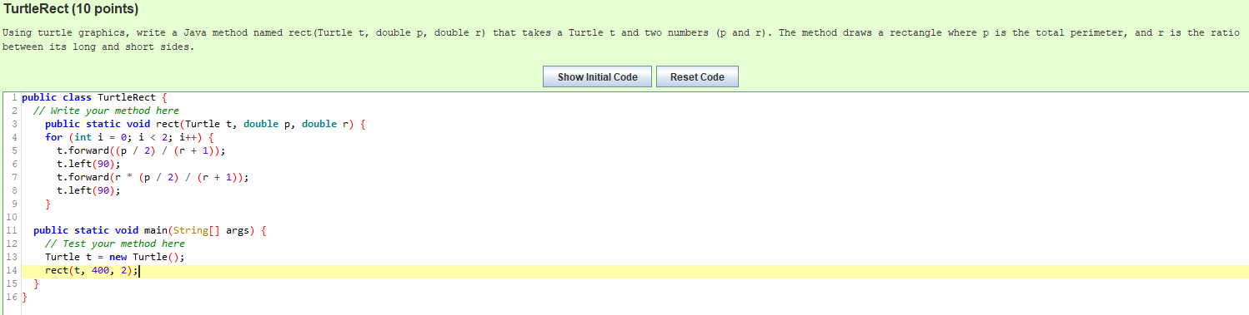
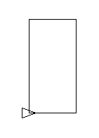
Practice Quiz

Slide 15

Lab Activity

Slide 16
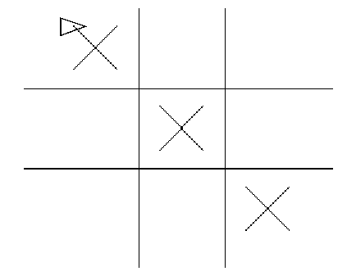
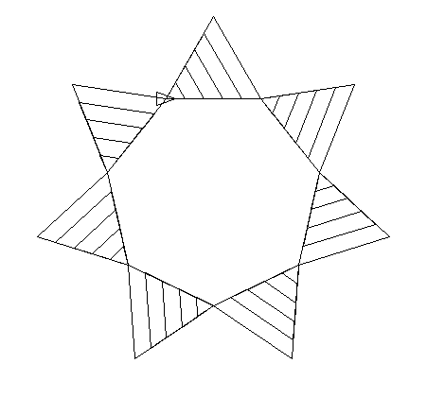
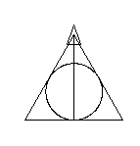


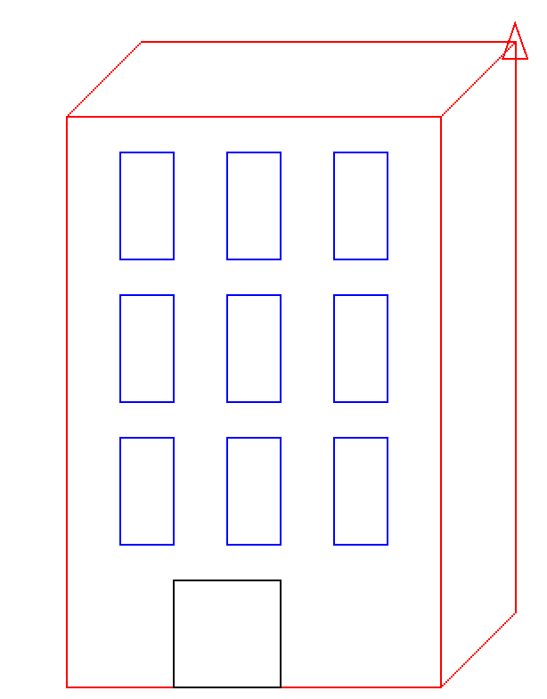
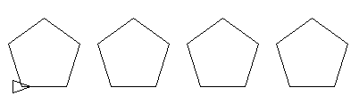
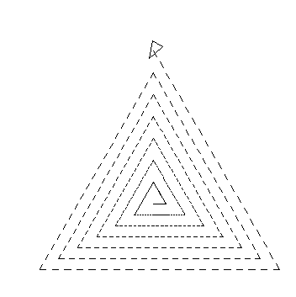
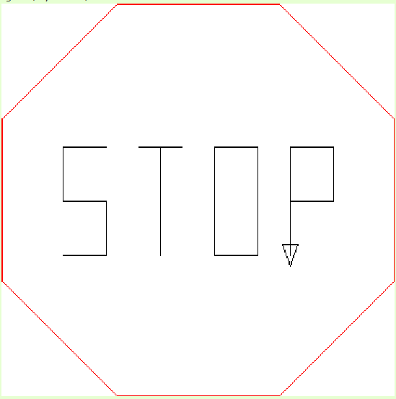
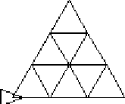
Gallary
With the Turtle.java library, you can draw multiple shapes...

Slide 17
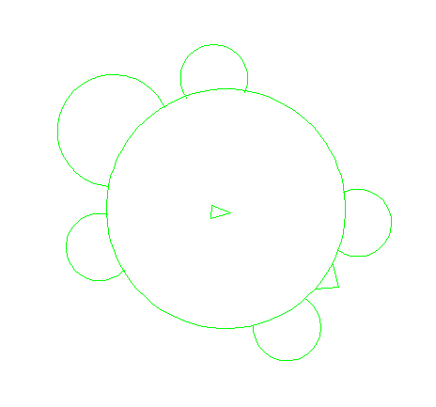
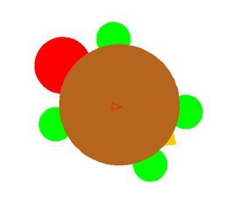
Exercise
Write a program lab02.java to draw a Turtle.
Separate functions to add Turtle’s head, legs, tail and body.
Starter code/template can be accessed through Canvas -> Modules
(Optional) Color your turtle if you finished early
Hints: Use t.fill() to add color. Note that this only works when the turtle is inside the shape to be filled!
Use this link to find any RGB colors (e.g., t.color(14, 62, 150) )

