Slide 1
CS 170 Lab 03

Slide 2
Types of Errors
Syntax Error: program fails compilation
Forgotten semicolon, misspelling of variable or method name, missing method parameters or return value, misplaced {}, etc.
Logical Error: program runs, but doesn’t do what is expected
Turtle draws wrong shape or pattern, printed value not correct, method doesn’t generalize to any input value, etc.
Runtime Error: program runs, but fails during execution
Division by zero, index out of bounds, out of memory, etc.

Slide 3
Debugging Tips
Start with the simplest sub-case (single for-loop iteration, smallest input parameter, etc.)
Compile and execute often
Fix one problem at a time
Syntax/Runtime Errors: note line number and name of error
Print statements: print variables to check their values, see how many times that for loop is really executing, etc.
Notes:
Feel free to add your own advice and experience! ☺

Slide 4
Values, Types, & Operators
Types:
int
double
String
Operators:
+ - * / %
String concatenation (+)
String length [method]
Operator Precedence
PEDMAS applies (% is DM)
Parentheses first
Exponents (i.e., powers and square roots, etc.)
Multiplication and Division (from left to right)
Addition and Subtraction (from left to right)
Generally left to right
Conversions
int -> double
Cast with (int)
Add 0.0 or multiply by 1.0
double -> int
Cast with (double)
int/double -> String
Concatenation with empty String
String -> int
Integer.parseInt(int)
String -> double
Double.parseDouble(double)
Notes:
This is what they should have seen in class so just a quick refresher

Slide 5
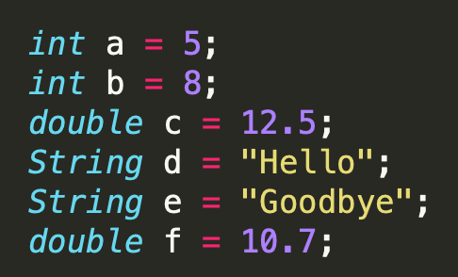
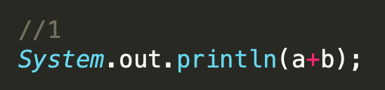
What is the result?
Notes:
13 (int)

Slide 6
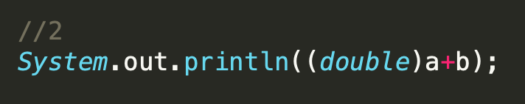
What is the result?
Notes:
13.0 (double)

Slide 7
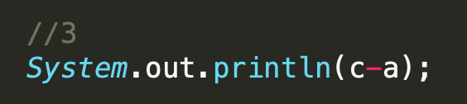
What is the result?
Notes:
7.5 (double)

Slide 8
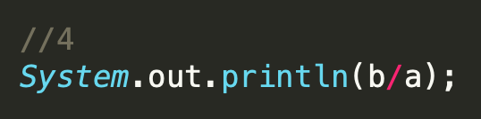
What is the result?
Notes:
1 (int)

Slide 9
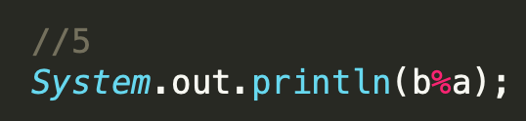
What is the result?
Notes:
3 (int)

Slide 10
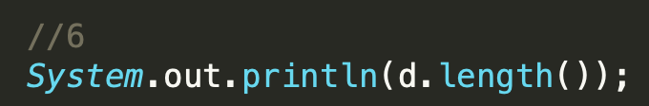
What is the result?
Notes:
5 (int)

Slide 11
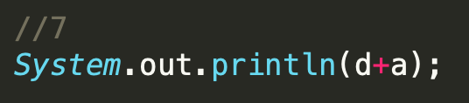
What is the result?
Notes:
Hello5 (String)

Slide 12
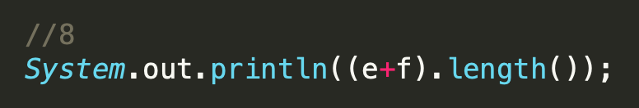
What is the result?
Notes:
11 (int)

Slide 13
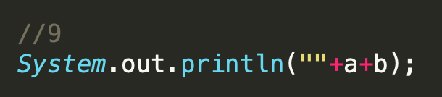
What is the result?
Notes:
58 (String)

Slide 14
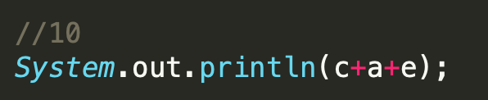
What is the result?
Notes:
17.5Goodbye (String)

Slide 15
Questions?

Slide 16
A Note About ASCII
ASCII = American Standard Code for Information Interchange
Provides an integer value for any character
char type is a single letter/ number/punctuation/etc.
char letter = 'a'; int asciiVal = (int)letter; // 97
int asciiVal = 77; char letter = (char)asciiVal; // M

Slide 17
Cryptography 101
Plaintext = readable, English-language text
Ciphertext = unreadable (hidden) text
Cipher = method of encryption
Encrypt = process of going from plaintext to ciphertext
Decrypt = process of going from ciphertext to plaintext

Slide 18
Caesar Ciphers
Ancient form of substitution cipher
The plaintext alphabet is shifted by some amount
Examples:
With a shift of 3, ‘a’ is encrypted as ‘d’
With a shift of 2, ‘m’ is encrypted as ‘o’

Slide 19
Put it all together…
Given plaintext and desired shift, treat each letter of the plaintext as a an int, add the shift, and get the ASCII value for the encrypted letter
Given ciphertext and shift, treat each letter of the plaintext as an int, subtract the shift, and get the ASCII value for the decrypted letter
We can write a program to implement a Caesar Cipher!

Slide 20
Lab Activity
TODO:
implement method encrypt_letter(char letter, int shift)
implement method decrypt_letter(char letter, int shift)
implement method guess_shift(String text)
determine shift to properly decrypt message #3
Submission Output:
Encrypted message #1 using shift = 3
Decrypted message #2 using shift = 4
Results of calling guess_shift for message #3
Decrypted message #3
Hints:
Methods encrypt_word and decrypt_word are implemented for you; note they call the letter versions
char + String = String
If you treat a char as an int, you can add, subtract, etc…
guess_shift should be generic to any input but somehow show the user the correct shift for a given input

