Slide 1
CS 170 Lab 04

Slide 2
Today
Review
More on Java types and size
More on Java Methods
Loop Accumulator
Questions
Group Activity

Slide 3
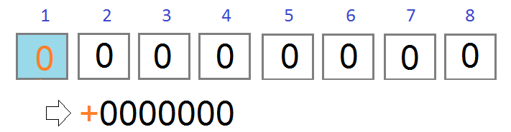
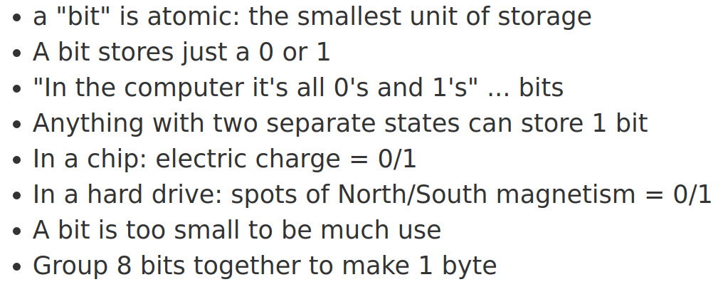
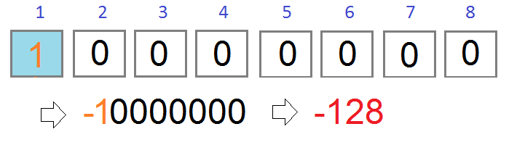
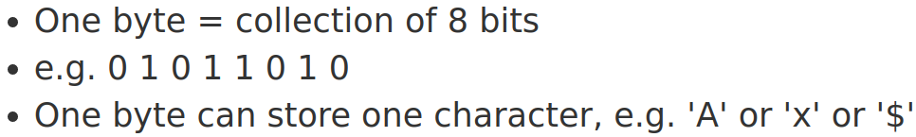
Bits and Bytes
A binary number is a number expressed in the base-2 numeral system or binary numeral system, a method of mathematical expression which uses only two symbols: typically "0" (zero) and "1" (one). (Wikipedia)
Computers use binary to store data:
Bit:
Byte:
Remember ASCII Table?

Slide 4
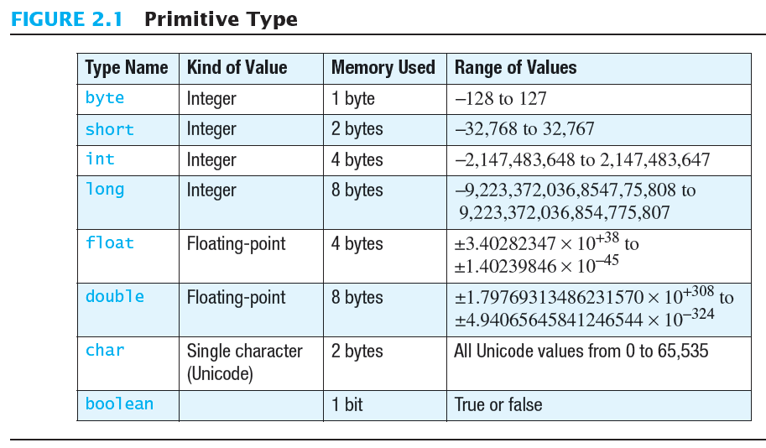
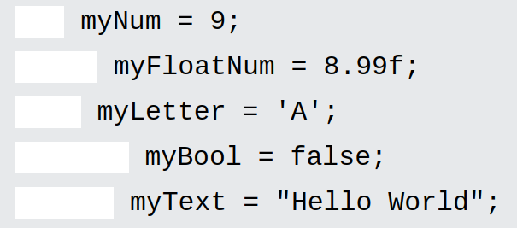
Java Types and Size
There are eight built-in types supported by Java to support integer, floating-point, character, and boolean values.
All primitive or basic data types hold numeric data that is directly understood by system.

Slide 5
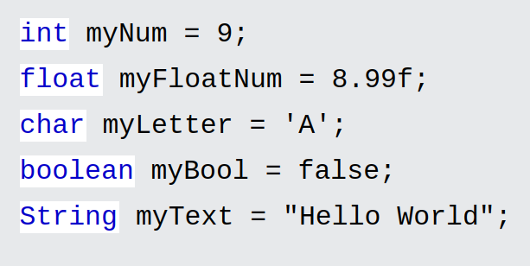
Java Types and Size
There are eight built-in types supported by Java to support integer, floating-point, character, and boolean values.
Note that f is used to identify the floating number belongs to float type. If f is not precised at the end, value is considered to be a double. And a double leads to more bytes in memory than float.

Slide 6
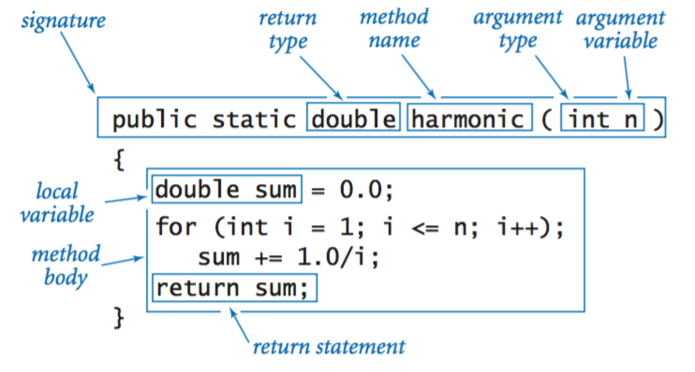
Recap: Methods
Naming Convention: Methods should be verbs, in mixed case with the first letter lowercase, with the first letter of each internal word capitalized, i.e. camelCase.

Slide 7
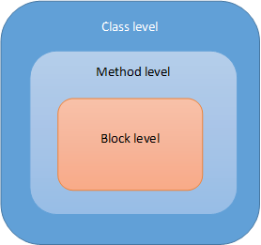


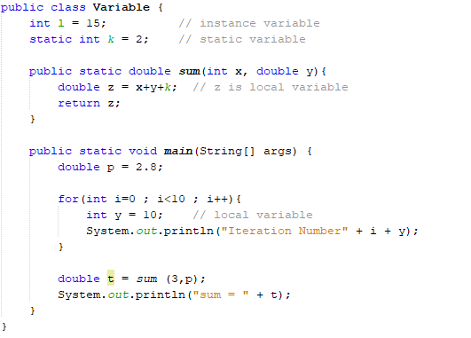







Variable scope

Slide 8
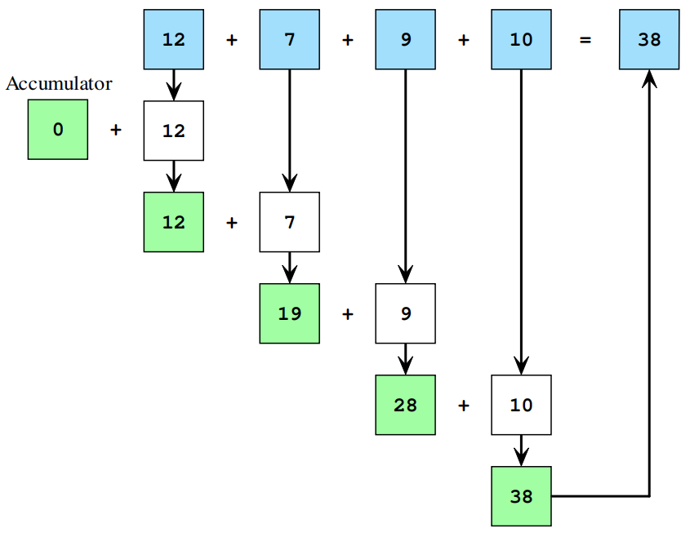
Loop Accumulation
An accumulator is a variable that the program uses to calculate a sum or product of a series of values. A computer program does this by having a loop that adds or multiplies each successive value onto the accumulator.
To visualize how this works try adding some numbers in your head, say 12, 7, 9 and 10.
To form a loop with an accumulator:
1. Before the loop begins, declare the accumulator (can be a Int, Double, or String) and initialize it to zero.
3. During each loop cycle, add the next value you wish to sum/concatenate onto the accumulator.

Slide 9

Lab Activity

Slide 10
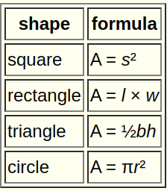
Lab Activity
Write a program to calculate the area of different geometric shapes, and you must use functions to calculate area for each shape. Here are the methods you should implement (write as many additional methods as you want):
area_circle(int radius) // returns the area of a circle (consider the data type)
area_square(int side) // returns the area of a square
area_triangle(int base, int height) // returns the area of a triangle
area_rectangle(int length, int width) // returns the area of a rectangle
2
2
12
Requirement and hint:
Be careful of the returned data type (e.g., area of the circle).
No template of methods this time, you need to implement by yourself.
Test cases have been given, feel free to try other cases.
8
Side of the square: 4
Radius of inner circle: 5
Radius of outer circle: 8
Radius of each circle: 2

Slide 11
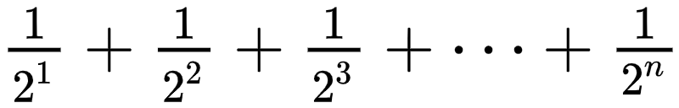
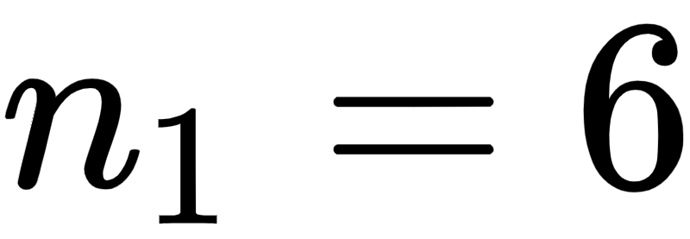
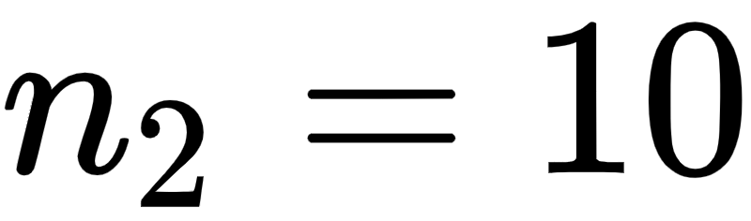

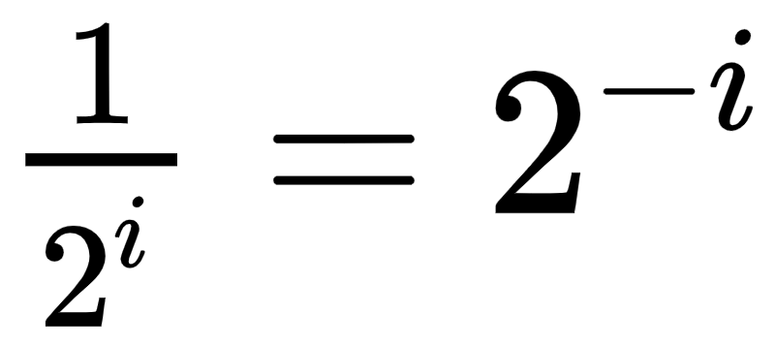
Lab Activity
In the same Java file, write method get_equation(int n) that can take a positive integer n and uses a loop to calculate:
Print the final results and return the equation.
Suppose and , the desired results are:
You do not need to print the exactly same equation as we showed here (requires if-else), the following is also acceptable:
Requirements:
Use Math.pow(int a, int b) to calculate the power, more details and usage can be found here: https://www.geeksforgeeks.org/math-pow-method-in-java-with-example/
Consider the for loop’s initialization and condition.
Hint:

