Slide 1
CS 170 Lab 09

Slide 2
Today
Recursion & Recursion Tracing Examples
Questions?
Lab Activity

Slide 3
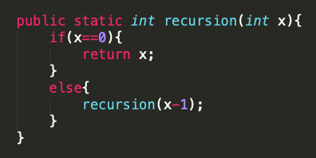
What is recursion?
A recursive function calls itself
Two parts:
Base case: defines when the recursion should stop
Recursive case: defines what to do if not base case
base case
recursive case

Slide 4
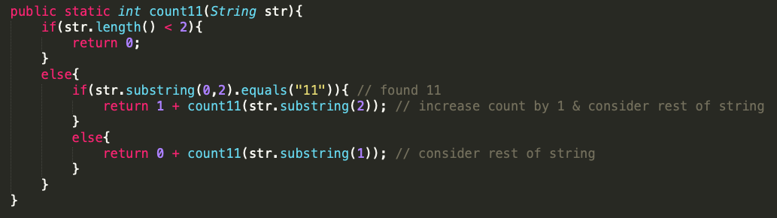
Example: count11
Given a string, compute recursively (no loops) the number of “11” substrings in the string. The “11” substrings should not overlap.

Slide 5
Example: count11
count11(“11a11”)
2
1 + count11(“a11”)
1+1 = 2
0 + count11(“11”)
0+1 = 1
1+0 = 1
1 + count11(“”)
0

Slide 6
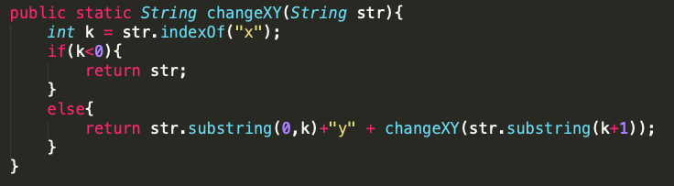
Example: changeXY
Given a string, compute recursively (no loops) a new string where all the lowercase ‘x’ chars have been changed to ‘y’ chars.

Slide 7
Example: changeXY
changeXY(“xxhixz”)
“yyhiyz”
“y” + “yhiyz” = yyhiyz”
“” + “y” + changeXY(“xhixz”)
“y”+ “hiyz” = “yhiyz”
“” + “y” + changeXY(“hixz”)
“hiy”+ “z” = “hiyz”
“hi” + “y” + changeXY(“z”)
“z”

Slide 8
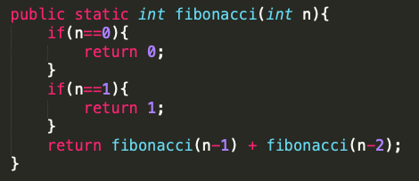
Example: Fibonacci
Define a recursive fibonacci(n) method that returns the nth Fibonacci number with n=0 representing the start of the sequence. Each value is the sum of the previous two values.
Fibonacci sequence: 0,1,1,2,3,5,8,13,21,…

Slide 9
Example: Fibonacci
fibonacci(0)
0
fibonacci(2)
1
fibonacci(1)
fibonacci(1)+fibonacci(0)
1+0 = 1
1
1
0

Slide 10
Example: Fibonacci
5
fibonacci(5)
fibonacci(4)+fibonacci(3)
2
3
fibonacci(3)+fibonacci(2)
fibonacci(2)+fibonacci(1)
2
1
1
fibonacci(2)+fibonacci(1)
fibonacci(1)+fibonacci(0)
fibonacci(1)+fibonacci(0)
1
fibonacci(1)+fibonacci(0)

Slide 11
Questions?

Slide 12
Lab Activity
Write two functions String decimalToBinary(int d) and int binaryToDecimal(String b) that convert numbers between decimal and binary representations.
Your implementations must use recursion (no loops allowed).
Binary numbers are represented as Strings and decimal numbers are ints. They may have any number of digits. Do not pad with zeros.
Reminders: (int) casts a double as an int, Integer.parseInt(String str) converts String to int, Math.pow(base, exponent) does exponentials
Submit in a class called lab09 with test cases & discussion comments
Math/ algorithm help: https://owlcation.com/stem/How-to-Convert-Decimal-to-Binary-and-Binary-to-Decimal

