Slide 1
CS 170 Lab 10

Slide 2
Today
Regular Expressions
Questions?
Lab Activity

Slide 3
Regular Expression Patterns
Symbol | Meaning
. | matches any single character except ‘\n’
[ ] | matches any character or character set appearing in [ ]
\w | matches any of [a-zA-Z0-9_]
\W | matches anything not matching \w
\s | Matches single whitespace character
\S | matches any non-whitespace character
\d | decimal digit [0-9]
\D | any non-digit character
^ $ | matches start (^) or end ($) of string
\ | escape a “special” character
+ * ? | one or more (+), zero or more (*), zero or one (?)
( ), {#} | grouping ( ), match certain number of times {#}

Slide 4
Java Regex with String Methods
String.matches(String regex) returns true if there is a regex match, false otherwise
“hello”.matches(“h\\w+”) -> true
“hello”.matches(“h\\w?”) -> false
String.replaceAll(String regex, String replace) returns String where any matches with regex are replaced by replace
“two too to”.replaceAll(“t[wo]+”, “2”) -> “2 2 2”
“abc123def”.replaceAll(“(\\D+)(\\d+)”, “$2$1”) -> “123abcdef”

Slide 5
Examples
Check if String email is an Emory email address:
email.matches(“\\w+@emory\\.edu”)
Check if String str has 2 consecutive numerical characters:
str.matches(“.*\\d\\d.*”)
Remove leading whitespace in String str:
str.replaceAll(“^\\s+”, “”)
Extract url from String str:
str.replaceAll(“(.*)(https://www\\.\\w+\\.\\w{3})(.*)”, “$2”)

Slide 6
Examples/ Practice
Find a regular expression that matches all examples in the YES list but none of the examples in the NO list.
Answer: \d{4}[!\?]\w?
YES | NO
1234! | 123!
5398?a | 5398a
3519!1 | 3519!11
9876? | 98765??

Slide 7
Examples/ Practice
Find a regular expression that matches all examples in the YES list but none of the examples in the NO list.
Answer: \D+-\w+-\d+
YES | NO
aBc-1y2-123 | 123-abc-456
W-7b-1357 | abc-!!-456
ABCd-66-1390 | WXY-def-xyz
sdf-a-789 | A--2

Slide 8
Examples/ Practice
Find a regular expression that matches all examples in the YES list but none of the examples in the NO list.
Answer: [A-Z][a-z]*e[a-z]+\d{3}
YES | NO
Red101 | Orange505
Yellow202 | Blue606
Green303 | White707
Teal404 | Black808

Slide 9
Examples/ Practice
Find a regular expression that matches all examples in the YES list but none of the examples in the NO list.
Answer: pi.?g.+n
YES | NO
pigpen | piedmont
pidgeon | pollen
piglin | piolgen
piggin | pidgn

Slide 10
Questions?

Slide 11
Lab Activity
Implement a method int evaluateExpression(String e) to evaluate mathematical expressions given as Strings.
The input Strings you should evaluate are of the form [number][operator][number] where [operator] is one of + - * / ^ %
You may use matches, replaceAll, and casting between Strings and integers. NO OTHER STRING METHODS ARE ALLOWED. String concatenation is not allowed.
If the input string is not of the proper format, print a warning to the user that the input format is not valid and return 0.

Slide 12
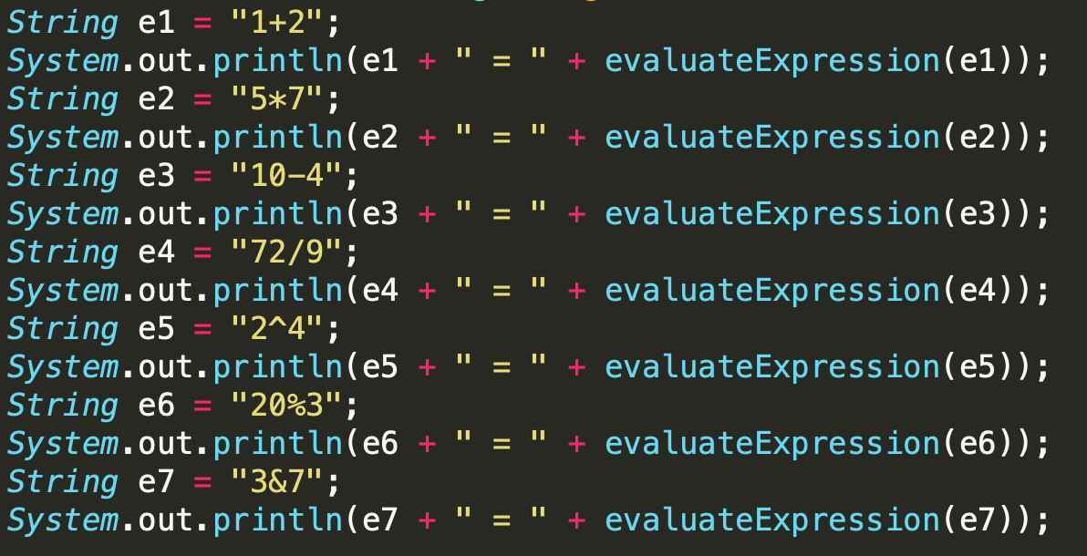
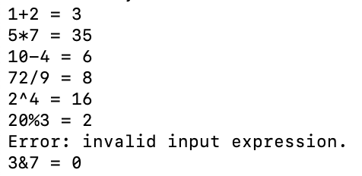
Lab Activity

Slide 13
Lab Activity
Submit in class called lab11 with many test cases and discussion comments!
Implement a method int evaluateExpression(String e) to evaluate mathematical expressions given as Strings.
The input Strings you should evaluate are of the form [number][operator][number] where [operator] is one of + - * / ^ %
You may use matches, replaceAll, and casting between Strings and integers. NO OTHER STRING METHODS ARE ALLOWED. String concatenation is not allowed.
If the input string is not of the proper format, print a warning to the user that the input format is not valid and return 0.

