Slide 1
CS170 Lab 11

Slide 2
Today
Reading User Input
File input/output
Questions?
Lab Activity

Slide 3
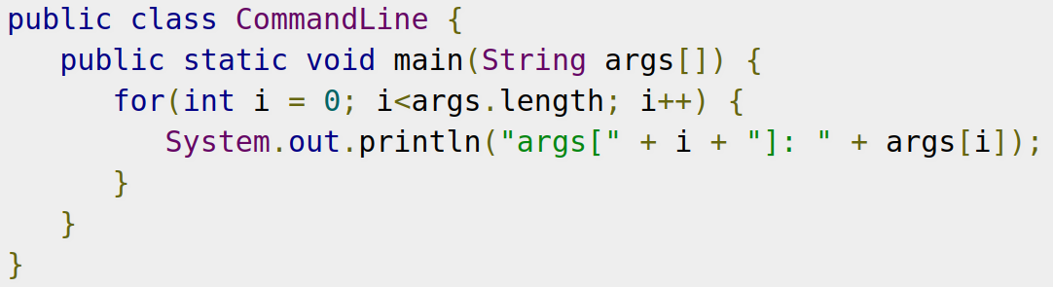
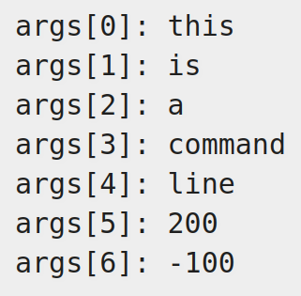
Reading User Input - Command-Line Arguments
https://docs.oracle.com/javase/tutorial/essential/environment/cmdLineArgs.html
A Java application can accept any number of arguments from the command line. This allows the user to specify configuration information when the application is launched.
Array of input arguments

Slide 4
Reading User Input - From Scanner
https://docs.oracle.com/javase/8/docs/api/java/util/Scanner.html
The Scanner class has methods for reading user input values while the program is running.
The Scanner class is in the java.util package.
import java.util.Scanner;
Scanner console = new Scanner(System.in);
“console” is a variable that refers to the Scanner object. It can have any variable name.
Scanner() is the constructor that sets up the object.
System.in is an object in the System class that refers to the standard input stream which, by default, is the keyboard.

Slide 5
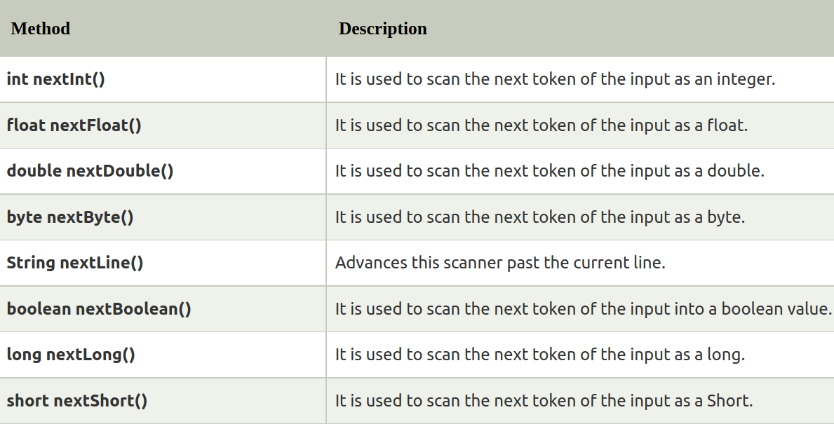
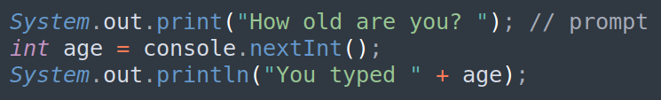
Reading User Input - From Scanner
Each method waits until the user presses Enter.
The value typed by the user is returned.
prompt: A message telling the user what input to type.
Console can take various data types

Slide 6
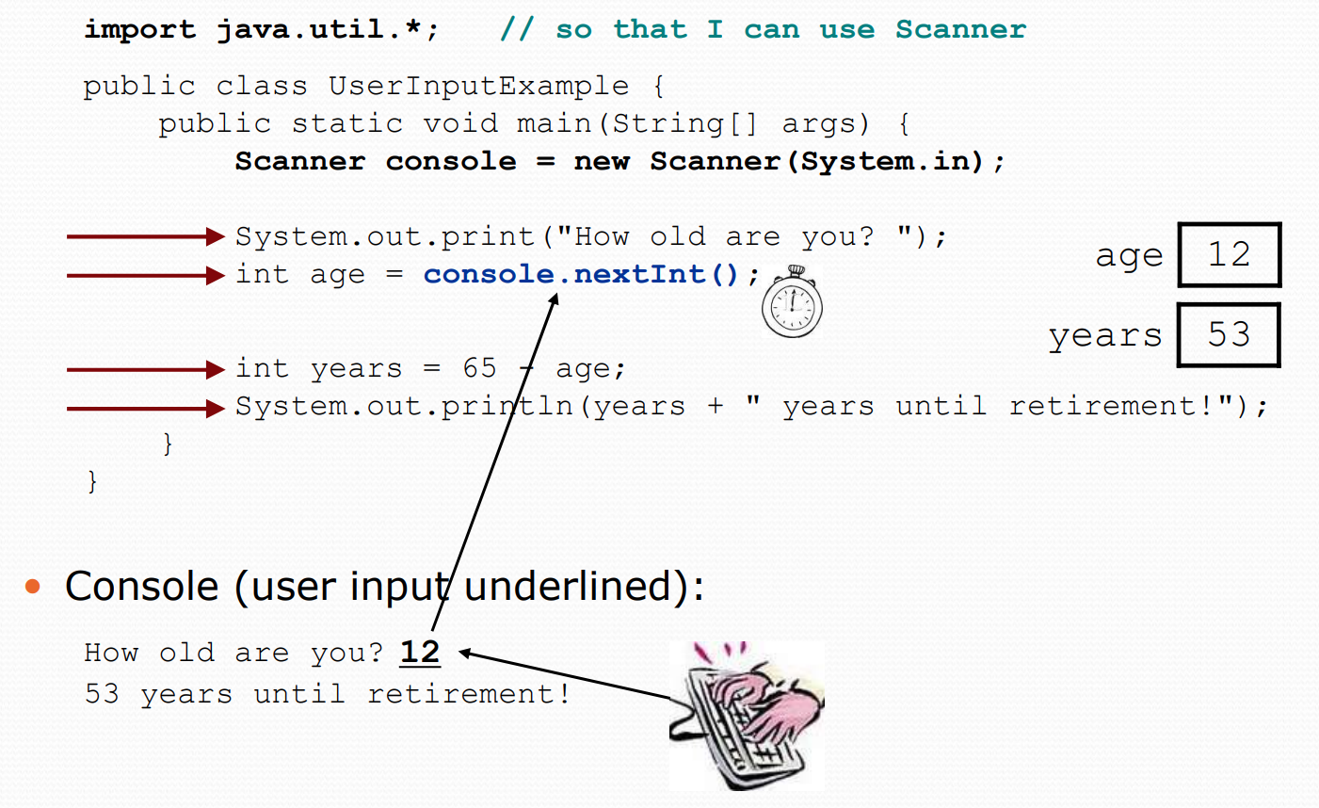
Reading User Input - From Scanner

Slide 7

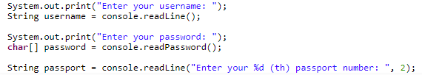
Reading User Input - From Console
In JDK 6 and later, we can use the Console class from java.io package to read from and write to the console.
To obtain a Console object, we'll call System.console():
Console console = System.console();
Next, the readLine() method of the Console class reads a line from the console:

Slide 8
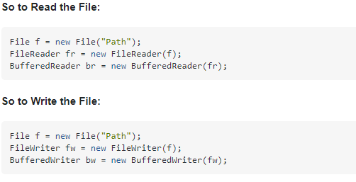
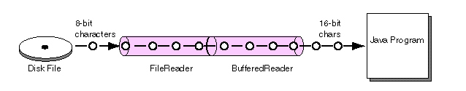
Read/Write from File
A FileReader class is a general tool to read in characters from a File.
The BufferedReader class can wrap around Readers, like FileReader, to buffer the input and improve efficiency.

Slide 9
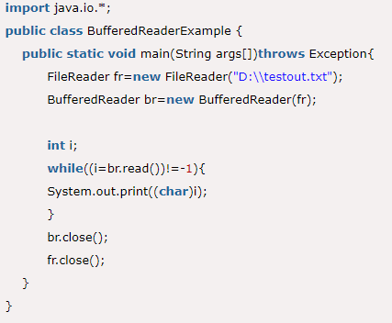
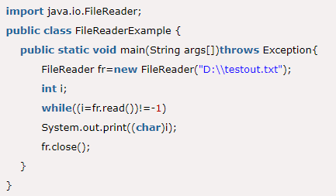
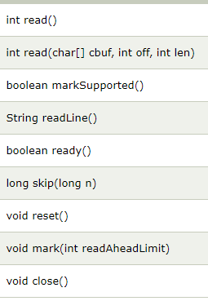

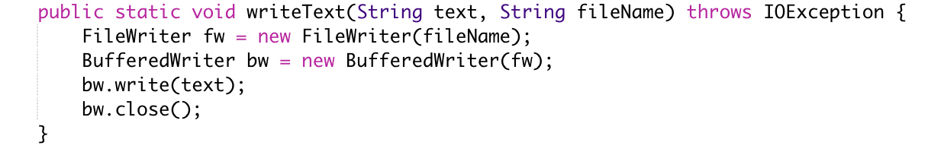
Read/Write from File

Slide 10
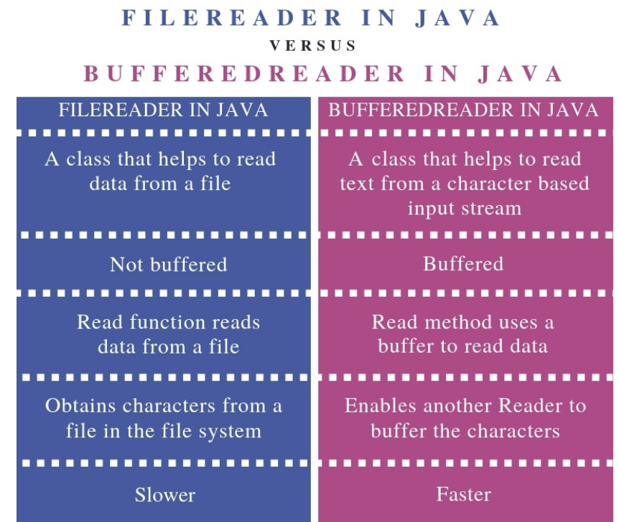
Read/Write from File
FileReader is an unbuffered character stream. This means it translates bytes from their internal character set to the local character set one byte at a time.
BufferedReader is a buffered stream. A FileReader can be wrapped in a BufferedReader for more efficient reading of a file.
It's generally a good idea to wrap a FileReader in a BufferedReader for improved performance.

Slide 11
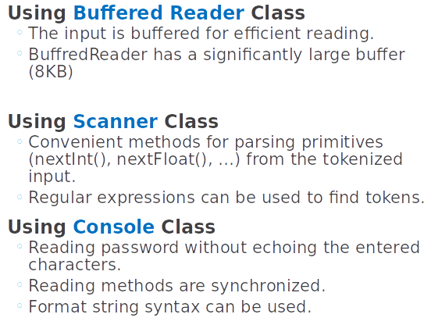
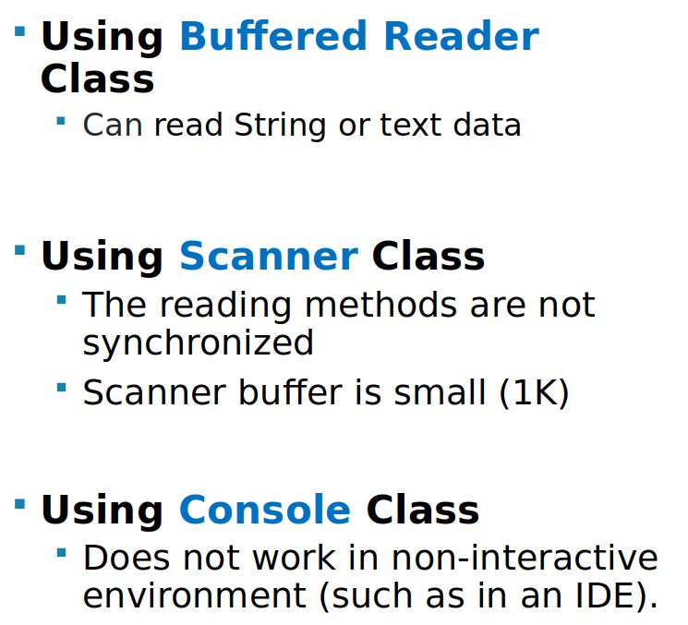
Pros and Cons

Slide 12
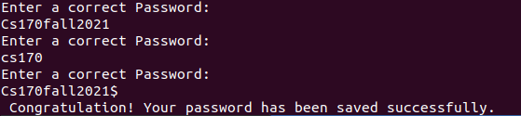
Practice Problem
Wrap up your program in a class Lab12, including discussions of the pros/cons of using both methods.
In lab12.java, write a program that asks a user to enter a password and keep asking till the user enters a correct one with the following format and congratulate the user for setting a password:
It is at least 8 - 20 long.
It contains at least one digit and one special character (!@#$%&).
Must contain one upper case letter and one lower case letter.
Examples:
Requirement:
Using two ways to read from the terminal (Scanner, Console). Write a program in all possible ways—one method for each.
Use regex to check if the input password is correct.
Write the correct password in to a file.

