Slide 1
CS 170 Lab 08

Slide 2
Today
More on Arrays!
Multidimensional Arrays in Java
Questions
Lab Activity!

Slide 3
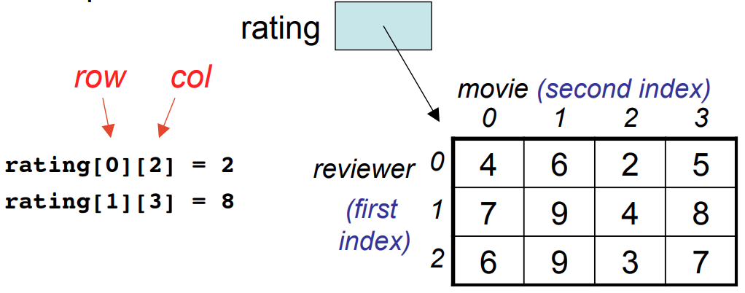
Multidimensional Array in Java
data_type[1st dimension][2nd dimension]...[Nth dimension] array_name = new data_type[size1][size2]….[sizeN];
For example, a 2-D array in Java is indexed by two subscripts, one for the row and one for the column, such that:

Slide 4
Similarity with 1D Arrays
Each element in the 2D array must by the same type
either a primitive type (e.g., int, double, ...) or object type (e.g., Turtle).
Subscripted variables can be use just like a variable:
rating[0][3] = 10;
Array indices must be of type int and can be a literal, variable, or expression.
rating[3][j] = j;
If an array element does not exists, the Java runtime system will give you an
ArrayIndexOutOfBoundsException

Slide 5
Declaring 2D Arrays
Declare a local variable rating that references a 2D array of int:
int[][] rating;
Create a 2D array with 3 rows and 4 columns and assign the reference to the new array to rating:
rating = new int[3][4];
Shortcut to declare and create a 2D array:
int[][] rating = new int[3][4];
Of course we can also build a 2-D array by directly assigning values to it:
Int[][] rating = {{1, 7, 3},{4, 5, 2},{5, 9, 12} };

Slide 6
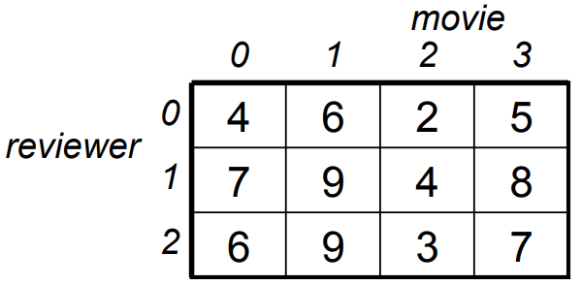
Example of using 2-D Array
Suppose we want to find the average score given by reviewer 2: double sum = 0; for (int col = 0; col <= 3; col++) { sum += rating[2][col]; } double average = sum / 4;

Slide 7
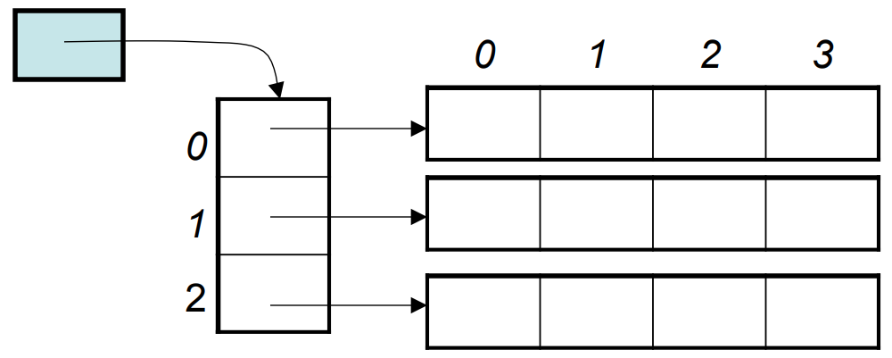
Size of 2D Array
A 2D array is a 1D array of (references to) 1D arrays.
int[][] rating = new int[3][4];
What is the value of rating.length?
Answer: 3, the number of rows (first dimension)
What is the value of rating[0].length?
Answer: 4, the number of columns (second dimension)

Slide 8

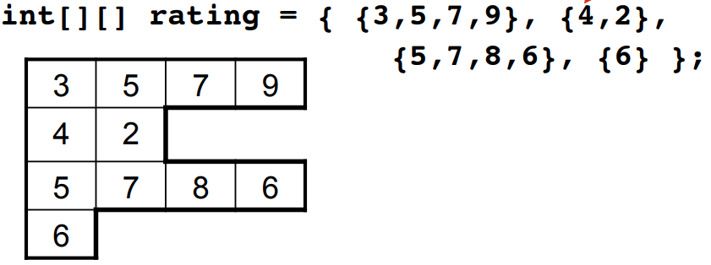
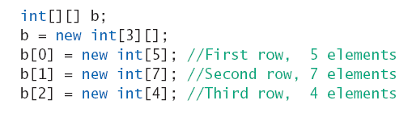
Ragged Arrays in Java
Since a 2D array is a 1D array of references to 1D arrays, each of these latter 1D arrays (rows) can have a different length.
How? There are two ways:

Slide 9
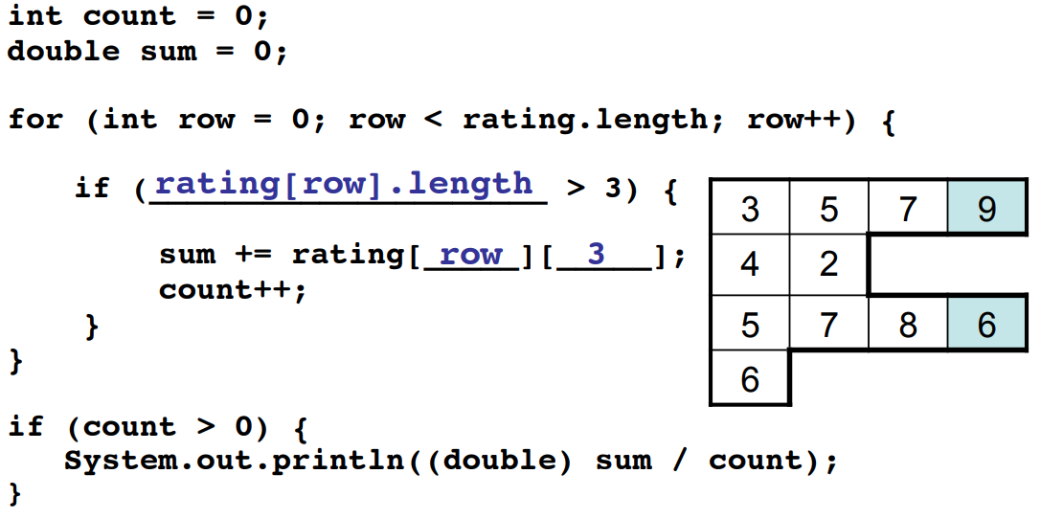
Example of using ragged 2-D Array
Print the average rating for the movie in column 3.

Slide 10
Exercise Time
Questions?

Slide 11
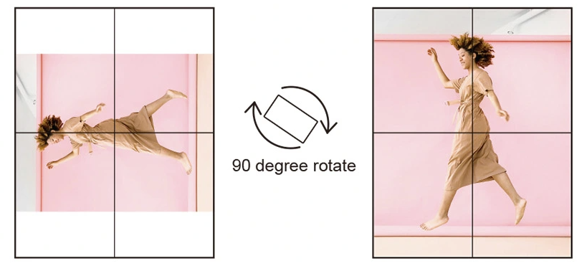
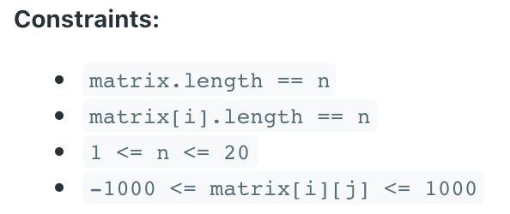
Activity - Transpose a matrix
Create a file called lab8.java. Given an n by n 2D matrix representing an image, write a method with signature
void rotateImage(int[][] matrix)
that rotates the image by 90 degrees (clockwise). See examples in next slide.
You have to rotate the image in-place, which means you have to modify the input 2D matrix directly. DO NOT allocate another 2D matrix and do the rotation.

Slide 12
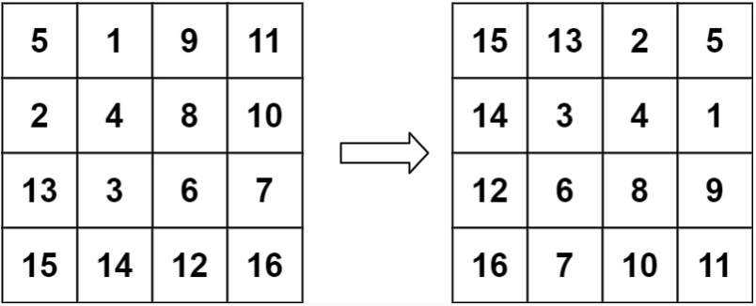
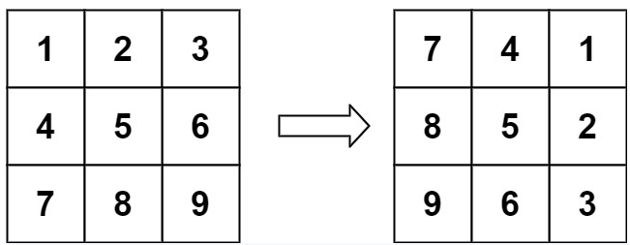

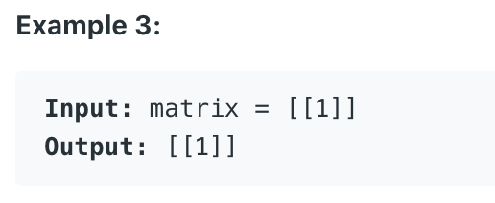
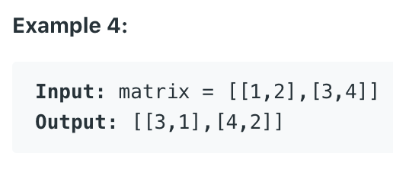
Examples

Slide 13
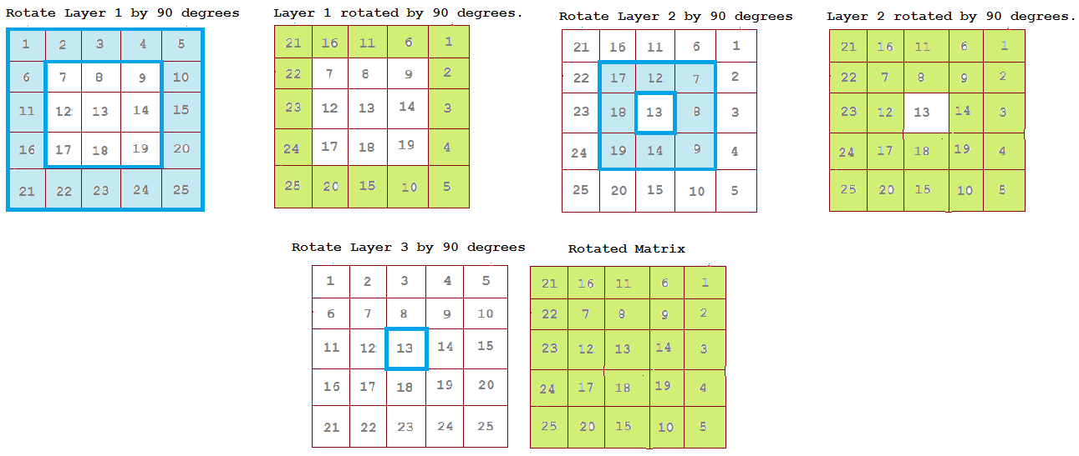
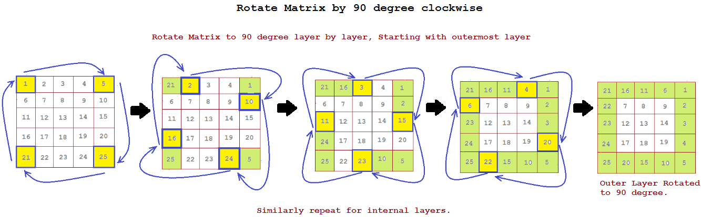
A More Specific Example

