Slide 1
CS 170 Lab 05

Slide 2
Today
Boolean Expressions
If-Else Statements
While Loops
Questions?
Lab Assignment

Slide 3
Boolean Expressions
Remember: boolean primitive type stores a single bit for true or false
Example: boolean isPositive = (number > 0);
Logical Operators:
&& | and
|| | or
! | not
== | equal to
!= | not equal to
Tip! It is good style to name boolean variables so they suggest a truth value:
isPositive
systemsAreOk
isDone

Slide 4
Examples: True or False?
boolean a = false; boolean b = true;
boolean c = false;
a && b
b && !c
a || !b || c
a == c
b != c
false
true
false
true
true

Slide 5
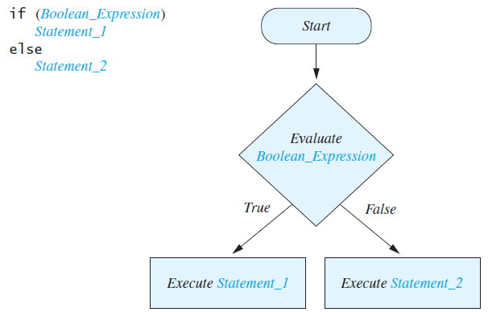
If-Else Statements
int number = -1;
if (number > 0){
System.out.println(“positive”);
}
else if (number < 0){
System.out.println(“negative”);
}
else{
System.out.println(“is zero!”);
}

Slide 6
Short-Circuit Evaluation
Sometimes, only part of a boolean expression needs to be evaluated in order to determine the overall value
If a is true, then (a || b) is true
If a is false, then (a && b) is false
In these cases, the program does not evaluate b
This is called short-circuit or lazy evaluation

Slide 7
Short-Circuit Evaluation
This means order matters and can help avoid runtime errors!
Example:
Suppose we have the expression if(sum/number > 5)
What if number = 0?
Runtime error!
Instead do: if((number != 0) && (sum/number > 5))

Slide 8
Notes on ==
Strings cannot be compared using ==
equals() function for Strings
Floats and Doubles cannot be directly compared using ==
Why?
Floating point values are approximations and may have a very small fractional part that is inexact
E.g. 0.1 might be really stored as 0.100000000000001
Solution: compare difference with a really small number
if(Math.abs(a-b) < 0.0000001)

Slide 9
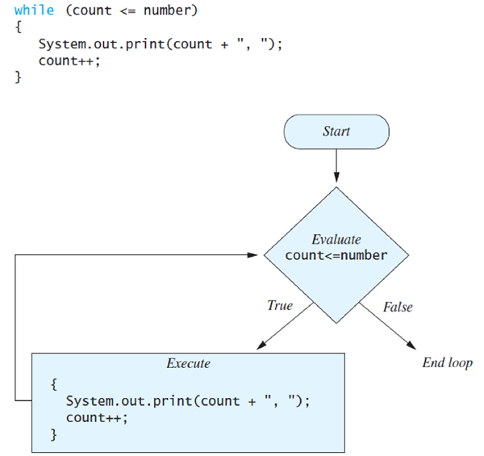
While Loops
Beware infinite loops!
Whatever variables involved in your loop condition should change over time so that the loop will terminate at some point

Slide 10
Questions?

Slide 11
Lab Activity (Problem #1)
Write a method called fizzBuzz(int start, int end) that prints all the numbers from start to end, inclusive, using these rules:
If a number is a multiple of 3, print “Fizz” instead of the number
If a number is a multiple of 5, print “Buzz” instead
If a number is a multiple of both 3 and 5, print “FizzBuzz” instead
Otherwise print the number
Examples:
fizzBuzz(1, 16) → 1 2 Fizz 4 Buzz Fizz 7 8 Fizz Buzz 11 Fizz 13 14 FizzBuzz 16
fizzBuzz(90, 100) → FizzBuzz 91 92 Fizz 94 Buzz Fizz 97 98 Fizz Buzz

Slide 12
Lab Activity (Problem #2)
Write two methods that find and print the (positive) factors of an input number int x.
The 1st method findFactorsFor(int x) should use a for loop
The 2nd method findFactorsWhile(int x) should use a while loop
For the same input, the outputs of these 2 functions should be identical
Include in your discussion comments any differences you notice between the two method versions. Is one better or worse than the other?
Examples:
findFactorsFor(10) → 1 2 5 10 findFactorsFor(42) → 1 2 3 6 7 14 21 42
findFactorsWhile(10) → 1 2 5 10 findFactorsWhile(42) → 1 2 3 6 7 14 21 42

Slide 13
Lab Activity (Summary)
fizzBuzz(int start, int end) prints all the numbers from start to end, inclusive, using these rules:
If a number is a multiple of 3, print “Fizz” instead of the number
If a number is a multiple of 5, print “Buzz” instead
If a number is a multiple of both 3 and 5, print “FizzBuzz” instead
Otherwise print the number
Two methods that find and print the (positive) factors of an input number int x:
findFactorsFor(int x) should use a for loop
findFactorsWhile(int x) should use a while loop
Discussion of differences & pros/cons for each version
Submit all methods in a class called lab05, testing each method in the main method
Include all teammates on the submission!
Include discussion comments

