Slide 1
CS 170 Lab 06

Slide 2
Today
String
While vs. Do-while
Break a Loop
Questions?
Lab Activity!

Slide 3
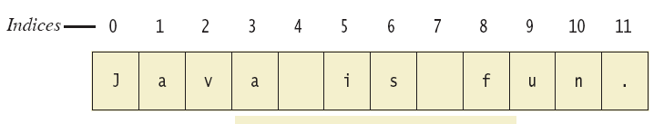

String in Java
A String object stores a sequence of characters.
Each character has an index (its position).
Positions start with 0, not 1.
The 'J' in "Java is fun." is in position 0
The 'f' in "Java is fun." is at index 8.

Slide 4
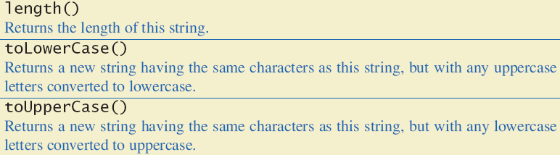
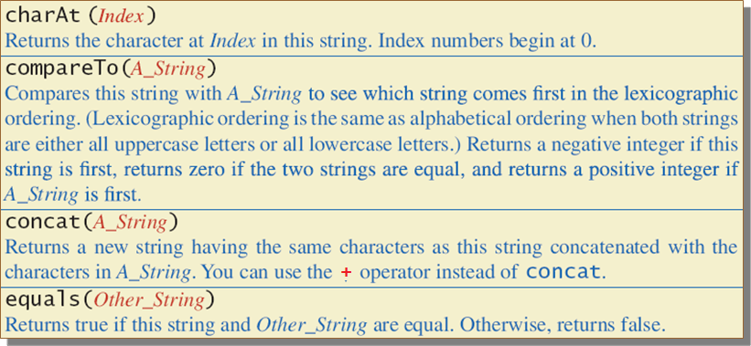
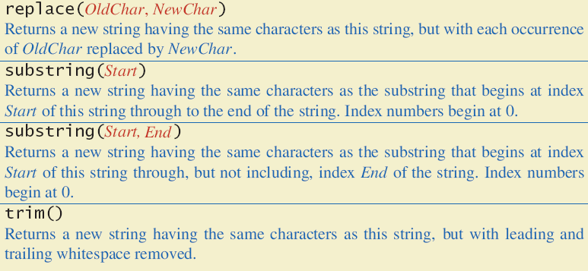
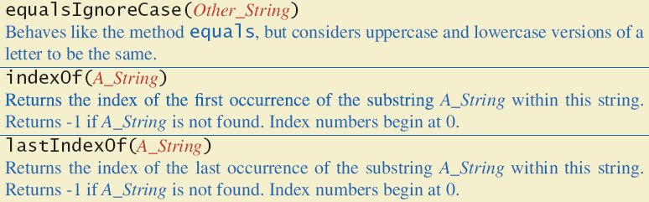
Frequently-used String Methods

Slide 5
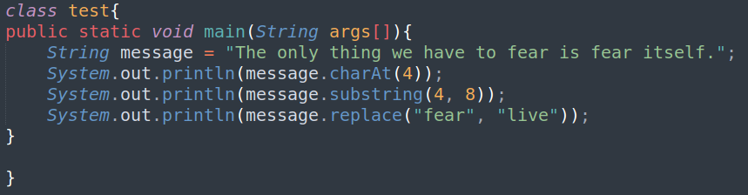

String Methods

Slide 6
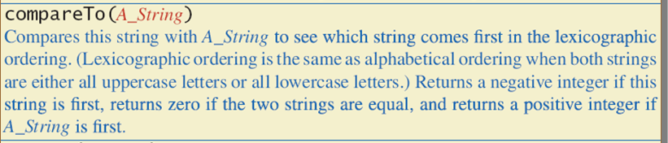
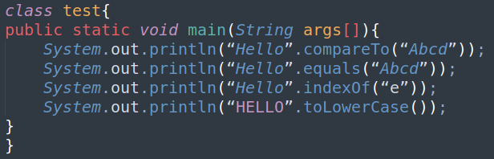
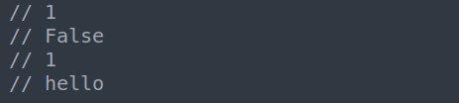
String Methods

Slide 7
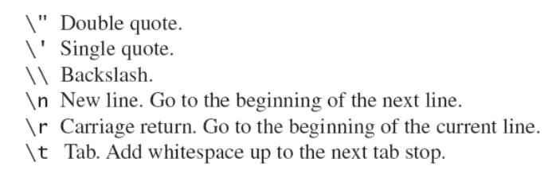
Escape Characters
Each escape sequence constitutes a single character,
Even though it is typed with two symbols.

Slide 8
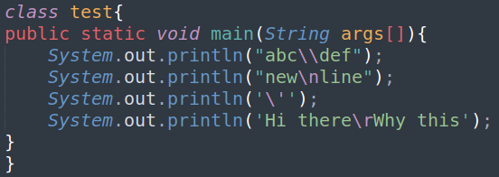
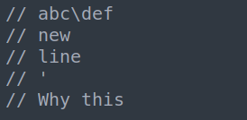
Example - Escape Characters

Slide 9
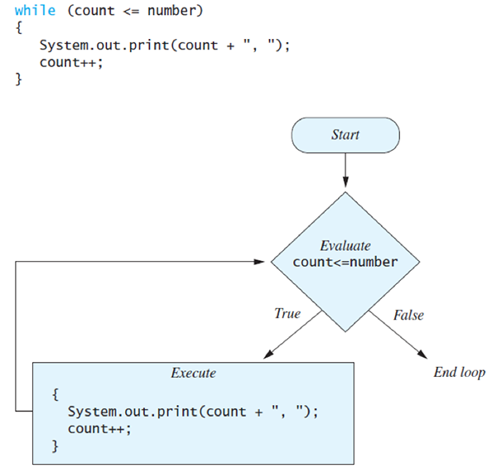
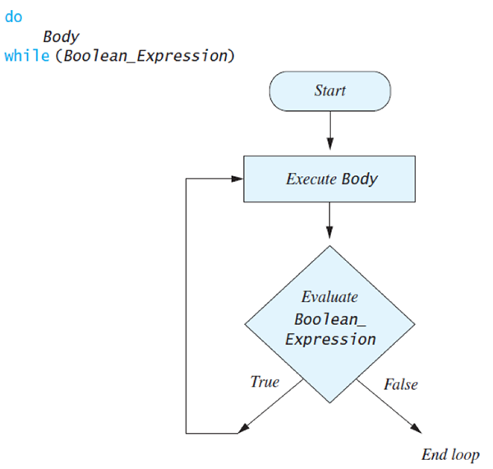
While Loop vs. Do-While Loop

Slide 10
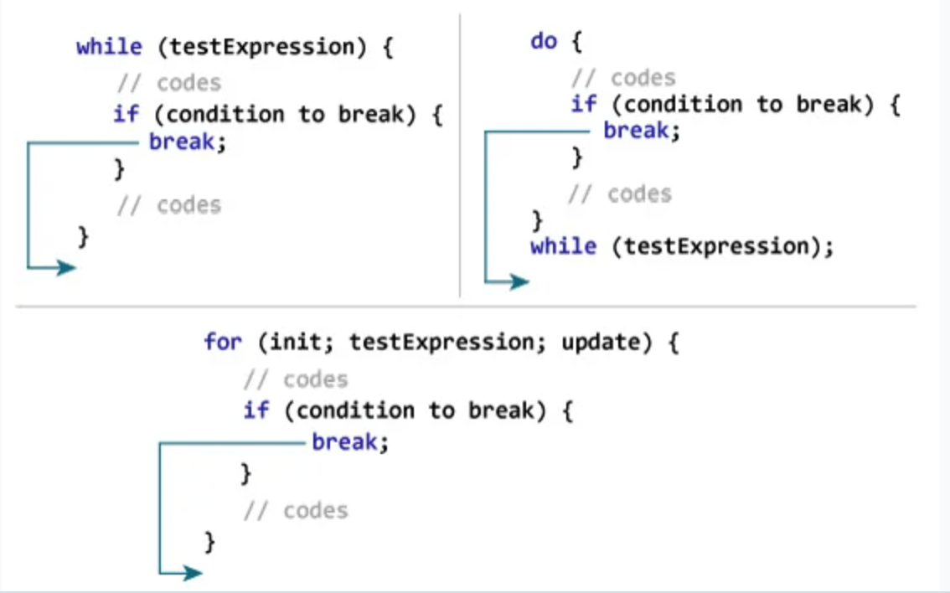
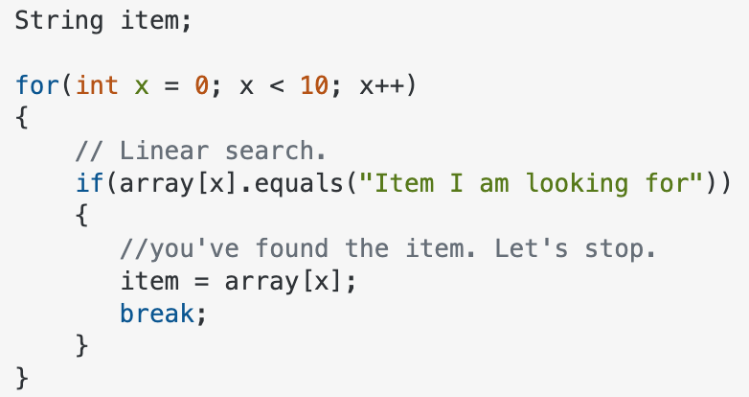
“Break” a Loop
The break statement can be used to jump out of a loop, which is a useful technique to let you exit the loop if a certain condition is met.
Example:

Slide 11
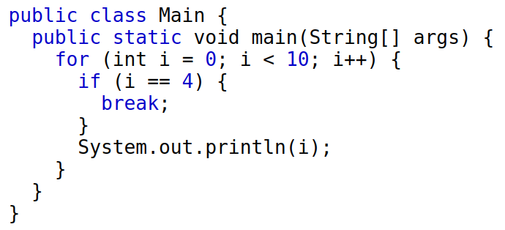
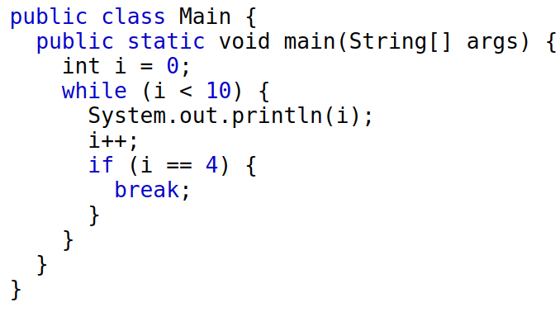
Bad cases of abusing break:
Considering the following two cases, you could avoid using break by properly setting the loop conditions.
Code readability can suffer with odd breaks, only use break when it’s necessary. For example, certain desired condition is reached (like a match is found)
In your homework/quiz, it will not have scenarios that you have to use “break”. However, we will practice the correct way of using “break” in the lab activity.

Slide 12
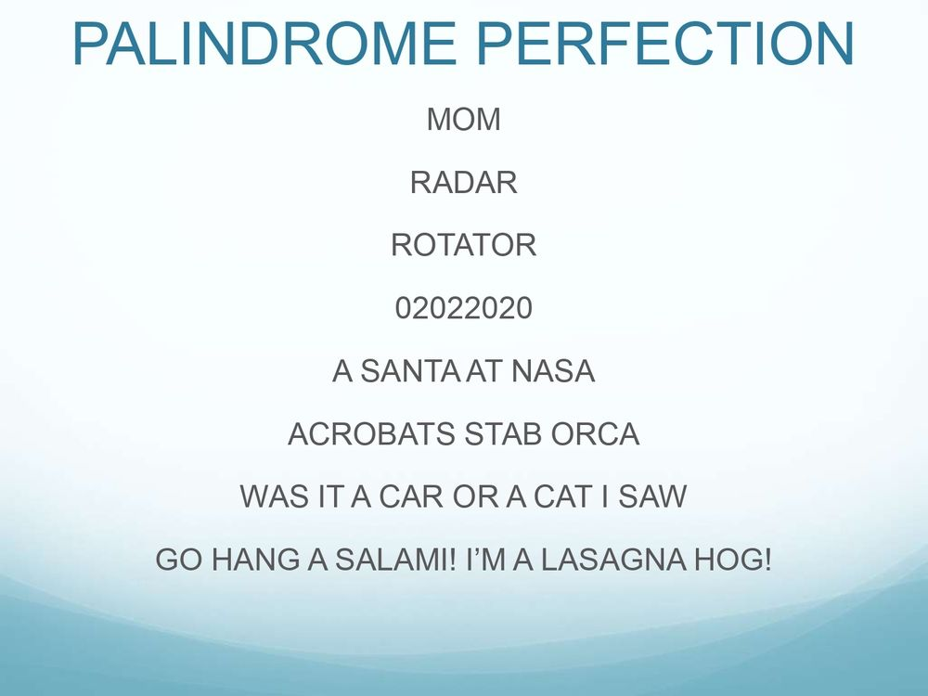

Palindrome Checker
Write a method isPalindrome(String str) which check if a string is a palindrome or not.
Note: A palindrome is a word, phrase or sequence that reads the same backward as forward, such as madam, racecar.
Example:
isPalindrome(“cs170”) → False
isPalindrome(“racecar”) → True
isPalindrome(“2002”) → True
Requirement:
Give two test cases: one returns True and one returns False

Slide 13
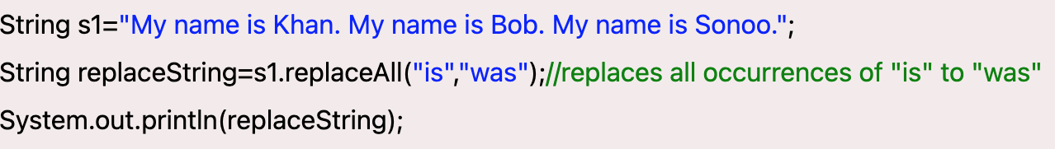
Reverse a String
1. Write a method reverseString_1(String text) that takes a sentence as input and return a new sentence that each word is reversed.
reverseString_1(“I love CS 170, I love coding!”)
“I evol SC 071 I evol gnidoc”
2. Write a method reverseString_2(String text) that takes a sentence as input and return a new sentence that the order of words is reversed.
reverseString_2(“I love CS 170, I love coding!”)
“coding love I 170 CS love I”
Note:
The input string can have punctuations (e.g., [,.'/<>!?(){};’:”]), but the returned string does not need to have punctuations. (Hint: remove them in the beginning)
Use “break” if certain condition is met. (e.g., when you have detected there is a space).
StringBuffer is prohibited.
Example of the replaceAll() method:

Slide 14
Group Activity Summary
1. Implement a method isPalindrome(String str) that checks if a string is a palindrome or not.
Example:
isPalindrome(“cs170”) → False
isPalindrome(“racecar”) → True
2. Implement two methods reverseString_1 and reverseString_2 that take one string as input.
For reverseString_1, it returns a new string that each word in the string is reversed.
For reverseString_2, it returns a new string that the order of words is reversed.
Requirements:
Submit all methods in a class called lab06, you could include as many auxiliary methods as you need. Testing each method in the main method.
For isPalindrome(String str), you should provide two test cases: one is true and one is false.
For reverseString, remove all punctuations before you reverse the string (Hint: replaceAll() in String class).
DO NOT USE StringBuffer
Include all teammates in your QTest Submission page

