Slide 1
CSH3J3 SISTEM PARALEL DAN TERDISTRIBUSI
Chapter 4: Remote Invocation

Slide 2
Outline Today
Request-Reply Protocols
RPC
Remote Method Invocation

Slide 3
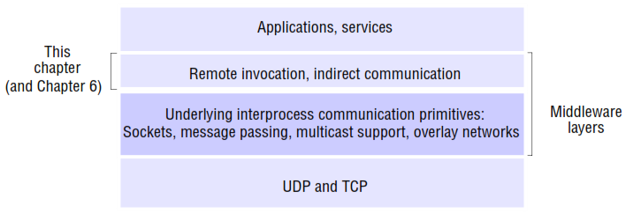
Introduction

Slide 4
1. Request-Reply Protocols
Request-Reply Communication is synchronous because the client process blocks until the reply arrives from the server.
Asynchronous request-reply communication is an alternative that may be useful in situations where clients can afford to retrieve replies later

Slide 5
Request-Reply Protocol
Operation: doOperation, getRequest and sendReply
It may be designed to provide certain delivery guarantees.
If UDP datagrams are used, the delivery guarantees must be provided by the request-reply protocol, which may use the server reply message as an acknowledgement of the client request message

Slide 6
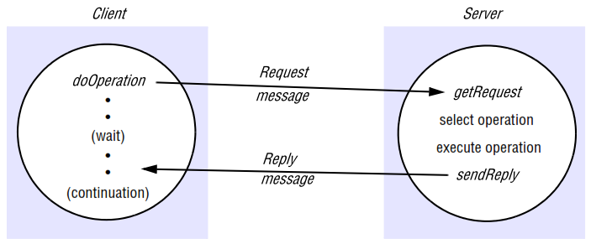
Request-Reply Communication

Slide 7
doOperation
sends a request message to the server whose Internet address and port are specified in the remote reference given as an argument
After sending the request message, doOperation invokes receive to get a reply message, from which it extracts the result and returns it to the caller
The caller of doOperation is blocked until the server performs the requested operation and transmits a reply message to the client process

Slide 8
getRequest
used by a server process to acquire service requests
When the server has invoked the specified operation, it then uses sendReply to send the reply message to the client.

Slide 9
sendReply
When the server has invoked the specified operation, it then uses sendReply to send the reply message to the client.
When the reply message is received by the client the original doOperation is unblocked and execution of the client program continues

Slide 10
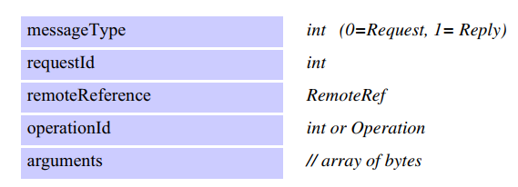
R-R message Structure

Slide 11
Characteristic of RR Protocol
The Request-Reply Protocol : doOperation, getRequest and sendReply
Message identifiers : requestId and identifier
Failure model : omission failures and messages are not guarantee delivered
Timeouts : return immediately, repeatedly
Discarding duplicate request messages : filter using requestId
Lost reply messages : repeat reply or not depends on idempotent
History : contains a record
Styles of exchange protocols : R-RR-RRA
Use of TCP streams to implement the request-reply protocol : reliably
HTTP : An example of a request-reply protocol

Slide 12
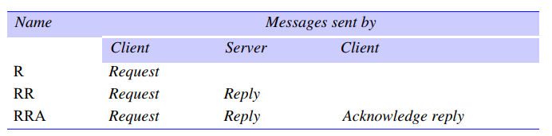
Style of Exchange Protocol

Slide 13
Request Protocol
a single Request message is sent by the client to the server.
The R protocol may be used when there is no value to be returned from the remote operation and the client requires no confirmation that the operation has been executed.
The client may proceed immediately after the request message is sent as there is no need to wait for a reply message.
This protocol is implemented over UDP datagrams and therefore suffers from the same communication failure

Slide 14
RR Protocol
useful for most client-server exchanges because it is based on the request-reply protocol
Special acknowledgement messages are not required, because a server’s reply message is regarded as an acknowledgement of the client’s request message
a subsequent call from a client may be regarded as an acknowledgement of a server’s reply message.

Slide 15
RRA
the exchange of three messages: request-reply-acknowledge reply
The Acknowledge reply message contains the requestId from the reply message being acknowledged.
This will enable the server to discard entries from its history.
The arrival of a requestId in an acknowledgement message will be interpreted as acknowledging the receipt of all reply messages with lower requestIds, so the loss of an acknowledgement message is harmless.
Although the exchange involves an additional message, it need not block the client, as the acknowledgement may be transmitted after the reply has been given to the client

Slide 16
2. RPC
The concept of a Remote Procedure Call (RPC) represents a major intellectual breakthrough in distributed computing, with the goal of making the programming of distributed systems look similar, if not identical, to conventional programming.
That is, achieving a high level of distribution transparency.
In RPC, procedures on remote machines can be called as if they are procedures in the local address space.

Slide 17
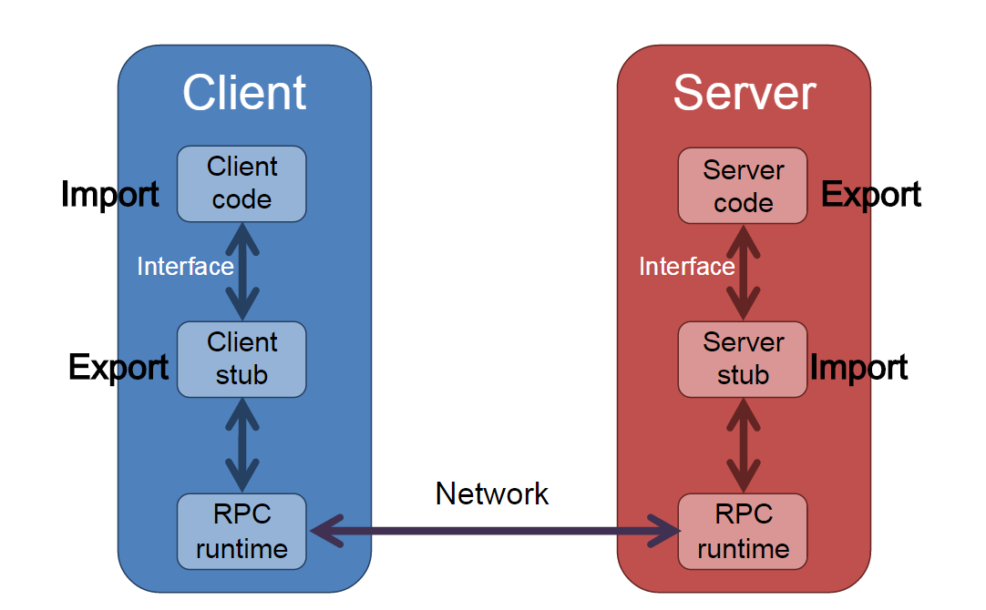

Slide 18
Sequence of event
The client calls the client stub. The call is a local procedure call, with parameters pushed on to the stack in the normal way.
The client stub packs the parameters into a message and makes a system call to send the message. Packing the parameters is called marshalling.
The client's local operating system sends the message from the client machine to the server machine.
The local operating system on the server machine passes the incoming packets to the server stub.
The server stub unpacks the parameters from the message. Unpacking the parameters is called unmarshalling.
Finally, the server stub calls the server procedure. The reply traces the same steps in the reverse direction.

Slide 19
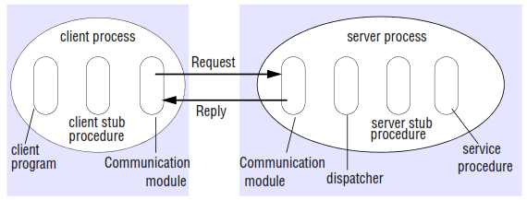
Role of Client and Server stub Procedures in RPC

Slide 20
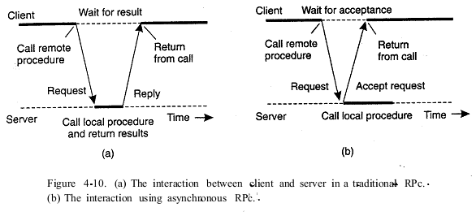
A client and server through two asynchronous RPCs

Slide 21
Case study: Sun RPC
RFC 1831 [Srinivasan 1995a] describes Sun RPC, which was designed for client-server communication in the Sun Network File System (NFS).
Sun RPC is sometimes called ONC (Open Network Computing) RPC.
The Sun RPC system provides an interface language called XDR and an interface compiler called rpcgen, which is intended for use with the C programming language.

Slide 22
Case study: Sun RPC
Sun RPC details :
Interface definition language : The Sun XDR language
Binding : a local binding service called the port mapper (well-known)
Authentication : request and reply messages
Client and server programs : www.cdk5.net/rmi

Slide 23
Design issues for RPC
Three issues that are important in understanding this concept:
Programming with interfaces :
Interfaces in distributed systems : modular programming, Extrapolating to distributed systems, software evolution
Interface definition languages: allow procedures implemented in different languages to invoke one another
RPC call semantics (Retry request message, Duplicate filtering, and Retransmission of results)
Maybe semantics
At-least-once semantics
At-most-once semantics
Transparency

Slide 24
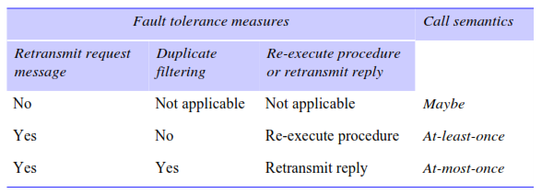
Call Semantics

Slide 25
Maybe Semantics
The remote procedure call may be executed once or not at all.
Maybe semantics arises when no fault-tolerance measures are applied and can suffer from the following types of failure : omission failure (request or reply is lost) and crash failure
Maybe semantics is useful only for applications in which occasional failed calls are acceptable

Slide 26
At-least-once Semantics
the invoker receives either a result, in which case the invoker knows that the procedure was executed at least once, or an exception informing it that no result was received
At-least-once semantics can be achieved by the retransmission of request messages, which masks the omission failures of the request or result message
If the operations in a server can be designed so that all of the procedures in their service interfaces are idempotent operations, then at-least-once call semantics may be acceptable

Slide 27
At-most-once Semantics
the caller receives either a result, in which case the caller knows that the procedure was executed exactly once, or an exception informing it that no result was received, in which case the procedure will have been executed either once or not at all.
This set of fault tolerance measures prevents arbitrary failures by ensuring that for each RPC a procedure is never executed more than once.

Slide 28
3. Remote Method Invocation
RMI vs RPC
Commonalities | Differences
support programming with interfaces | full expressive power of object-oriented programming in the development of distributed systems software
constructed on top of request-reply protocols and can offer a range of call semantics | all objects in an RMI-based system have unique object references
similar level of transparency

Slide 29
a. Design issues for RMI
The key added design issue relates to the object model and, in particular, achieving the transition from objects to distributed objects.
The object model : Object references, Interfaces, Actions, Exceptions, and Garbage collection
Distributed objects : The state of an object consists of the values of its instance variables
The distributed object model : extensions to the object model to make it applicable to distributed objects
Actions in a distributed object system : is initiated by a method invocation, which may result in further invocations on methods in other objects.
Notes:
Object references: Objects can be accessed via object references.
Interfaces: An interface provides a definition of the signatures of a set of methods
Actions : Action in an object-oriented program is initiated by an object invoking a method in another object.
Exceptions : Programs can encounter many sorts of errors and unexpected conditions of varying seriousness.
Garbage collection : It is necessary to provide a means of freeing the space occupied by objects when they are no longer needed.

Slide 30
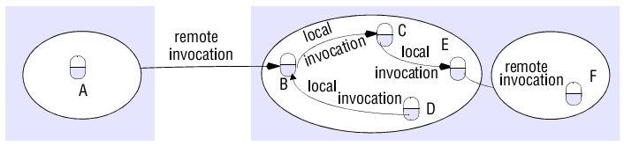
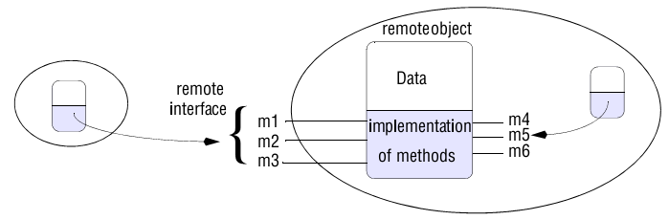
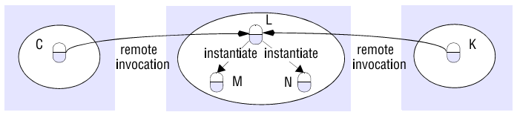
objects are accessed
Remote and local method invocations
A remote object and its remote interface
Instantiation of remote objects

Slide 31
b. Implementation of RMI
Communication module : the message type, its requestId and the remote reference of the object to be invoked.
Remote reference module : responsible for translating between local and remote object references and for creating remote object references.
Servants : is an instance of a class that provides the body of a remote object
The RMI software : Proxy, Dispatcher, and Skeleton.
Dynamic invocation : An alternative to proxies
Server and client programs : java.sun.com

Slide 32
